Slide 1
Bootstrap
Build Fast & Responsive Sites

Slide 2
What is Bootstrap?
Bootstrap is an open source product from Mark Otto and Jacob Thornton who were both employees at Twitter.
It is sleek, intuitive, and powerful mobile first front-end framework for faster and easier web development.

Slide 3
Why Bootstrap ?
Mobile first approach
Browser Support
Easy to get started
Responsive design
Uniform solution for building UI
Beautiful and functional built-in components

Slide 4
Let’s Get Our Hands Dirty
Let’s get started by including Bootstrap’s production-ready CSS and JavaScript via CDN without the need for any build steps.
Create HTML file
Include bootstrap CSS and JS (optionally popper)
See your Bootstrapped page in browser

Slide 5
Bootstrap Functionalities
Layout
Breakpoints
Contents
Colors
Forms
Components
Container
Grids
Columns / Gutter
Typography
Images
Tables
Form Controls
Checks & Radios
Input Groups & Floating Labels
Form Validations
Buttons
Alerts
Progress Bar
Pagination
Navbar
Modal
Utilities
Vector Icons

Slide 6
Layout : Breakpoints
Breakpoints are customizable widths that determine how your responsive layout behaves across device or viewport sizes in Bootstrap
Breakpoint | Class infix | Dimensions
Extra Small | None | <576px
Small | sm | ≥576px
Medium | md | ≥768px
Large | lg | ≥992px
Extra Large | xl | ≥1200px
Extra Extra Large | xxl | ≥1400px

Slide 7
Layout : Containers
Containers are a fundamental building block of Bootstrap that contain, pad, and align your content within a given device or viewport.
Bootstrap comes with three different containers
.container, which sets a max-width at each responsive breakpoint
.container-{breakpoint}, which is width: 100% until the specified breakpoint
.container-fluid, which is width: 100% at all breakpoints

Slide 8
Layout : Grid System
Powerful mobile-first flexbox grid to build layouts of all shapes and sizes with twelve column system
Bootstrap’s grid system can adapt across all six default breakpoints, and any breakpoints you customize.
How the grid system comes together -
Grid supports six responsive breakpoints
Containers center and horizontally pad your content
Rows are wrappers for columns
Columns are incredibly flexible
Gutters are also responsive and customizable
Sass variables, maps, and mixins power the grid

Slide 9
Layout : Columns
You can modify columns with a handful of options for alignment, ordering, and offsetting thanks to flexbox grid system.
You can also use column classes to manage widths of non-grid elements
How the Columns works -
Columns build on the grid’s flexbox architecture
When building grid layouts, all content goes in columns
Bootstrap includes predefined classes for creating fast, responsive layouts

Slide 10
Layout : Gutters
Gutters are the padding between your columns, used to responsively space and align content in the Bootstrap grid system
Gutters are the gaps between column content, created by horizontal padding
Gutters start at 1.5rem (24px) wide
Gutters can be responsively adjusted

Slide 11
Typography
Typography | Description
h1 to h6 | Heading Classes. H1 being the highest font size.
display headings | In addition to traditional headings, headings to stand out.
Lead | Make a paragraph stand out by adding .lead
Blockquotes | For quoting blocks of content from another source within your document
Lists | Remove the default list-style and left margin on list items (immediate children only)
.mark | will apply the same styles as <mark>
.small | will apply the same styles as <small>
.text-decoration-underline | will apply the same styles as <u>
.text-decoration-line-through | will apply the same styles as <s>

Slide 12
Working With Images
You can use CSS Classes for opting images into responsive behavior (so they never become wider than their parent) and add lightweight styles to them
Images in Bootstrap are made responsive with . This applies max-width: 100%; and height: auto; to the image so timg-fluid. hat it scales with the parent width
You can use .img-thumbnail to give an image a rounded 1px border appearance
Align images with the helper float classes or text alignment classes.

Slide 13
Working With Tables
Add the base class .table to any <table>, then extend with optional modifier classes or custom styles
All table styles are not inherited in Bootstrap, meaning any nested tables can be styled independent from the parent
Table Classes | Description
.table-striped | to add zebra-striping to any table row within the <tbody>
.table-striped-columns | to add zebra-striping to any table column
.table-hover | to enable a hover state on table rows within a <tbody>
.table-active | to highlight a table row or cell
.table-bordered | for borders on all sides of the table and cells
.table-responsive | to make any table responsive across all viewports

Slide 14
Components
Buttons
Use Bootstrap’s custom button styles for actions in forms, dialogs, and more with support for multiple sizes, states, and more
Alerts
Provide contextual feedback messages for typical user actions with the handful of available and flexible alert messages
Progress Bar
Custom progress bars featuring support for stacked bars, animated backgrounds, and text labels
Pagination
Pagination to indicate a series of related content exists across multiple pages
Navbar
Bootstrap’s powerful, responsive navigation header, the navbar. Includes support for branding, navigation, and more
Modal
Bootstrap’s JavaScript modal plugin to add dialogs to your site for lightboxes, user notifications, or completely custom content

Slide 15
Bootstrap Icons
Free, high quality, open source icon library with over 1,600 icons
Use them with or without Bootstrap in any project
npm i bootstrap-icons

Slide 16
SASS
Maintainable CSS

Slide 17
What is SASS ?
Nowadays, stylesheets are getting larger, more complex, and harder to maintain. SASS is the rescue.
Sass has features that don't exist in CSS yet like nesting, mixins, inheritance, and other goodies that help you write robust, maintainable CSS
SASS (Syntactically Awesome Stylesheet) is a CSS pre-processor, which helps to reduce repetition with CSS and saves time.
You can install Sass on Windows, Mac, or Linux by downloading the package for your operating system by running the command –
npm install sass -g

Slide 18
Why SASS?
A pre-processing language which provides indented syntax (its own syntax) for CSS.
Provides some features, which are used for creating stylesheets that allows writing code more efficiently and is easy to maintain.
It is a super set of CSS, which means it contains all the features of CSS and is an open source pre-processor,
Provides the document style in a good, structured format than flat CSS.
Uses re-usable methods, logic statements and some of the built-in functions such as color manipulation, mathematics and parameter lists.

Slide 19
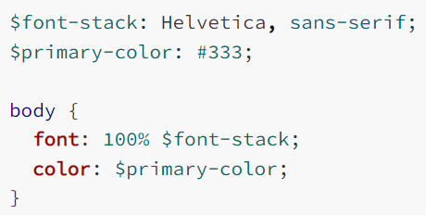
SASS : Variables
Think of variables as a way to store information that you want to reuse throughout your stylesheet.
You can store things like colors, font stacks, or any CSS value you think you'll want to reuse.
Sass uses the $ symbol to make something a variable.
Sass variables can be extremely powerful when working with brand colors and keeping them consistent throughout the site.

Slide 20
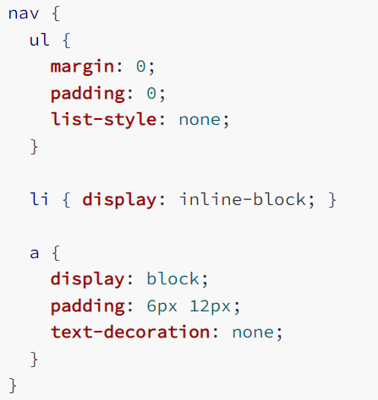
SASS : Nesting
When writing HTML you've probably noticed that it has a clear nested and visual hierarchy. CSS, on the other hand, doesn't.
Sass will let you nest your CSS selectors in a way that follows the same visual hierarchy of your HTML.
Be aware that overly nested rules will result in over-qualified CSS that could prove hard to maintain and is generally considered bad practice.

Slide 21
SASS : Partials
_partial.scss
You can create partial Sass files that contain little snippets of CSS that you can include in other Sass files.
A partial is a Sass file named with a leading underscore. You might name it something like _partial.scss.
The underscore lets Sass know that the file is only a partial file and that it should not be generated into a CSS file.

Slide 22
SASS : Modules
Sass provides many built-in modules which contain useful functions
These modules can be loaded with the @use rule like any user-defined stylesheet, and their functions can be called like any other module member.
All built-in module URLs begin with sass: to indicate that they're part of Sass itself.

Slide 23
SASS : Built-in Modules
sass:math
provides functions that operate on numbers.
sass:string
makes it easy to combine, search, or split apart strings.
sass:color
making it easy to build color themes.
sass:list
lets you access and modify values in lists.
sass:map
makes it possible to look up the value associated with a key in a map
sass:selector
provides access to Sass’s powerful selector engine.
sass:meta
exposes the details of Sass’s inner workings.

Slide 24
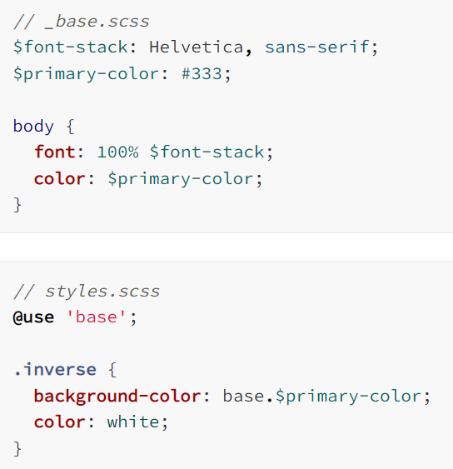
SASS : Modules
You don't have to write all your Sass in a single file. You can split it up however you want with the @use rule.
@use rule loads another Sass file as a module, which means you can refer to its variables, mixins, and functions in your Sass file with a namespace based on the filename.
Using a file will also include the CSS it generates in your compiled output.

Slide 25
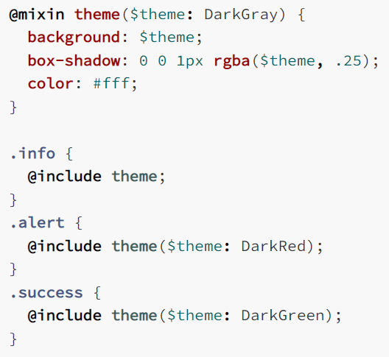
SASS : Mixins
A mixin lets you make groups of CSS declarations that you want to reuse throughout your site.
It helps keep your Sass very DRY. You can even pass in values to make your mixin more flexible.
Using a file will also include the CSS it generates in your compiled output.
After you create your mixin, you can then use it as a CSS declaration starting with @include followed by the name of the mixin.

Slide 26
SASS : Inheritance
Using @extend lets you share a set of CSS properties from one selector to another.
A placeholder class is a special type of class that only prints when it is extended, and can help keep your compiled CSS neat and clean
The CSS for placeholder classes will not be generated, till it is extended.

Slide 27
SASS : Operators
Sass has a handful of standard math operators like +, -, *, math.div(), and %.
It helps keep your Sass very DRY. You can even pass in values to make your mixin more flexible.
Using a file will also include the CSS it generates in your compiled output.
After you create your mixin, you can then use it as a CSS declaration starting with @include followed by the name of the mixin.

Slide 28
SASS : Flow Control
Sass provides a number of at-rules that make it possible to control whether styles get emitted, or to emit them multiple times with small variations.
They can also be used in mixins and functions to write small algorithms to make writing your Sass easier.
Four Flow Control Rules:
@if controls whether or not a block is evaluated.
@each evaluates a block for each element in a list or each pair in a map.
@for evaluates a block a certain number of times.
@while evaluates a block until a certain condition is met.

Slide 29
References
READING MATERIAL
VIDEO TUTORIAL LINKS
https://sass-lang.com/documentation
https://www.tutorialspoint.com/sass/
https://getbootstrap.com/
https://www.youtube.com/watch?v=_a5j7KoflTs
https://www.youtube.com/watch?v=_kqN4hl9bGc&list=PL4cUxeGkcC9jxJX7vojNVK-o8ubDZEcNb
https://www.youtube.com/playlist?list=PL6n9fhu94yhXd4xnk-j5FGhHjUv1LsF0V

