Slide 1
Architecture pattern
Architecture pattern define the major components and their relationships in a system, addressing questions like how data flows, how modules or components interact, and how the system's overall goals are achieved.
Architecture patterns are high-level, fundamental structural designs for organizing a software system. They provide a blueprint for the overall structure of a system.
Examples of architecture patterns include the Model-View-Controller (MVC) pattern, Client-Server architecture, anMicroservices architecture, Monolithic architecture, d Event-Driven architecture.

Slide 2
Design pattern
Design patterns offer well-established and proven solutions to common design problems. They help improve code maintainability, extensibility, and reusability by promoting best practices for structuring code. Design patterns are usually associated with code-level commonalities. They provide various schemes for refining and building smaller subsystems.
Design patterns are lower-level solutions to recurring design problems within a specific context in a software system. They address issues related to the design and implementation of individual classes, objects, or components.
Examples of design patterns include the Singleton pattern, Factory pattern, Observer pattern, Strategy pattern, and Decorator pattern.

Slide 3
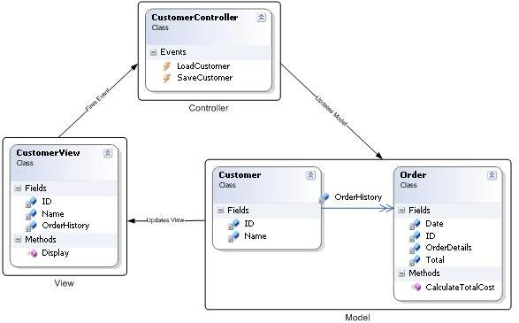
MVC

Slide 4
MVC
The MVC pattern is a UI presentation pattern that focuses on separating the UI (View) from its business layer (Model).
The pattern separates responsibilities across three components: the view is responsible for rending UI elements, the controller is responsible for responding to UI actions, and the model is responsible for business behaviors and state management.
In most implementations, all three components can directly interact with each other and in some implementations, the controller is responsible for determining which view to display (Front Controller Pattern)
Controllers are based on behaviors and can be shared across views

Slide 5
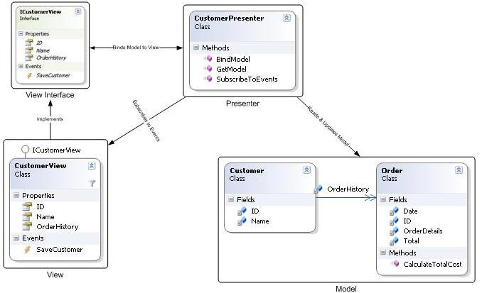
MVP

Slide 6
MVP
The pattern separates responsibilities across four components: the view is responsible for rending UI elements, the view interface is used to loosely couple the presenter from its view, the presenter is responsible for interacting between the view/model, and the model is responsible for business behaviors and state management.
In some implementations, the presenter interacts with a service (controller) layer to retrieve/persist the model.
The view interface and service layer are commonly used to make writing unit tests for the presenter and the model easier.
Usually, view presenter map one to one. Complex views may have multi presenters.
Easier to unit test because interaction with the view is through an interface

Slide 7
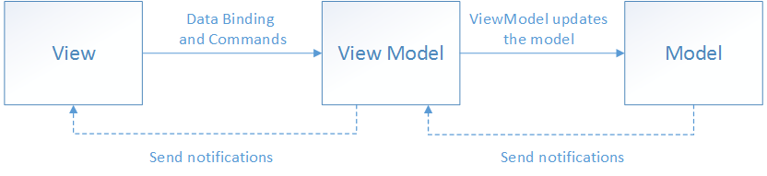
MVVM

Slide 8
MVVM
There are three core components in the MVVM pattern: the model, the view, and the view model
The view "knows about" the view model, and the view model "knows about" the model, but the model is unaware of the view model, and the view model is unaware of the view. Therefore, the view model isolates the view from the model, and allows the model to evolve independently of the view.
The view is responsible for defining the structure, layout, and appearance of what the user sees on screen
Ideally, each view is defined in XAML, with a limited code-behind that does not contain business logic

Slide 9
MVVM
The view model implements properties and commands to which the view can data bind to, and notifies the view of any state changes through change notification events.
The view model is also responsible for coordinating the view's interactions with any model classes that are required. There's typically a one-to-many relationship between the view model and the model classes.
Model classes are non-visual classes that encapsulate the app's data.
model can be thought of as representing the app's domain model, which usually includes a data model along with business and validation logic

