Slide 1
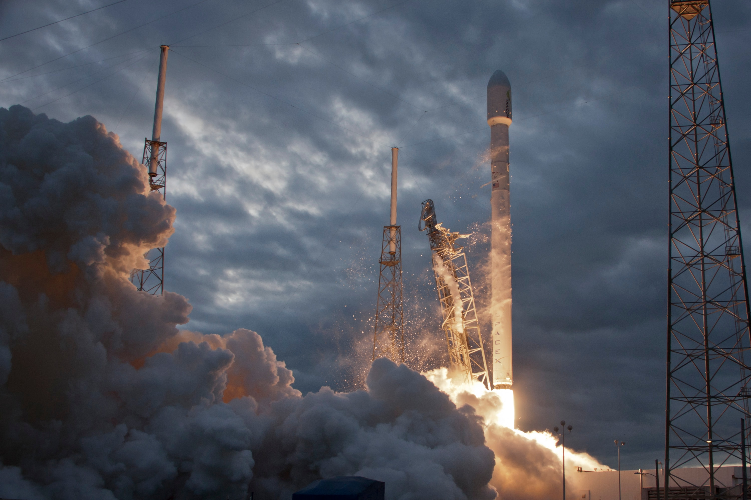

SpaceX Launch Prediction – Capstone Project
Jitesh Bhola
July 11,2023

Slide 2

Introduction
In this course, the successful landing of Falcon 9 – first stage was predicted.
SpaceX advertises the launch of Falcon 9 with price much less than other competitors due to the ability to reuse the first stage.
Therefore, prediction of the first stage landing can help to determine the entire launch cost.
This information can be used if an alternate company wants to bid against SpaceX for a rocket launch.

Slide 3
METHODOLOGY
Data collection and Data Wrangling :
Falcon 9 Launch data will be collected from Wiki pages using web scraping.
Another way of gathering data is SpaceX REST API.
Raw data from table would be transformed to clean data.
Functions such as Booster, Launchpad, payload, and core will be used to deal with null values etc. to get actual values.

Slide 4
METHODOLOGY
Data Visualization:
Use Catplot to visualize the data by choosing different groups of data
For example, compare between payload mass and flight number to see if successful
launch is dependent on the payload mass

Slide 5
METHODOLOGY
Predictive Analysis
Using machine learning methods to predict the launch
First need to standardize the dataset
Split into train and test sets
Use different methods to train the datasets and compare the accuracy

Slide 6
INSIGHTS FROM EDA

Slide 7
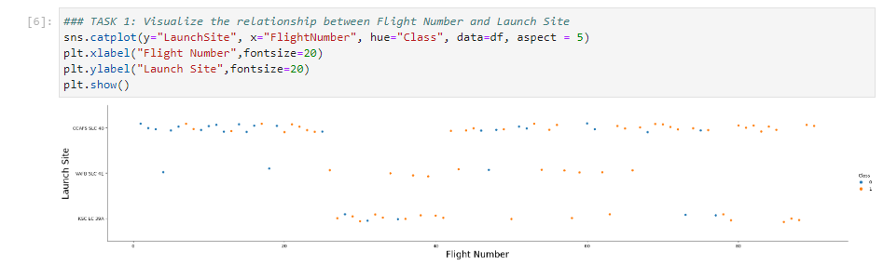
FLIGHT NUMBER VS. LAUNCH SITE

Slide 8
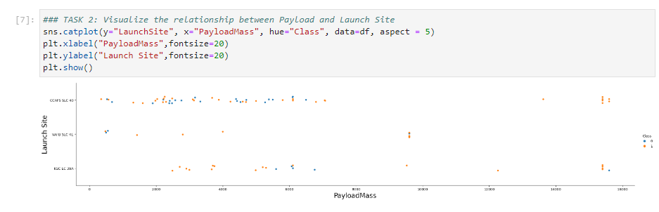
PAYLOAD VS. LAUNCH SITE

Slide 9
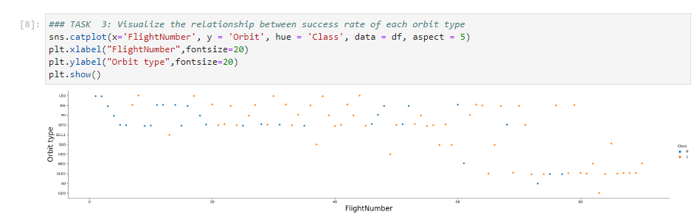
FLIGHT NUMBER VS. ORBIT TYPE

Slide 10
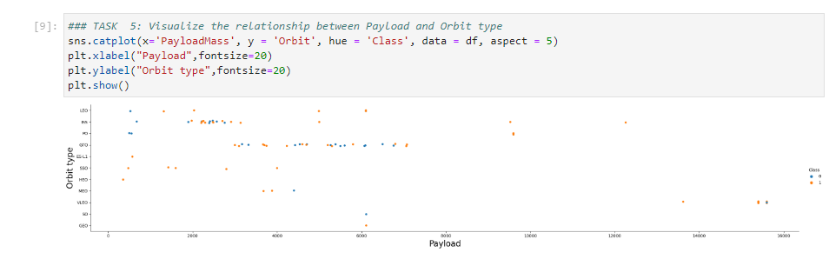
PAYLOAD VS. ORBIT TYPE

Slide 11
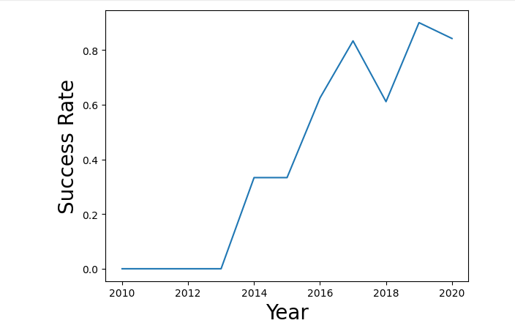
LAUNCH SUCCESS YEARLY TREND

Slide 12
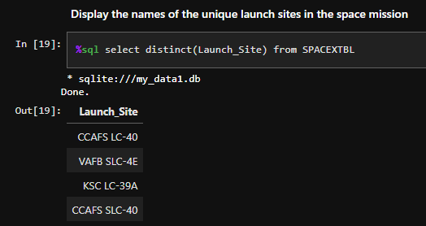
ALL LAUNCH SITE NAMES

Slide 13
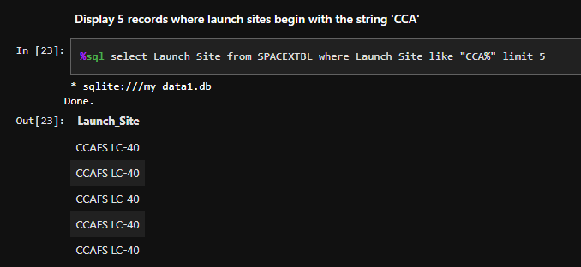
LAUNCH SITE NAMES BEGIN WITH 'CCA'

Slide 14
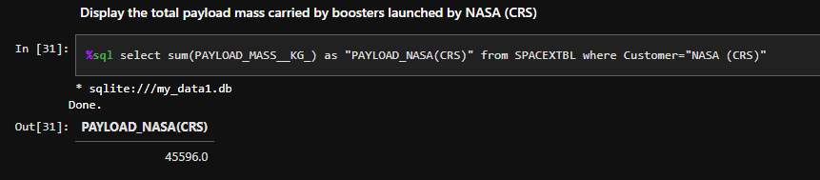
TOTAL PAYLOAD MASS

Slide 15
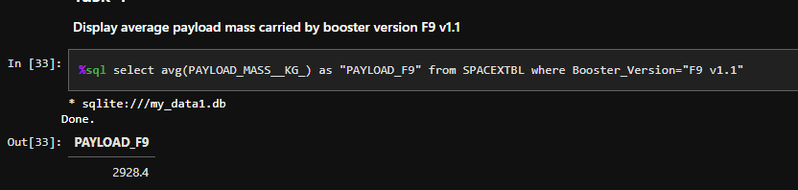
AVERAGE PAYLOAD MASS BY F9 V1.1

Slide 16
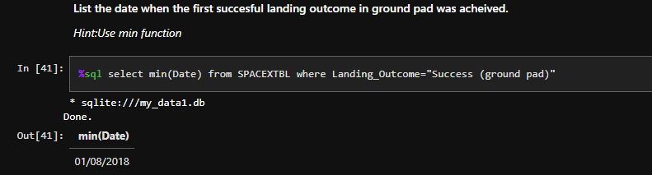
FIRST SUCCESSFUL GROUND LANDING DATE

Slide 17
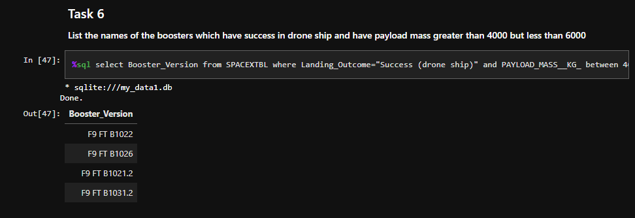
SUCCESSFUL DRONE SHIP LANDING WITH PAYLOAD BETWEEN 4000 AND 6000

Slide 18
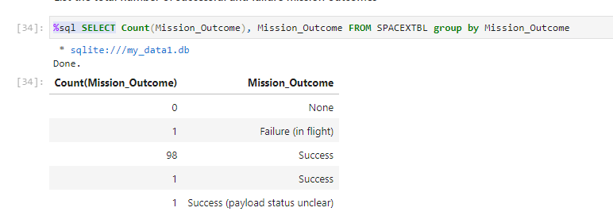
TOTAL NUMBER OF SUCCESSFUL AND FAILURE MISSION OUTCOMES

Slide 19
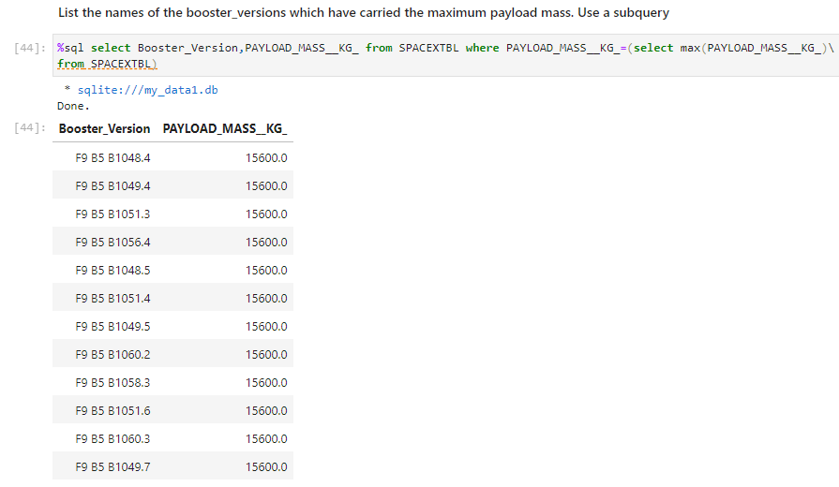
BOOSTERS CARRIED MAXIMUM PAYLOAD

Slide 20
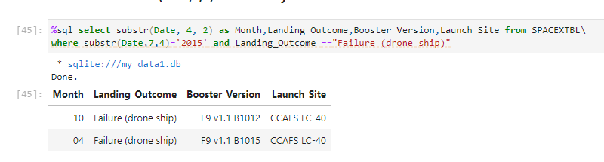
2015 LAUNCH RECORDS

Slide 21
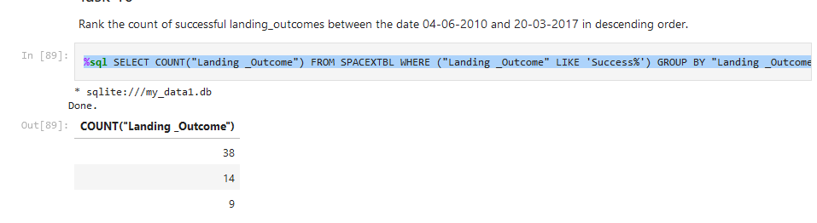
RANK LANDING OUTCOMES BETWEEN 2010-06-04 AND 2017-03-20

Slide 22
LAUNCH SITES PROXIMITY ANALYSIS

Slide 23
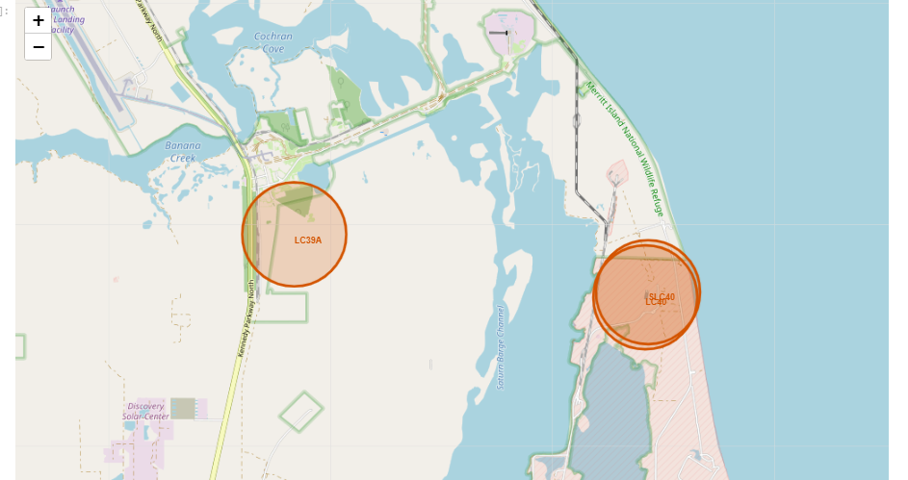
FOLIUM MAP WITH MARKERS OF LANDING SITES

Slide 24
PREDICTIVE ANALYSIS CLASSIFICATION

Slide 25
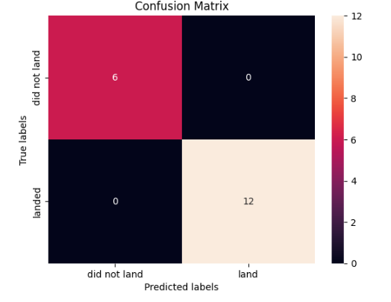
CONFUSION MATRIX

Slide 26
CONCLUSIONS
Accuracy for Logistics Regression method: 0.8333333333333334
Accuracy for Support Vector Machine method: 0.8333333333333334
Accuracy for Decision tree method: 0.7777777777777778
Accuracy for K nearest neighbors method: 0.8333333333333334

Slide 27

THANK YOU

