Slide 1
Assignment 1.
Design suitable Data structures and implement Pass-I and Pass-II of a two-pass assembler for pseudo-machine. Implementation should consist of a few instructions from each category and few assembler directives. The output of Pass-I (intermediate code file and symbol table)should be input for Pass-II.

Slide 2
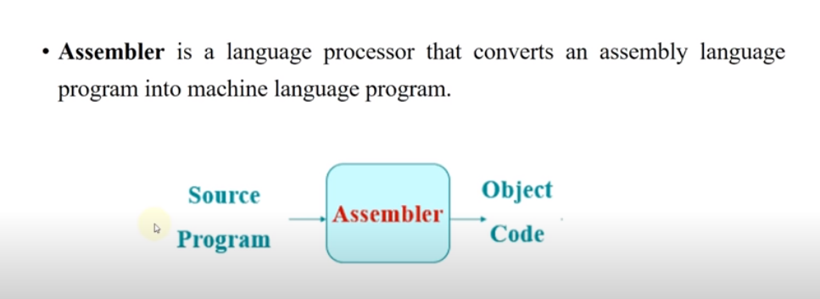
Assembler

Slide 3
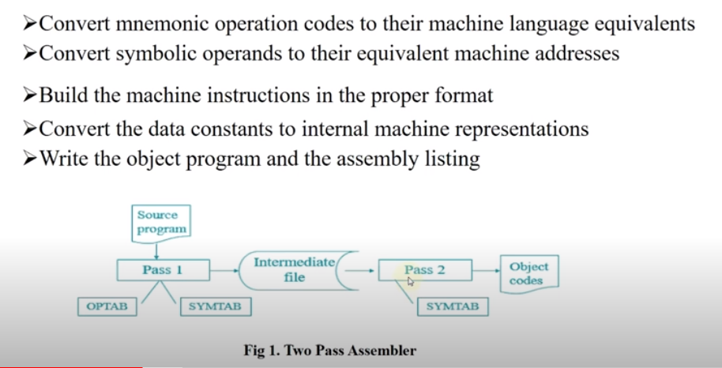
Assembler Introduction

Slide 4
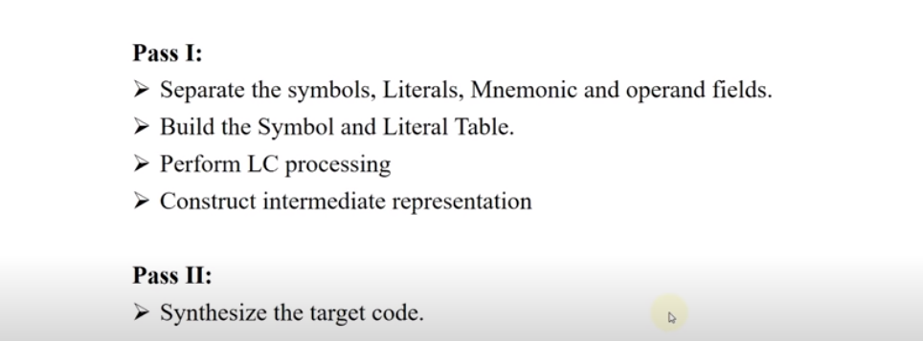
Design of Two Pass Assembler

Slide 5
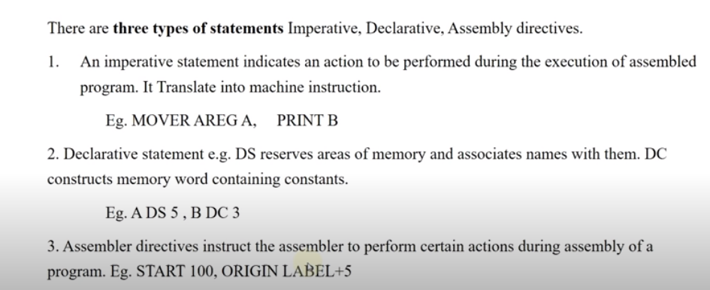
Assembly Language Statements

Slide 6
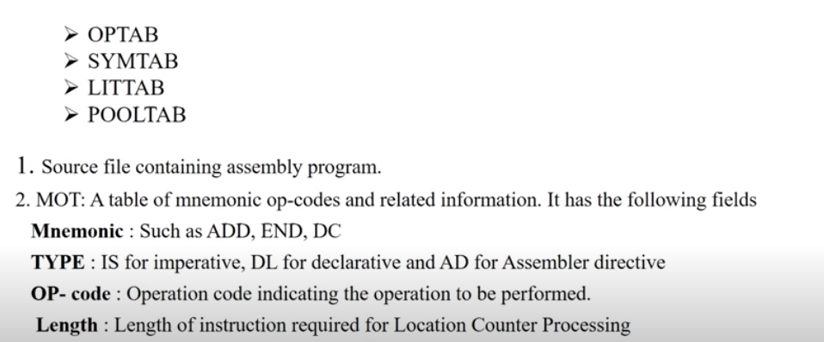
Data Structures Required for Assembler

Slide 7
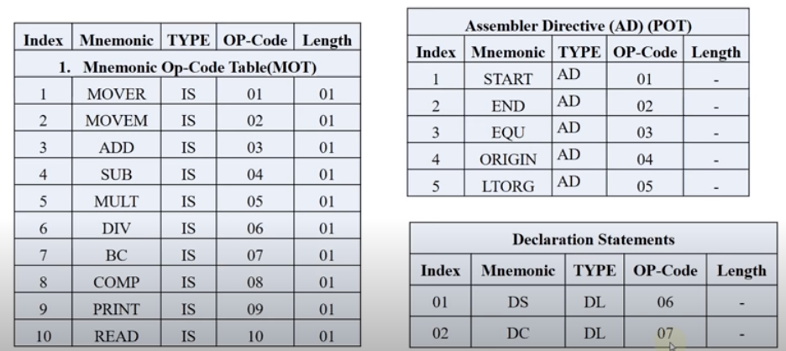
Op-code Table

Slide 8
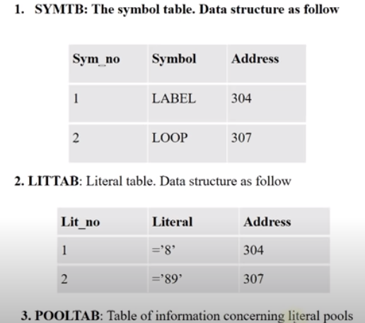
Data Structures

Slide 9
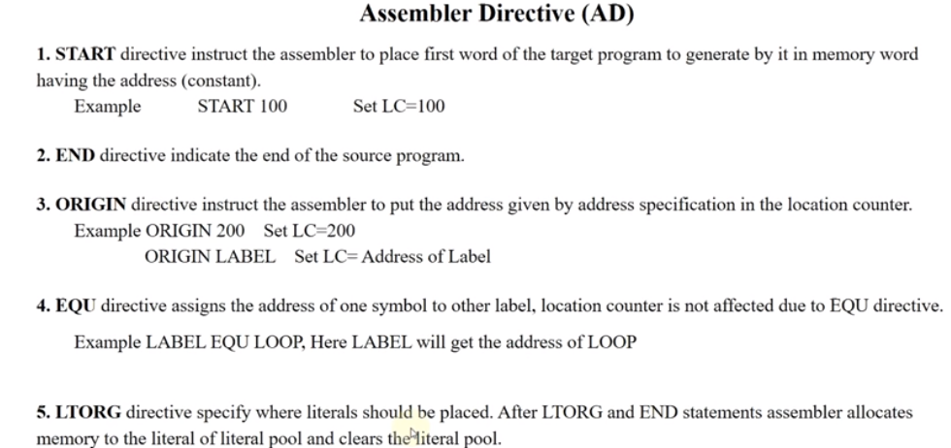

Slide 10
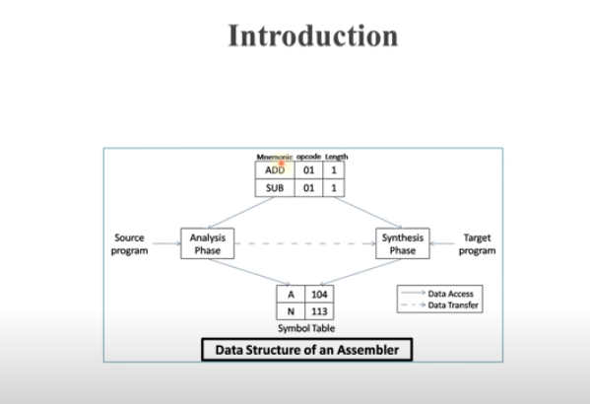

Slide 11
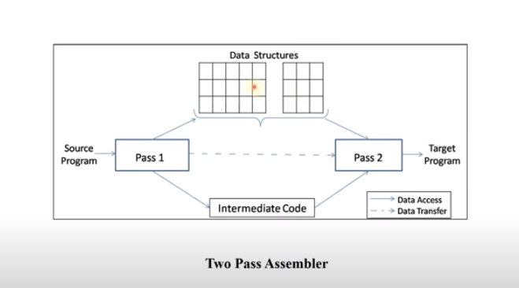

Slide 12
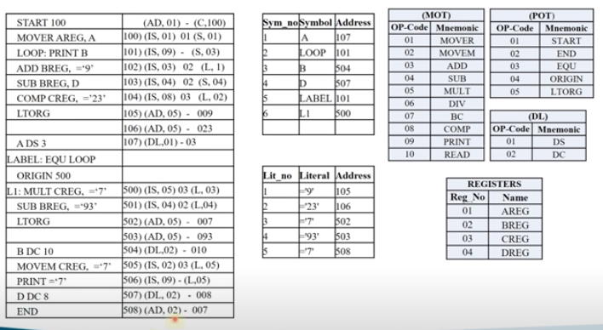

Slide 13
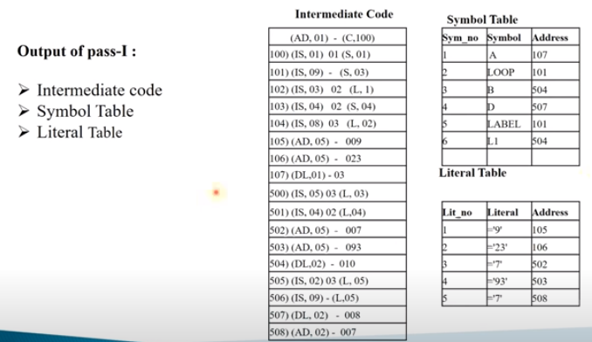

Slide 14
Pass-II Assembler

Slide 15
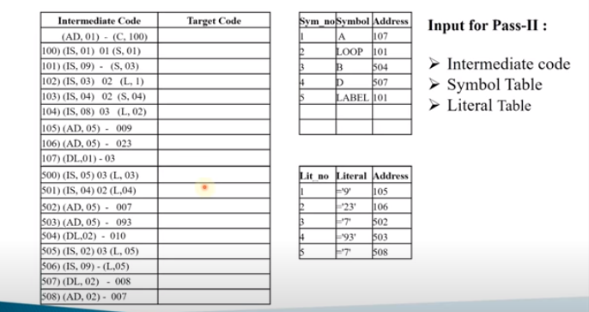

Slide 16
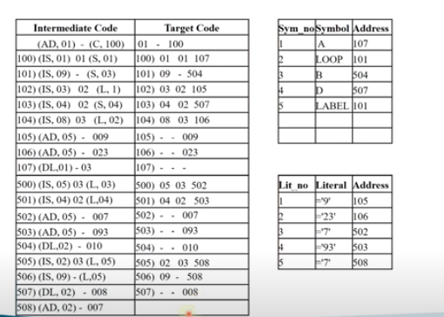

Slide 17
