Slide 1

EDA on NETFLIX dataset
Jiteshwar Anjale

Slide 2
Agenda
Description of Dataset
Business questions
Data Exploration
Data Cleaning
Data visualization
Conclusions

Slide 3
Dataset
This dataset consists of tv shows and movies available on Netflix as of 2019. The dataset is collected from Flixable which is a third-party Netflix search engine.
In 2018, they released an interesting report which shows that the number of TV shows on Netflix has nearly tripled since 2010. The streaming service’s number of movies has decreased by more than 2,000 titles since 2010, while its number of TV shows has nearly tripled. It will be interesting to explore what all other insights can be obtained from the same dataset.
Integrating this dataset with other external datasets such as IMDB ratings, rotten tomatoes can also provide many interesting findings.

Slide 4
Business Questions
Some of the interesting questions (tasks) which can be performed on this dataset -
Understanding what content is available in different countries
What are most popular genres on Netflix
Is Netflix has increasingly focused on TV rather than movies in recent years.
What are the rating for Netflix contents
Which county have highest Netflix content listed

Slide 5
Description of Netflix Dataset
This dataset contains data collected from Netflix of different TV shows and movies from the year 2008 to 2021.
type: Gives information about 2 different unique values one is TV Show and another is Movie
title: Gives information about the title of Movie or TV Show
director: Gives information about the director who directed the Movie or TV Show
cast: Gives information about the cast who plays role in Movie or TV Show
release_year: Gives information about the year when Movie or TV Show was released
date_added: Gives information about the date when Movie or TV Show was added on Netflix
rating: Gives information about the Movie or TV Show are in which category (eg like the movies are only for students, or adults, etc)
duration: Gives information about the duration of Movie or TV Show
listed_in: Gives information about the genre of Movie or TV Show
description: Gives information about the description of Movie or TV Show
Country: Country where the content is available to watch

Slide 6
Derived variables
We have derived 2 fields from date_added variable for analysis
year_added: Gives information about the year when Movie or TV Show was added on Netflix
month_added: Gives information about the month when Movie or TV Show was added on Netflix

Slide 7
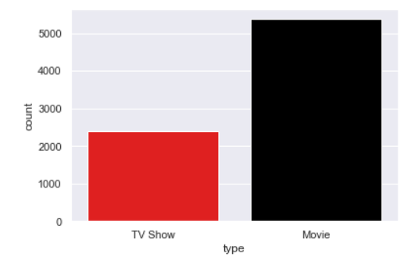
Analysis of Movies vs TV Shows
Netflix have more movies than TV Shows

Slide 8
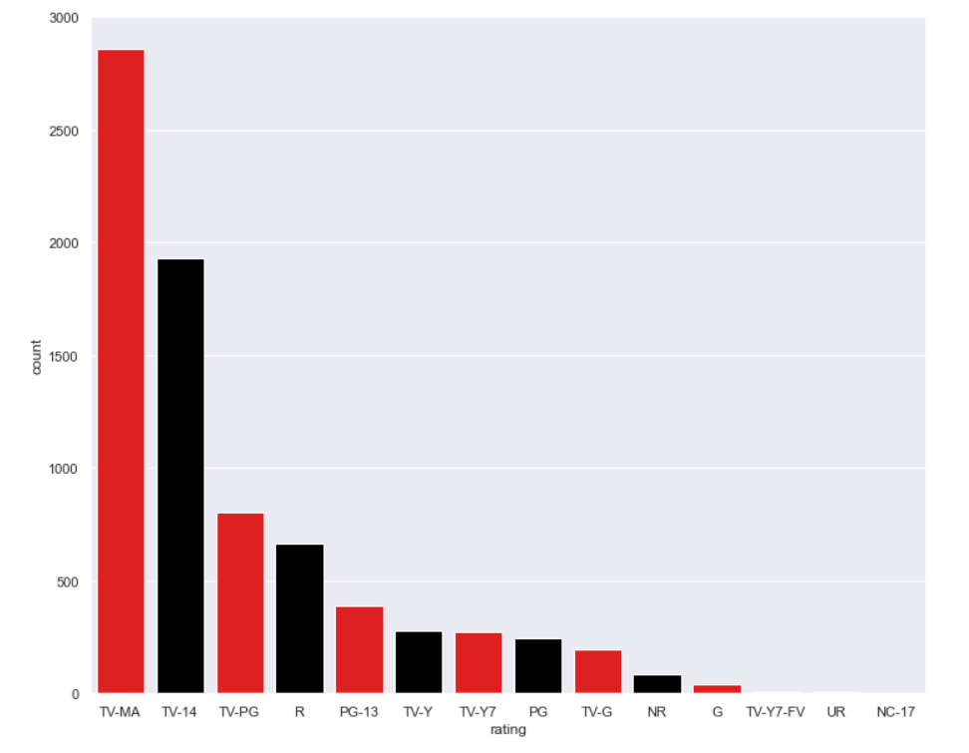
Movie Ratings Analysis
The largest count of movies are made with the 'TV-MA' rating."TV-MA" is a rating assigned by the TV Parental Guidelines to a television program that was designed for mature audiences only.
Second largest is the 'TV-14' stands for content that may be inappropriate for children younger than 14 years of age.
Third largest is the very popular 'R' rating. An R-rated film is a film that has been assessed as having material which may be unsuitable for children under the age of 17 by the Motion Picture Association of America.

Slide 9
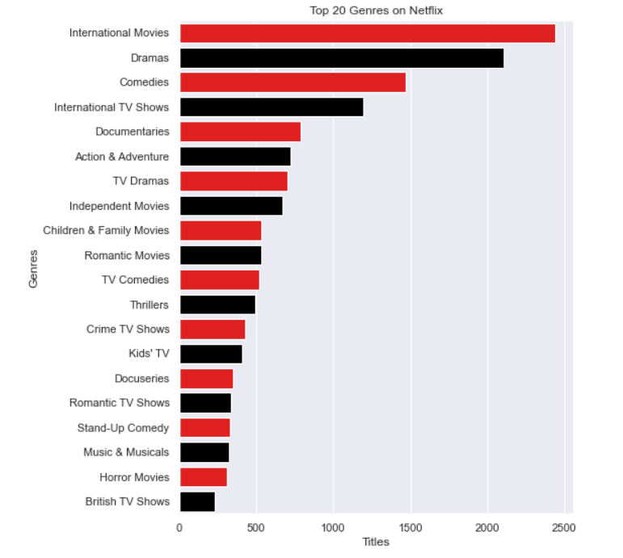
Popular Genres Analysis
In terms of genres, international movies takes the cake surprisingly followed by dramas and comedies. Even though the United States has the most content available, it looks like Netflix has decided to release a ton of international movies.
The reason for this could be that most Netflix subscribers aren't actually in the United States, but rather the majority of viewers are actually international subscribers.

Slide 10
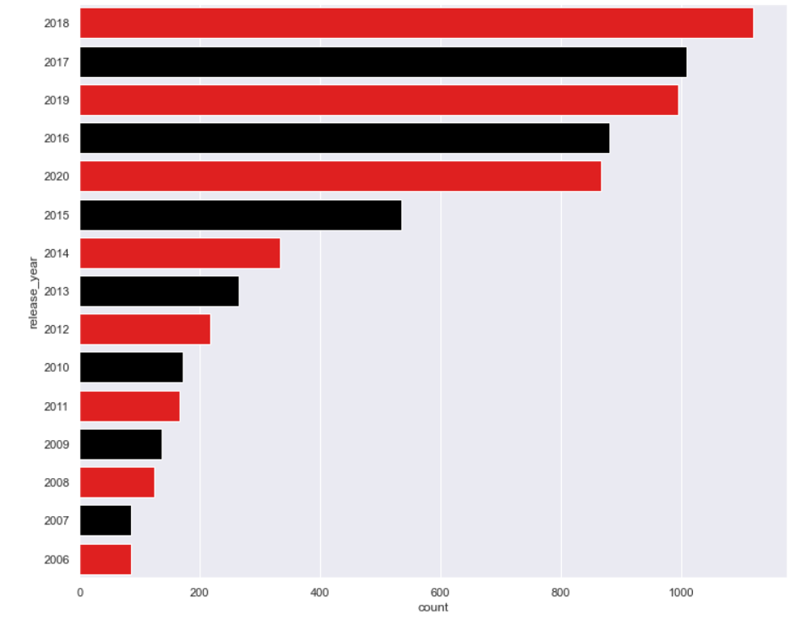
Released Year Wise Analysis
So, 2018 was the year when most of the movies were released.

Slide 11
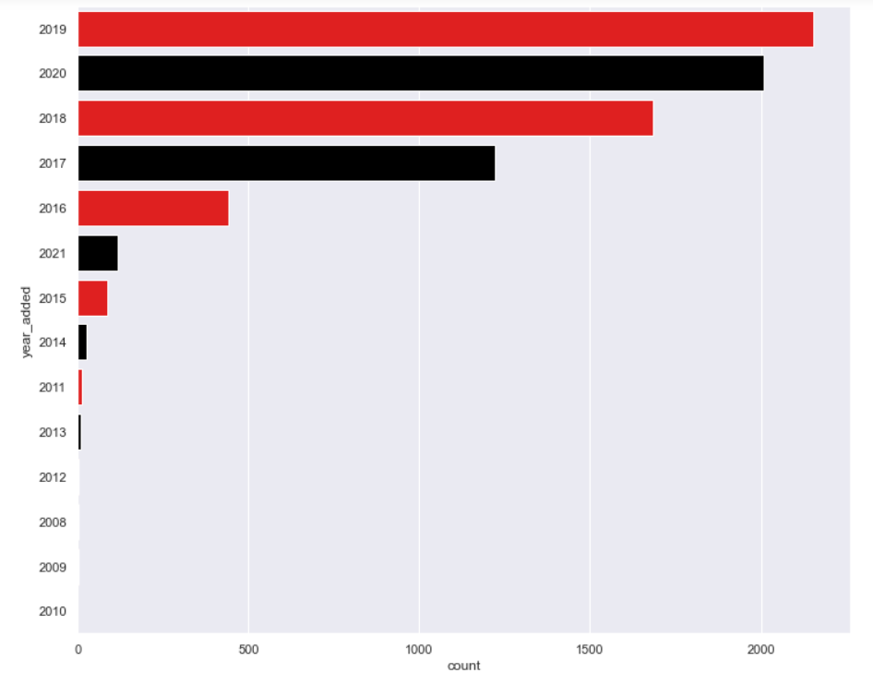
Added Year Wise Analysis
So, 2019 was the year when most of the movies were added on Netflix.

Slide 12
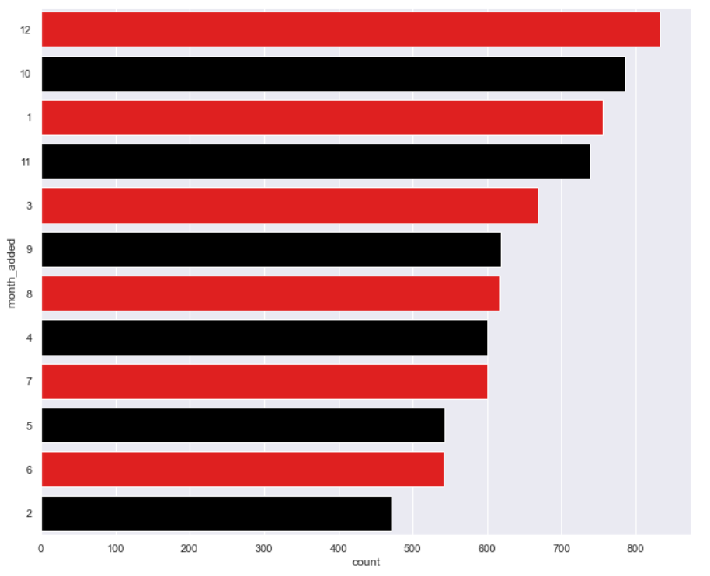
Added Month Wise Analysis
So, Dec is the month when most of the movies were added on Netflix.

Slide 13
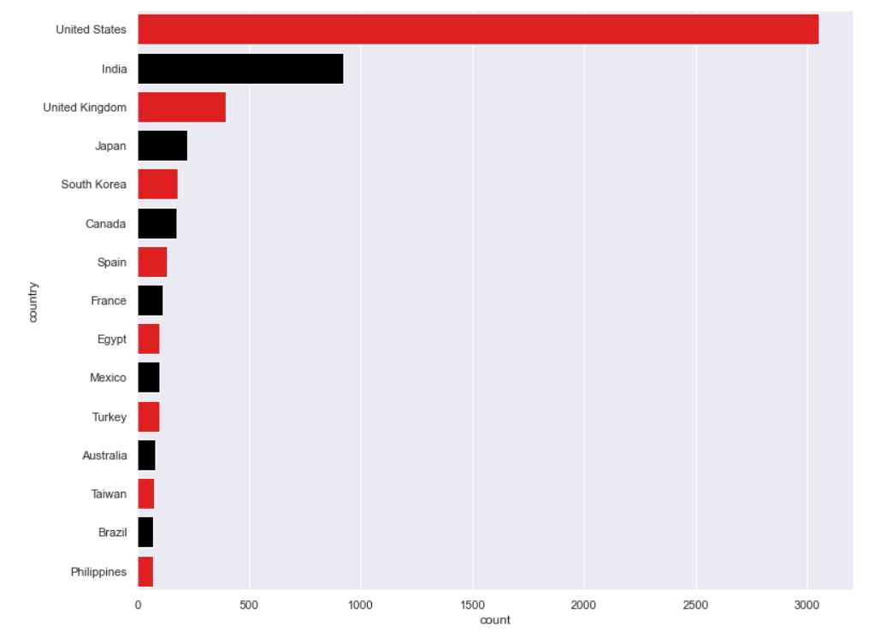
Countries with highest rated content Analysis
United States have highest rated content on the Netflix.

Slide 14
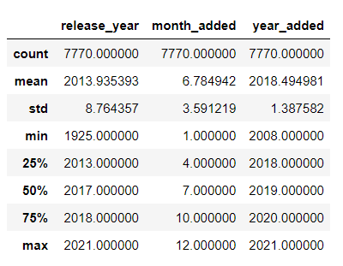
Mean, Mode, spread,Std Deviation
There are 7770 total records in the Netflix dataset
Release year for Netflix content have spread between 1925 to 2021 with mean as 2013 and std dev of 8.7 years.
Added year for Netflix content have spread between 2008 to 2021 with mean as 2018 and std dev of 1.3 years.
Added month for Netflix content have spread between 1 to 12 with mean as 6.7 and std dev of 3.5 months.

Slide 15
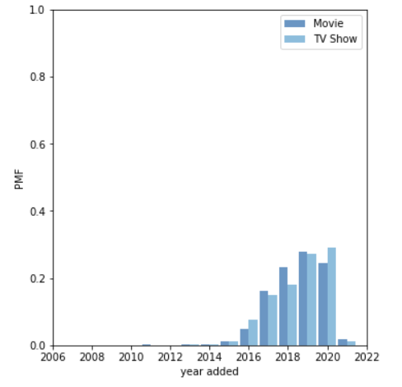
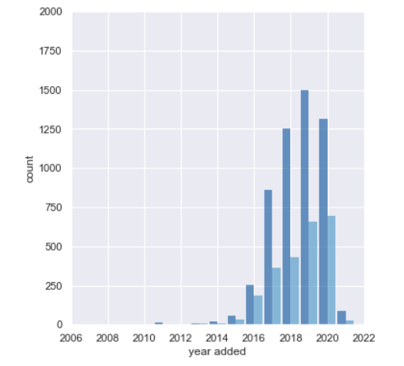
PMF of Movie and TV Show
Based on the PMF plot, we can say that more TV shows are added than Movies in 2020.
But as per histogram it shows that more movies are added in 2020.

Slide 16
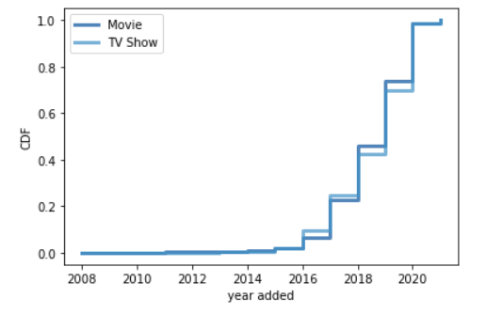
CDF of Movie and TV Show
The CDF shows that around 80% of the current netflix movies and shoes were added between 2016 to 2019.

Slide 17
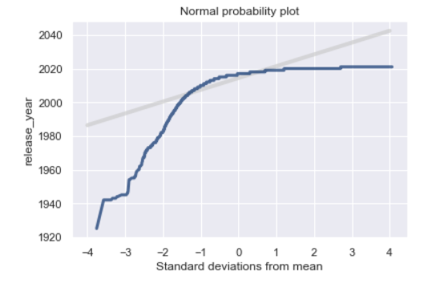
Normality distribution of released_year
The line is not straight that means the released year for the Netflix content is not uniform.

Slide 18
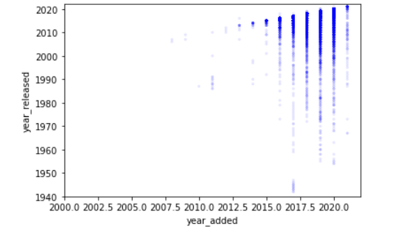
Scatter plot of year_added vs year_released
Covariance=1.23
Correlation=0.10
The positive covariance and correlation shows that there is strong relation between year_added and year_released for any content on Netflix.

Slide 19
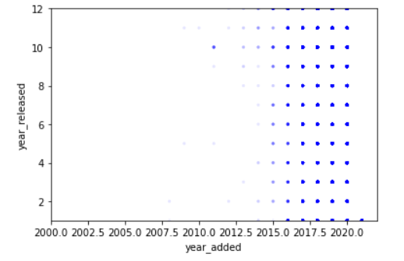
Scatter plot of year_added vs month_added
Covariance= -0.66
Correlation= -.133
The negative covariance and correlation shows that there is inverse relation between year_added and month_added for any content on Netflix.

Slide 20
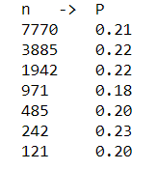
Hypothesis testing of released_year
Test: difference in mean year TV shows and movies added on Netflix
Conclusion: As expected, tests that are positive with large sample sizes become negative as we take away data. But the pattern is erratic, with some positive tests even at small sample sizes.

Slide 21
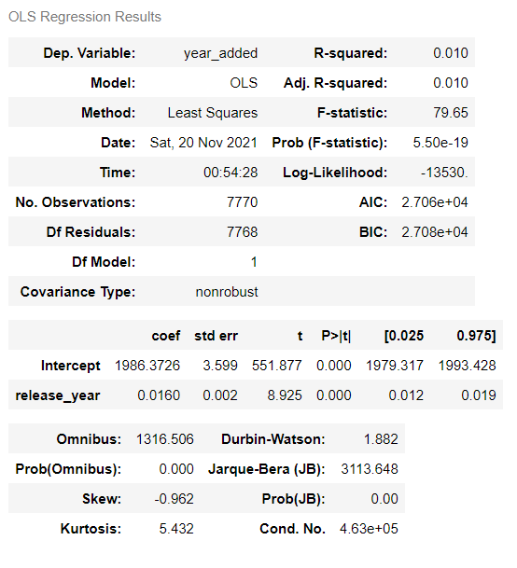
Linear Regretion year_added ~ released_year
Standard Errors assume that the covariance matrix of the errors is correctly specified.
The condition number is large, 4.63e+05. This might indicate that there are strong multicollinearity or other numerical problems.

Slide 22
Conclusion
As we noted through this notebook; Netflix is very popular among various social classes, and as we all know it has increased in popularity during the Covid-19 pandemic.
Netflix is continuedly adding new content on their platform. We can see exponential growth in new content after 2016.
Most of the content added on Netflix in 2018 and 2019 are released in same year.
There are many different genres available on Netflix to attract wide range of subscribers.
‘International movies’ is the top genre present on Netflix.
Majority of Netflix content is available in USA.

Slide 23
Thank you!

