Slide 1

BreifMail
Ai powered email summarizer
TEAM CODESTORM:
VENUGOPAL m (1wa23cs038)
Yashwanth s(1wa23cs050)
Varun R(1bm24cs430)

Slide 2
1 Problem Statement
Professionals and students receive a large number of emails daily, making it difficult to quickly identify important information.
Reading every email fully consumes time and reduces productivity.
Key Issues
Email overload
Time wasted reading long emails
Important information gets missed
Difficulty prioritizing emails quickly
Objective
Build an AI-powered Email Summarizer that automatically reads emails and generates short, meaningful summaries so users can understand the message instantly.

Slide 3
2 Solution Architecture
System Workflow
User Login
User enters Gmail ID and App Password.
Email Fetching
The system connects to Gmail using IMAP protocol.
Emails are retrieved from the inbox.
Email Processing
Email body text is extracted and cleaned.
AI Summarization
NLP model processes the email text.
Generates a short and clear summary.
User Interface
Streamlit dashboard displays:
Email subject
Sender
AI-generated summary

Slide 4
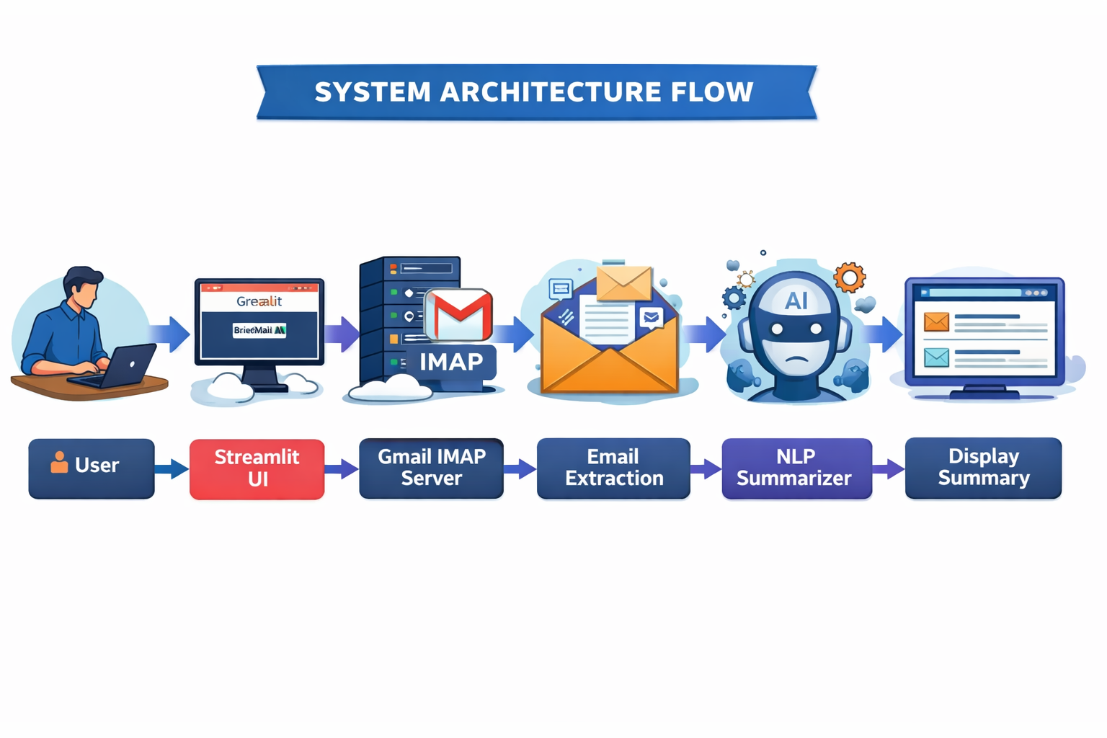

Slide 5
3 Tech Stack
Frontend
Streamlit
Python UI components
Backend
Python
AI / NLP
TextBlob / NLP summarization
Natural Language Processing
Email Integration
IMAP protocol
Gmail App Password authentication

Slide 6
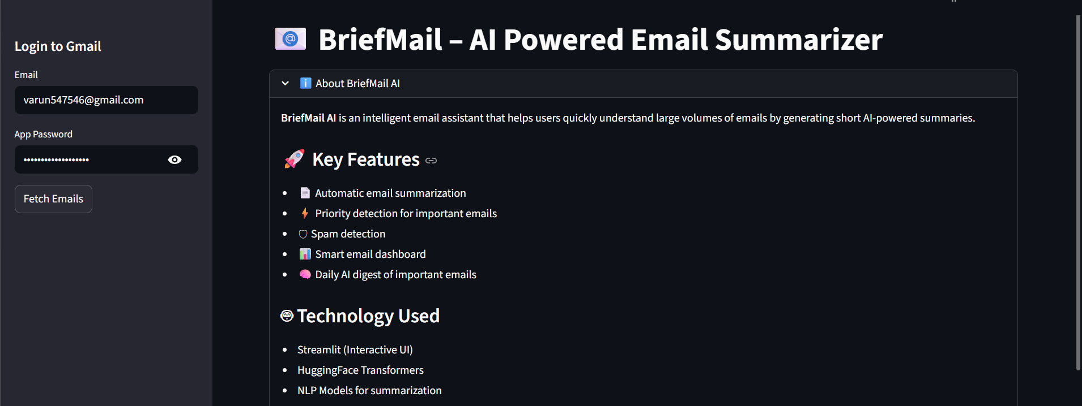
Fig 1. Home Page

Slide 7
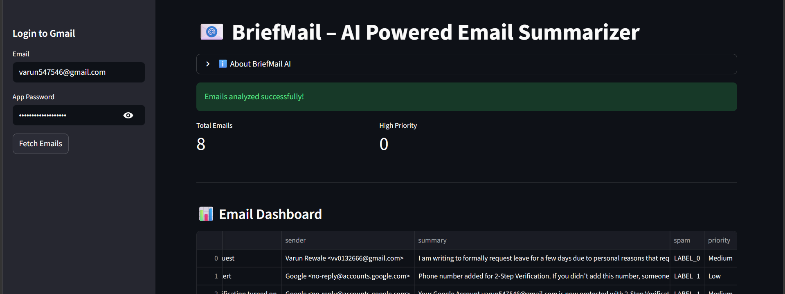
Fig 2 . Email Dashboard

Slide 8
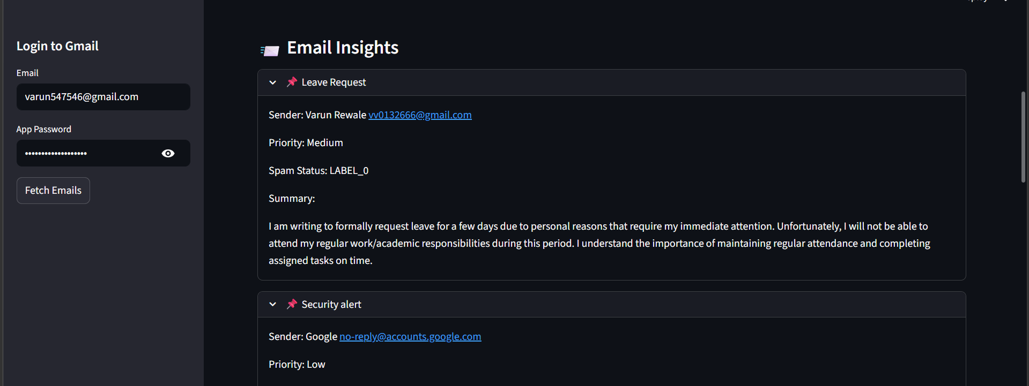
Fig 3. Email Insights

Slide 9
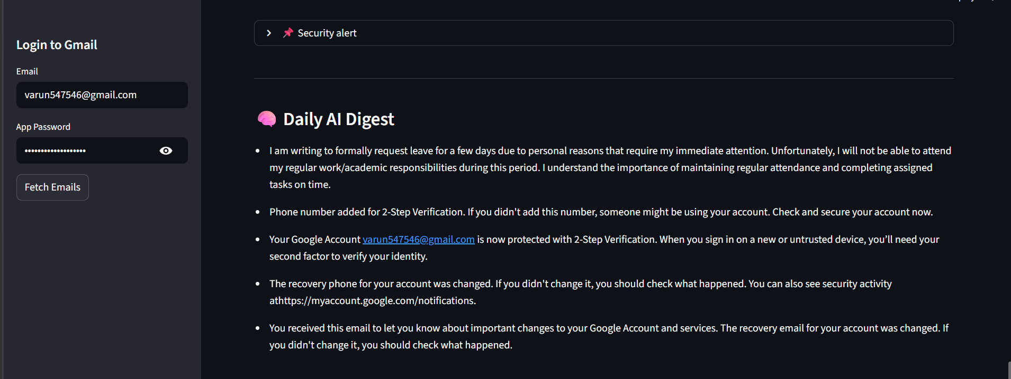
Fig 4.Daily Digest

Slide 10
5 Demo Instructions
Step 1
Run the application:
streamlit run app.py
Step 2
Open browser:
http://localhost:8501
Step 3
Login using:
Gmail ID
Gmail App Password
Step 4
Click Fetch Emails
Step 5
System will:
Retrieve emails
Generate summaries
Display them in the dashboard

Slide 11
6 Future Improvements
AI Improvements
Use LLMs like GPT / BERT for better summaries
Sentiment analysis of emails
Productivity Features
Priority email detection
Spam filtering
Email categorization (Work / Personal / Urgent)
Smart Alerts
Notify user of important emails
Integration
Outlook and Yahoo support
Mobile application
Advanced Features
Email reply suggestions
Meeting extraction from emails
Task creation from emails

Slide 12
Thank You

