Slide 1
RADAR: an In-building RF-based user location and tracking system
By P. Bahl and V.N. Padmanabhan
Telvis Calhoun
Wireless Sensor Networks
CSC8908-005
Dr. Li
8/27/2008

Slide 2
Overview
Goal
  Track indoor objects using WIFI (802.11b)
Experiment
  3 base stations and 1 mobile node in an indoor environment.
Results
  Authors show they can track objects within 2-3 meters.

Slide 3
Other Indoor Tracking Methods
Wide-Area Cellular Systems
  Angle of Arrival (AOA)
  Time difference of arrival (TDOA)
  Not useful indoors due to RF reflections
Infrared Techniques
  Scales poorly due to limited range of IR
  Installation and maintenance costs.
  Poor performance in direct sunlight.

Slide 4
RADAR
Uses RF signal strength (SS) from multiple receiver locations to triangulate the user’s coordinates.
Can be used for location aware applications.
  Detect nearest printer
Authors examine empirical and RF model technique

Slide 5
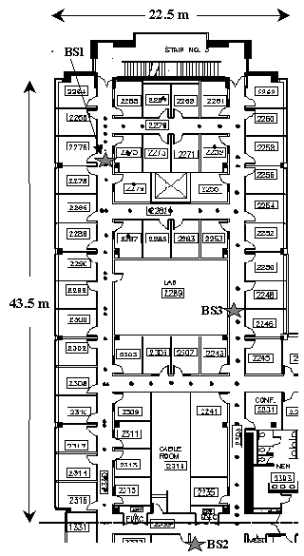
Test Environment
3 Base Stations
10500 sq ft
Lucent WaveLAN cards.
200m/50m/25m range for open/semi-open/closed areas.
Map of Testbed

Slide 6
Empirical Data Collection
Mobile host 4 UDP packets per second with 6-byte payload.
Each base station records the signal strength with timestamp (t, bs, ss)
User indicates current location on mobile application
Store orientation since it causes variation in detected signal.
Mobile node records (t,x,y,d)
Data collection phase repeated for 70 distinct locations for 4-directions.

Slide 7
Generate Signal Information
Merge Data
  Merge data from 3 base stations and mobile node.
  Generate tuple (x, y, d, ss(i), snr(i)) where i is the base station ID.
Determine closest matches.
  Use multi-dimensional search algorithm to compare off-line and on-line data. Calculate building layout
Cohen-Sutherland line-clipping algorithm to compute the number of walls that obstructed direct line of sight base stations and locations.

Slide 8
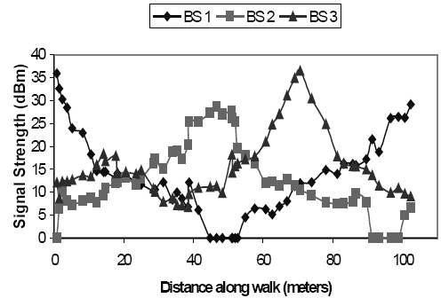
Analysis
Convert physical space to signal space (ss1,ss2,ss3)
Nearest Neighbor in Signal Space (NNSS) using Euclidean distance.

Slide 9
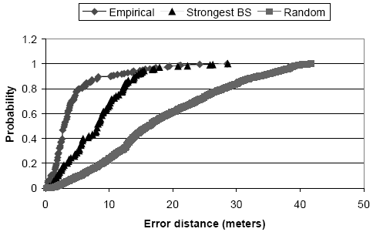
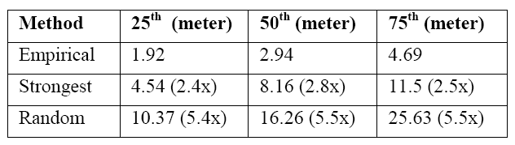
Comparison
Empirical Method is more accurate than other tracking methods.

Slide 10
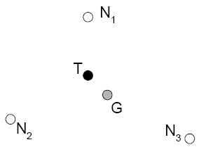
K-nearest neighbors
Average k neighbors (in signal space)
Result: Small k has some benefit and large k is not accurate.
K-neighbors in signal space are not near in physical space.
An illustration of how averaging multiple nearest (N1, N2, N3) can lead to a guess (G) that is closer to the user’s true location (T) than any of the neighbors is individually.

Slide 11
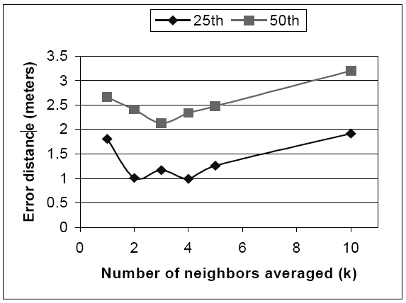
Max signal strength across orientations.
Combine highest SS of 4 orientations.
Final tuple may contain SS for different orientations.
Simulate case where SS is not obstructed by the human body.
Decrease data size to 70 instead of 70*4.
Reduced Dataset with k-neighbors.

Slide 12
Other Analysis Methods
Accuracy did not decrease with number or data points.
Accuracy decreased with decreased samples.
Ignoring radio orientation decreases accuracy
Tracking Mobile User as sequence of location determination problems.
  Use 10 sample window. Results are only slightly worse.

Slide 13

Radio Propagation Model
Use mathematical model for indoor RF propagation to directly calculate users position.
Empirical method is accurate but depends on accurate training data.
Based on Multipath Fading Models
  Transmitted signal reaches the receiver via multiple paths.
  Rayleigh fading, Rician distribution, Attenuation Factor
Wall attenuation factor
  Accommodate loss due to building. Empirically determined attenuation caused by wall.
Wall Attenuation Factor Formula

Slide 14
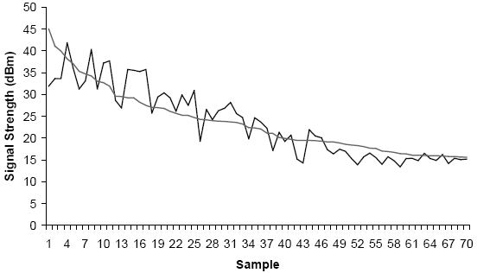
Empirical vs. RF Model
Actual SS fluctuates more than RF model
RF Model can track objects to within 4 to 8 meters
Predicted SS vs Actual SS

Slide 15
References
P. Bahl and V. N. Padmanabhan, "RADAR: an in-building RF-based user location and tracking system," in INFOCOM 2000. Nineteenth Annual Joint Conference of the IEEE Computer and Communications Societies. Proceedings. IEEE, 2000, pp. 775-784 vol.2.

Slide 16
Conclusions
Authors show WIFI can be used to track objects.
Empirical Method can track objects within 2-3 meters.
RF Model Method can track objects within 4-8 meters.

