Slide 1
Privacy and security Implications on Wireless (Wi-Fi)
J R O Sirimanne
2013 MIS 021
Supervisor: Dr. Chamath Keppitiyagama

Slide 2
Road Map
Introduction
Background
Design of the research
Research findings
Conclusion
Continuing the project: future works

Slide 3
Introduction
Wi-Fi is the popular wireless networking technology using radio waves operate in 2.4GHz and 5GHz bands
a huge growth in Wi-Fi enabled devices and Wi-Fi hotspots within past few years
Tomography refers to imaging by sections or sectioning, through the use of any kind of penetrating wave
Radio tomographic imaging (RTI) offers a new way to image passive objects in buildings and outdoor environments using received signal strength (RSS).
Signal Strength is measured in decibel (db)
RSSI is a measurement of the power present in a received radio signal

Slide 4
Privacy
freedom from interference or intrusion
the right "to be let alone,“
Privacy and tomography???
In tomography it is possible to map objects
Objects can be anything including “HUMANS”
No way to know whether someone is using tomographic technologies
“Human movements can be mapped even without their knowledge” !!!
Privacy is breached

Slide 5
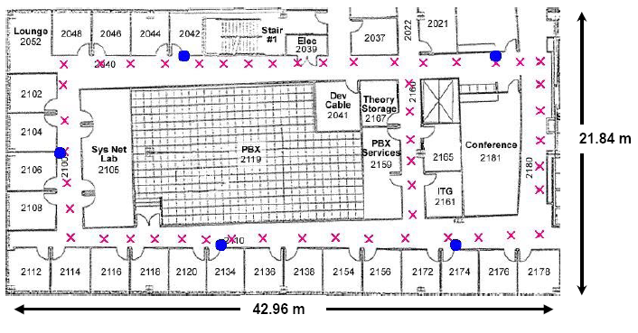
Related Work
RADAR: An In-Building RF-based User Location and Tracking System by Paramvir Bahl and Venkata N. Padmanabhan IEEE Infocom 2000, volume 2, pages 775-784, March 2000.
An In-building RF-based user location and tracking system
WiFi-based localization
Fingerprinting, RSSI profiling

Slide 6
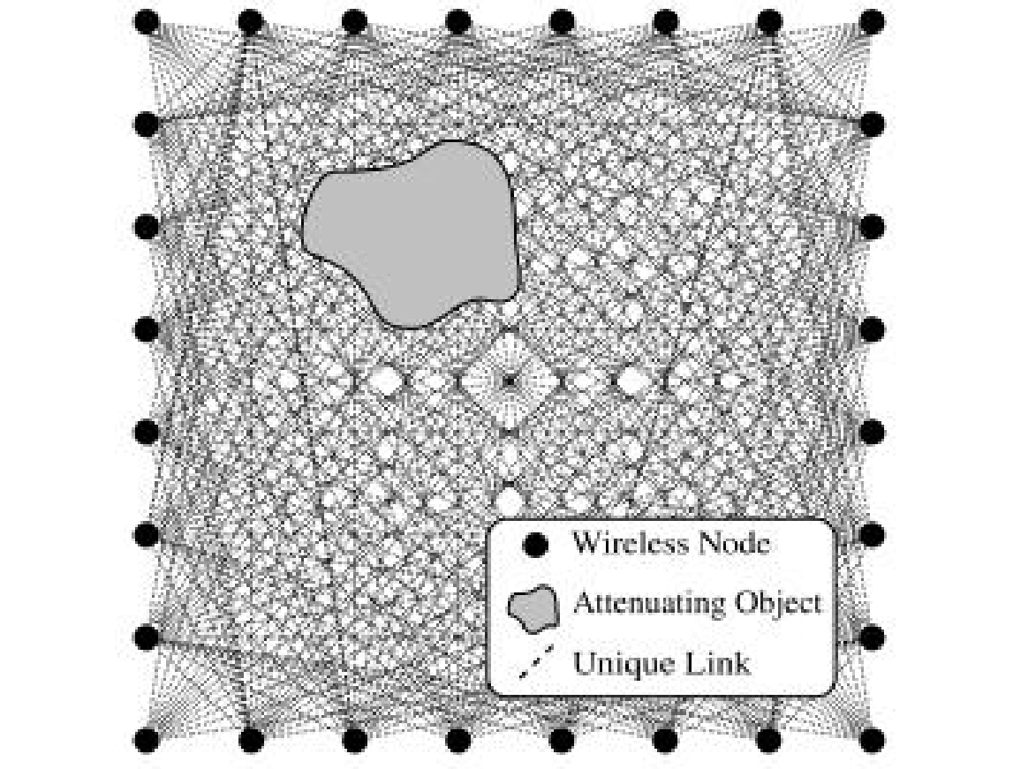
Related Work Contd…
J. Wilson and N. Patwari, “Radio tomographic imaging with wireless networks,” IEEE Transactions on Mobile Computing, vol. 9, no. 5, pp. 621–632, May 2010. Published, 01/08/2010.
tracks humans moving through a building
An illustration of an Radio tomographic imaging (RTI) network. Each node broadcasts to the others, creating many projections that can be used to reconstruct an image of objects inside the network area.

Slide 7
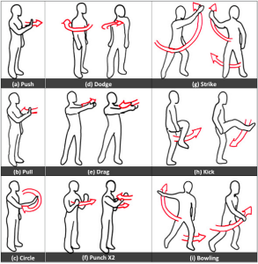
Related Work Contd…
WiSee; Pu, Q., Gupta, S., Patel, S. and Gollakota, S. (2013). Whole-Home Gesture Recognition Using Wireless Signals. In: The 19th Annual International Conference on Mobile Computing and Networking (Mobicom'13).
Tracks human gestures
WiSee, is a novel approach to gesture recognition that leverages Wi-Fi signals to enable whole-home sensing and recognition of human gestures. WiSee can correctly detect nine gestures with 94% average accuracy from 900 tested gestures.

Slide 8
Related Work Contd…
Study on wireless sensor based industrial tomography systems by Chiew Loon Goh, Nor Muzakir Nor Ayob, Ruzairi Abdul Rahim, Herlina Abdul Rahim, Muhammad Jaysuman Pusppanathan, Mohd. Hafiz Fazalul Rahiman, Leow Pei Ling, Zulkarnay Zakaria.
survey on wireless based industrial tomography system, and to review design challenges in the field of embedded wireless solutions

Slide 9
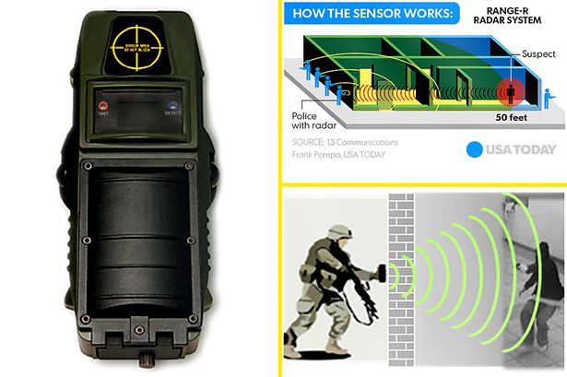
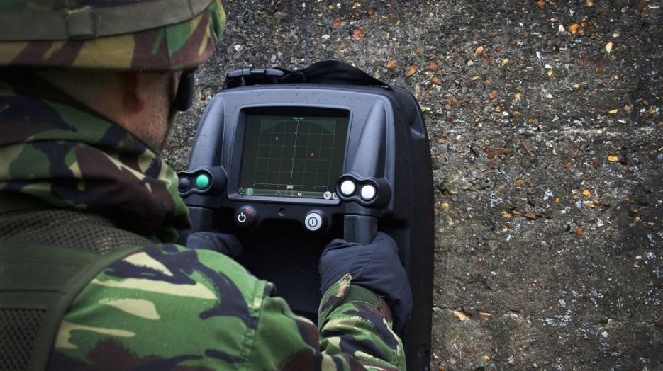
Related Work - Products
See through walls radar – used for military and tactical purposes

Slide 10
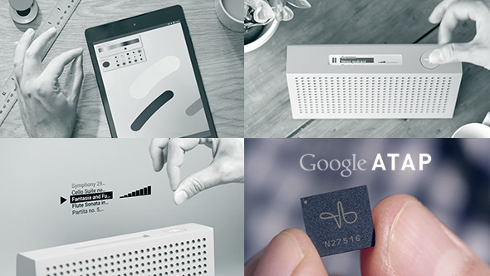
Related Work–Products Contd..
Google's Project Soli
Using radar to enable new types of touchless interactions
The Soli sensor can track sub-millimeter motions at high speed and accuracy

Slide 11

Research Question
Is there a significant amount of wireless signal strength drop when there is a human inside the line of sight of the wireless access point and data gathering computer?
How accurately we can identify human presence by observing received signal strength indicator (RSSI) values.

Slide 12

Initial Design
Creating initial scenario sets to gather data
Developed to answer first research question
Try to make them as close as possible to real world situations
Two variables
Wireless access point
Data gathering computer
At any given time one is constant

Slide 13
Scenarios – Set 1
When Wireless access points position is a constant and its in the middle of the room
Wireless access point Data gathering computer
Scenario 1 Scenario 2 Scenario 3
Scenario 4 Scenario 5 Scenario 6

Slide 14
Scenarios – Set 1 Contd…
When Wireless access points position is a constant and its in the middle of the room
Wireless access point Data gathering computer
Scenario 7 Scenario 8

Slide 15
Scenarios – Set 2
When Wireless access points position is a constant and its in a corner of the room
Wireless access point Data gathering computer
Scenario 9 Scenario 10 Scenario 11
Scenario 12

Slide 16
Scenarios – Set 3
When Wireless access point's position is a constant and its in a middle corner of the room
Wireless access point Data gathering computer
Scenario 13 Scenario 14 Scenario 15
Scenario 16

Slide 17

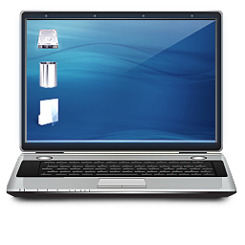
Gathering Data
Received Signal Strength is gathered from scenarios mentioned earlier.
Using a python script
http://recolog.blogspot.com/2015/03/plotting-wifi-signal-strength-variation.html
15 minutes of Received Signal Strength Data
Approximately 6 samples per second (value every 0.166 ms)
Received Signal Strength Data is saved to a text file
Wireless Access Point
Laptop

Slide 18
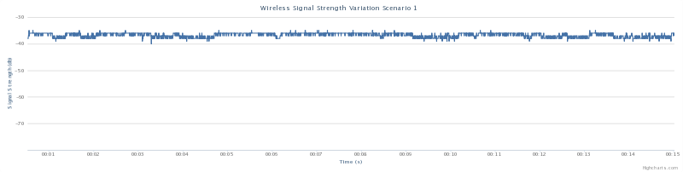
Analyzing Data
Plot signal strength values in a graph for scenario 1
Draw normal distribution graphs for each scenario
X axis = Signal Strength in db
Y axis = Density of probability (the chance of obtaining values near corresponding points on the X-axis)

Slide 19
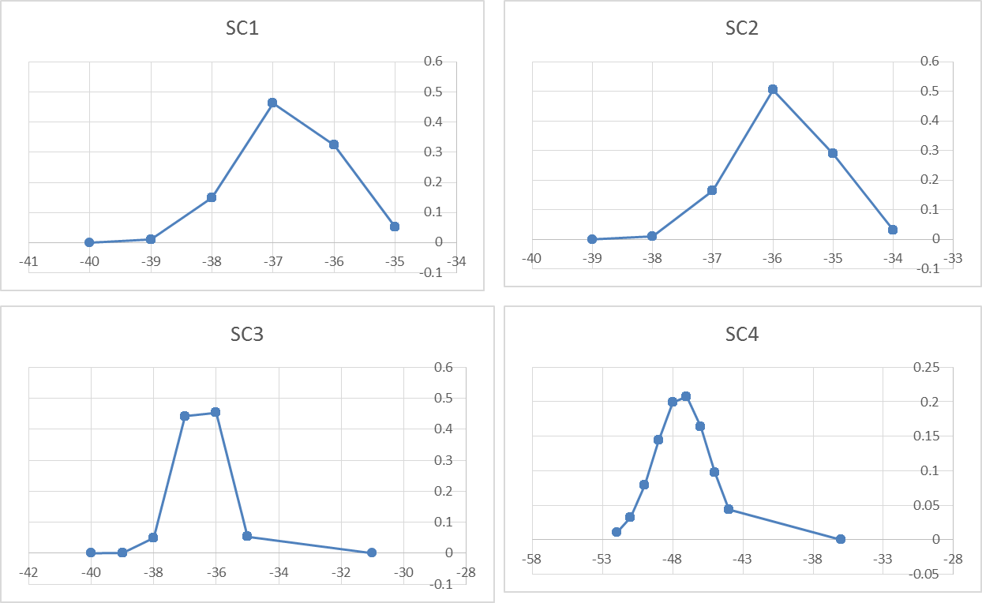
Normal Distribution Graphs Set 1

Slide 20
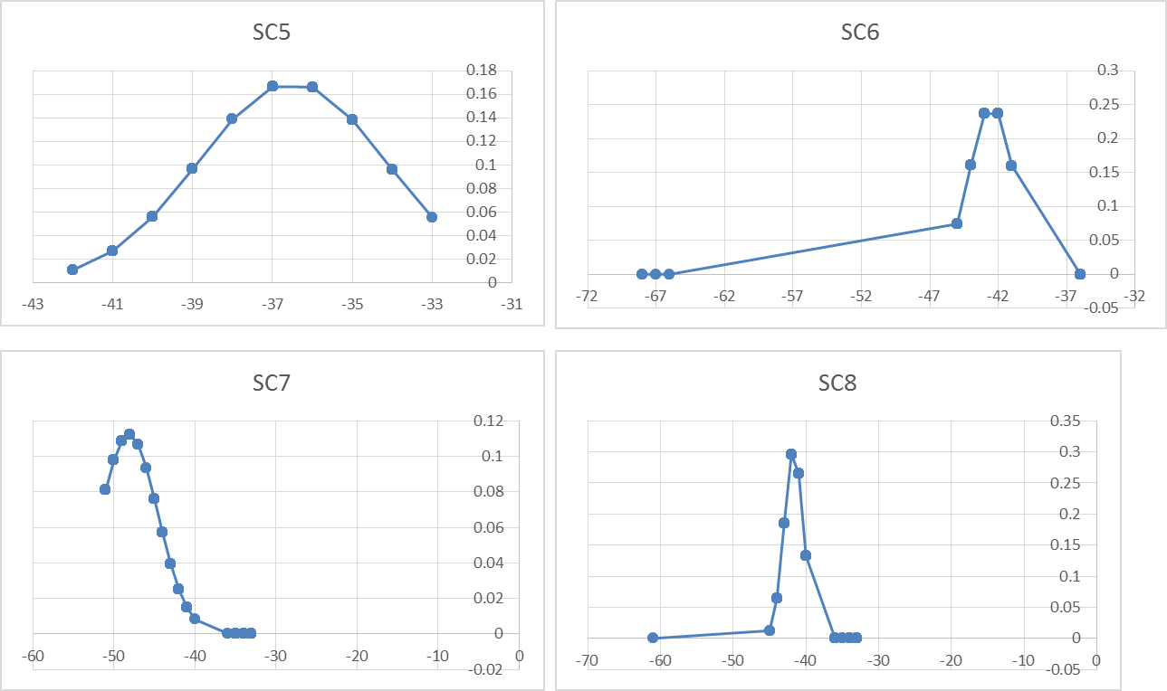
Normal Distribution Graphs Set 1 Contd…

Slide 21
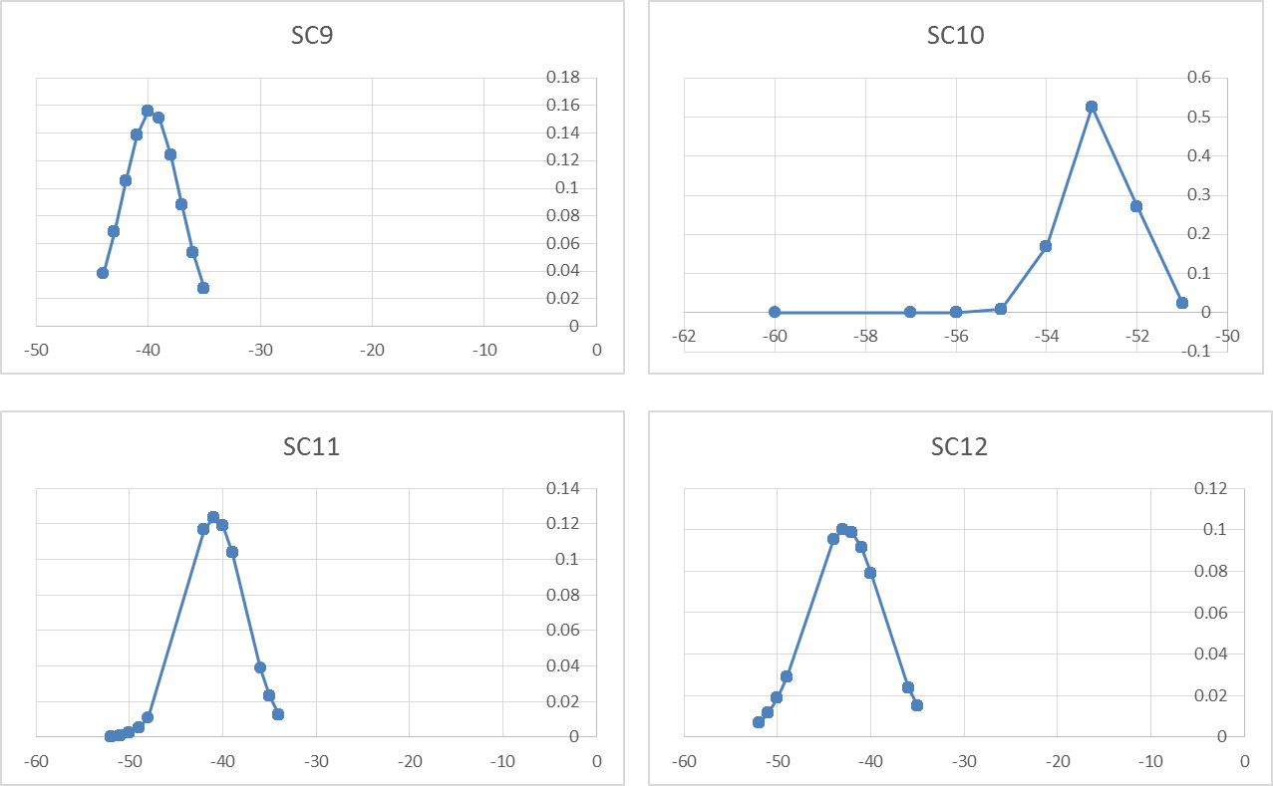
Normal Distribution Graphs Set 2

Slide 22
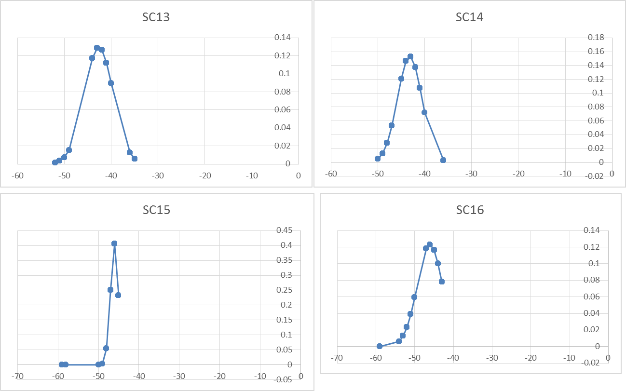
Normal Distribution Graphs Set 3

Slide 23
Initial Analysis Results
We are seeing a different distribution patterns and distribution peaks for the different scenarios.
Possible to continue the project forward
Randomly select scenario 12
scenario 12 will be introduced by a human object and sub scenarios will be designed based on scenario 12

Slide 24
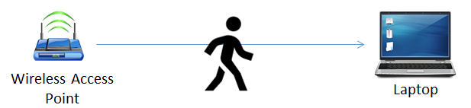
Design phase 2
Creating advance scenario sets to gather data
Try to make them as close as possible to real world situations
Three variables
Wireless access point
Data gathering computer
Human object
At any given time two of these are constant

Slide 25
Scenarios – Set 4
From above scenarios we randomly select scenario 12 and place a human between Wireless access point and Data gathering computer
Wireless access point Data gathering computer
Human
Here position of Wireless access point and Data gathering computer is constant and human position is the variable
Scenario 12-1 Scenario 12-2 Scenario 12-3

Slide 26
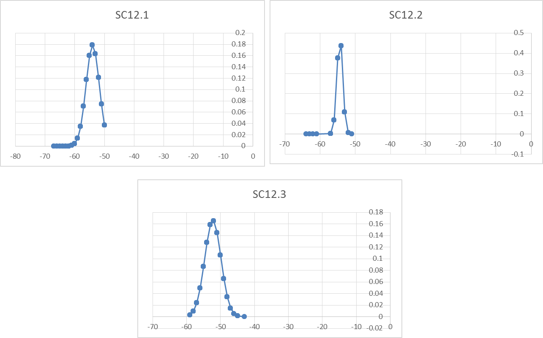
Normal Distribution Graphs Set 4

Slide 27
Answering Research Question 1
to answer first research question we use a statistical approach
statistical hypothesis testing
is an assumption about a population parameter. This assumption may or may not be true. Hypothesis testing refers to the formal procedures used by statisticians to accept or reject statistical hypotheses.
Building the hypothesis
Null hypothesis – H₀ = there is no change to amount of wireless signal strength when there is a human and no human inside the line of sight of the wireless access point and data gathering computer
Alternative hypothesis – H₁ = there is a significant amount of wireless signal strength drop when there is a human inside the line of sight of the wireless access point and data gathering computer

Slide 28
Answering Research Question 1..
Proving the hypothesis with regard to scenario 12
Using a 0.05 level of significance
Calculate values
Null hypothesis: μ = -42.78019231
Alternative hypothesis: μ ≠ -42.78019231
The t-value is t = 0. This is below the .05 standard, so the result is statistically significant for all scenarios
Scenario | Mean (db) | T-Test value
Scenario 12 | -42.78019231 | -
Scenario 12 - 1 | -53.95653846 | 0
Scenario 12 - 2 | -54.40423077 | 0
Scenario 12 - 3 | -52.2975 | 0

Slide 29
Answering Research Question 2
To answer second research question we use a probability based approach
Normal Probability Density Function
Can get the occurrence probability of a value in a distribution
Again we are using the scenario 12 and its sub scenarios
take the RSSI value with highest frequency from these scenarios and calculate the occurrence probability
Scenario | RSSI value with highest frequency (dBm) | Occurrence probability
Scenario 12 | -42 | 0.577422691
Scenario 12 - 1 | -53 | 0.665829879
Scenario 12 - 2 | -54 | 0.692344273
Scenario 12 - 3 | -51 | 0.705490974

Slide 30
Answering Research Question 2 ...
Results show that the occurrence probability and the highest frequency value differ when the human is moved in line-of-sight of the wireless access point and the data gathering computer
With more than 50% confidence level we can derive the position of the human
Proves by using radio tomographic methodologies can be used to violate privacy of an individual even without him knowing that he is being tracked

Slide 31
Conclusion
Study opened a new area in the field of radio tomography
Both research questions got the answers
First research question used the statistical hypothesis testing
Statistical hypothesis testing uses mean and standard deviation to prove or disprove the concepts
For scenarios 12, 12.1, 12.2 and 12.3 [mean, standard deviation] [-42.78019231 dBm, 3.994749386] , [-53.95653846 dBm, 2.232675289] , [-54.40423077 dBm, 0.804429328], [-52.2975 dBm. 2.401623461]
From these results mean is different for all the scenarios.
After calculating the T-Test value it is 0;
proved that there is indeed a significant level of RSSI level drop when there is a human obstructing the line of sight and it can be easily identified

Slide 32
Conclusion
Second research question is to localize the human obstacle to identify his whereabouts.
Used probability based approach.
Using the normal probability density function to calculate the occurrence probability of the highest occurrence of RSSI values
Occurrence probability of a RSSI value is unique to a specific scenario
scenario 12 the highest occurrence RSSI value is -42dBm with an occurrence probability of 0.577422691, scenario 12.1 -53dBm and 0.665829879, scenario 12.2 -54dBm and 0.692344273, scenario 12.3 -51dBm and 0.705490974.
can determine a person’s location with more than 50% probability

Slide 33
Future works
Expansion of the researching environment
Extending to the outdoor environments as well as in hybrid situations by converging both indoor and outdoor environments.
Error correction for environmental factors
Effects on a wireless signals by weather factors like wind, temperature and humidity.
Errors due to radio noise levels
Radio noises in the environment
Not a constant it keeps on changing
Human fingerprinting to uniquely identify a person
Analyze signal level drops by individuals
Fingerprinting different people using signal level drops that are unique to them.

Slide 34
Future works Contd...
Real-time framework to identify human presence
This study uses offline methods for analyzing
Analyze data in real time to get the outputs.
Auditing framework to identify privacy breach points in a typical environment

Slide 35
Questions?

Slide 36
Thank You!

