Slide 1
RADAR: An In-Building RF-based User Location and Tracking System
Paramvir Bahl and Venkata N. Padmanabhan
Microsoft Research

Slide 2
Related work
GPS
Active badge
  Scales poorly due to the limited range of IR
  Significant installation and maintenance cost
  Performs poorly in the presence of direct sunlight
RF based wide-area cellular system
  Locate cellular phone by measuring the
    Signal attenuation
    Angle of arrival (AOA)
    Time difference of arrival (TDOA)
  Promise in outdoor environment
  The effectiveness is limited by the multiple reflections suffered by RF signal

Slide 3
Introduction to RADAR
Radio frequency based wireless network in a in-building environment
Similar to Duress Alarm Location System (DALS), but someway different because DALS
  is dependent on specialized hardware
  does not use propagation model
  does not factor in orientation

Slide 4
Experimental Testbed of RADAR
The testbed is located on the second floor of a 3-strorey building
43.5m by 22.5m, 980 sq. m, including more than 50 rooms
3 base station is placed in the floor
  Pentium-based PC running FreeBSD 3.0
  with wireless adapter
  Record the information from mobile host
Mobile host
  pentium-based laptop computer running MS Win95
  Broadcast packets (beacons) periodically
Both base station and mobile host was equipped with a Digital RoamAbout NIC
  based on Lucent’s popular WaveLan RF LAN technology
  The network operates in the 2.4 GHz license-free ISM (Industrial, Scientific and Medical) band

Slide 5
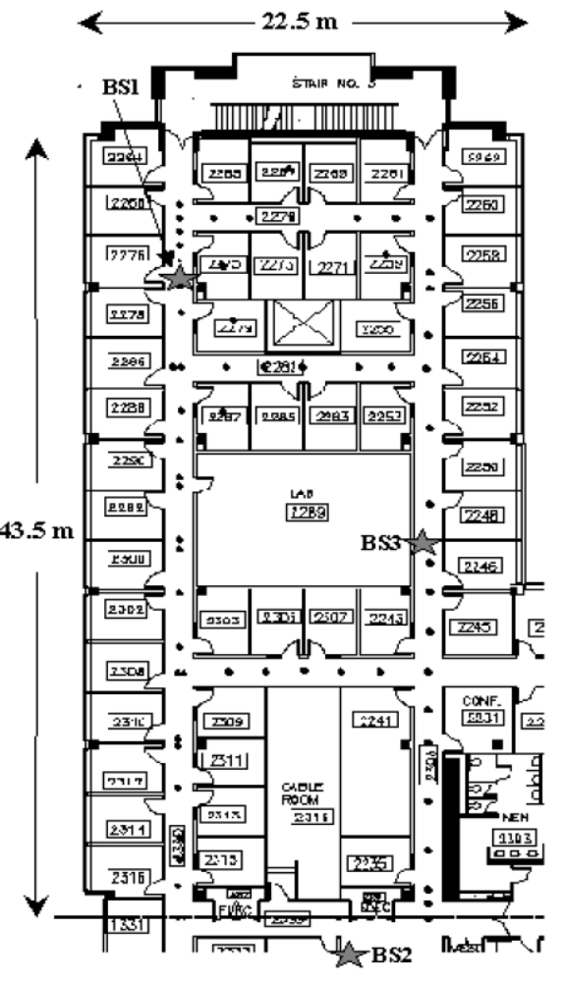

Slide 6
Basic idea
Offline phase
  Detect or compute the signal strength at specific location
  Process and analysis the data we collected
Real time phase
  Detect the signal strength at a random location
  Run NNSS (nearest neighbors in signal space) algorithm to search the fittest location

Slide 7
Offline phase
Two approaches to detect the signal strength at specific location
  Empirical method
  Radio propagation model

Slide 8
Empirical method
First synchronize the clock
The mobile host broadcast UDP packet at the rate of 4/sec
Each BS records the tuple (t, bs, ss) and
(t, x, y, d). the former tuple will also be record at real time phase
Merge the tuples using timestamp t ➔
(x, y, d, ss_{i}) i = 1,2,3
Sample for 70 location, each for at least 20 times
Use the sample mean value Instead of the raw data

Slide 9
Radio propagation model
Motivation
  Reduce the dependence on empirical data
Use the mathematical model of indoor signal propagation, which considers the reflection, diffraction, scattering of radio
  Rayleigh fading model : unrealistic
  Racian distribution model : difficult to determine the model parameters
  Floor Attenuation Factor propagation model : accept !!

Slide 10
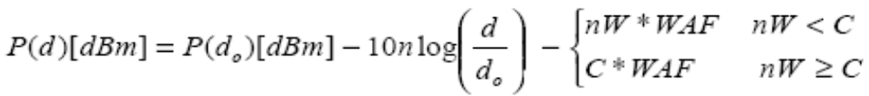
FAF propagation model
P(d) : the signal strength at distance d
n : the rate at which the path loss increase
with distance
d₀ : the distance of the reference point
C : the maximum number of obstructions (walls)
up to which the attenuation factor makes a
difference
nW : the walls between T-R
WAF : the wall attenuation factor

Slide 11
Determine the parameter of FAF model
WAF
n
P(d₀)

Slide 12
Real time phase
First synchronize the clock
The mobile host broadcast UDP packet at the rate of 4/sec
Each BS records the tuple (t, bs, ss)
Run NNSS (nearest neighbors in signal space) algorithm to search the fittest location ➔ use the Euclidean distance i.e.,
sqrt((ss₁-ss’₁)²+(ss₂-ss’₂)²+(ss₃-ss’₃)²)

Slide 13
Analysis – Empirical method
Use the 70*4 = 280 combinations
Pick one of the location and orientation at random
Conduct an NNSS search for the remaining 69 points times 4 direction ➔ we get the worst measured accuracy
Compare with the
  Strongest BS selection
    Guess the user’s location to be the same as the location of the BS that records the strongest SS
  Random selection

Slide 14
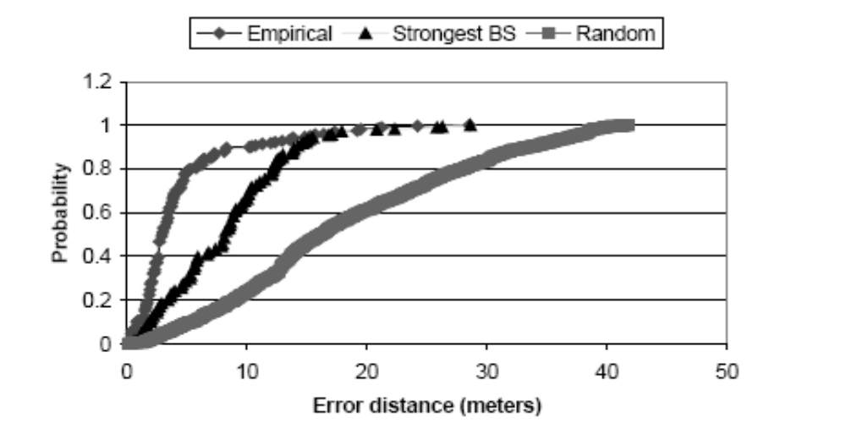
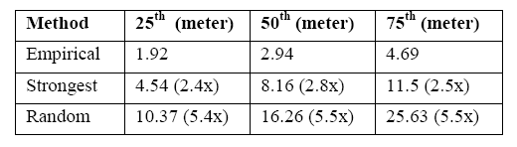
Analysis – Empirical method

Slide 15
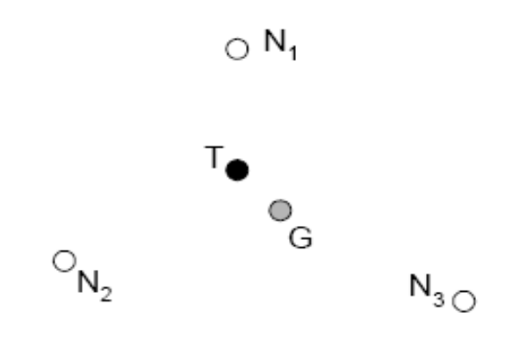
Analysis – Empirical method
Multiple nearest neighbors
  The intuition is that often there are multiple neighbors that are at roughly the same distance from the point of interest (in signal space).
  Average k nearest neighbors to estimate the user location

Slide 16
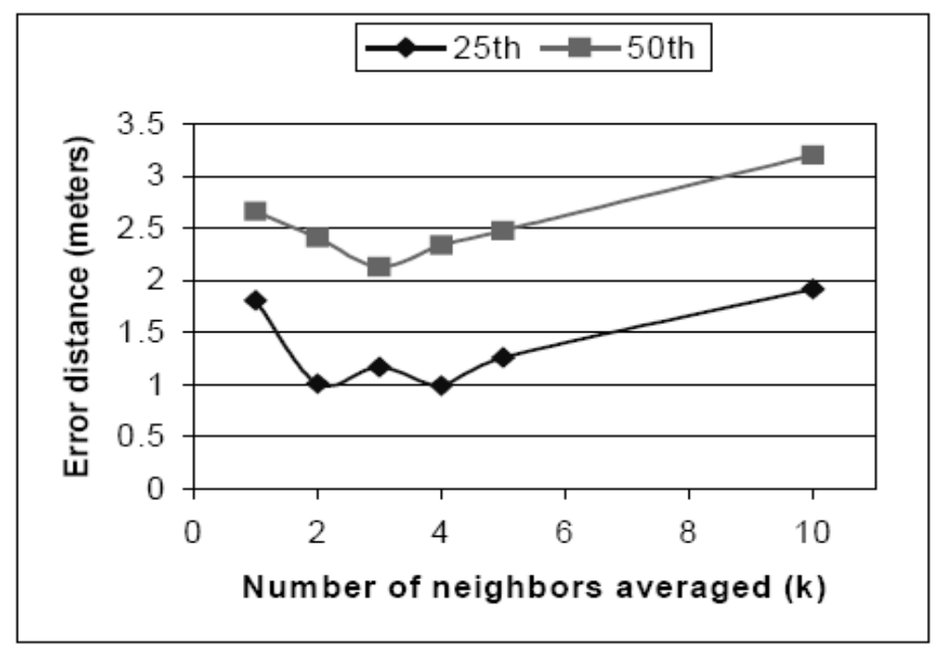
Analysis – Empirical method
Max signal strength across orientation

Slide 17
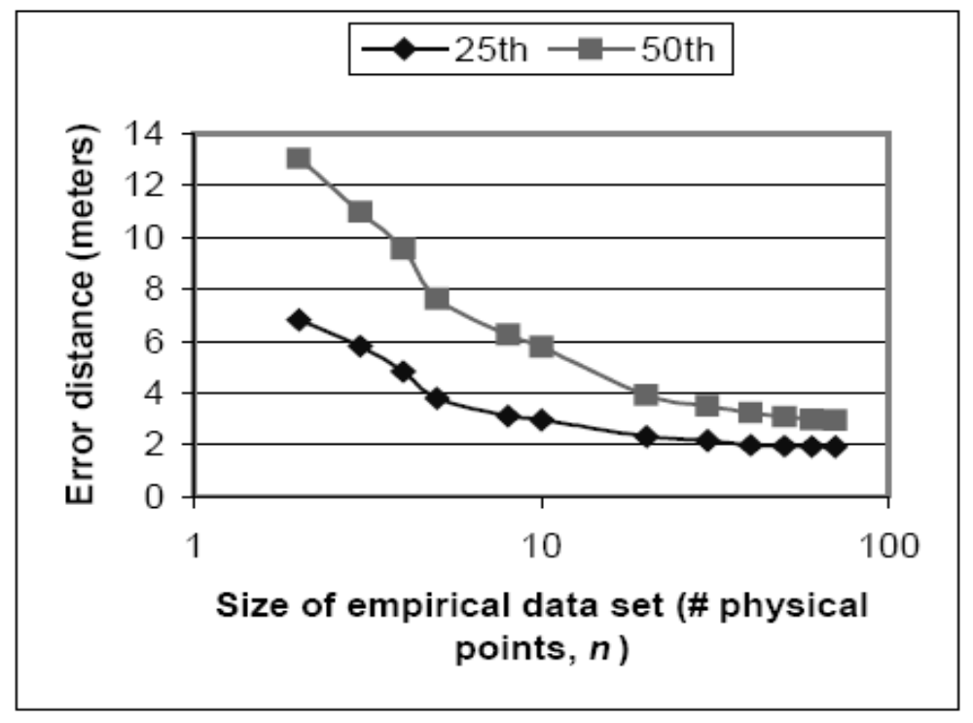
Analysis – Empirical method
Impact of the number of data points

Slide 18
Analysis – Empirical method
Impact of the number of samples
  Real time sample
Impact of user orientation
Tracking a mobile user
  reduce the problem of tracking the mobile user to a sequence of location determination problems for a (nearly stationary) user.
  use a sliding window of 10 samples to
  compute the mean signal strength on a continuous basis.
  Only slightly worse than that for locating a stationary user.

Slide 19
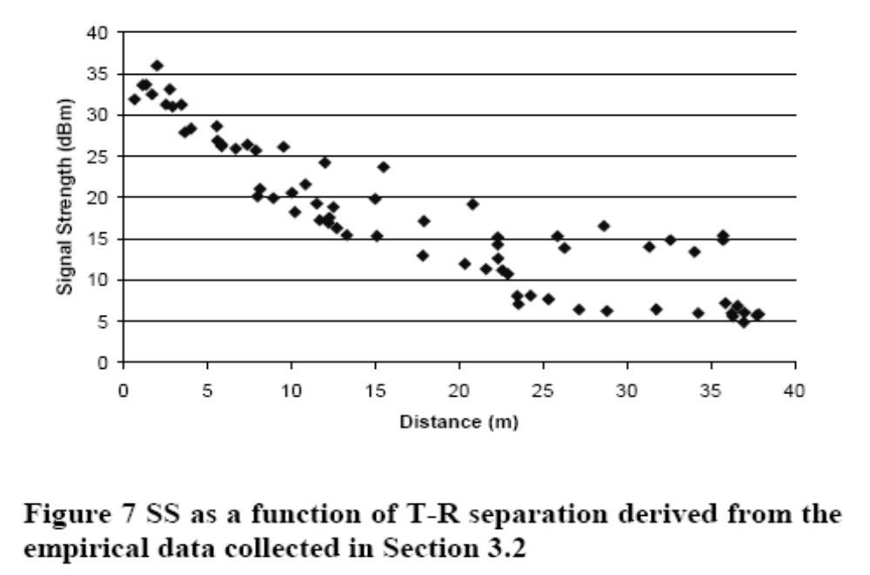
Analysis – radio propagation model

Slide 20
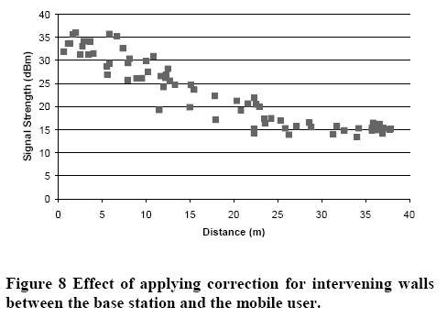
Analysis – radio propagation model

Slide 21
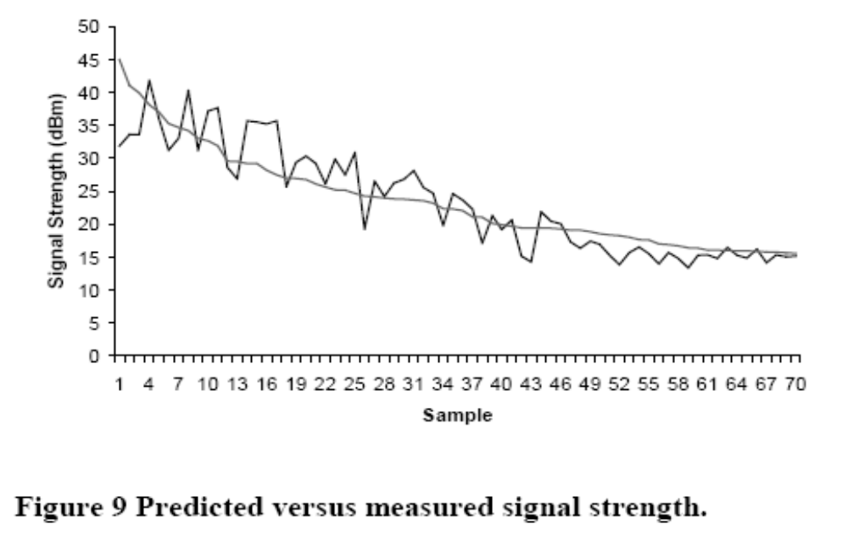
Analysis – radio propagation model

Slide 22
Contribution

