Slide 1
Privacy and security Implications on Wireless (Wi-Fi)
J R O Sirimanne
2013 MIS 021

Slide 2
Road Map
Introduction
Background
Design of the research
Research findings so far…

Slide 3
Introduction
Wi-Fi is the popular wireless networking technology using radio waves operate in 2.4GHz and 5GHz bands
a huge growth in Wi-Fi enabled devices and Wi-Fi hotspots within past few years
Tomography refers to imaging by sections or sectioning, through the use of any kind of penetrating wave
Radio tomographic imaging (RTI) offers a new way to image passive objects in buildings and outdoor environments using received signal strength (RSS).
Signal Strength is measured in decibel (db)
RSSI is a measurement of the power present in a received radio signal

Slide 4
Privacy
freedom from interference or intrusion
the right "to be let alone,“
Privacy and tomography???
In tomography it is possible to map objects
Objects can be anything including “HUMANS”
No way to know whether someone is using tomographic technologies
“Human movements can be mapped even without their knowledge” !!!
Privacy is breached

Slide 5
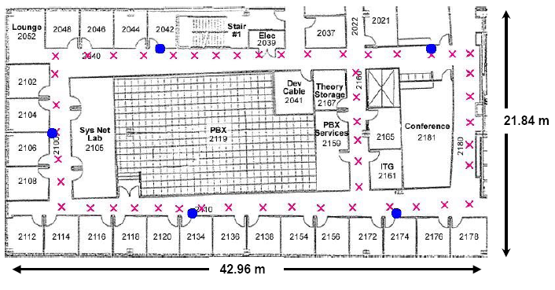
Related Work
RADAR: An In-Building RF-based User Location and Tracking System by Paramvir Bahl and Venkata N. Padmanabhan IEEE Infocom 2000, volume 2, pages 775-784, March 2000.
An In-building RF-based user location and tracking system
WiFi-based localization
Fingerprinting, RSSI profiling

Slide 6
Related Work Contd…
J. Wilson and N. Patwari, “Radio tomographic imaging with wireless networks,” IEEE Transactions on Mobile Computing, vol. 9, no. 5, pp. 621–632, May 2010. Published, 01/08/2010.
tracks humans moving through a building
An illustration of an Radio tomographic imaging (RTI) network. Each node broadcasts to the others, creating many projections that can be used to reconstruct an image of objects inside the network area.

Slide 7
Related Work Contd…
Study on wireless sensor based industrial tomography systems by Chiew Loon Goh, Nor Muzakir Nor Ayob, Ruzairi Abdul Rahim, Herlina Abdul Rahim, Muhammad Jaysuman Pusppanathan, Mohd. Hafiz Fazalul Rahiman, Leow Pei Ling, Zulkarnay Zakaria.
survey on wireless based industrial tomography system, and to review design challenges in the field of embedded wireless solutions

Slide 8
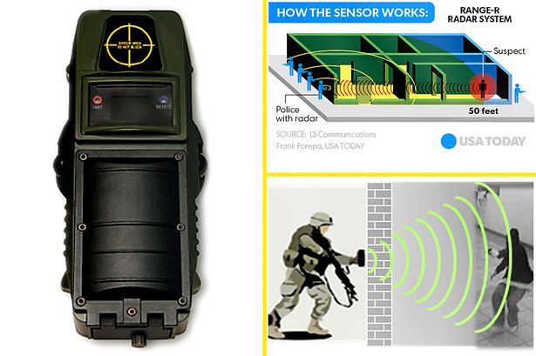
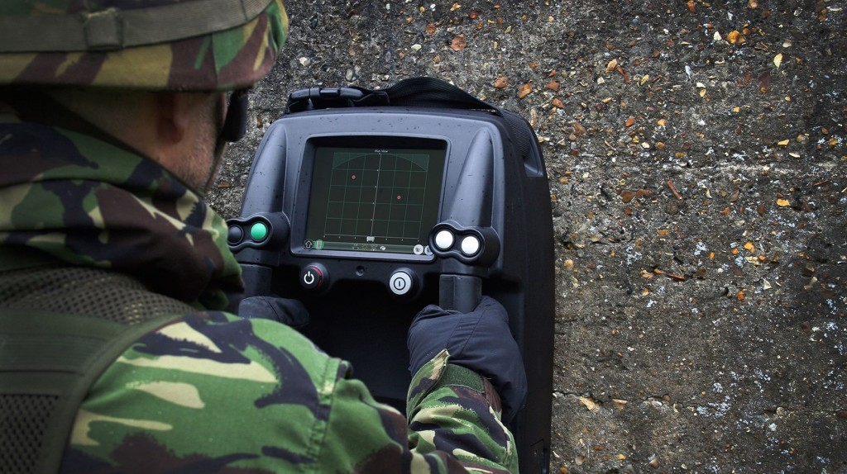
Related Work - Products
See through walls radar – used for military and tactical purposes

Slide 9
Related Work–Products Contd..
Google's Project Soli
Using radar to enable new types of touchless interactions
The Soli sensor can track sub-millimeter motions at high speed and accuracy

Slide 10

Research Question
Is there a significant amount of wireless signal strength drop when there is a human inside the line of sight of the wireless access point and data gathering computer?
How accurately we can identify human presence by observing received signal strength indicator (RSSI) values.

Slide 11

Design
Creating initial scenario sets to gather data
Developed to answer first research question
Try to make them as close as possible to real world situations
Two variables
Wireless access point
Data gathering computer
At any given time one is constant

Slide 12
Scenarios – Set 1
When Wireless access points position is a constant and its in the middle of the room
Wireless access point Data gathering computer
Scenario 1 Scenario 2 Scenario 3
Scenario 4 Scenario 5 Scenario 6

Slide 13
Scenarios – Set 1 Contd…
When Wireless access points position is a constant and its in the middle of the room
Wireless access point Data gathering computer
Scenario 7 Scenario 8

Slide 14
Scenarios – Set 2
When Wireless access points position is a constant and its in a corner of the room
Wireless access point Data gathering computer
Scenario 9 Scenario 10 Scenario 11
Scenario 12

Slide 15
Scenarios – Set 3
When Wireless access points position is a constant and its in a middle corner of the room
Wireless access point Data gathering computer
Scenario 13 Scenario 14 Scenario 15
Scenario 16

Slide 16
Scenarios – Set 4
From above scenarios we randomly select scenario 12 and place a human between Wireless access point and Data gathering computer
Wireless access point Data gathering computer
Human
Here position of Wireless access point and Data gathering computer is constant and human position is the variable
Scenario 12-1 Scenario 12-2 Scenario 12-3

Slide 17


Gathering Data
Received Signal Strength is gathered from scenarios mentioned earlier.
Using a python script
http://recolog.blogspot.com/2015/03/plotting-wifi-signal-strength-variation.html
15 minutes of Received Signal Strength Data
Approximately 6 samples per second (value every 0.333 ms)
Received Signal Strength Data is saved to a text file
Wireless Access Point
Laptop

Slide 18
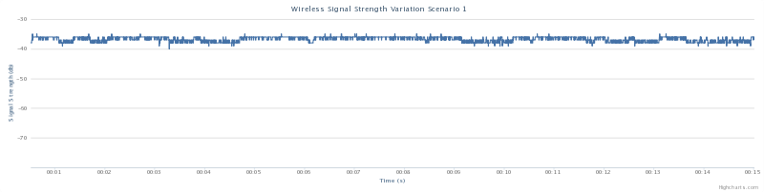
Analyzing Data
Plot signal strength values in a graph for scenario 1
Draw normal distribution graphs for each scenario
X axis = Signal Strength in db
Y axis = Density of probability (the chance of obtaining values near corresponding points on the X-axis)

Slide 19
Normal Distribution Graphs Set 1

Slide 20
Normal Distribution Graphs Set 1 Contd…

Slide 21
Normal Distribution Graphs Set 2

Slide 22
Normal Distribution Graphs Set 3

Slide 23
Normal Distribution Graphs Set 4

Slide 24
Answering Research Question
Answer first research question we use a statistical approach
statistical hypothesis testing
is an assumption about a population parameter. This assumption may or may not be true. Hypothesis testing refers to the formal procedures used by statisticians to accept or reject statistical hypotheses.
Building the hypothesis
Null hypothesis – H₀ = there is no change to amount of wireless signal strength when there is a human and no human inside the line of sight of the wireless access point and data gathering computer
Alternative hypothesis – H₁ = there is a significant amount of wireless signal strength drop when there is a human inside the line of sight of the wireless access point and data gathering computer

Slide 25
Answering Research Question..
Proving the hypothesis with regard to scenario 12
Using a 0.05 level of significance
Calculate values
Null hypothesis: μ = -42.78019231
Alternative hypothesis: μ ≠ -42.78019231
The t-value is t = 0. This is below the .05 standard, so the result is statistically significant for all scenarios
Scenario | Mean (db) | T-Test value
Scenario 12 | -42.78019231 | -
Scenario 12 - 1 | -53.95653846 | 0
Scenario 12 - 2 | -54.40423077 | 0
Scenario 12 - 3 | -52.2975 | 0

Slide 26
Continuing the project
Gather more data from other scenarios
Statistically find is there a significant change for other scenarios
Develop a method to find the accuracy of tracking (answering research question 2)
Benchmark with other related projects

Slide 27
Questions?

Slide 28
Thank You!

