Slide 1
Power BI Dashboard for Supermarket Sales
An Interactive Analysis of Sales Performance
Jithesh Gowda
12/04/2025

Slide 2
Introduction
Objective:
1.Visualize Super Market sale using Power BI.
2. Identify Trends in revenue, customer demographics and product performance.
3. Enable interactive data exploration for better decision making.

Slide 3
Dataset overview
The dataset includes:
Branches & Cities: Yangon(A),Mandalay(B) and Naypyitaw(C)
Product line: Electronic accessories , Home and lifestyle , Health and beauty , Sports and travel , Fashion accessories and Food and beverages .
Payment Method: Cash, Credit Card, Wallet
Financial Metrics: Unit Price, Quantity, Tax, Total Sales, Gross Margin, Rating.

Slide 4
Dashboard Components
Sales Summary: Total revenue, gross income, number of transactions
Sales Trends: Revenue fluctuations over time
Branch & City Analysis: Performance comparison
Customer Insights: Gender & Membership distribution
Product Performance: Best-selling categories
Ratings & Payment Analysis: Customer satisfaction and payment preferences

Slide 5
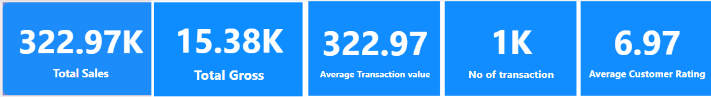
Sales Summary
Total Revenue: 322.97K
Gross Income: 15.38K
Average Transaction Value: 322.97
Number of Transactions: 1000

Slide 6
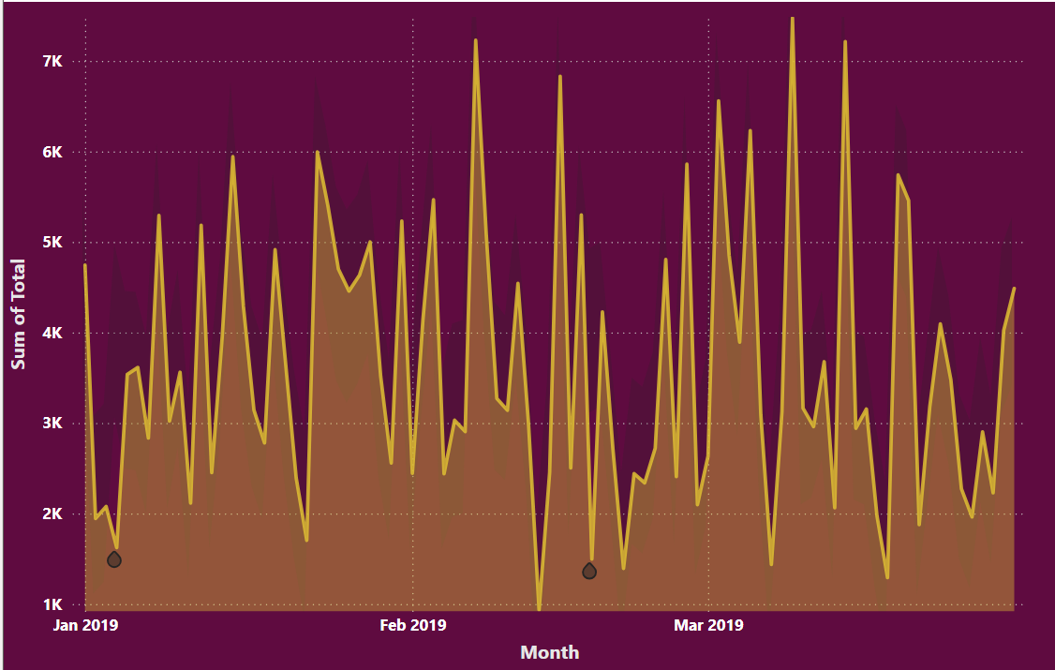
Sales Trends
The highest sale was recorded on March 9, amounting to 7.47K.
The lowest sale occurred on February 13, with 934.24.
The data reflects fluctuations without any consistent upward or downward trend.
January saw higher sales compared to February and March, with 352 transactions totaling 116.2K.

Slide 7
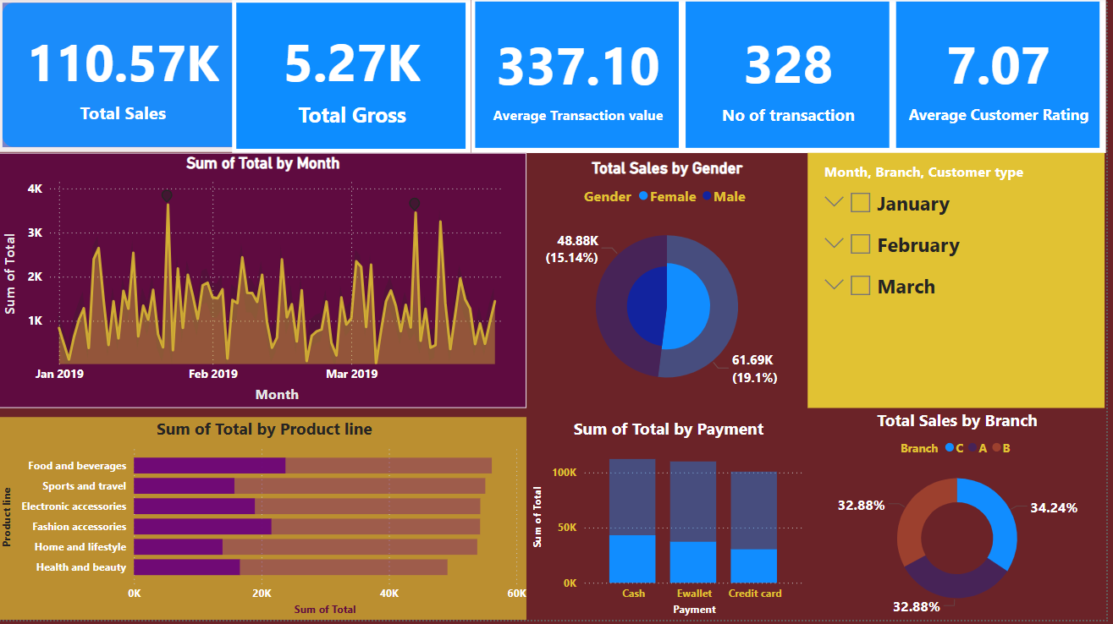
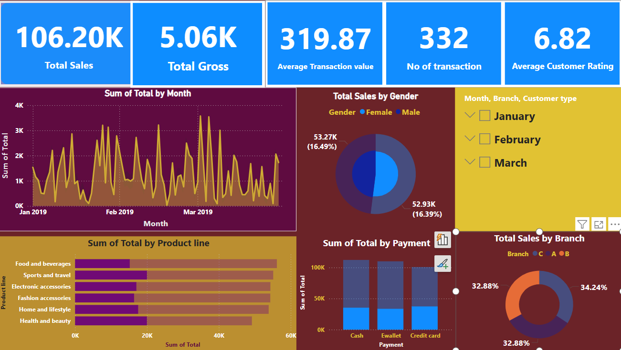
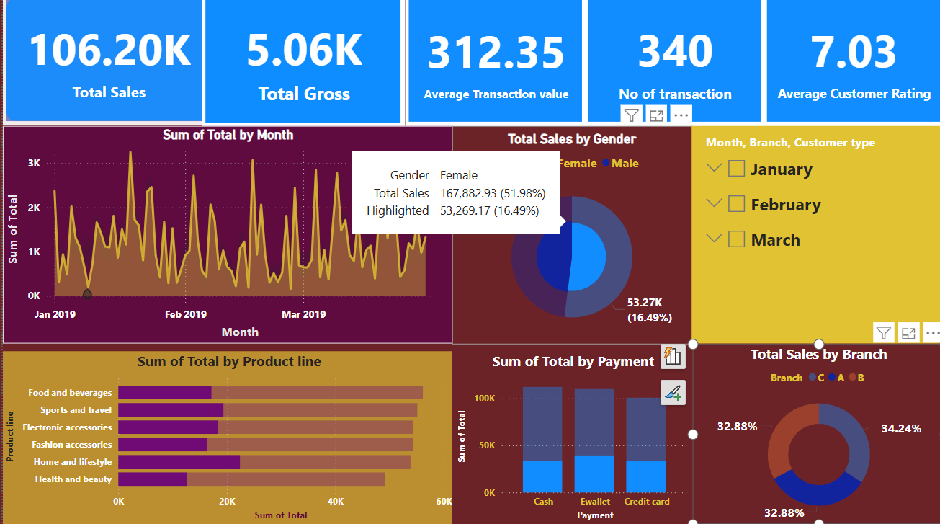
Branch & City Performance
Branch C
Each branch contributes nearly equally to the overall performance.
Branch B
Branch A

Slide 8
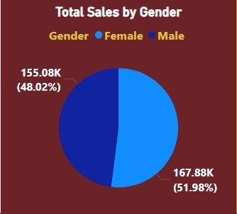
Customer Insights
Male and female customers have nearly the same
total purchase amounts.
Female customers tend to focus more on the Health
and Lifestyle category.
Male customers show higher interest in Food & Beverages and Electronic Accessories.
More males have opted for subscriptions compared to females.
The average transaction value for males is ₹335.10, while for females it is ₹310.79.

Slide 9
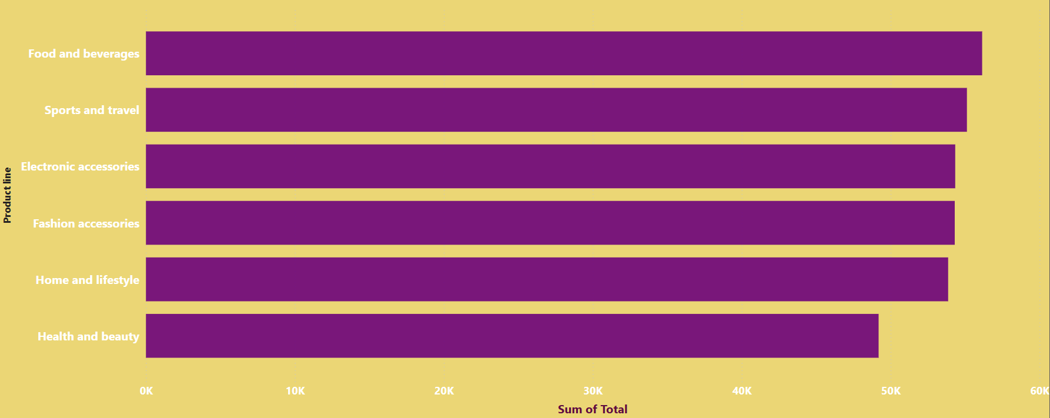
Product Performance
Food and Beverages is the highest-selling category with ₹56.14K in sales.
Health and Beauty is the lowest-selling category with ₹49.19K in sales.
For Home and Lifestyle purchases, customers prefer using credit cards over e-wallets and cash

Slide 10
Ratings & Payment Preferences
Average ratings across product lines
Payment Preferences
Electronic accessories :6.92
Home and lifestyle :6.84
Health and beauty:7.00
Sports and travel :6.92
Fashion accessories:7.03
Food and beverages: 7.11
Cash:34.74%
Ewallet:34.06%
Credit card:31.2%

Slide 11
Conclusion & Key Takeaways
Conclusion:
The overall performance indicates stable revenue with diverse customer engagement across branches and product categories. Sales patterns show no consistent trend but reflect high customer activity in January. Male and female customers exhibit similar purchasing behavior in terms of spending, with slight differences in category preferences. Payment methods are fairly balanced, with a slight tilt towards cash and e-wallets, while credit cards dominate specific segments like Home and Lifestyle.
Takeaways:
Total Revenue reached ₹322.97K from 1,000 transactions, with a healthy gross income of ₹15.38K.
January outperformed other months with 352 transactions totaling ₹116.2K.
Food and Beverages is the top-performing category, while Health and Beauty lags behind.
Male customers are more inclined towards electronics and food, whereas female customers focus more on health and lifestyle.
Subscription uptake is higher among males, with males also showing a slightly higher average transaction value.
All branches contribute almost equally, indicating balanced operational performance.
Payment methods are well-distributed, with cash (34.74%) and e-wallets (34.06%) being slightly preferred over credit cards (31.20%).
Credit cards are the top choice for Home and Lifestyle purchases.

