Slide 1
Enhancing Performance of Deep Learning Models with different Data Augmentation Techniques
By,
Jithesh Kurungote Balakrishnan
SJSU ID: 014654679

Slide 2
Introduction
The machines nowadays are fed by new Artificial Intelligence techniques which makes them intelligent enough to apprehend and cognize the visual world better than humans
This leads to the field of computer vision which is taking a great leap forward today
These visual perceptions include object recognition for identifying a specific object in the given image data, object detection by doing the semantic analysis and labelling it under a class, understanding the scene to parse the image into a meaningful segment
Deep convolutional neural networks have done exceptionally well in the field of computer vision. These neural networks are showing incredible results in computer vision tasks. The convolutional neural networks CNN preserves the features of the image data when complex images are taken into consideration by maintaining their spatial and temporal dependencies. However, when it comes to big data, many of the applications does not have much access to data like medical images

Slide 3
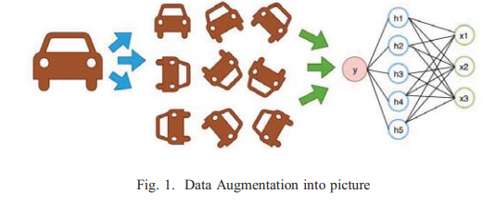
Data augmentation is a set of techniques that are used to increase the size and quality of the image with label preserving transformations
It is the method of creating new data by having different data orientations as shown in Fig. 1.
Data augmentation helps the researchers in two ways: first by generating more data from limited amount of data, secondly it restrains over fitting
To build a better learning model, the validation error rate should decrease correspondingly with training error. Data augmentation plays a crucial role in achieving this by inflating data set thereby decreasing the distance among training, validation and test data sets

Slide 4
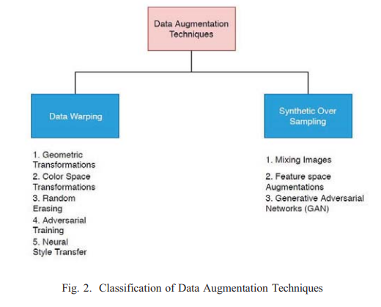
Data augmentation techniques
Data Warping
Oversampling

Slide 5
Data Augmentation based on Data Warping
Geometric Transformations
Flipping
Color Space
Cropping
Rotation
Translation
Noise Injection

Slide 6
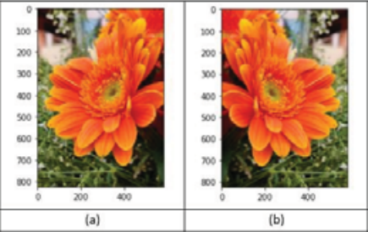

Flipping
The image can be flipped either horizontally or vertically
It produces images by rotating the image at the multiple of 90 degrees
Vertical flipping can be done by rotating the image by 180 degrees and then perform a horizontal flip.
This augmentation technique is label preserving on datasets like CIFAR-10 and ImageNet

Slide 7
Color Space
The color space transformations are also referred to as photometric transformations
In this technique, 3 stacked matrix of the image is created where each matrix is of size height X width
The matrix represent the pixel values for the individual RGB color value
The color distributions of the image can be altered to overcome the problem of lighting challenges

Slide 8
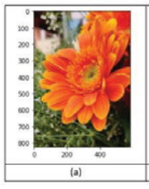
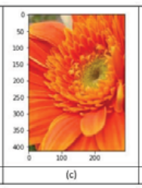


Cropping
Randomly sampling a particular section of the original image is called as cropping. The section is then resized to the size of the original image
It is a part of the original image and then resizing the image to some scale if necessary.
This method is also called as random cropping. The random cropping and translation are different in the sense that cropping will decrease the size of the image while translations preserve its spacial dimensions

Slide 9
Rotation
Depending upon the need, the image can be rotated either at the 90 degrees angles or it can orient at minute angles
If the background of the image is of black or white color then newly added color in the form of noise will blend in the image
But if there are different colors present in the background of the image then it will not blend and the network will learn it in the form of a feature of the image.
The rotation degree parameter will determine the safety of the augmentations. It is useful in digit recognition for slight rotations.

Slide 10
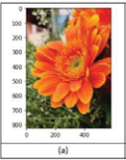
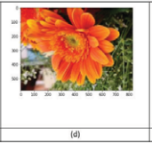

When we increase the degree of the rotation, the label of the data is not preserved after transformation.
The below figure shows how rotation is applied to an image.

Slide 11
Translation
In order to identify the object in any part of the image, then translation concept is applied to image
It involves moving of the image along the X or Y direction or both. Left, right, up and down shifting of images is useful in avoiding positional bias in the data
This augmentation helps the network to look everywhere inside the image which may result in the addition of background noise in the image

Slide 12
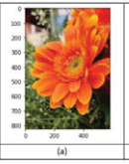
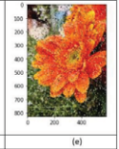

Noise Injection
Noise injection is an important technique of data augmentation as it helps in preventing overfitting of the neural network model
Generally, salt and pepper noise are added to the image. This refers to the addition of white and black dots in the image below
Addition of noise to the image can help the model to learn properly

Slide 13
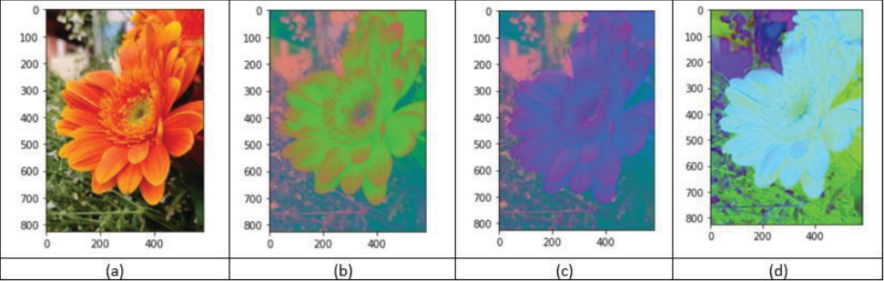
b) Color Space Transformations
Here the image is transformed into 3 stacked matrices.
First image is transformed with first multi-dimension color space RGB
Second image is then transformed with second multi-dimensional color space CMYK.
A histogram is formed by aggregating the RGB color channel of an image’s pixel value.

Slide 14
c. Random Erasing
In order to prevent the partial occlusion in object and improve generalization ability of CNN model, Random Erasing data augmentation technique came into picture
Here the image is occluded in a random position and with a arbitrary-sized patch or rectangular-region

Slide 15
d. Adversarial Training
This is an algorithm that perceive highly resembled image to cheat the classifier
The machine learning models can be easily mis leaded by slightly perturbated images
These perturbated images are called as Adversarial Training

Slide 16
e. Neural Style Transfer
Transforming images in style of another image by forming an aesthetic imagery by separating and combining image content and style
It is an image optimization technique
It takes the content image, type of style that we want to incorporate as an image and the input image
Later, combined together in such a way that the input image is modified so that it looks like the content image, but “painted” in the style of the style image

Slide 17
Data Augmentation based on Oversampling
Mixing Images
Also called as Sample Pairing
A random image is chosen from training data and overlayed on another image in order to synthesize a new sample
Here we can generate N 2 new samples from N training samples
Mixing images can also be done by random cropping and patching

Slide 18
b. Feature-Space Augmentations
Here low-level representation is done which are high-dimensional in nature.
Mapping of the images by networks is done either to binary classes or to n *1 vectors.
Noise, interpolation, and extrapolation are the types of feature space augmentations

Slide 19
c. Generative Adversarial Network
This network is used to develop artificial samples from the dataset and these samples have similar characteristics as that of original set.
There are two models
Generator Model- will generate new samples
Discriminator model- will take the input from the domain and predicts the binary class labels generated (real or fake).

Slide 20
Other Overfitting Solutions
a. Transfer Learning
Transfer Learning makes use of knowledge acquired while solving one problem to solve another similar kind of problem
It is important to reduce the problem of overfitting
b. Drop-out
It is a regularization technique
Solution to reduce overfitting by using a single model to simulate different network architectures by randomly removing some features at each iteration during training process
c. Batch Normalization
Used to normalize the activations in a layer
This technique is in addition with standardization is also used preprocessing the pixel values

