Slide 1
DDeepeeutDeeoencoder
Deep Anomaly Detection using Variational Autoencoders
Kollapudi Jithin
23b1236

Slide 2
Problem Statement
Input:
Multidimensional fully/partially labelled dataset (PCA-transformed features, Time, Amount, pixels, etc)
Output:
Binary classification (anomaly(1) or normal(0))
Example:
Input: Image of a dog given original data of cat pictures(few dog pictures as anomalies)
Output: 1

Slide 3
Goal Of Models
These models aim to solve the core anomaly detection challenge — distinguishing rare anomalies from abundant normal data — using semi-supervised learning and representation learning.

Slide 4
Aim of Anomaly Detection
We want to reliably detect rare and diverse irregularities in data, often without labels, in a way that scales and adapts across domains and data types.
NOTE: Vital in high-risk domains such as cybersecurity, finance, and healthcare where undetected anomalies can lead to major damage or loss.

Slide 5
Motivation
Why did you choose this problem?
This problem is has several real world applications and hasn’t yet been solved to an extent such that all such applications are satisfied. Credit card fraud for example is very hard to detect with existing algorithms and any better algorithm is always preferable. Data for such cases is also unlabeled if that person hasn’t committed fraud or anomaly if they have. So such data must go through semi supervised learning with very little labels. Anomaly detection seemed to be a very interesting problem dealing with real world problems and needs some intense thought to understand and deal with it.

Slide 6
Motivation
What makes it interesting, impactful, or challenging?
The fact that this problem has so many facets to look for and that not all work due to some hidden reason makes it an challenging and interesting problem:
Oversampling Anomaly data won’t work as anomalies are not clustered and taking parts of 2 anomalies might make a point which is actually normal.
Undersampling Normal Data may seem very useful but it loses important information very fast even if you take undersampling methods such as clustered undersampling.
Since the AUC-PR directly relates to anomaly detection this can be used as the loss for the network!!
And many more novel ideas

Slide 7
Motivation
Is there a real-world application or gap this project addresses?
Yes there are multiple real world applications for anomaly detection:
Cybersecurity – intrusion detection
Financial fraud detection
Healthcare anomaly in vitals/imaging

Slide 8
Literature Review
Brief background and prior work related to your problem.
Isolation Forest, One-Class SVM, Autoencoder, Deep SVDD, DevNet, AnoGAN, ADGAN and OC-NN are some of the prior work related to anomaly detection
Key papers or methods that inspired your approach.
Our approach was heavily inspired by DevNet and autoencoder logic. Combining both their implementation was key to perform better than either.
Ref: Devnet->https://arxiv.org/pdf/1911.08623
Autoencoders->https://cybersecurity.springeropen.com/articles/10.1186/s42400-022-00134-9

Slide 9
Dataset
Example Data Instance: First Line of Annthyroid21 (relevant to thyroid disease)
Dim_0,Dim_1=0,Dim_2=0,Dim_3=0,Dim_4=0,Dim_5=0,Dim_6=0,Dim_7=0,Dim_8=0,Dim_9=0,Dim_10=0,Dim_11=0,Dim_12=0,Dim_13=0,Dim_14=0,Dim_15=0,Dim_16,Dim_17,Dim_18,Dim_19,Dim_20,class
0.75,1,0,1,1,1,1,1,0,1,1,1,1,1,1,1,0.001132,0.08078,0.197324,0.300926,0.225,0
Statistics:
This particular example has 20 dimensions, 7201 samples and all unlabelled data marked as ‘normal’, ie 0.
Heavy class imbalance → 7.42% of 1s
Dataset source → https://github.com/GuansongPang/deviation-network/tree/master/dataset

Slide 10
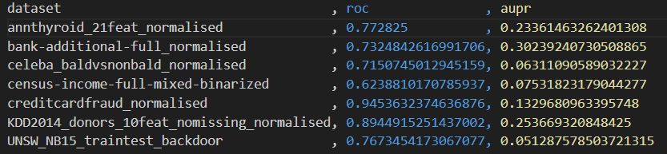
Isolation Forest Baseline
Results:
Isolation forest uses decision trees to detect anomalies by isolating observations and any new input runs through these trees to get to an existing leaf node(1 original datapoint). If

Slide 11
DevNet 1/4
MODEL DESCRIPTION:
1. Data Preparation : Combine a large unlabeled dataset (mostly normal examples) with a tiny set of truly anomalous samples.
Shuffle and batch so that each training batch contains half “known anomalies” and half presumed-normal points.
2. Reference Sampling : Every batch, DevNet draws a fresh set of random numbers from a standard Normal distribution. These serve simply as a “yardstick” to tell us what zero-mean, unit-variance behavior looks like.
3. Forward Pass : Encoder (feature extractor) : one or two fully-connected layers giving final lower dimension features.
Scoring head(a single linear neuron on top of those features) : Its raw output is the “anomaly score.”
4. Deviation Computation : It measures how far each score is from the random-sample average, in “standard-deviation units.”
In code, you subtract the sample mean and divide by the sample standard deviation.
5. Deviation Loss : Normal samples are penalized whenever their score drifts too far from zero—DevNet wants “normal” points to stay near that reference baseline. Known anomalies are penalized whenever their score falls below a pre-set margin (typically 5 “sigmas”). In practice this margin ensures the network learns to push anomaly scores high.
6. Backward Pass & Update : Standard optimizers like Adam or RMSProp update both the encoder and scoring head together, using that single “deviation loss” function.
7. Interpretability : Because you’re always comparing against a unit Normal reference, you can interpret DevNet’s outputs exactly like a Z-score: a score of 2 means “two standard deviations above normal,” which corresponds roughly to the top 2.5% of any Normal distribution.

Slide 12
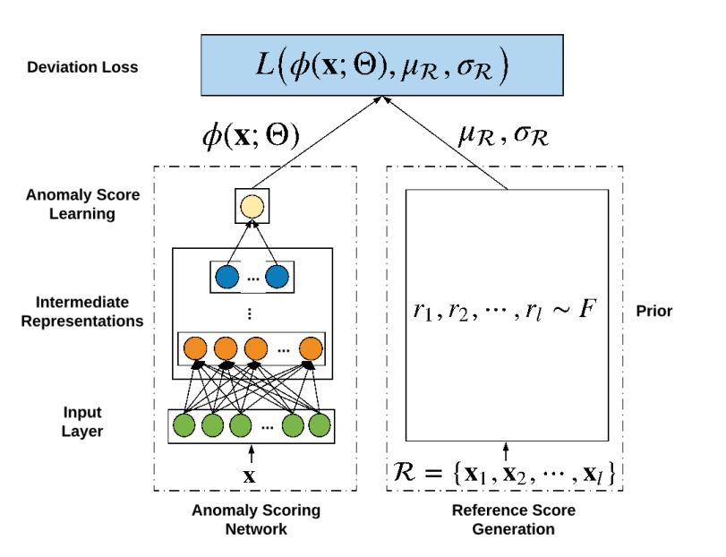
DevNet 2/4
This is the mathematical overview of the network. μ_{R} and σ_{R} are derived from the prior distribution of N(0,1). The anomaly score as the output of the final neuron of the neural network can be used to determine whether a sample is an anomaly or is a normal data point.

Slide 13
DevNet 3/4
Implementation Details:
Libraries: os, pandas, numpy, joblib, sklearn and tensorflow.
  Os, joblib and pandas for data handling and reading.
  Numpy for calculations over vectorized data.
  Sklearn and tensorflow for the main machine learning applications.
Functions and their purposes:
  dataloading : to access data from the directory based on the type of file available.
  get_data_from_svm_light : get data from an svm file.
  AUC_Callback : Define a custom callback function to get the best AUC-PR value over the epochs.
  create_deviation_loss : (1 − y)|dev(x)|+y*max(0,a−dev(x)), where dev(x) is the output of the network for x.

Slide 14
DevNet 4/4
Functions and their purposes(cont.):
e. dev_network : Different network architectures based on requirements.
f. Batch_generation : Take normal and anomalous data in equal proportion for each batch.
g. Inject_noise : creates new noisy samples(specify number in input) using say 5% of some inputs and 95% of others to create completely new and noisy data.
h. Run_devnet : complete implementation of logic described in slide 1 for devnet. Goes over all files; deletes outliers such that only 30 remain so that data is usable for anomaly detection; using these 30 sample data points create more using inject_noise; Then finally fit the model with callbacks and output aucpr score over x_test.

Slide 15
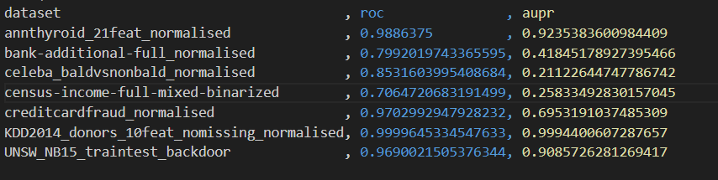
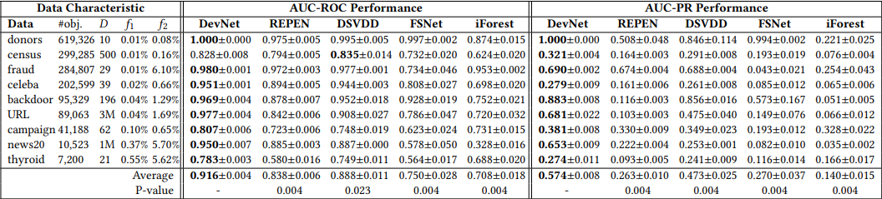
DevNet Results

Slide 16
Idea 1: Focal Loss DevNet 1/1
The model this approach was based on was DevNet but is different on the account of loss.
The idea was that loss needs to focus on hard to classify samples (samples which output a value very close to the margin are hard to classify), and to do so, a new loss function was developed called focal loss similar to the ‘focus of a lens’.
This provided some improvements low AUPR cases by original DevNet, but significantly worsened AUPR for the datasets with a good AUPR by DevNet.
Code Explanation:
Extra functions (and changes) over DevNet:
Create_focal_deviation_loss: This uses the gamma value to make the loss more affected by changes to close to margin samples.
Changes to margin and multiple other hyperparameters to handle the change in logic of loss.

Slide 17
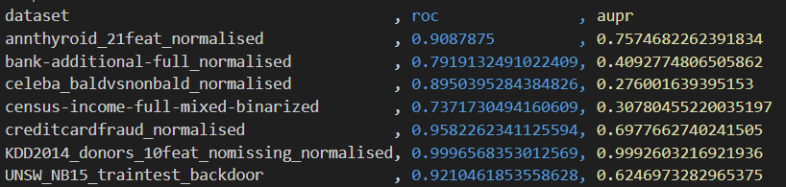
Focal Results
FOCAL
DEVNET

Slide 18
Idea 2: Variational DevNet 1/3
This is based on Autoencoders and DevNet at the same time. The way autoencoders classify anomalies is significantly similar to DevNet as anomalies are those which give high reconstruction error. By utilizing the Gaussian distribution implicitly learned by the autoencoder as the reference in DevNet’s deviation loss, the anomaly scoring becomes more manageable. The mean and median of the new distribution are a natural easy mapping from given data as thats what was done by autoencoder and this the network now has an easier mapping to deal with to detect anomalies rather than generalizing to N(0,1).

Slide 19
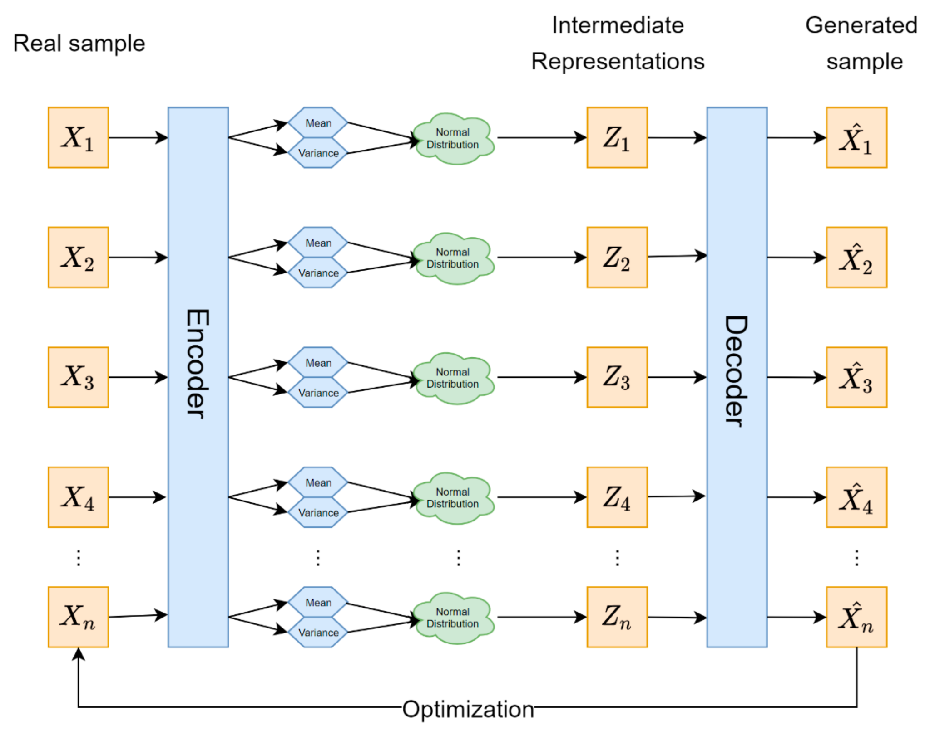
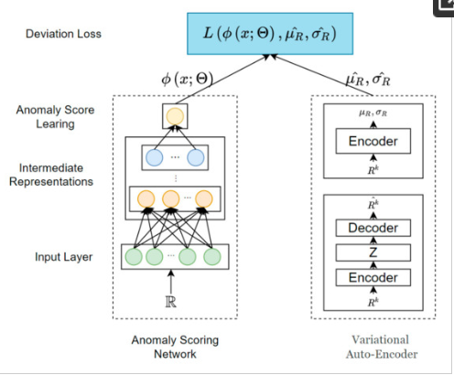
Idea 2: Variational DevNet 2/3

Slide 20
Idea 2: Variational DevNet 3/3
Code explanation:
Extra functions(and a few changes) over DevNet:
Sampling: Used to generate a latent vector (z) that follows a Gaussian distribution.
Build_vae: to create the encoder and decoder neural nets: recon error and KL divergencesed
Run_vdevnet: changed from normal run_devnet on several places. Firstly this runs the VAE network to first find the variance and mean for the DevNet to use for better accuracy.

Slide 21
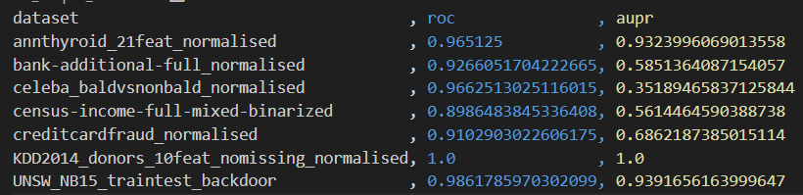
Variational DevNet Results
VDEVNET
DEVNET

Slide 22
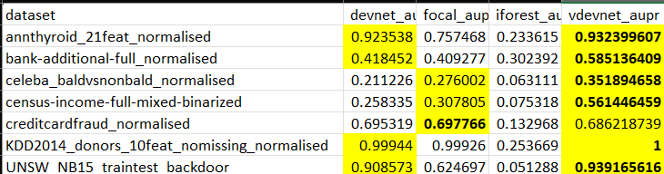
Results

Slide 23
Analysis
The qualitative pattern is clear: the “deviation” term gives the model extra guidance to focus on true outliers rather than incidental noise irrespective of whether anomalies are diverse (no cluster, many distinct positions for anomalies) or subtle (anomalies only slightly different from normal data).
AUC-PR which gives a more detailed analysis of accuracy of a model in an imbalanced dataset seems is the best in VDevNet and the second spot is claimed by DevNet or FocalLossDevNet. This implies VDevNet is a marked improvement over any of the others.
117% improvement for census data, 66% for celeba, 40% for bank while the others are high enough for only a slight improvement to be possible.

Slide 24
Analysis
iForest seems to be redundant as most algorithms after it have beaten it by a huge margin.
Focal Loss did better on datasets which had low AUPR on DevNet, while did worse than DevNet on datasets with high AUPR, making it a more stable choice.
This probably means that some weighted losses work better on some difficult to differentiate datasets, which in hindsight seems obvious.
It is a logical that if we iterate over multiple the gamma for Focal Loss, we will definitely get better results than DevNet.

Slide 25
Analysis
In addition to the numerical datasets, we also tried out anomaly detection on Image Datasets, yielding highly intuitive visualisations, and also proving the power of deviation loss.
Using our loss function combined with a CNN architecture to deal with images, we did the anomaly scoring for images, but in the process, the neural network also helped us find what parts of the image were the source of anomaly, if any.
The value of gradients appearing for each pixel’s associated weight in the neural network, actually contains the information about that pixel’s contribution in the training. Higher the gradient, more likely to be a source of anomaly

Slide 26
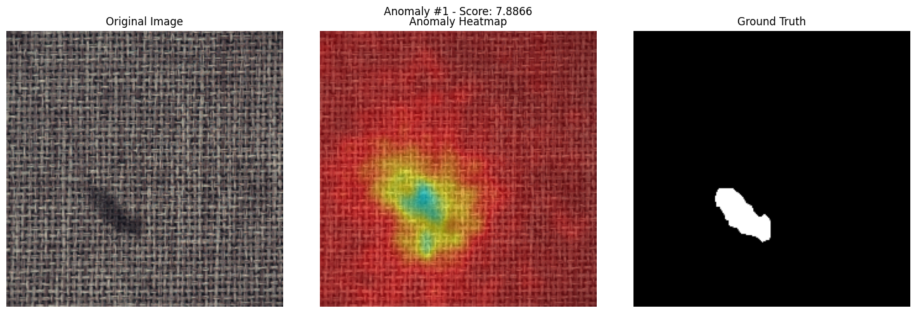
Analysis
So a heatmap of gradients in the shape of image as follows, provides a great way of analysing anomalies -
(Here ground truth is known, useful for comparing with the heatmap)

Slide 27
Learnings
SUMMARY:
For anomaly detection, we learnt about the Deviation network model- comprising of a neural network with a new loss function called Deviation Loss, which aims to significantly differentiate the anomalies.
DevNet outperformed many of the current anomaly detection models, with the ability to capture the anomalies even when the labelled data is a lot less in size.
The output of DevNet, Anomaly Score, is very intuitive and interpretable.
We made improvements to DevNet, especially by introducing a variational encoder decoder to improve the feature representation.
For image datasets, DevNet enable visualising the source of anomalies in the image.

Slide 28
Learnings
KEY TAKEAWAYS:
The idea of how we can design suitable loss functions to achieve a predictive-model’s objective specifically, and how powerful a carefully designed loss function can be.
Effective Few-shot learning for largely unlabeled anomalous data
An intuitive anomaly-analysis technique for image datasets

Slide 29
Learnings
Learning Outcomes:
Few shot learning, by utilising the gaussian property of anomalous data
We got a hands-on experience of using the various tools and libraries of Python (like PyTorch, Tensorflow, etc. )
We learnt how teamwork helps us to find new ideas and refine them, using our varying perspective. Also it helped a lot to work on the project in a modularised manner, increasing efficiency and productivity.
Experimenting and researching over various possibilities often yields very useful insights, like we were able to improve on the research paper using our experimentation on the model design.

Slide 30
Error analysis
Undersampling Of Normal Data:
The idea was that if clustered undersampling was implemented, we may be able to somehow decrease the heavy imbalance faced by anomalies while not losing significant information. However what we are generating is a distribution of normal points and points appearing on areas with very low probability of normal data are marked anomalous. So if we delete some points from a heavily dense area of normal points it will make the general distribution more spread out which causes some anomalies to reach the probability threshold to be called normal.

Slide 31
Error analysis
Oversampling Of Anomalous Data:
Oversampling data requires original data points to be a part of some cluster but if the points are diverse(multiple distinct anomalies caused by different conditions) then oversampling using SMOTE or ADASYN gives new data which might be normal but we marked anomalous and thus ruin the performance of our model.

Slide 32
Improvements over the paper
What did you contribute that’s new?
Firstly we improved the score for DevNet itself as compared to the paper especially for thyroid dataset which reached AUPR of 0.92 from 0.27 !! Further the implementation of VDevNet was also done completely by us, using just the theory available online. Focal Loss was also our addition to the paper code to improve performance in subtle data(anomalies and normal data very close).

Slide 33
Improvements over the paper
How did you enhance or extend the original work?
Implementation of new loss functions like Focal Loss was also a novel idea implemented by our codes. DevNet alone was basically a neural network with loss defined such that anomalous data got rewarded for being outside the margin and normal data was rewarded for being near the mean which is a novel idea, yet combining with Autoencoders was a specially unique idea that gave phenomenal results over all datasets and beat all other algorithms by a wide margin.

Slide 34
Demo
For demo, we have made a browser interface using Streamlit
To keep it intuitive and for better visualisation, we have incorporated the feature of detecting and plotting the parts of image with their chances of being anomalous using a heatmap, same as the size of image (shown in analysis before).
A trained model has to be uploaded and then on uploading any image of the suitable dataset, you can see its anomaly score, the anomaly heatmap, with changeable parameters like image size for resolution, etc.

Slide 35
Summary and Conclusion
Creating an ML algorithm which can, with high precision and recall label a partially labelled heavily imbalanced dataset is the main aim of the problem.
This is a vast field and a vague problem statement (since datasets maybe diverse or subtle, may have many dimensions or just a few). Thus some algorithms will definitely perform better than others in certain cases, but we aim to find a general algorithm that can do nearly as good or better than every algorithm.
There is a lot of scope for further work in this field especially creating lightweight and faster versions which can be deployed for use in various fields like cryptography and medicine.
Notes:
Main conclusion or insight.
Any potential future work or open challenges

