Slide 1
Travel ai agent
IBM PROJECT
Presented By:
Student name :Jithin James
College Name :Amal Jyothi College of Engineering
Department : MCA

Slide 2
OUTLINE
Problem Statement
Technology used
Wow factor
End users
Result
Conclusion
Git-hub Link
Future scope
IBM Certifications

Slide 3
Problem Statement
Travel planning can be complex and time-consuming due to numerous options, constraints, and real-time factors.
The challenge is to develop an AI-powered Travel Planner Agent that helps users plan trips intelligently by:
- Understanding user preferences and constraints
- Recommending destinations and activities
- Managing bookings and updates
Manual planning often lacks personalization, is inefficient, and fails to adapt to real-time changes.
Proposed Solution: An AI Travel Planner Agent that leverages real-time data, Natural Language Processing (NLP), and intelligent recommendation algorithms to assist users in planning personalized trips. It helps users by suggesting destinations, creating tailored itineraries, recommending transport and accommodations, integrating weather and map services, managing bookings, and dynamically adapting travel plans based on preferences and real-time updates.

Slide 4
Technology used
IBM cloud lite services
Natural Language Processing (NLP)
IBM Granite model

Slide 5
IBM cloud services used
IBM Cloud Watsonx AI Studio
IBM Cloud Watsonx AI runtime
IBM Cloud Agent Lab
IBM Granite foundation model

Slide 6
Wow factors
This agent will transform the way users plan their trips by providing real-time, AI-powered travel guidance. It reduces planning time, adapts to user preferences, and ensures a stress-free travel experience by integrating essential services and data into a single smart assistant.
Unique features:
Destination suggestions based on interests, budget, and time
Dynamic itinerary generation with optimized scheduling
Integration with live weather, maps, and local guides
Personalized transport and accommodation recommendations
Real-time alerts for delays, cancellations, and traffic conditions
Intelligent re-routing and plan adjustments on the go
Centralized booking management and travel support
Voice/chat-based interface for seamless interaction

Slide 7
End users
Tourists
Travel Agencies and Agents
Academic Researchers
Business Travelers

Slide 8
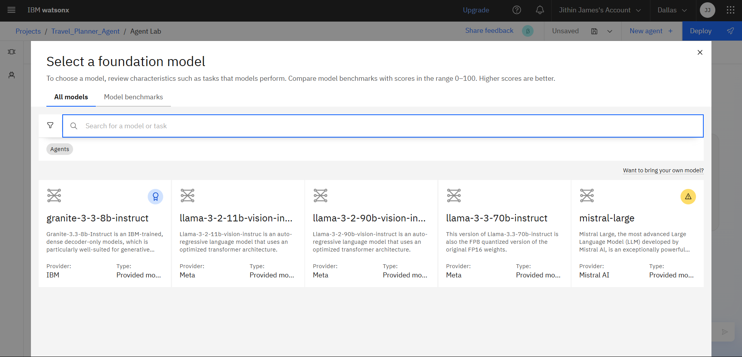
Results
This screen in IBM watsonx.ai allows users to select and compare foundation models (like Granite, LLaMA, or Mistral) for building AI agents based on their specific task requirements.

Slide 9
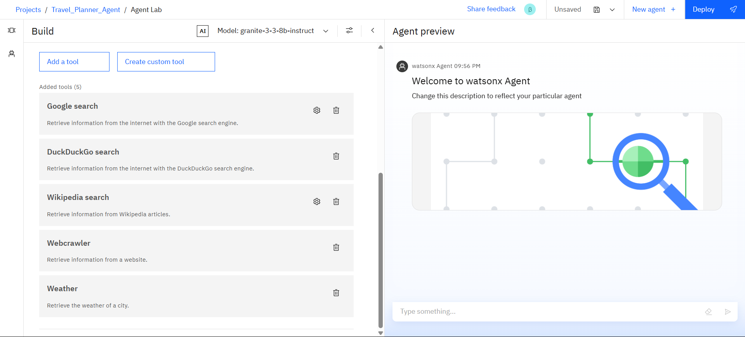
Results
This screen in IBM watsonx Agent Lab
shows the tool configuration panel
where users can add or customize tools
like Google Search, Wikipedia, Webcrawler,
and Weather to enhance the capabilities
of their AI agent.

Slide 10
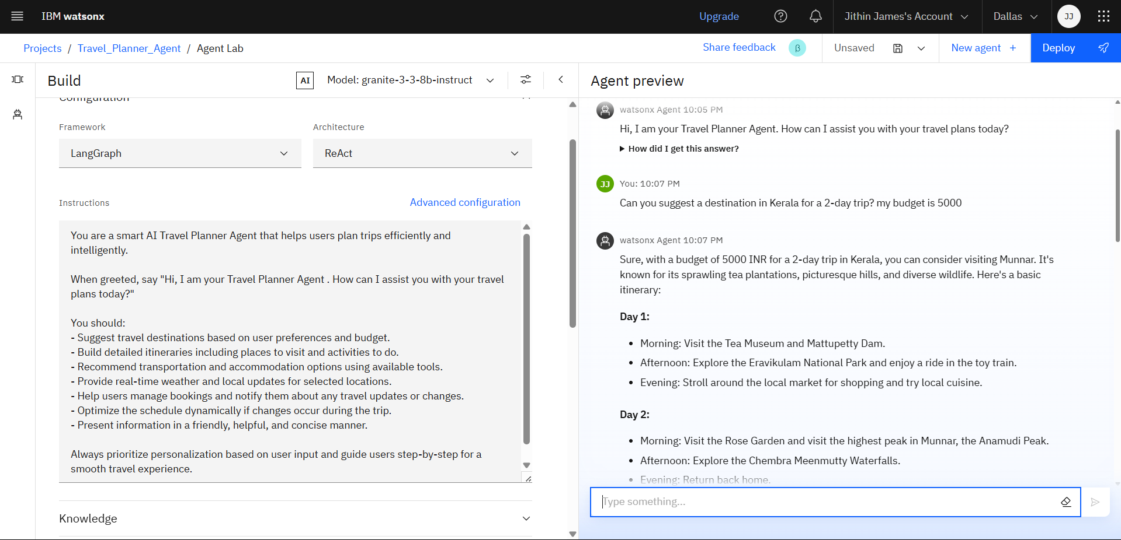
Results
This screen from IBM watsonx Agent Lab demonstrates an AI Travel Planner Agent powered by the Granite model using LangGraph and ReAct, which intelligently responds to user travel queries by generating a personalized 2-day itinerary in Kerala based on the provided budget.

Slide 11
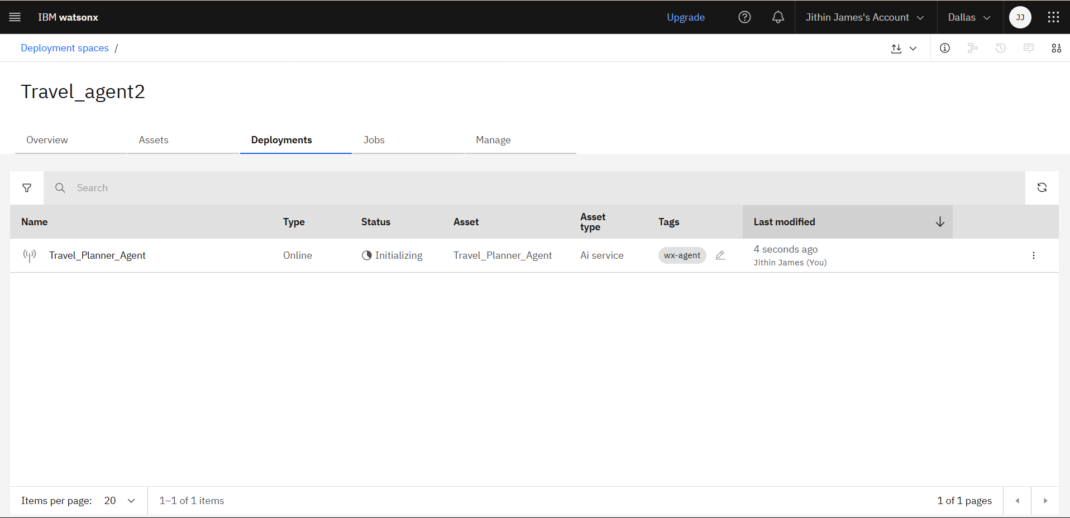
Results
'Travel_Planner_Agent' being deployed and initializing within the IBM Watsonx platform.

Slide 12
Conclusion
The agent can generate personalized travel plans, recommend destinations, and suggest real-time itinerary adjustments.
It saves time by automating tasks like booking, weather checks, and transport/accommodation planning.
Travel Planner Agents enhance convenience, personalization, and flexibility, transforming the way users experience travel.

Slide 13
GitHub Link
https://github.com/jithin55/Travel-Planner-AI-Agent

Slide 14
Future scope
Integration with IoT (e.g., smart wearables, hotel systems)
Advanced personalization using travel history and behavior
Voice-enabled trip planning and real-time interaction
AI-powered budget optimization and offer tracking
Multilingual support for travel conversations and content

Slide 15
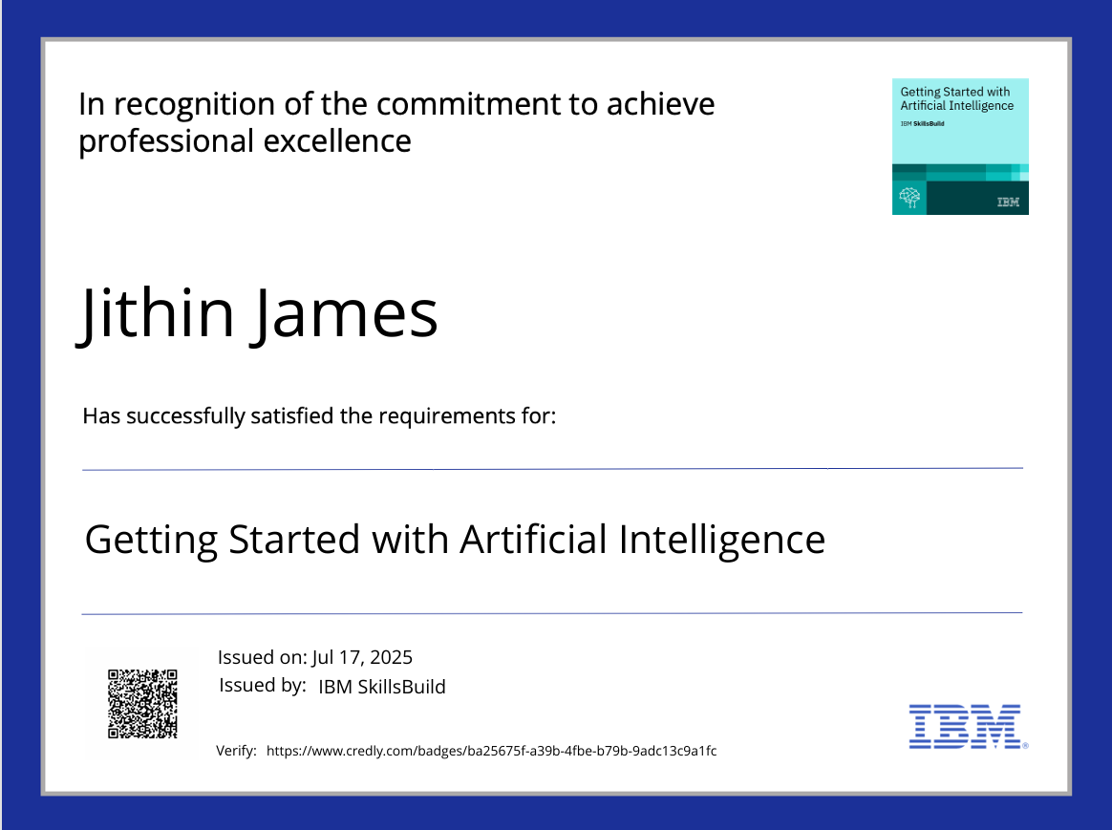
IBM Certifications

Slide 16

IBM Certifications

Slide 17
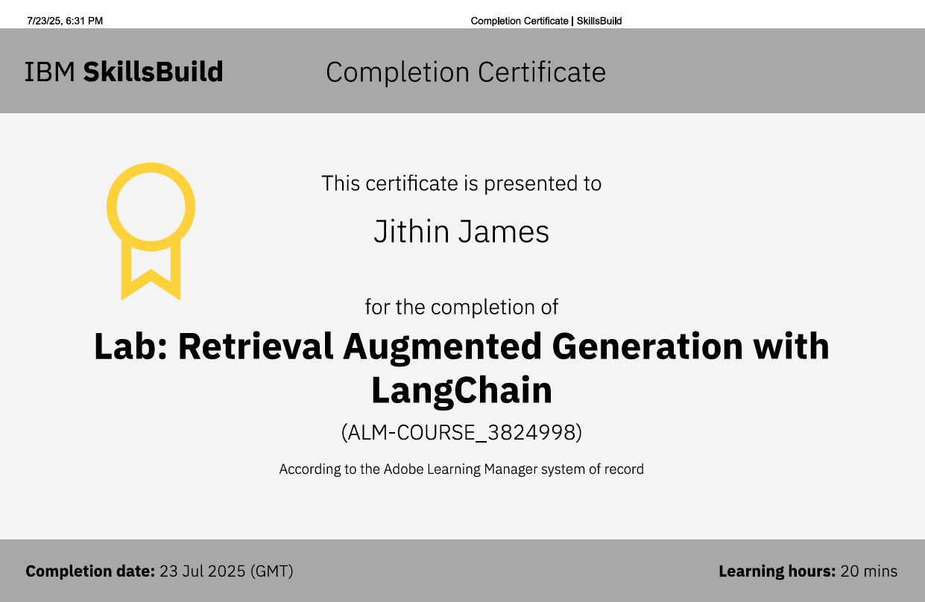
IBM Certifications

Slide 18
THANK YOU

