Slide 1
Typescript

Slide 2
INTRODUCTION
TypeScript is a typed superset of JavaScript
TypeScript compiles to plain JavaScript
TypeScript is pure object oriented with classes, interfaces
var message:string = "Hello World“
console.log(message)

Slide 3
Local workspace/Online codeing
www.typescriptlang.org/Playground
Install Text Editor(Visual Studio Code)
Install nodejs
Type
Open .ts file in command prompt
npm install -g typescript
tsc FileName.ts
node FileName.js

Slide 4
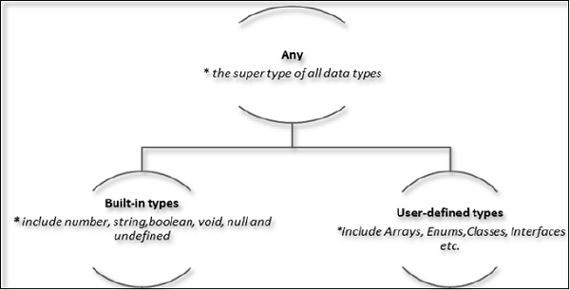
Types

Slide 5
Data type | Keyword | Description
Number | number | Double precision 64-bit floating point values. It can be used to represent both, integers and fractions.
String | string | Represents a sequence of Unicode characters
Boolean | Boolean | Represents logical values, true and false
Void | void | Used on function return types to represent non-returning functions
Null | null | Represents an intentional absence of an object value.
Undefined | undefined | Denotes value given to all uninitialized variables

Slide 6
Variables
var name:string = “Your Name";
var age:number = 50;
var mark:number = 42.50
var sum = score1 + score2
console.log("name"+name)
console.log("first score: "+score1)
console.log("second score: "+score2)
console.log("sum of the scores: "+sum)

Slide 7
Operator
Arithmetic operators
Logical operators
Relational operators
Bitwise operators
Assignment operators
Ternary/conditional operator
String operator
Type Operator

Slide 8
Typeof
let num :string= "12"
console.log(typeof num);

Slide 9
Decision Making
if statement
if...else statement
else…if and nested if statements
switch statement

Slide 10
loop
for loop
while loop
do… while

Slide 11
Functions
Optional Parameters
function disp_details(id:number,name:string,mail_id?:string) {
console.log("ID:", id);
console.log("Name",name);
if(mail_id!=undefined)
console.log("Email Id",mail_id);
}
disp_details(123,"yourName");
disp_details(111,"name","mailId@xyz.com");

Slide 12
Rest Parameters
function addNumbers(...nums:number[]) {
var i;
var sum:number = 0;
for(i = 0;i<nums.length;i++) {
sum = sum + nums[i];
}
console.log("sum of the numbers",sum)
}
addNumbers(1,2,3)
addNumbers(10,10,10,10,10)

Slide 13
Default Parameters
function calculate_discount(price:number,rate:number = 10) {
var discount = price * rate;
console.log("Discount Amount: ",discount);
}
calculate_discount(10)
calculate_discount(10,20)

Slide 14
Lambda Expression and Lambda Statement
var foo = (x: number) => {
x = x / 10
alert(x)
}
foo(10)

Slide 15
Arrays
Simple Array
Array Object
var nums:number[] = [1,2,3,3]
console.log(nums[0]);
console.log(nums[1]);
var alphas:string[];
alphas = ["1","2","3","4"]
console.log(alphas[0]);
console.log(alphas[1]);
var arr_names:number[] = new Array(4)
for(var i = 0;i<arr_names.length;i++) {
arr_names[i] = i * 2
console.log(arr_names[i])
}

Slide 16
Interfaces
Interfaces contain only the declaration of the members
interface interface_name {
}
interface IPerson {
firstName:string,
lastName:string,
sayHi: ()=>string
}

Slide 17
Single Interface Inheritance
interface Person {
age:number
}
interface Employee extends Person {
designation:string
}
var emp = <Employee>{};
emp.age = 57
emp.designation = "Manager"
console.log("Age: " + emp.age)
console.log("designation: " + emp.designation)

Slide 18
Multiple Interface Inheritance
interface Academics {
maths: number,
chemistry:number
}
interface Sports {
sportsmark:number
}
interface Marks extends Academics, Sports {
}
var Final:Marks = { maths:12, chemistry:23,sportsmark:12}
console.log("Academics Total: " + (Final.maths + Final.chemistry))
console.log("Total Mark: "+(Final.maths+Final.chemistry+Final.sportsmark))

Slide 19
Classes
blueprint for creating objects
A class encapsulates data for the object
class class_name {
//class scope
}

Slide 20
class Car {
engine:string;
constructor(engine:string) {
this.engine = engine
}
disp():void {
console.log("Engine is : "+this.engine)
}
}
var obj = new Car("Tata");
obj.disp();

Slide 21
Class Inheritance
class Shape {
Area:number
constructor(a:number) {
this.Area = a
}
}
class Circle extends Shape {
disp():void {
console.log("Area of the circle: "+this.Area)
}
}
var obj = new Circle(223);
obj.disp()

Slide 22
Class inheritance and Method Overriding
class ParentClass {
doPrint():void {
console.log("doPrint() from Parent called…")
}
}
class ChildClass extends ParentClass {
doPrint():void {
super.doPrint()
console.log("doPrint() is printing a string…")
}
}
var obj = new ChildClass()
obj.doPrint()

Slide 23
Classes and Interfaces
interface ILoan {
interest:number
}
class AgriLoan implements ILoan {
interest:number
rebate:number
constructor(interest:number,rebate:number) {
this.interest = interest
this.rebate = rebate
}
calc(): number{
return this.interest*this.rebate
}
}
var obj = new AgriLoan(10,2)
console.log("Interest is : "+obj.calc())

