Slide 1
Angular 2

Slide 2
An open source JavaScript framework to build web applications
It was built by the developers at Google

Slide 3
Features of Angular 2
Components −The earlier version of Angular had a focus of Controllers but now has changed the focus to having components over controllers. Components help to build the applications into many modules. This helps in better maintaining the application over a period of time.
TypeScript − The newer version of Angular is based on TypeScript. This is a superset of JavaScript and is maintained by Microsoft.
Services − Services are a set of code that can be shared by different components of an application. So for example if you had a data component that picked data from a database, you could have it as a shared service that could be used across multiple applications.

Slide 4
To start working with Angular 2
Npm
Git
Editor

Slide 5
various ways to get started
everything from scratch
quick start at Angular Github
Angular CLI
https://github.com/angular/quickstart
Npm install
git clone https://github.com/angular/quickstart distFolder

Slide 6
Hello App

Slide 7
Modules
import { NgModule } from '@angular/core';
import { BrowserModule } from '@angular/platform-browser';
import { AppComponent } from './app.component';
@NgModule({
imports: [ BrowserModule ],
declarations: [ AppComponent ],
bootstrap: [ AppComponent ]
})
export class AppModule { }

Slide 8
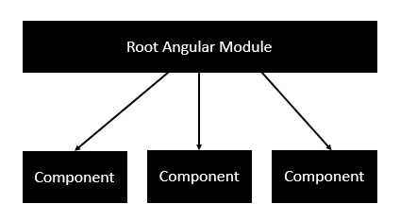
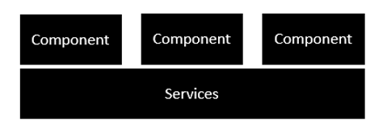
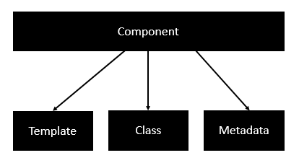
Architecture

Slide 9
Components
Template − This is used to render the view for the application. This contains the HTML that needs to be rendered in the application. This part also includes the binding and directives.
Class − This is like a class defined in any language such as C. This contains properties and methods. This has the code which is used to support the view. It is defined in TypeScript.
Metadata − This is used to decorate Angular JS class with additional information.

Slide 10
Templates
import { Component } from '@angular/core';
@Component({
selector: 'demo-app',
templateUrl: 'app/app.component.html'
})
export class AppComponent{
appTitle: string = 'Welcome';
}

Slide 11
ngIf
import { Component } from '@angular/core';
@Component({
selector: 'demo-app',
template: '<div *ngIf = 'appStatus'>{{appTitle}} </div> '
})
export class AppComponent {
appTitle: string = 'Welcome';
appStatus: boolean = true;
}

Slide 12
ngFor
import { Component } from '@angular/core';
@Component({
selector: 'demo-app',
template: `<div *ngFor = 'let lst of appList'>
<ul>
<li>{{lst.ID}}</li>
<li>{{lst.Name}}</li>
</ul>
</div> `
})
export class AppComponent {
appTitle: string = 'Welcome';
appList: any[] = [ {
"ID": "1",
"Name" : "One"
},
{
"ID": "2",
"Name" : "Two"
} ];
}

Slide 13
service
import { Injectable } from '@angular/core';
@Injectable()
export class calcService {
constructor() { }
getproducts(a:number,b:number): any {
return a*b
}
getsum(a:number,b:number):any{
return a+b
}
}

Slide 14
HTTP
import { Injectable } from '@angular/core';
import { Http , Response } from '@angular/http';
import { Observable } from 'rxjs/Observable';
import 'rxjs/add/operator/map';
import 'rxjs/add/operator/do';
import { IProduct } from './product';
@Injectable()
export class ProductService {
private _producturl='app/products.json';
constructor(private _http: Http){}
getproducts(): Observable<IProduct[]> {
return this._http.get(this._producturl)
.map((response: Response) => <IProduct[]> response.json())
.do(data => console.log(JSON.stringify(data)));
}
}

Slide 15
Routing

Slide 16
Navigation
this._router.navigate(['/Path']);

Slide 17
Forms
import { NgModule } from '@angular/core';
import { BrowserModule } from '@angular/platform-browser';
import { AppComponent } from './app.component';
import { FormsModule } from '@angular/forms';
import { ProductFormComponent } from './product-form.component';
@NgModule({
imports: [ BrowserModule,FormsModule],
declarations: [ AppComponent,ProductFormComponent],
bootstrap: [ AppComponent ]
})
export class AppModule { }

