Slide 1
Introduction to SPIM Simulator
Jayaraj P B

Slide 2
SPIM Simulator
SPIM is a software simulator that runs programs written for MIPS processors
SPIM’s name is just MIPS spelled backwards
SPIM can read and immediately execute MIPS assembly language files or MIPS executable files
SPIM contains a debugger and provides a few operating system-like services

Slide 3
MIPS Processors
MIPS is a load-store architecture, which means that only load and store instructions access memory
Computation instructions operate only on values in registers

Slide 4
MIPS Registers
Name Number Usage
$zero 0 constant 0
$at 1 reserved for assembler
$v0~$v1 2~3 return value of a function
$a0~$a3 4~7 arguments
$t0~$t7 8~15 temporary (not preserved across call)
$s0~$s7 16~23 saved temporary (preserved across call)
$t8~$t9 24~25 temporary (not preserved across call)
$k0~$k1 26~27 reserved for OS kernel
$gp 28 pointer to global area
$sp 29 stack pointer
$fp 30 frame pointer
$ra 31 return address

Slide 5


MIPS: Software Conventions for Registers
16 | s0 | callee saves
. . .
23 | s7
24 | t8 | temporary (cont’d)
25 | t9
26 | k0 | reserved for OS kernel
27 | k1
28 | gp | pointer to global area
29 | sp | stack pointer
30 | fp | frame pointer
31 | ra | return Address caller saves
0 | zero constant 0
1 | at reserved for assembler
2 | v0 results from callee
3 | v1 returned to caller
4 | a0 arguments to callee
5 | a1 from caller: caller saves
6 | a2
7 | a3
8 | t0 temporary
. . .
15 | t7

Slide 6
Pseudoinstructions
Here's a list of useful pseudo-instructions.
mov $t0, $t1: Copy contents of register t1 to register t0.
li $s0, immed: Load immediate into to register s0.
  The way this is translated depends on whether immed is 16 bits or 32 bits.
la $s0, addr: Load address into to register s0.
lw $t0, address: Load a word at address into register t0
Similar pseudo-instructions exist for sw, etc.

Slide 7
Pseudoinstructions
Translating Some Pseudoinstructions
mov $t0, $s0
li $rs, small
li $rs, big
la $rs, big
addi $t0, $s0, 0
addi $rs, $zero, small
lui $rs, upper(big) ori $rs, $rs, lower(big) lui $rs, upper(big) ori $rs, $rs, lower(big)
where small means a quantity that can be represented using 16 bits, and big means a 32 bit quantity. upper( big ) is the upper 16 bits of a 32 bit quantity. lower( big ) is the lower 16 bits of the 32 bit quantity.
upper( big ) and lower(big) are not real instructions. If you were to do the translation, you'd have to break it up yourself to figure out those quantities.

Slide 8
Arithmetic Instructions
add rd, rs, rt rd ← rs + rt
sub rd, rs, rt rd ← rs – rt
mul rd, rs, rt rd ← rs * rt
div rd, rs, rt rd ← rs / rt
rem rd, rs, rt rd ← rs % rt
neg rd, rs rd ← - rs

Slide 9
Branch Instructions
beq rs, rt, label branch to label if rs == rt
bne rs, rt, label branch to label if rs != rt
bgt rs, rt, label branch to label if rs > rt
bge rs, rt, label branch to label if rs >= rt
blt rs, rt, label branch to label if rs < rt
ble rs, rt, label branch to label if rs <= rt
b label branch to label

Slide 10
Memory Layout
7ffffff
Stack segment
Dynamic data
Data segment
Static data
10000000
Text segment
400000
Reserved

Slide 11
MIPS Assembler Directives
Top-level Directives:
  .text
    indicates that following items are stored in the user text segment, typically instructions
  .data
    indicates that following data items are stored in the data segment
  .globl sym
    declare that symbol sym is global and can be referenced from other files

Slide 12
MIPS Assembler Directives
Common Data Definitions:
  .word w1, …, wn
    store n 32-bit quantities in successive memory words
  .half h1, …, hn
    store n 16-bit quantities in successive memory halfwords
  .byte b1, …, bn
    store n 8-bit quantities in successive memory bytes
  .ascii str
    store the string in memory but do not null-terminate it
      strings are represented in double-quotes “str”
      special characters, eg. \n, \t, follow C convention
  .asciiz str
    store the string in memory and null-terminate it

Slide 13
MIPS Assembler Directives
Common Data Definitions:
  .float f1, …, fn
    store n floating point single precision numbers in successive memory locations
  .double d1, …, dn
    store n floating point double precision numbers in successive memory locations
  .space n
    reserves n successive bytes of space
  .align n
    align the next datum on a 2^{n} byte boundary.
    For example, .align 2 aligns next value on a word boundary.
    .align 0 turns off automatic alignment of .half, .word, etc. till next .data directive

Slide 14
System Calls
SPIM provides a small set of operating system-like services through the system call (syscall) instruction
To request a service, a program loads the system call code into register $v0 and arguments into registers $a0~$a3
System calls that return values put their results in register $v0

Slide 15
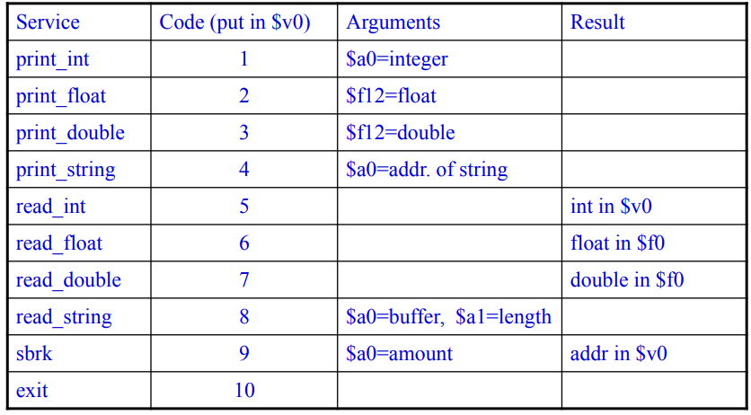
System Call Code

Slide 16
QtSPIM
QtSpim is software that will help you to simulate the execution of MIPS assembly programs.
It does a context and syntax check while loading an assembly program.
In addition, it adds in necessary overhead instructions as needed, and updates register and memory content as each instruction is executed.
Download the source from the SourceForge.org link at: http://pages.cs.wisc.edu/~larus/spim.html
Alternatively, you can go directly to: http://sourceforge.net/projects/spimsimulator/files/
Versions for Windows, Linux, and Macs are all available

Slide 17
QtSPIM
QtSPIM window is divided into different sections:
The Register tabs display the content of all registers.
Buttons across the top are used to load and run a simulation
  Functionality is described in Figure 2.
The Text tab displays the MIPS instructions loaded into memory to be executed.
  From left-to-right, the memory address of an instruction,
the contents of the address in hex, the actual MIPS instructions where register numbers are used, the MIPS assembly that you wrote, and any comments you made in your code are displayed.
The Data tab displays memory addresses and their values in the data and stack segments of the memory.
The Information Console lists the actions performed by the simulator.

Slide 18
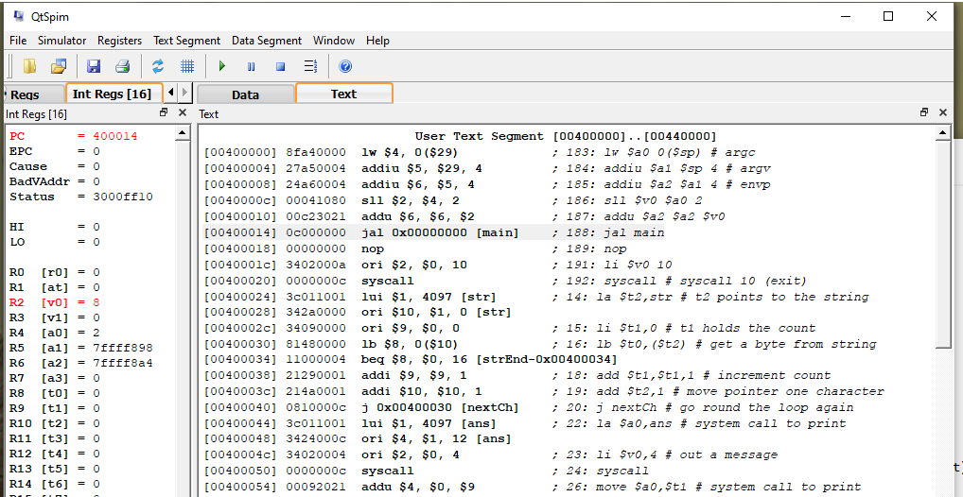
QtSpim simulator - screenshot

Slide 19
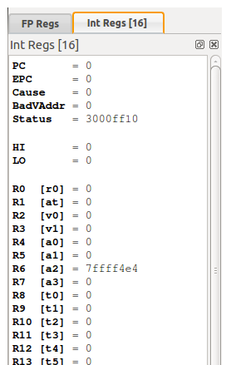
Register panel

Slide 20
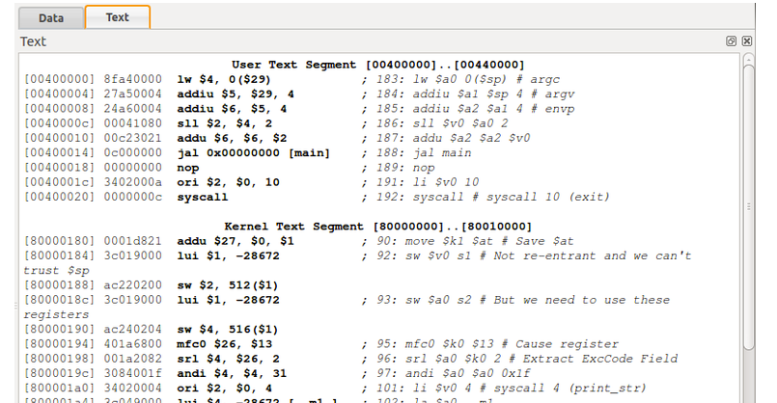
Memory panel: text panel

Slide 21
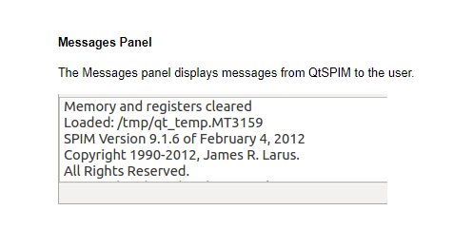
Message panel

Slide 22
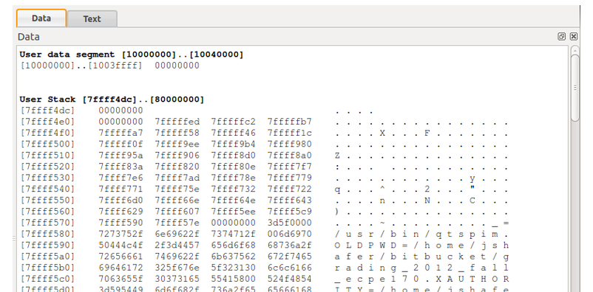
Memory panel :data segment

Slide 23
Program template
.data
# data segment
.text
.globl main
main:
# your code will come here
EXIT: li $v0,10
syscall

Slide 24
Program for reading a string
.data
theString: .space 64
.text
main:
li $v0, 8
la $a0, theString
li $a1, 64
syscall
jr $ra

Slide 25
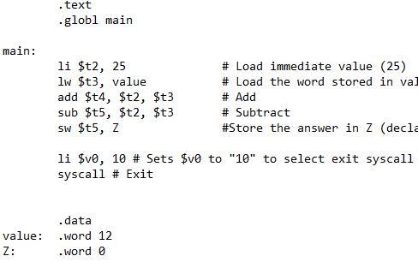

Slide 26
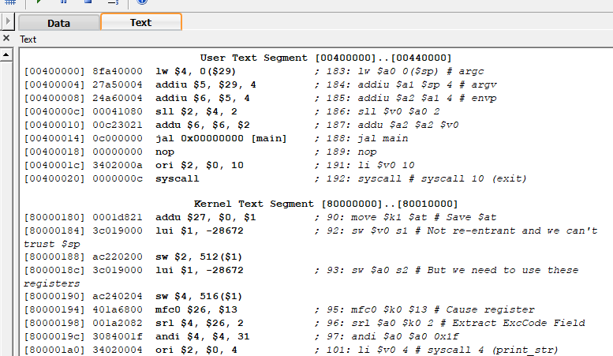
User text segment

Slide 27
QtSPIM Program Example
A Simple Program
#sample example 'add two numbers’
.text | # | text | section
.globl main | # | call | main by SPIM
main:
la $t0, value
# load address ‘value’ into $t0
lw |  | $t1, | 0($t0) | # | load | word 0(value) into $t1
lw |  | $t2, | 4($t0) | # | load | word 4(value) into $t2
 | add $t3, $t1, $t2 |  |  | # | add two numbers into $t3
 | sw $t3, 8($t0) |  |  | # | store word $t3 into 8($t0)
.data value: | .word 10, 20, 0 |  |  | # # | data section data for additionl

Slide 28
QtSPIM Example Program
## Program adds 10 and 11
.text | # | text | section
.globl main | # | call | main by SPIM
main:
ori | $8,$0,0xA | # | load | “10" | into register | 8
ori | $9,$0,0xB | # | load | “11" | into register | 9
add | $10,$8,$9 | # # | add registers 8 and 9, put result in register 10

Slide 29
QtSPIM Example Program: swap2memoryWords.asm
## Program to swap two memory words
.data
.word 7
.word 3
# load data
.text
.globl main
main:
lui | $s0, | 0x1001 # load data area start address 0x10010000
lw | $s1, | 0($s0)
lw | $s2, | 4($s0)
sw | $s2, | 0($s0)
sw | $s1, | 4($s0)

