Slide 1
Introduction to Sockets
Jan 2023

Slide 2
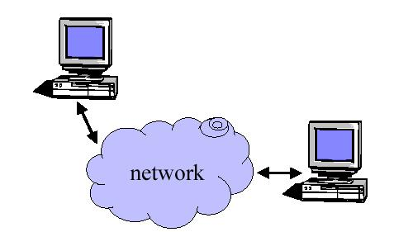
Why do we need sockets?
Provides an abstraction for interprocess communication

Slide 3
Definition
The services provided (often by the operating system) that provide the interface between application and protocol software.
Application
Network API
Protocol A
Protocol B
Protocol C

Slide 4
Functions
  Define an “end- point” for communication
  Initiate and accept a connection
  Send and receive data
  Terminate a connection gracefully
Examples
  File transfer apps (FTP), Web browsers
  (HTTP), Email (SMTP/ POP3), etc…

Slide 5
Types of Sockets
Two different types of sockets :
  stream vs. datagram
Stream socket :( a. k. a. connection- oriented socket)
  It provides reliable, connected networking service
  Error free; no out- of- order packets (uses TCP)
  applications: telnet/ ssh, http, …
Datagram socket :( a. k. a. connectionless socket)
  It provides unreliable, best- effort networking service
  Packets may be lost; may arrive out of order (uses UDP)
  applications: streaming audio/ video (realplayer), …

Slide 6
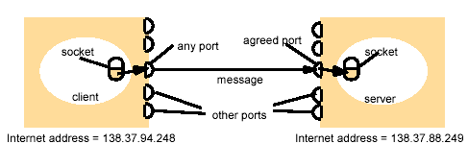
Addressing
Client
Server

Slide 7
Addresses, Ports and Sockets
Like apartments and mailboxes
  You are the application
  Your apartment building address is the address
  Your mailbox is the port
  The post-office is the network
  The socket is the key that gives you access to the right mailbox

Slide 8
Client – high level view
Create a socket
Setup the server address
Connect to the server
Read/write data
Shutdown connection

Slide 9
int connect_ socket( char *hostname, int port) {
int sock;
struct sockaddr_in sin;
struct hostent *host;
sock = socket( AF_ INET, SOCK_ STREAM, 0);
if (sock == -1)
return sock;
host = gethostbyname( hostname);
if (host == NULL) {
close( sock);
return -1;
}
memset (& sin, 0, sizeof( sin));
sin. sin_ family = AF_ INET;
sin. sin_ port = htons( port);
sin. sin_ addr. s_ addr = *( unsigned long *) host-> h_ addr_ list[ 0];
if (connect( sock, (struct sockaddr *) &sin, sizeof( sin)) != 0) {
close (sock);
return -1;
}
return sock;
}

Slide 10
Server – high level view
Create a socket
Bind the socket
Listen for connections
Accept new client connections
Read/write to client connections
Shutdown connection

Slide 11
Listening on a port (TCP)
int make_ listen_ socket( int port) {
struct sockaddr_ in sin;
int sock;
sock = socket( AF_ INET, SOCK_ STREAM, 0);
if (sock < 0)
return -1;
memset(& sin, 0, sizeof( sin));
sin. sin_ family = AF_ INET;
sin. sin_ addr. s_ addr = htonl( INADDR_ ANY);
sin. sin_ port = htons( port);
if (bind( sock, (struct sockaddr *) &sin, sizeof( sin)) < 0)
return -1;
return sock;
}
Make the socket
Setup up the struct

Slide 12
accepting a client connection (TCP)
int get_ client_ socket( int listen_ socket) {
struct sockaddr_ in sin;
int sock;
int sin_ len;
memset(& sin, 0, sizeof( sin));
sin_ len = sizeof( sin);
sock = accept( listen_ socket, (struct sockaddr *) &sin, &sin_ len);
return sock;
}
Setup up the struct
Accept the client connection
accept(int sockefd, struct sockaddr * claddr, socklen_t * addrlen)
/* return nonnegative descriptor if OK, -1 on error
return the next completed connection from the front of the
completed connection queue.
if the queue is empty,
the process is put to sleep(assuming blocking socket)*/

Slide 13
Sending / Receiving Data
With a connection (SOCK_STREAM):
  int count = send(sock, &buf, len, flags);
    count: # bytes transmitted (-1 if error)
    buf: char[], buffer to be transmitted
    len: integer, length of buffer (in bytes) to transmit
    flags: integer, special options, usually just 0
  int count = recv(sock, &buf, len, flags);
    count: # bytes received (-1 if error)
    buf: void[], stores received bytes
    len: # bytes received
    flags: integer, special options, usually just 0
  Calls are blocking [returns only after data is sent (to socket buf) / received]

Slide 14
socket()
TCP Server
bind()
Well-known port
TCP Client
listen()
Socket()
accept()
connect()
Connection establishment
blocks until connection from client
write()
Data(request)
read()
process request
Data(reply)
write()
read()
close()
End-of-file notification
read()
close()

Slide 15
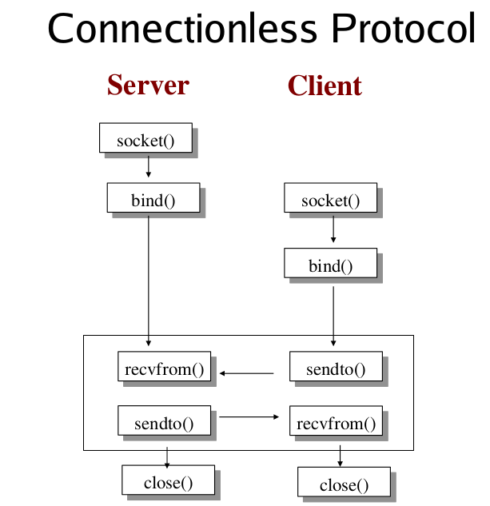

Slide 16
Dealing with blocking calls
Many functions block
  accept(), connect(),
  All recv()
For simple programs this is fine
What about complex connection routines
  Multiple connections
  Simultaneous sends and receives
  Simultaneously doing non-networking processing

Slide 17
Dealing with blocking (cont..)
Options
  Create multi-process or multi-threaded code
  Turn off blocking feature (fcntl() system call)
  Use the select() function
What does select() do?
  Can be permanent blocking, time-limited blocking or non-blocking
  Input: a set of file descriptors
  Output: info on the file-descriptors’ status
  Therefore, can identify sockets that are “ready for use”: calls involving that socket will return immediately

Slide 18
select function call
int status = select()
  Status: # of ready objects, -1 if error
  nfds: 1 +largest file descriptor to check
  readfds: list of descriptors to check if read-ready
  writefds: list of descriptors to check if write-ready
  exceptfds: list of descriptors to check if an exception is registered
  Timeout: time after which select returns

