Slide 1

Playwright NeW KID oN THE BLOCK
1.21 GWS
Presentor: Jithin Jose Jacob
https://github.com/jithinjosejacob/1.21GWS-PlaywrightTestRunner

Slide 2
Agenda
What is Playwright
Core Concepts
Futuristic Features of Playwright
Demo of Playwright Features
Selenium, Cypress and Playwright

Slide 3
What is Playwright
Playwright is a Node.js library to run automated tests in chromium, firefox and webkit with a single API
Playwright’s device emulation can be used to test your responsive web apps in mobile web browsers
Supports Major Language bindings – JavaScript/TypeScript, Java, Python and C#
https://playwright.dev/ - Official Website
Current version – 1.21 as of May 2022
Maintained by a team at Microsoft
Notes:
Devices - https://github.com/microsoft/playwright/blob/0a6ae11da1dfe5bc49c1005e9baed730391aaac0/types/types.d.ts#L12844-L12951

Slide 4
Core Concepts
Browser - A Browser refers to an instance of Chromium, Firefox or WebKit.
Context - A BrowserContext is an isolated incognito-alike session within a browser instance. Used for specifying required device as well.
Page - A Browser context can have multiple pages. A Page refers to a single tab, new tab or a popup window within a browser context.

Slide 5
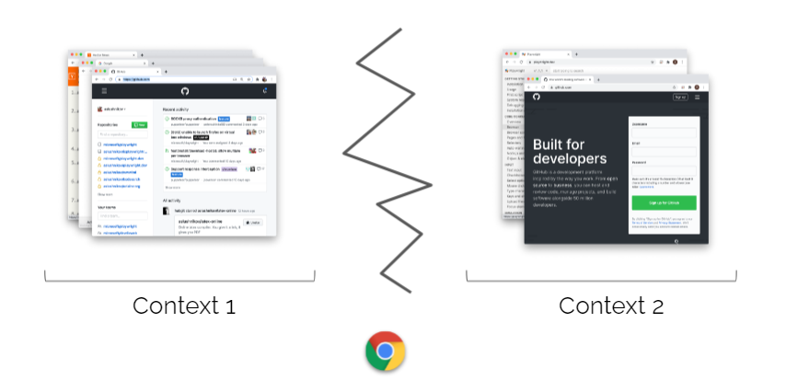
Browser Contexts

Slide 6
Unique Features of Playwright
CrossBrowser (Chromium, Firefox, WebKit) and Device Emulation
Autowaits and Custom waits -waitForSelector, waitForNavigation(Element and Page level waits)
Locators – Strict Mode, Refetch locator from DOM
API Testing – API tests and poll an api
Evaluating an expression (page.eval)
Geolocation(Change location to a particular coordinates)
Visual Testing(Visual Regression Testing)
TraceViewer(Viewing Trace of tests)
Playwright Inspector(Debugging tests)

Slide 7
Demo of Futuristic Features
https://github.com/jithinjosejacob/1.21GWS-PlaywrightTestRunner
Device Emulation
Reuse Authentication State
Fail Annotation
Visual Testing
Trace Viewer
Playwright Inspector

Slide 8
Comparison
 | Selenium | Cypress | Playwright
Language Bindings | All major languages | JS/TS | JS/TS, Java ,Python, C#
Open Source | Yes | Majority of features are free | Yes
Waits | Explicit , Implicit waits | Wait for Network Calls to Complete | Auto Waits & Custom Waits
Browsers | All major browsers | Chromium, Firefox | Chromium, Firefox, Webkit
Mobile Emulation | Yes | No, Indirectly through Viewport adjustment | Yes
MultiTab, Iframe and Multi Domain | Yes | Limited | Yes
Parallel execution | Yes | Yes, comes under paid plan | Yes
Test Runners/ Assertions | Yes | Only Cypress related | Yes

Slide 9
Limitations
Cannot run browser tests in IE
Cannot be used to test Native Mobile Apps

Slide 10
Support Forums
Slack – For general queries
https://aka.ms/playwright-slack
Github discussions
Github issues- Raising Bugs/Questions/Improvements
https://github.com/microsoft/playwright/issues

Slide 11

Questions

