Slide 1

Playwright
https://github.com/microsoft/playwright
STAG Meetup
Presentor: Jithin Jose Jacob

Slide 2
Agenda
What is Playwright
Core Concepts
Unique Features of Playwright
Demo of Playwright Features
Playwright Tests in github actions(CI Pipeline)
Comparison - Selenium, Cypress and Playwright

Slide 3
What is Playwright
Playwright is a Node.js library to run automated tests in chromium, firefox and webkit with a single API.
Playwright’s device emulation can be used to test your responsive web apps in mobile web browsers.
Supports Major Language bindings – JavaScript/TypeScript, Java, Python and C#
https://playwright.dev/ - Official Website
Current version - 1.15.0 as of Sept 2021
Maintained by a team at Microsoft
Notes:
Devices - https://github.com/microsoft/playwright/blob/0a6ae11da1dfe5bc49c1005e9baed730391aaac0/types/types.d.ts#L12844-L12951

Slide 4
Playwright Evolution
2009-2019 WebKit Web Inspector Chrome Developer Tools
2011-... Chrome DevTools Protocol
2015-2016 Node.js Debugger
2017-2019 Puppeteer
2019-... Playwright

Slide 5
Core Concepts
Browser - A Browser refers to an instance of Chromium, Firefox or WebKit.
Context - A BrowserContext is an isolated incognito-alike session within a browser instance. Used for specifying required device as well.
Page - A Browser context can have multiple pages. A Page refers to a single tab, new tab or a popup window within a browser context.

Slide 6
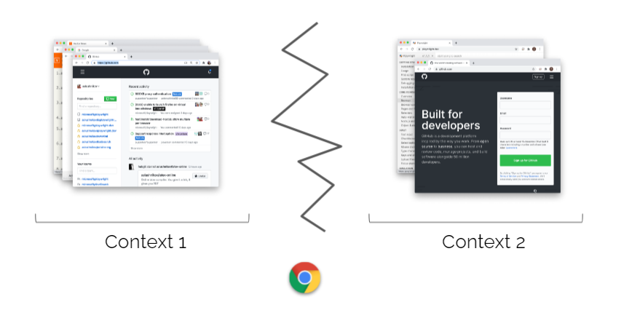
Browser Contexts

Slide 7
Browser Contexts
Disadvantages of creating Browser for every test
Never Restart a Browser
Slow instantiation (>100ms)
Huge memory overhead
Advantages of creating contexts
✅ Always create Browser Contexts
Full isolation
Fast instantiation (~1ms)
Low overhead

Slide 8
Selectors
Simple Code Snippet in Js
const browser = await chromium.launch(); // Create browser
const context = await browser.newContext(); // Create context
const page = await context.newPage(); // Create page
await page.goto('https://help.afterpay.com/hc/en-au'); // Use page for actions
await page.fill("id=username", "value"); // Using id or data-testid
await page.click(`.menu-button`); // CSS selector
await page.click(`//button[@text=‘Submit’]'); // XPath selector
await page.click(`text=Get in touch`); // Text selector
await page.click(`:nth-match(:text(“Search"), 3)`); // N-th match
await page.click(`input:right-of(:text(“Search"))`); // Layout
await page.click(`//a >> text=Afterpay`); // Composite(xpath + text)

Slide 9
Test Runners
playwright/test
Jest / Jasmine
AVA
Mocha
Note: Playwright tests could be written in cucumber as well
These are Js based Test Runners. We could use any Test Runner based on language binding we choose.

Slide 10
Reporting
dot
list
line
JSON (json)
Junit (xml)
Experimental Allure Support(html)

Slide 11
Unique Features of Playwright
CrossBrowser(Chromium, Firefox, WebKit) and Device Emulation
Autowaits. Custom waits -waitForSelector, waitForNavigation(Element and Page level waits)
API Testing
page.eval(Evaluating an expression)
GeoLocation(Geo Location)
Visual Testing(Visual Regression Testing)
TraceViewer(Viewing Trace of tests)
Playwright Inspector(Debugging tests)

Slide 12

Demo of Unique Features
https://github.com/jithinjosejacob/playwright_stag
https://github.com/jithinjosejacob/playwright_stag/actions/

Slide 13
Comparison
 | Selenium | Cypress | Playwright
Language Bindings | All major languages | JS/TS | JS/TS, Java ,Python, C#
Open Source | Yes | Majority of features are free | Yes
Waits | Explicit , Implicit waits | Wait for Network Calls to Complete | Auto Waits & Custom Waits
Browsers | All major browsers | Chromium, Firefox | Chromium, Firefox, Webkit
Mobile Emulation | Yes | No, Indirectly through Viewport adjustment | Yes
MultiTab, Iframe and Multi Domain | Yes | Limited | Yes
Parallel execution | Yes | Yes, comes under paid plan | Yes
Test Runners/ Assertions | Yes | Only Cypress related | Yes

Slide 14
Additional Capabilities of Playwright
Intercept network activity for stubbing and mocking
Support for web components via shadow-piercing selectors
Native input events for mouse and keyboard
Upload and download files
Parallel Instances through workers
Experimental Vue and React Selector Engines
CI Integrations using custom Docker Images
Support for ThirdParty Integrations like BrowserStack, Applitools, Moon(Kubernetes) and Sauce Labs

Slide 15
Limitations
Cannot run browser tests in IE
Cannot be used to test Native Apps

Slide 16
Upcoming Features
Experimental Electron.js support released
Go language support coming soon
Opening TraceViewer without setting up the repo and installing playwright dependancies

Slide 17

Questions

