Slide 1
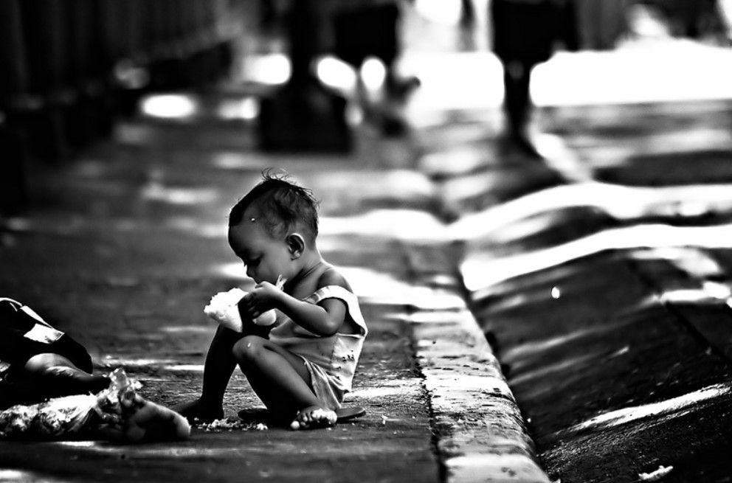

HELP International – NGO Fighting Poverty
Author : Jithin Prakash K
Clustering Assignment
DSC June 2020

Slide 2

Problem statement.
HELP International – NGO, has an objective to eliminate poverty by providing the people of backward countries with basic amenities and relief during the time of disasters and natural calamities.
A sum of $10 Million fund is raised recently. This amount needs to be strategically and effectively used across the globe. An analysis need performed to find the countries that are in direst need of money.
Notes:
Insert a map of your country.

Slide 3

analysis approach
Step 1
Step 2
Step 3
Step 4
Read the Data
Analyse the data
Prepare the data
Outlier Analysis
Visualize the Data
Scale the data
Hopkins Readiness
K Means Clustering
Hierarchical Clustering
Decision Making
Notes:
Insert a map of your country.

Slide 4
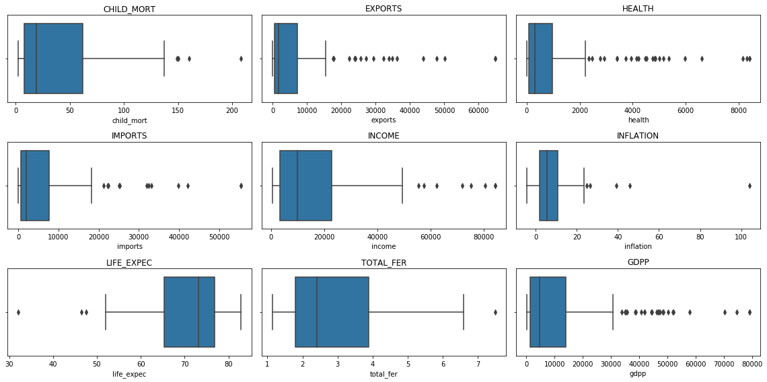
Box Plots for the features
Child mortality ranges between 0-145 with median 20 and there are outliers towards higher mortality.
Exports ranges between 0-15000 with median 1700 and there are outliers towards higher Export values.
Health ranges between 0-2100 with median 320 and there are outliers towards higher Health values.
Imports ranges between 0-18000 with median 2050 and there are outliers towards higher Import values.
Income value ranges between 0-50000 with median 9950 and there are outliers towards higher incomes.
Inflation value ranges between -4-25 with median 5 and there are outliers towards higher values of inflation.
Life Expectancy value ranges between 51-84 with median 72 and there are outliers towards lower values.
Total Fertility value ranges between 1-6.5 with median 2.4 and there are outliers towards higher values.
GDPP value ranges between 0-30000 with median 5000 and there are outliers towards higher GDPP values.
Notes:
Insert a map of your country.

Slide 5
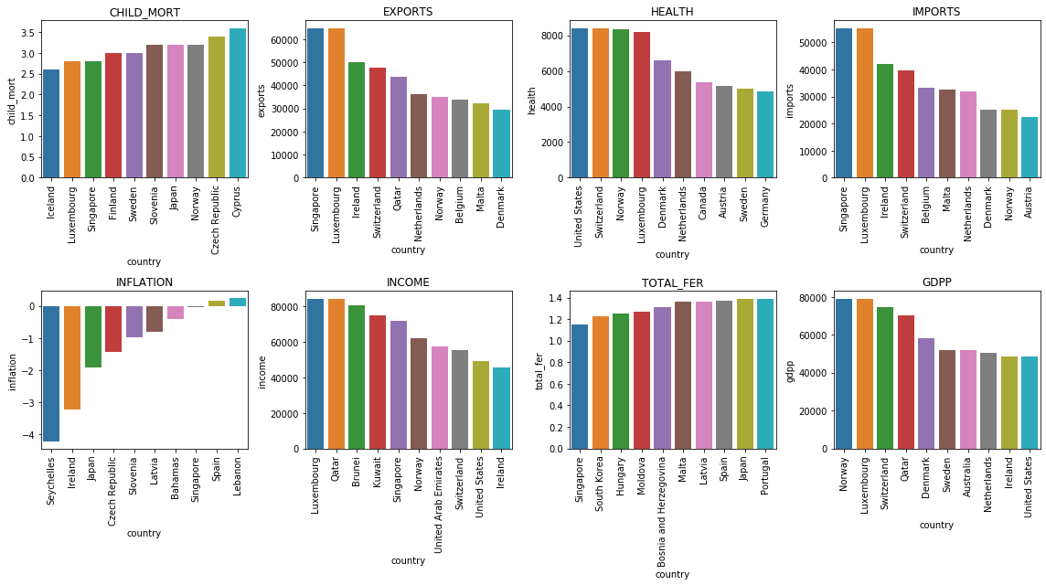
TOP 10 Developed countries - EDA
Notes:
Insert a map of your country.

Slide 6
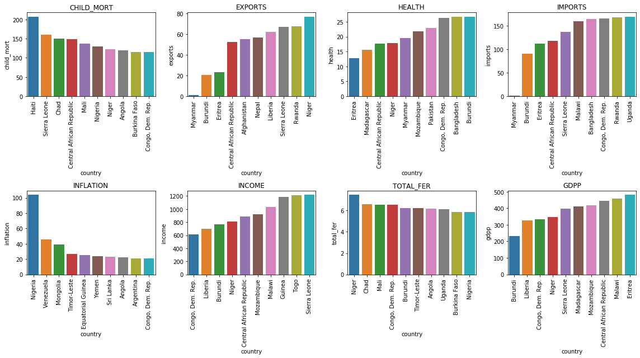
TOP 10 under Developed countries - EDA
Notes:
Insert a map of your country.

Slide 7
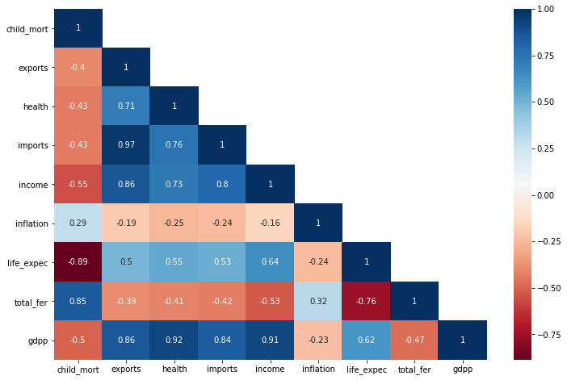
Correlation heatmap
Life expectancy and child mortality are highly negatively correlated.
Total fertility and child mortality are highly positively correlated.
Life expectancy and total fertility are negatively correlated.
Imports and exports are positively correlated.
Income and exports are highly positively correlated.
GDPP is highly positively correlated with Income, Imports, Health and Exports
Notes:
Insert a map of your country.

Slide 8
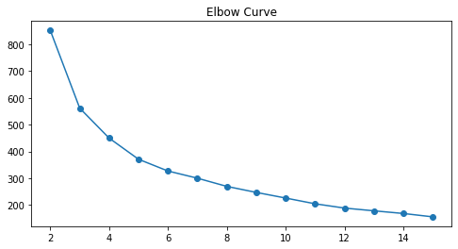
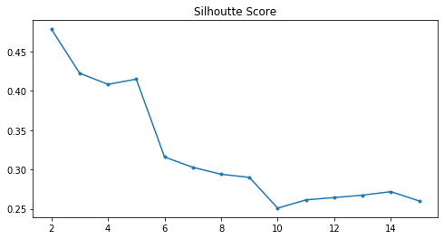
K-Means Clustering (1/4)…
Elbow-curve / Sum of Squared Distance
Silhouette Score
Both Elbow curve and Silhouette Score shows that number of clusters (k) = 3 is apt number for the clusters.
Notes:
Insert a map of your country.

Slide 9
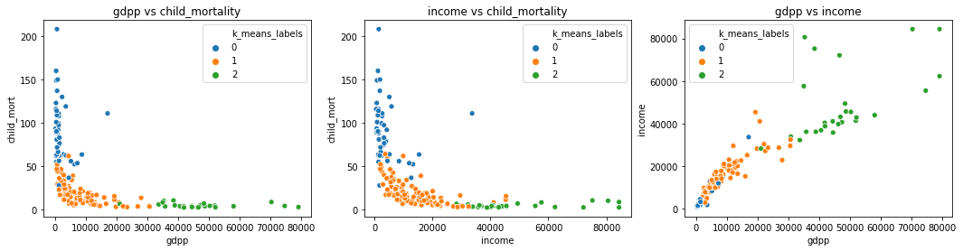
K-Means Clustering (2/4)…
Cluster 0 is distributed in low GDPP and high child mortality.
Cluster 1 is distributed in low GDPP and low child mortality.
Cluster 2 is distributed in high GDPP and low child mortality.
Cluster 0 is distributed in low income and high child mortality.
Cluster 1 is distributed in low income and low child mortality.
Cluster 2 is distributed in high income and low child mortality.
Cluster 0 is distributed in low income and low GDPP.
Cluster 1 is distributed in average income and average GDPP.
Cluster 2 is distributed in high income and high GDPP.
Notes:
Insert a map of your country.

Slide 10
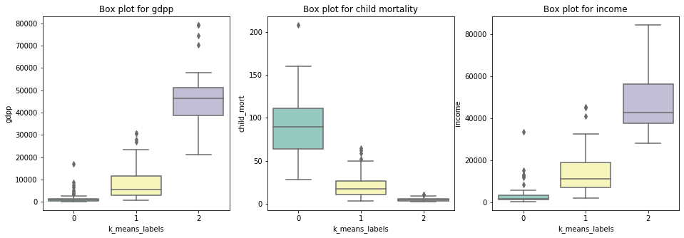
K-Means Clustering (3/4)…
Cluster | GDPP | Income | Child Mortality
0 | Low | Low | High
1 | Low | Low | Low
2 | High | High | Low
Cluster-0 has low median and less distribution for GDPP and income and higher median and spread for child morality.
Cluster-1 has median at lower side for GDPP , income and child morality, however the distribution and mean are higher than cluster-0 and lower than cluster-2 for income and GDPP.
Cluster-2 has high median and higher spread for GDPP and income, however the spread and median is low for child morality
Notes:
Insert a map of your country.

Slide 11
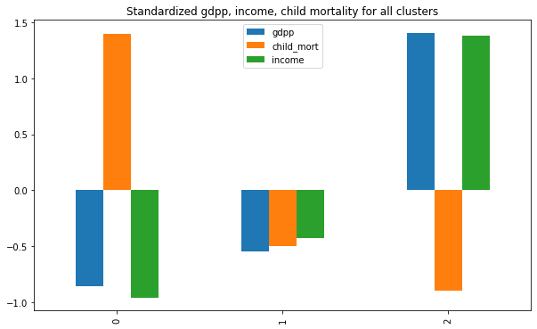
K-Means Clustering (4/4)
COUNTRIES THAT REQUIRE AID
( UNDER DEVELOPED COUNTRIES )
Sl No | Country | GDPP | Child mortality | Income
1 | Burundi | 231.0 | 93.6 | 764.0
2 | Liberia | 327.0 | 89.3 | 700.0
3 | Congo, Dem. Rep. | 334.0 | 116.0 | 609.0
4 | Niger | 348.0 | 123.0 | 814.0
5 | Sierra Leone | 399.0 | 160.0 | 1220.0
6 | Madagascar | 413.0 | 62.2 | 1390.0
7 | Mozambique | 419.0 | 101.0 | 918.0
8 | Central African Republic | 446.0 | 149.0 | 888.0
9 | Malawi | 459.0 | 90.5 | 1030.0
10 | Eritrea | 482.0 | 55.2 | 1420.0
Cluster 0 - Low GDPP, Low Income and High Child mortality - These are the countries who are in need of aid.
Cluster 1 - Low GDPP, Low Income and Low Child Mortality
Cluster 2 - High GDPP, High Income and Low Child Mortality. – These are the developed Countries
Notes:
Insert a map of your country.

Slide 12
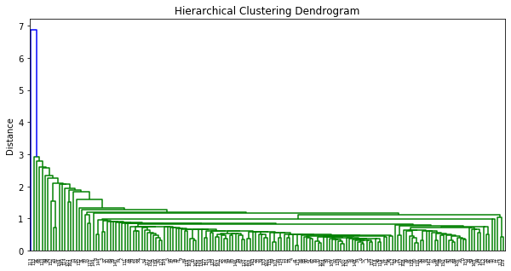
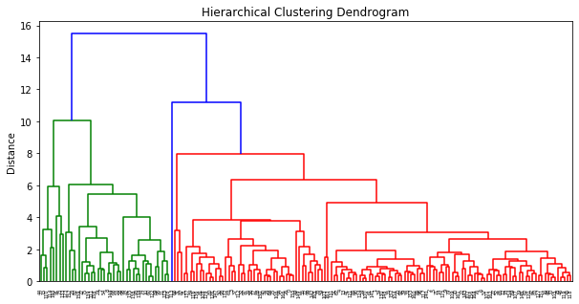
Hierarchical Clustering (1/4)…
Single Linkage
Complete Linkage
The dendrogram is not proper for single Linkage.
Dendrogram shows proper distinction for complete linkage.
Number of cluster (k) = 4 seems to be a good option. (cut tree distance is : 8-10)
Notes:
Insert a map of your country.

Slide 13
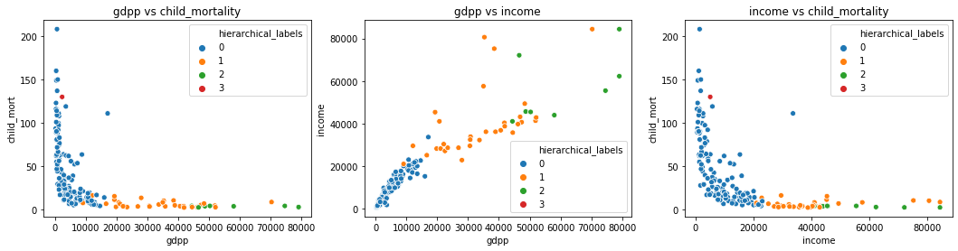
Hierarchical Clustering (2/4)…
Cluster 0 has low GDPP, low income and high child mortality.
Cluster 1 has low GDPP, low income and low child mortality.
Cluster 2 has high GDPP, high income and low child mortality.
Cluster 3 has low GDPP, low income and high child mortality.
Notes:
Insert a map of your country.

Slide 14
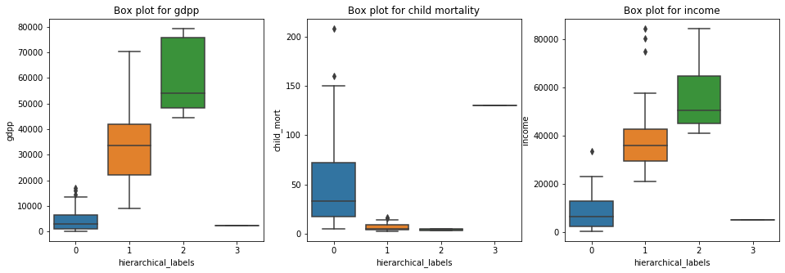
Hierarchical Clustering (3/4)…
Cluster | GDPP | Income | Child Mortality
0 | Low | Low | High
1 | High | High | Low
2 | High | High | Low
3 | Low | Low | High
Cluster 0 has lower distributions for GDPP and income and higher distribution for child morality.
Cluster-1 has higher spread for income and GDPP and lower spread and median for child mortality.
Cluster-2 has higher spread and median for income and GDPP and lower spread and median for child mortality.
Cluster-3 has only 1 data point lower value for GDPP and income and higher value for child morality.
Notes:
Insert a map of your country.

Slide 15
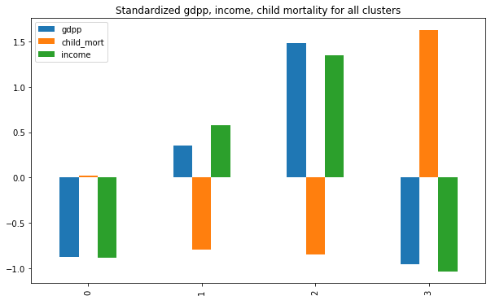
Hierarchical Clustering (4/4)
COUNTRIES THAT REQUIRE AID
( UNDER DEVELOPED COUNTRIES )
Sl No | Country | GDPP | Child mortality | Income
1 | Burundi | 231.0 | 93.6 | 764.0
2 | Liberia | 327.0 | 89.3 | 700.0
3 | Congo, Dem. Rep. | 334.0 | 116.0 | 609.0
4 | Niger | 348.0 | 123.0 | 814.0
5 | Sierra Leone | 399.0 | 160.0 | 1220.0
6 | Madagascar | 413.0 | 62.2 | 1390.0
7 | Mozambique | 419.0 | 101.0 | 918.0
8 | Central African Republic | 446.0 | 149.0 | 888.0
9 | Malawi | 459.0 | 90.5 | 1030.0
10 | Eritrea | 482.0 | 55.2 | 1420.0
11 | Nigeria | 2330.0 | 130.0 | 5150.0
Cluster 0 and Cluster 3 - Low GDPP, Low Income and High Child mortality - These are the countries who are in need of aid.
Cluster 1 - Low GDPP, Low Income and Low Child Mortality
Cluster 2 - High GDPP, High Income and Low Child Mortality.
Notes:
Insert a map of your country.

Slide 16
countries in the direst need of aid
Sl No | Country | GDPP | Child mortality | Income
1 | Burundi | 231.0 | 93.6 | 764.0
2 | Liberia | 327.0 | 89.3 | 700.0
3 | Congo, Dem. Rep. | 334.0 | 116.0 | 609.0
4 | Niger | 348.0 | 123.0 | 814.0
5 | Sierra Leone | 399.0 | 160.0 | 1220.0
6 | Madagascar | 413.0 | 62.2 | 1390.0
7 | Mozambique | 419.0 | 101.0 | 918.0
8 | Central African Republic | 446.0 | 149.0 | 888.0
9 | Malawi | 459.0 | 90.5 | 1030.0
10 | Eritrea | 482.0 | 55.2 | 1420.0
Notes:
Insert a map of your country.

Slide 17

Thank YOU

