Slide 1


LEAD SCORE CASE STUDY
jithin Prakash K
ABHISHEK BHattACHARYA

Slide 2
Introduction
This case study is performed in accordance with the data provided for an education company called X Education. The case study will help to analyze and filter the probable professional (leads) who can opt for a course in X education and become customers. There are various parameters which came into play during this analysis and with the help of statistical and modelling techniques we have tried to get a good amount of insight to find the potential leads who can become customers.
Since the dataset provided for contains numerous factors , the objective is to consider those variables which has a direct impact on the application of the customer also consider the variables with a correct amount of data.
The whole study has been done on the google colab IDE using Python coding utilizing the numpy, pandas, matplotlib, seaborn, stats models and sklearn libraries.

Slide 3
Approach
The case study is carried out by keeping several things in mind which includes different considerations like analyzing the missing values, imputation method with reasons to replace the missing values, plotting the data to check the correlations, visualizing the binary, numeric and categorical features.
The analysis has been done on the dataset by imputing/removing data for the sake of improving efficiency of data prediction. Identifying the variables as Categorical and Numerical and then deducing their correlation is also a part of this study. The variance is checked for the features and eliminated when found low. The analysis also includes visualization and model building techniques such as splitting data into train and test, feature elimination, logistic regression, plotting ROC curve, accuracy measures etc.

Slide 4
Problem Statement
X Education sells online courses to industry professionals. On any given day, many professionals who are interested in the courses land on their website and browse for courses.
The company markets its courses on several websites and search engines like Google. Once these people land on the website, they might browse the courses or fill up a form for the course or watch some videos. When these people fill up a form providing their email address or phone number, they are classified to be a lead. Moreover, the company also gets leads through past referrals. Once these leads are acquired, employees from the sales team start making calls, writing emails, etc. Through this process, some of the leads get converted while most do not. The typical lead conversion rate at X education is around 38.5%.
The requirement is to analyze the data in such a way so that potential leads can be identified easily which will make lead conversion rate to go up easily. Also to obtain the variables/features/categories that highly impact the lead conversion.

Slide 5
Key Steps Involved
Reading and loading the data from source file to python pandas data frame.
Analysing the data-frame to get the information of the columns, datatypes, their statistical values like mean, median, mode and percentiles.
Applying data cleansing and data pre-processing techniques.
Finding the missing values and imputing the same.
Data transformation to convert some negative values in positive like no. of days, prices etc.
Finding out the categorical and numerical variables.
Analysing the numeric variables to detect the outliers.
Visualising the categorical , numerical and binary variables.
Converting the categorical features to dummy variables.
Assessing the correlation between the dummy variables.
Performing feature elimination to remove the insignificant variables.
Data Modelling and logistic regression model building, assessing VIF and p-Values to refine the model.
Plotting different charts for better insights and easy understanding.
Concluding the insights.

Slide 6
Analysis Approach
Step 1
Step 2
Step 3
Step 4
Read the Data
Analyse the data
Prepare the data
Outlier Analysis
Visualize the Data
Scale the data
Recursive Feature Elimination
Variance Inflation Factor
Confusion Matrix, Accuracy
Predicting Leads
Notes:
.

Slide 7
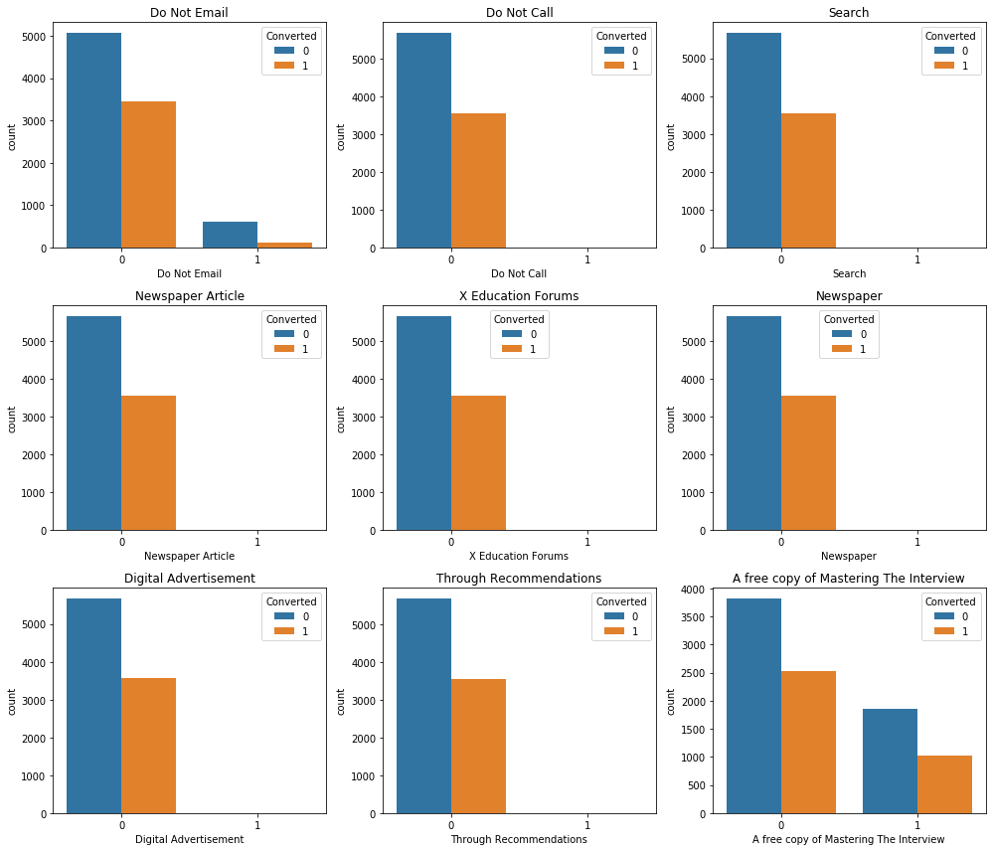
Binary Features Visualization
Most of these features show low variance, i.e. most of the data lies in ‘No’ category and these variables do not have an effect in the target variable since these are with low variance and hence dropped
A free copy of Mastering The Interview : Shows 69% of NOs and 31% YES.

Slide 8
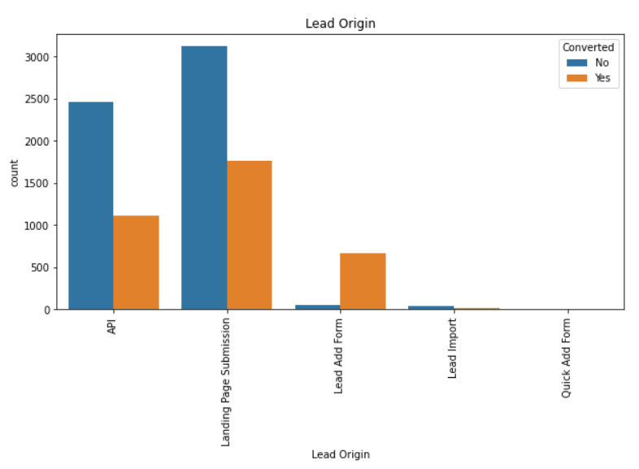
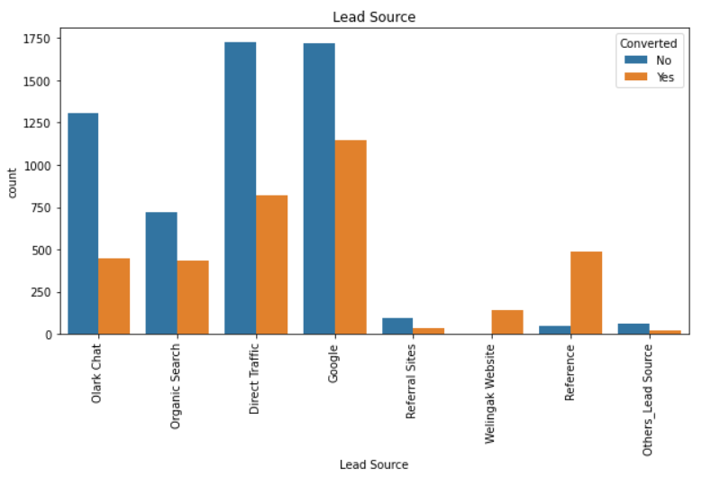
Categorical Features Visualization (1/3)
Landing Page Submission, has higher number of leads, and higher number of conversion
API, also has higher number of leads, and higher number of conversion but bit less compared to landing page submission.
The Lead Add Form has higher number of conversion rate compared to other categories, however, the number of lead is less.
Quick Add form has the least number of leads.
The Direct Traffic and Google has more number of leads, however Google has a higher conversion compared to direct traffic.
Lead conversion for Reference is Higher and for Welingak Website is also slightly higher.
Olark Chat ratios conversion rate is lower.

Slide 9
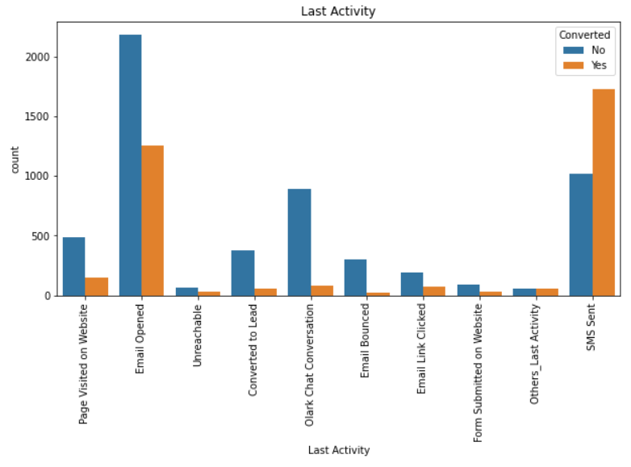
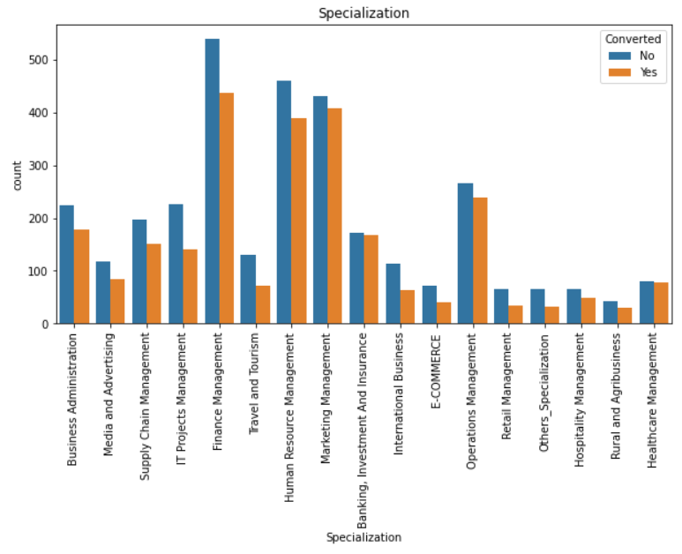
Categorical Features Visualization (2/3)
SMS sent leads have highest conversion rate.
Number of leads are more for email opened and so is the count of conversions.
Olark chat conversation has less number of conversions
More number of leads are from Finance Management specializations.
Conversion rates are more for Banking, Investments, Marketing Management and Operation Management.
Total Number of leads are less from Health care Management, however there is approximately 50% conversion rate so need to concentrate more on such group.

Slide 10
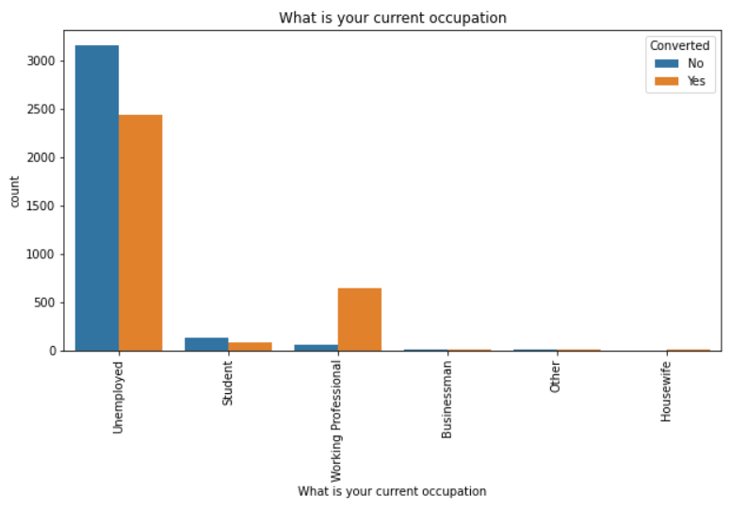
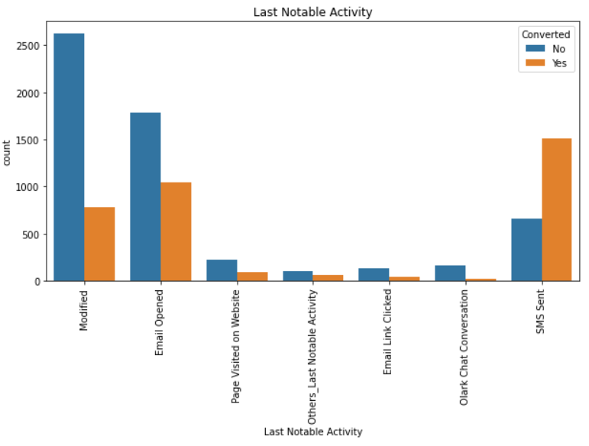
Categorical Features Visualization (3/3)
Unemployed are high in both converted and non converted categories.
The rate of leads conversion is higher for Working Professional.
Modified has more number of leads, however the conversion rate is low.
Total number of leads are less from Others category
SMS Sent has higher lead conversion rate and number.

Slide 11
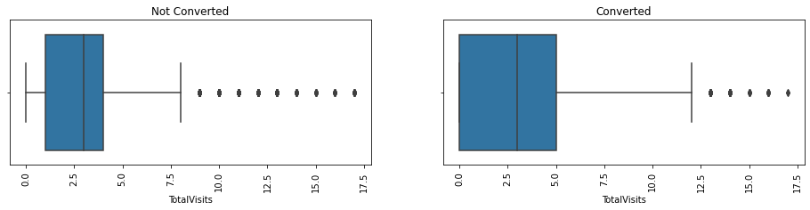
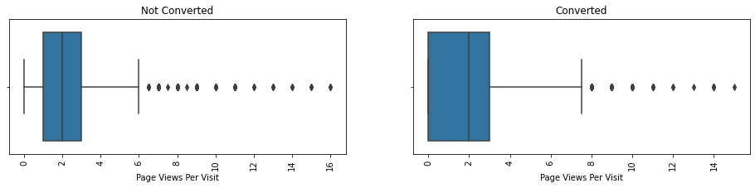
Numerical Features Visualization
The Median of total visits for non converted is 2.7 and max is at 7.5
The Median of total visits for converted is around 2.7 and max is at 12.5.
The spread is more for converted, with minimum and 25th percentile at 0.
The box plot has outliers at higher values.
The Median of Page View per visit for non converted is 2 and max is at 6
The Median of Page View per visit for converted is around 2 and max is at 7.8.
The spread is more for converted, with minimum and 25th percentile at 0

Slide 12
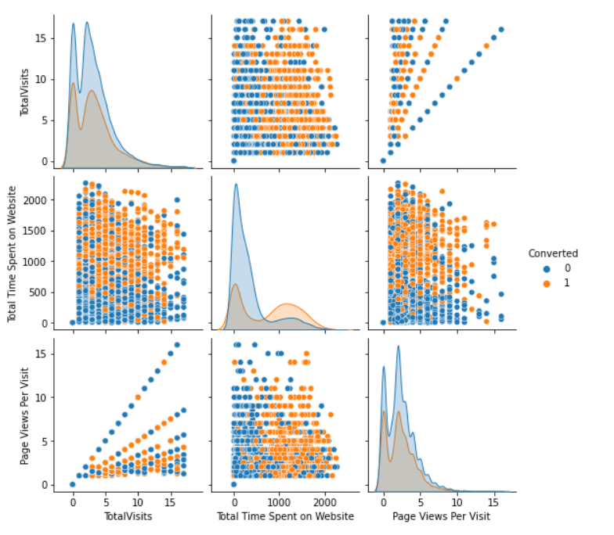
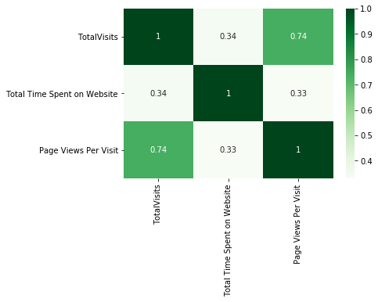
Numerical Features – Pair plot and Heatmap
The distribution plot shows that all the numerical data is right skewed and the converted leads show a bimodal trend.
Total Visits and Page Views per Visit are positively correlated

Slide 13
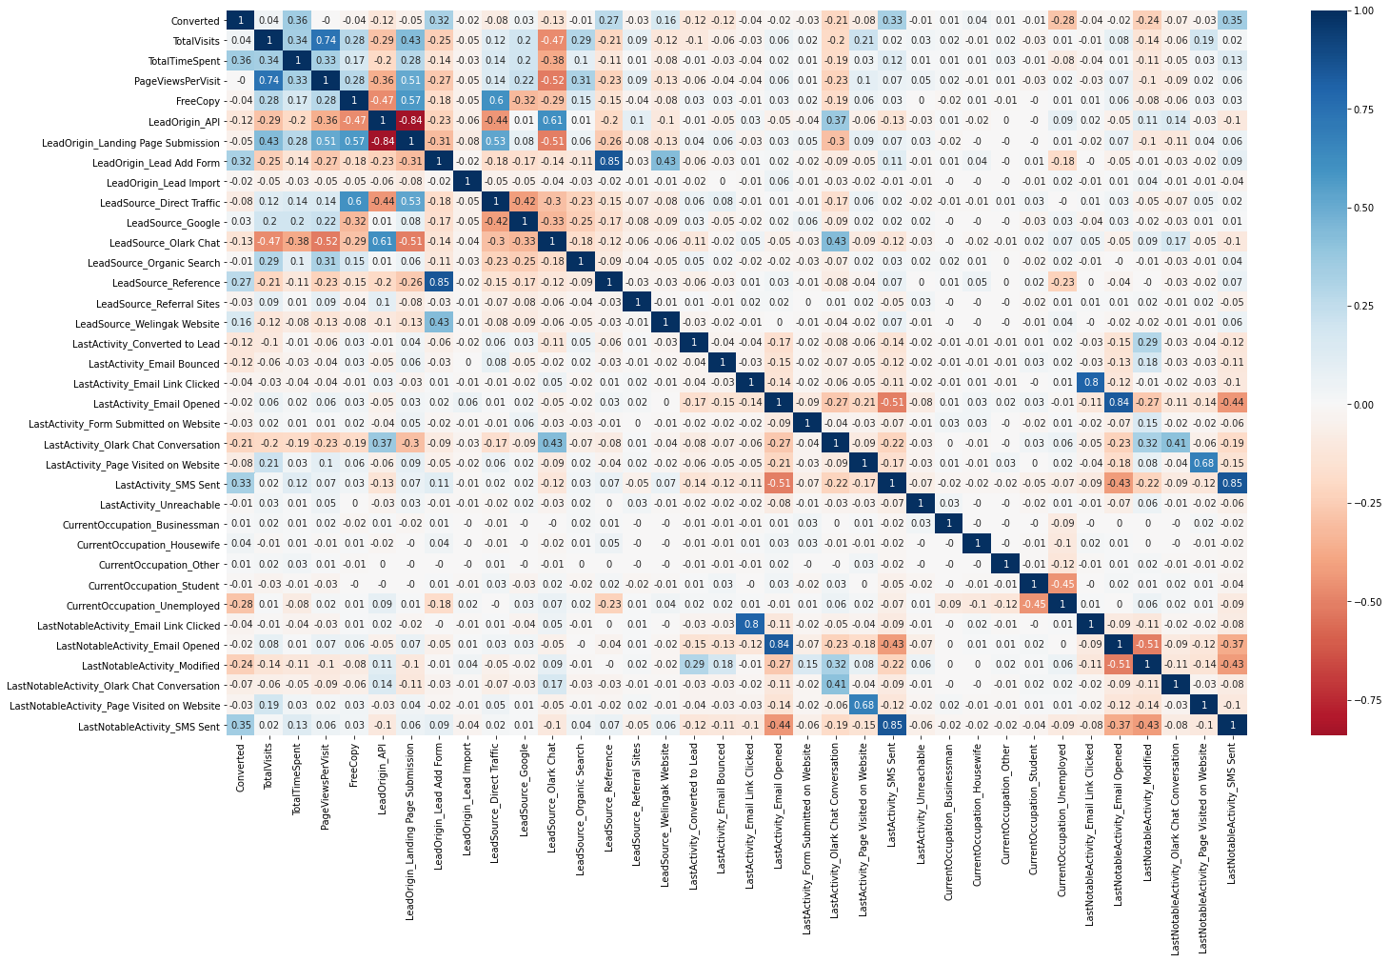
Correlation with dummy variables
Lead Origin API and Lead Origin Landing Page Submission are highly negatively correlated.
Lead Source Reference and Lead Origin Lead Add form are highly positively correlated.
Last Notable activity email link clicked and Last activity email link clicked are highly positively correlated.
Last Notable activity email opened and Last activity email opened are highly positively correlated.
Last Notable activity SMS sent and Last activity SMS sent are highly positively correlated.

Slide 14
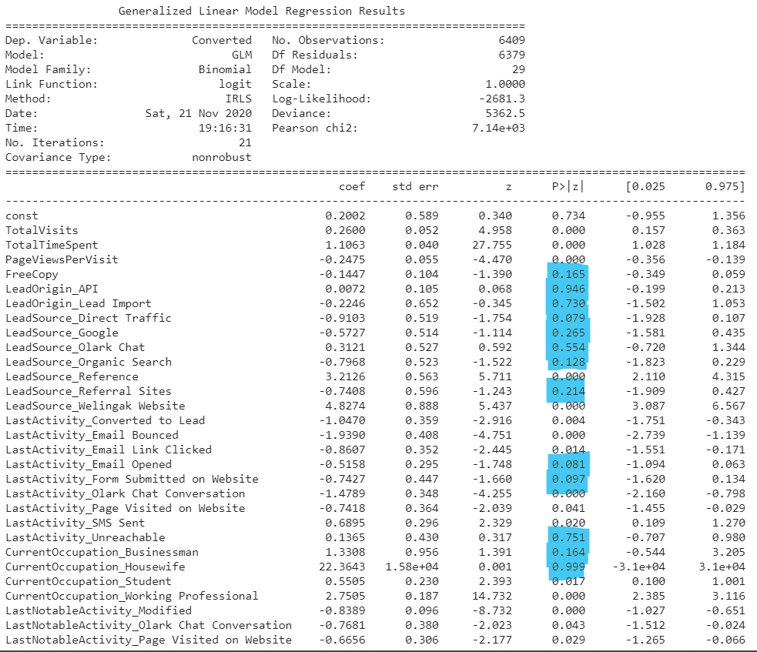
Model building with all features
It is evident from the results that most of the features are having higher p-values and those can be eliminated using RFE method.

Slide 15
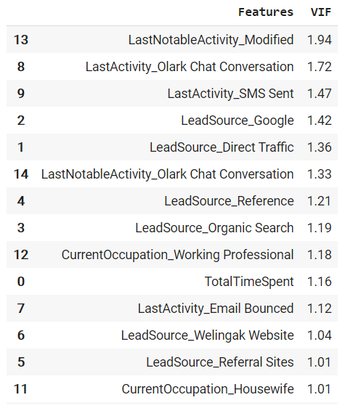
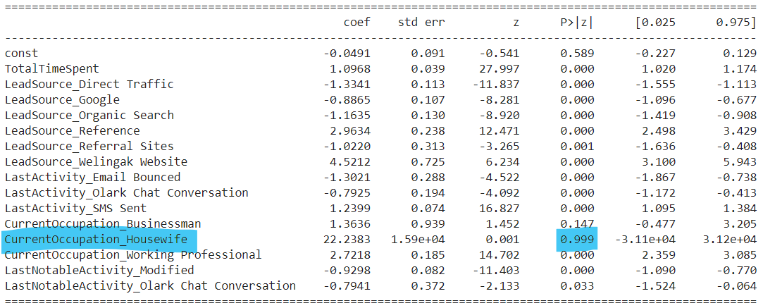
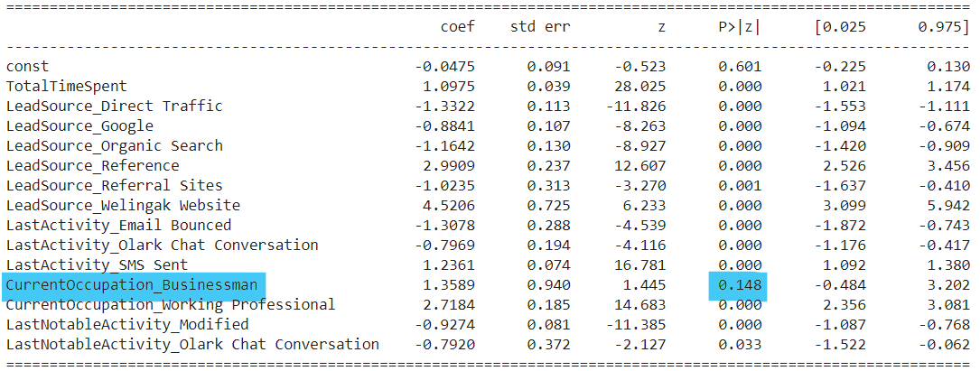
Model building after applying RFE
The RFE methods helps in eliminating most of the features with collinearity.
Further, model is fine tuned by eliminating features having higher p-values and VIF.

Slide 16
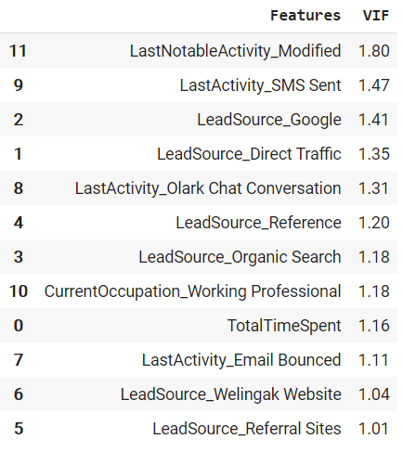
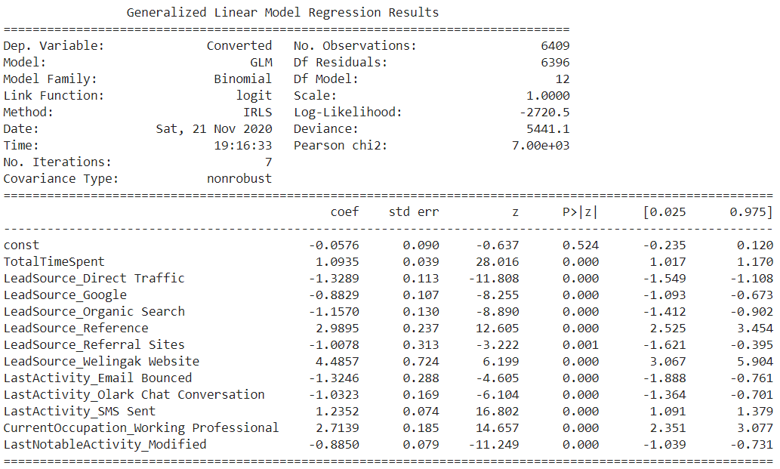
Final Model
The final model clearly depicts that all the features are having p-value less than 0.05 and VIF < 5.

Slide 17
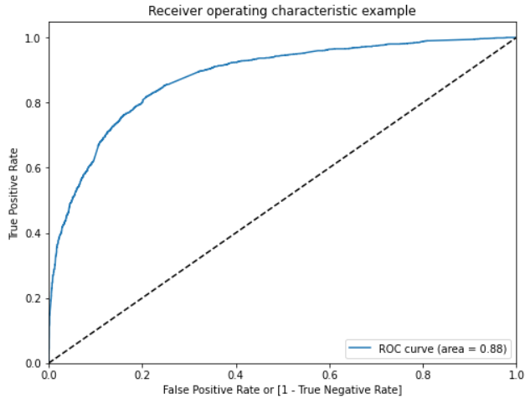
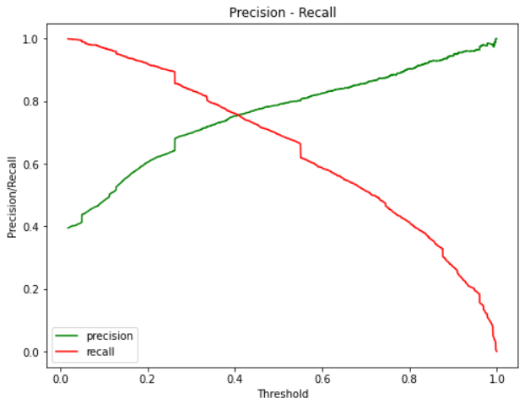
Accuracy Measures
ROC Curve
Precision - Recall
Confusion Matrix
 | Predicted No | Predicted Yes
Actual No | 3443 | 465
Actual Yes | 765 | 1736
Accuracy | Precision | Recall Sensitivity | Specificity | F1 Score | Threshold
0.81 | 0.79 | 0.69 | 0.88 | 0.74 | 0.50

Slide 18
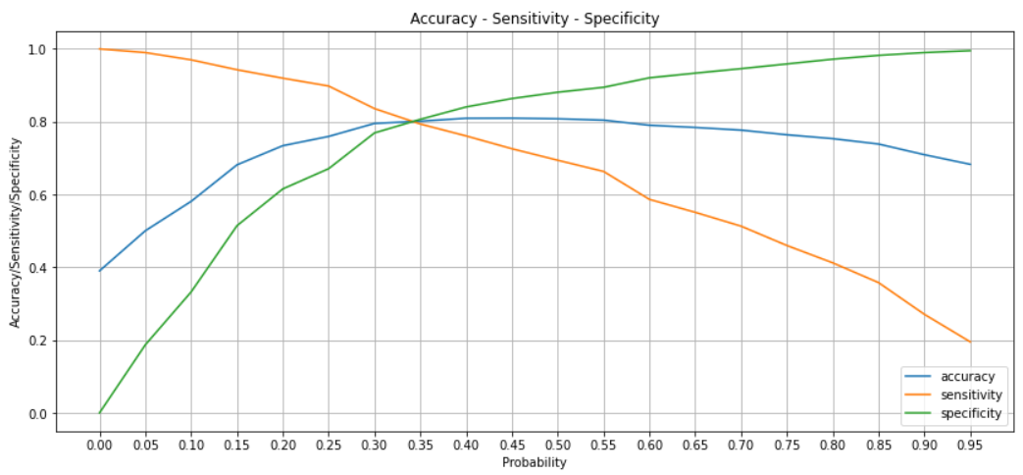
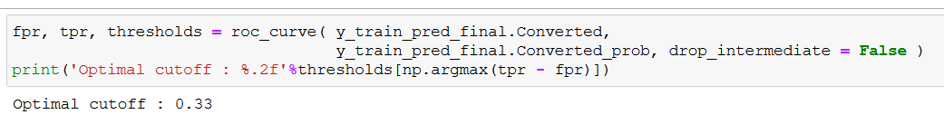
Optimal Cutoff Point
By plotting the accuracy ,sensitivity and specificity, we get 0.33 as the optimum point to take it as a cutoff

Slide 19
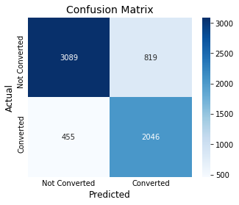

Accuracy Measures for Optimal cutoff
Confusion Matrix – Training set
Confusion Matrix – Testing set
With optimal cut-off threshold, we have a model accuracy of 0.80 for training set and 0.79 for testing set.
The ability to predict conversions correctly by the model (precision) is 71% for training set and 68% for test set.
Ability to detect the lead conversion, i.e. the sensitivity of the model is 82% for training set and 83% for test set. In this case to reduce the false negatives, i.e. model predicting a converted lead as not converted need to be reduced so that there is no risk and we don’t lose lead conversion. A higher sensitivity in turn mean a lower false negative rate.
 | Accuracy | Precision | Recall Sensitivity | Specificity | F1 Score | Threshold
Training Set | 0.80 | 0.71 | 0.82 | 0.79 | 0.76 | 0.33
Testing Set | 0.79 | 0.68 | 0.83 | 0.77 | 0.75 | 0.33

Slide 20
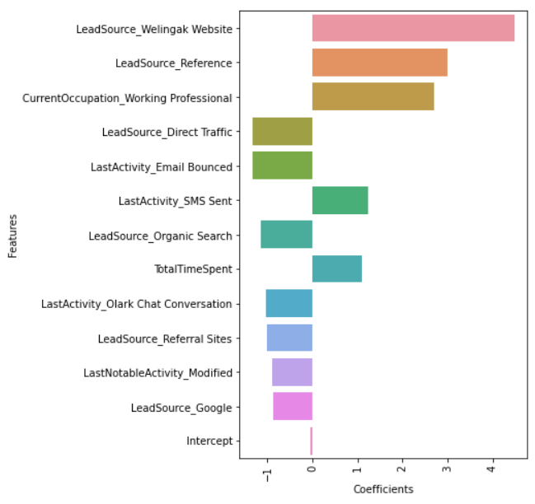
Conclusion
The following are the recommendation to the X Education
The features that have a larger impact on lead conversion are in the order of:
Lead Source
Welingak Website - Should be considered
Reference - Should be considered
Direct Traffic - Should be avoided
Organic Search - Should be avoided
Referral Sites - Should be avoided
Google - Should be avoided
Current Occupation
Working Professional - Should be considered
Last Activity
Email Bounced - Should be avoided
SMS Sent - Should be considered
Olark Chat Conversation - Should be avoided
Total Time Spent - Should be considered
Last Notable Activity
Modified - Should be avoided

Slide 21
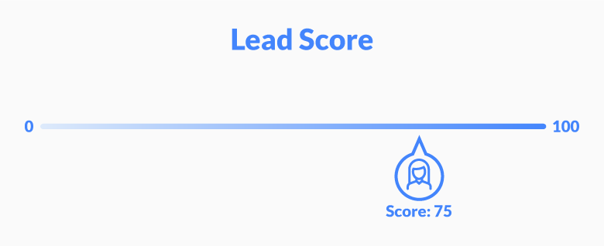
Thank you

