Slide 1





QUANTA (data + intelligence) Quantum Unified Automation for Next-Gen Ticket Analysis

Slide 2
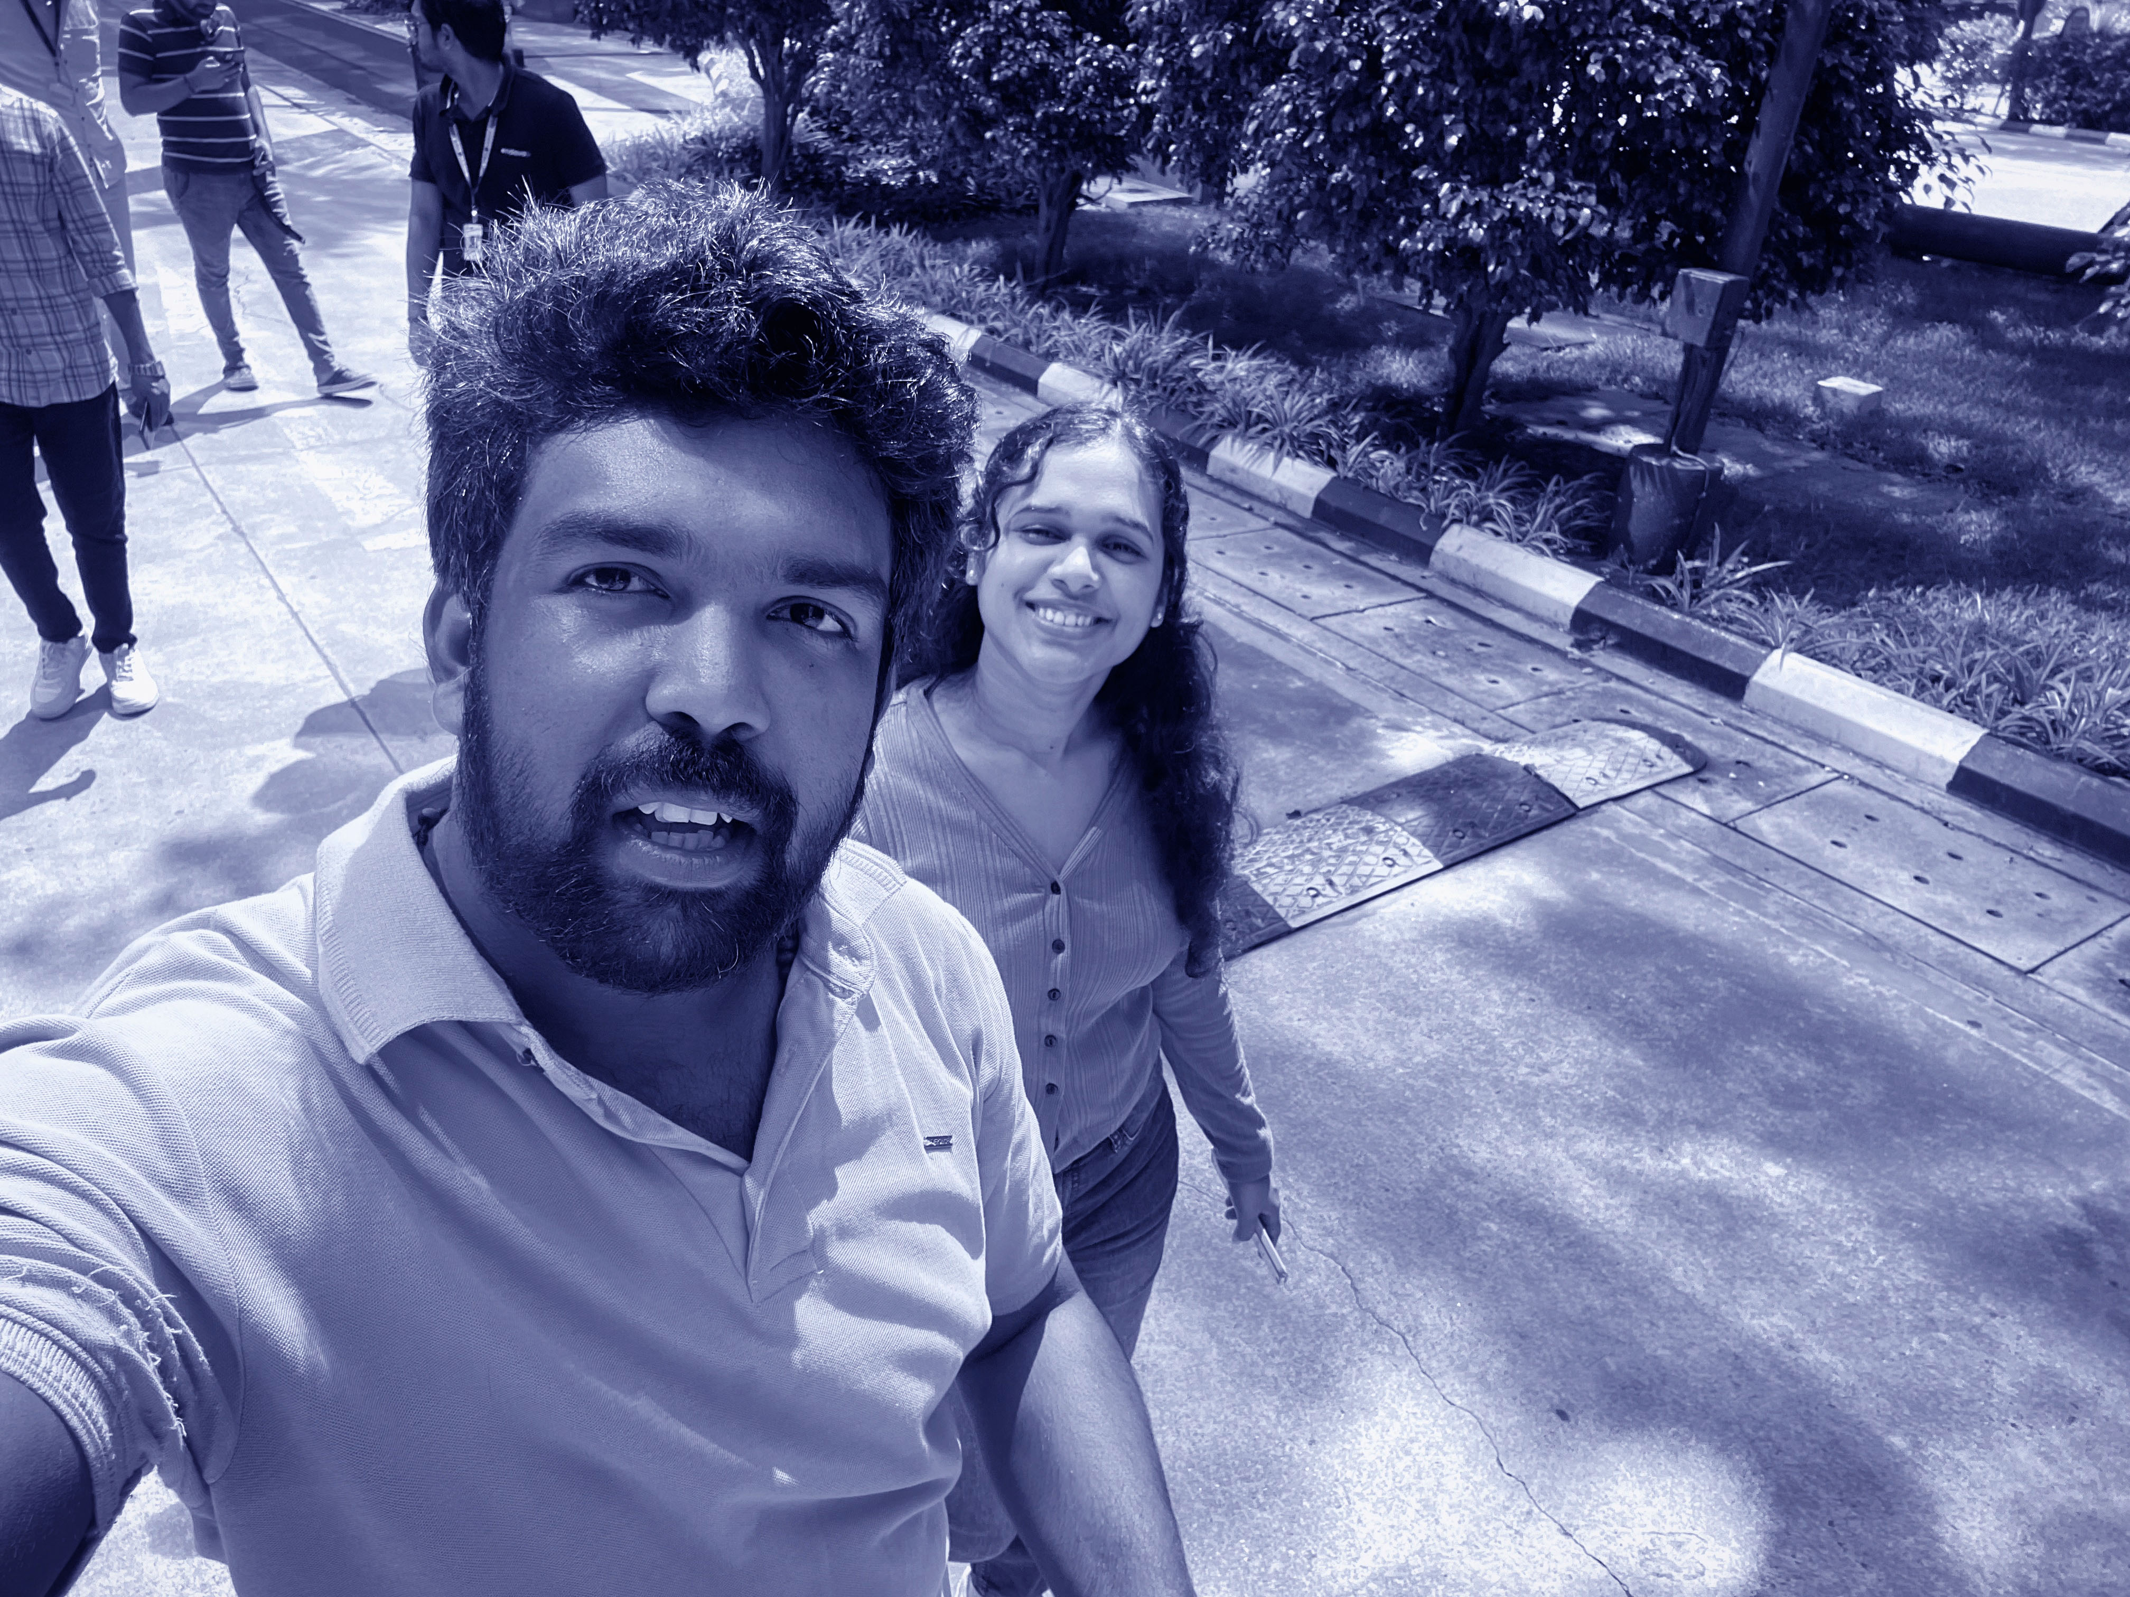
Hello!
We are Jithu Paul and Jahnavi Bodala.
We are here because we love creating ideas that drive innovation..

Slide 3
Great ideas become powerful innovations when intelligence, automation, and purpose come together to solve real-world challenges effectively.

Slide 4


Executive Summary

Slide 5
Executive Summary
AI system identifies and automates high-volume repetitive tasks.
Integrates Unity API, GDAT API, OEM telemetry for intelligent decision-making.
Reduces manual workload and improves operational consistency.
Delivers measurable ROI through time and cost savings.

Slide 6








Introduction

Slide 7
Introduction
Traditional ticket workflows rely heavily on manual analysis.
Project Forge uses AI to learn recurring patterns.
Automates task execution end-to-end across enterprise environments.

Slide 8
Problem Statement
No Measurable Operational Insights
There is no unified system to track ROI or measure the true impact of automation.
1
Lack of Intelligent Automation
Delays, human errors, increased MTTR, and no automated OEM/GDAT validation result from missing automation.
2
High Manual Workload
Thousands of Unity/Jira tickets still require heavy manual triage, causing operational slowdowns.
3

Slide 9
Solution Objective
ANALYSIS
Identify repetitive tasks from past ticket patterns.
SELECTION
Prioritize tasks based on volume and impact.
DEVELOPMENT
Develop automation scripts using Python or PowerShell.
EXPOSURE
Expose automation workflows through secure MCP APIs.
MEASUREMENT
Track time saved and automation efficiency continuously.
SCALABILITY
AI improves accuracy and scales automation over time.

Slide 10
Challenges & Gaps
OVERLOAD
Manual ticket analysis consumes significant time and effort daily.
REPETITION
Large volumes of repetitive, low-value tasks reduce operational efficiency.
OEM and GDAT verification steps slow down ticket processing.
Bottlenecks
No automated ROI analytics to measure automation effectiveness.
Blindspots

Slide 11
Solution Overview
Traditional ticket workflows rely heavily on manual analysis.
Automates task execution end-to-end across enterprise environments.
Extract data intelligently from Unity, GDAT, and OEM sources.
Automate selected tasks using scripts exposed through MCP APIs.
Extract
Analyze
Automate
Measure
Analyze patterns to identify repetitive tickets requiring automation.
Measure ROI continuously to track automation impact accurately.

Slide 12
Step 1: Data Extraction
AI connects to Unity API to retrieve 6–12 months of data.
Normalizes and cleans data using pandas.
Tickets stored in PostgreSQL.

Slide 13
Step 2: Pattern Recognition
NLP using Sentence-BERT + spaCy.
Clustering to group related tickets.
Ranking logic identifies top automation candidates.

Slide 14
Step 3: AI Script Generation
AI generates pseudo-script templates.
Automation deployed to Linux Automation Server.
Scheduled daily using cron or Airflow.

Slide 15
Step 4: GDAT Validation
AI queries GDAT REST API.
Extracts environment (PRD/UAT/DEV).
Routes ticket to appropriate OEM environment.

Slide 16
Step 5: OEM Metric Verification
AI queries OEM 13c API.
Analyzes CPU/tablespace/password metrics.
Performs automatic closure if severity is cleared.

Slide 17
Step 6: Continuous Automation
AI queries OEM 13c API.
Analyzes CPU/tablespace/password metrics.
Performs automatic closure if severity is cleared.

Slide 18

ROI Formula

Slide 19
ROI Formula
A = Avg. minutes to manually resolve ticket.
B = Number of such tickets per year.
C = Avg. engineer cost per hour.
Time Saved = (A × B) / 60
Cost Saved = Time Saved × C

Slide 20
ROI Example
A = 10 minutes
B = 3000 tickets
C = ₹600/hour
Time Saved = 500 hours/year
Cost Saved = ₹3,00,000/year

Slide 21
Automation Components

Slide 22
Automation Components
Data Cleaning
Ipandas, PostgreSQL – Used to clean, structure, and normalize large ticket datasets to ensure accurate analysis and automation readiness.
NLP
BERT, spaCy – Processes and understands ticket text, extracting patterns and similarities to identify tasks suitable for automation.
Scheduling
Cron, Airflow – Automates routine job execution, ensuring scripts run reliably at scheduled intervals without manual involvement.
Dashboards
Power BI, Tableau – Creates interactive visual reports to monitor automation performance, ticket trends, and ROI insights
Security
CyberArk – Protects credentials and manages secure access for automation scripts interacting with enterprise systems.
CI/CD
GitLab, Jenkins – Provides automated build, testing, and deployment pipelines to continuously deliver updated automation scripts.

Slide 23
Solution Workflow

Slide 24
Expected Benefits
Automated ticket intelligence.
Reduced manual repetitive work.
Faster OEM/GDAT verification.
Real-time ROI tracking.
Scalable AI-driven operations.

Slide 25
Conclusion
Project Forge transforms repetitive DBA tasks into an AI-driven workflow.
Provides measurable ROI and improved operational efficiency.
Scalable to other IT domains beyond DBA.

Slide 26

Thanks!

