Slide 1

📊 Exploratory Data Analysis (EDA)
✈️ On Airline Flight Data
Jithin Kumar

Slide 2
🔍 Key Business Questions
1. Airline with highest average flight duration
2. Longest source–destination average durations
3. Flights per airline and class (Business/Economy)
4. Departure time of day with longest durations
5. Airlines with fewest unique routes
6. Non-stop vs connecting flight costs
7. Top 5 most frequent flight routes
8. Cities with most departures
9. Do last-minute bookings cost more?
10. Airline dominance on certain routes

Slide 3
Dataset
Consists of 11 Columns with data and 1 Index column.
Has 0 Null or NaN values.
SpiceJet, Air Asia, Vistara, GO_FIRST, Indigo, Air India.
Columns – index, airline, flight, source city, departure time, stops, arrival time, destination city, class, duration, days left, price
An already pre-processed and cleaned dataset.

Slide 4
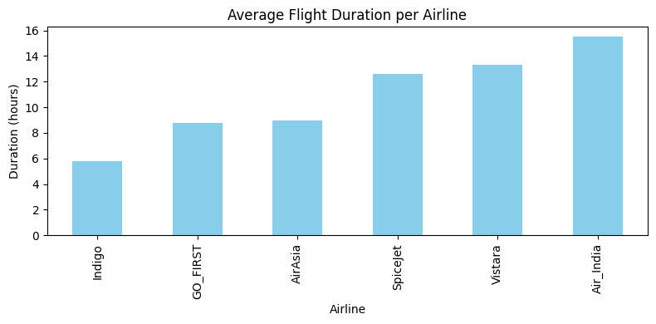
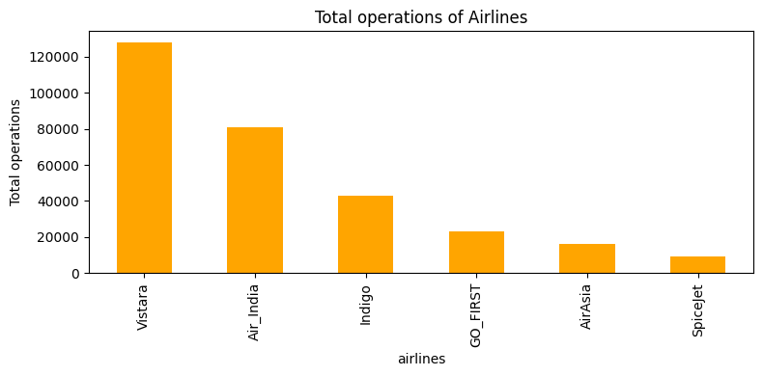
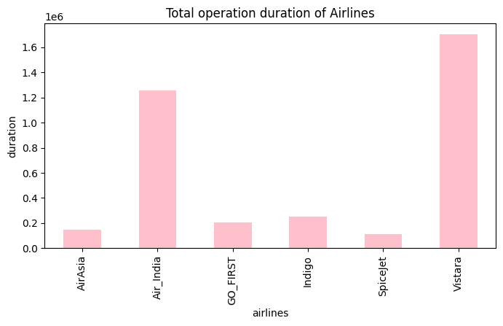
Q1- Which airline has the highest average flight duration?
Air India has higher average flight duration with less operations than Vistara, which means Air India operates more longer flights.
Vistara has the highest total operational duration.

Slide 5
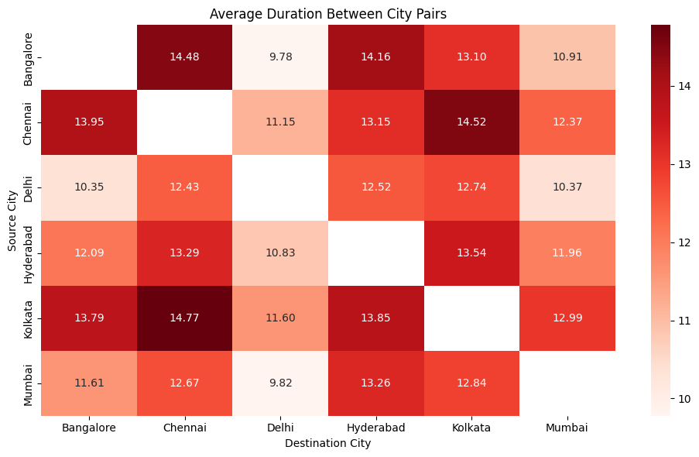
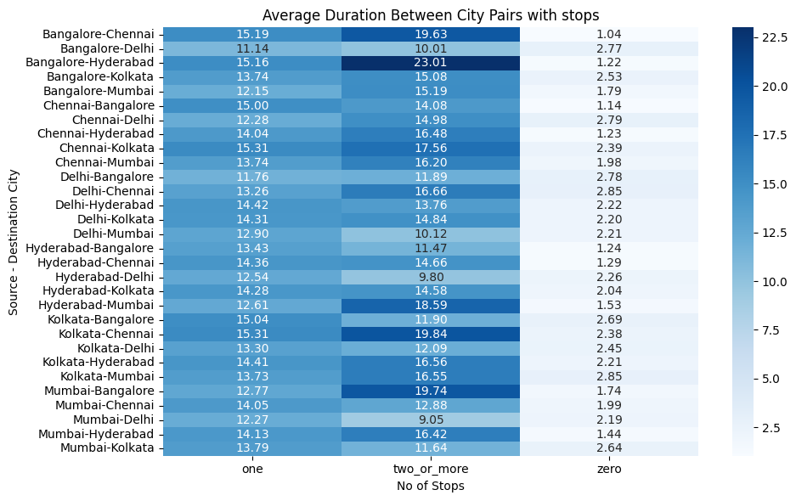
Q2- Which source–destination city pairs have the longest average duration?
On an average the routes between Kolkata to Chennai and vice versa seems to have a longer duration of flight. Considering the geography this seems valid. But as we look closer the Bangalore to Chennai routes are also having an higher average even though they are comparatively closer in distance.
With the second heatmap we can find that the factors affecting the average duration are the stops or layovers in between the flights.

Slide 6
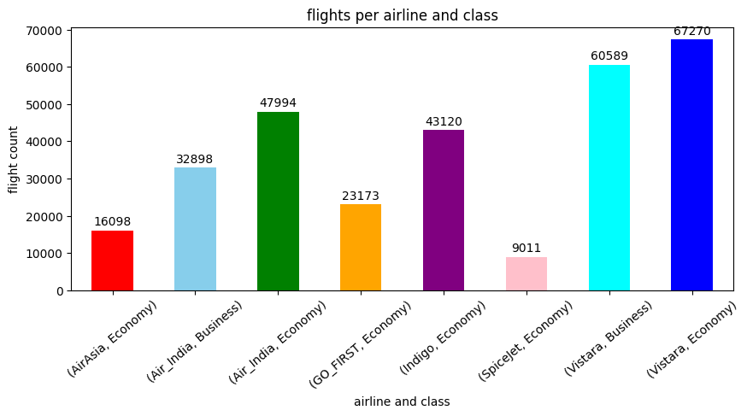
Q3 - How many flights are recorded per airline and class?
From this bar graph we can find that Air India and Vistara are the only airlines that provide both passenger classes(Business, Economy).
As per the graph Vistara’s Economy flights are involved in more operations, also competing almost equally with its own Business class flights.
With Air India coming second and Spicejet at last in terms of operations.

Slide 7
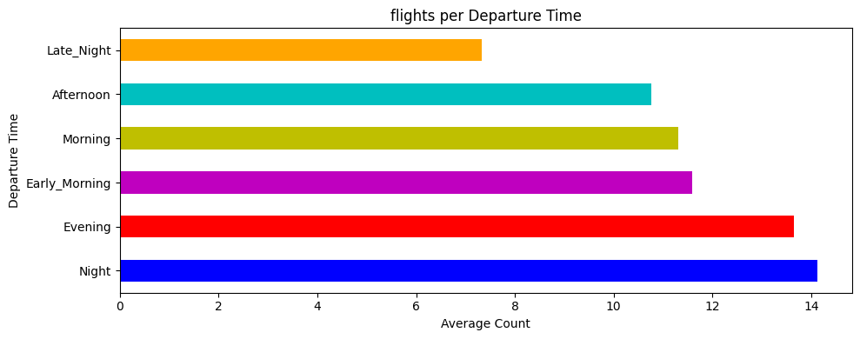
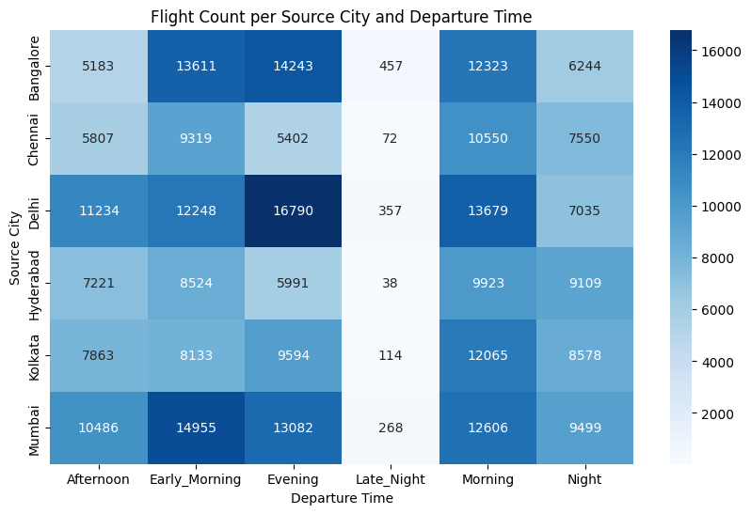
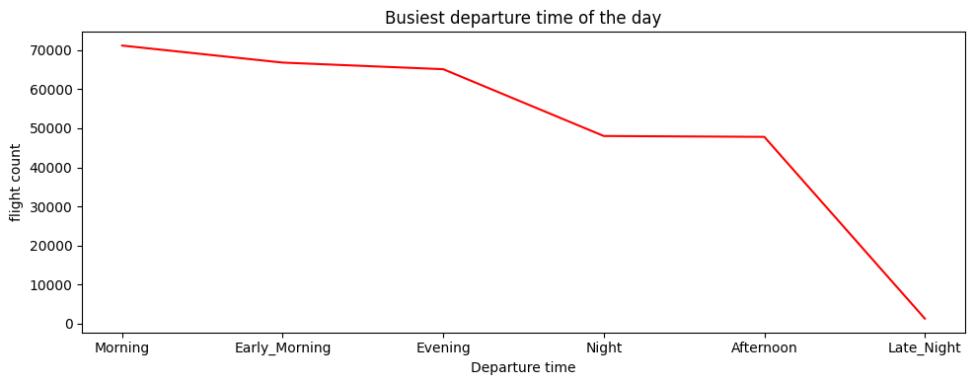
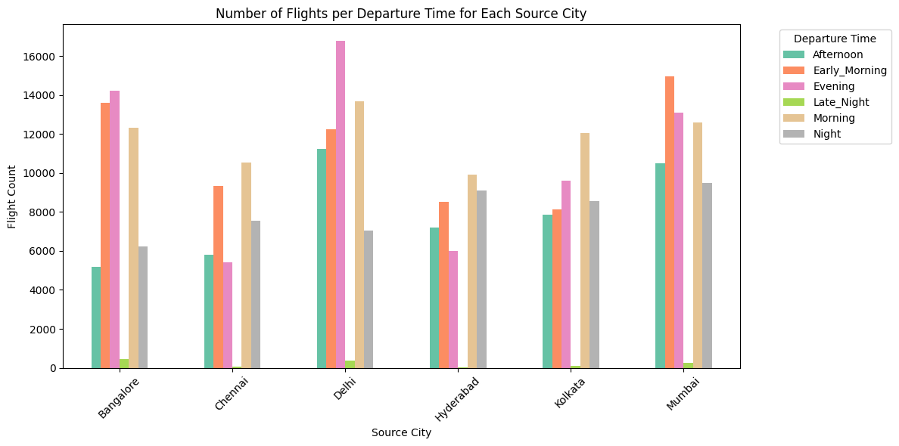
Q4- Which time of day (Departure Time) has the longest average durations?

Slide 8
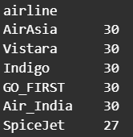
Starting of with analysing the average longest flight duration with respect to the departure time, ended up with getting more insights from the data like overall busiest time of the day and further finding the busiest origin or source city along with finding the busiest departure time for each source city.
Flights departing at nights tend to have an higher average flight durations.(Horizontal bar plot)
Overall Mornings are the busiest and Late nights are the less busiest departure time of the day.(Line graph)
With Delhi being the most busiest source city among the other cities with Evenings being the most busier Departure time in Delhi.
---------------------------------------------------------------------------------------------------------------
Q5- Which airlines operate the least unique routes?
Spicejet has the least unique operating routes with 3 routes lesser than the other, the other airlines have the similar operating routes.

Slide 9
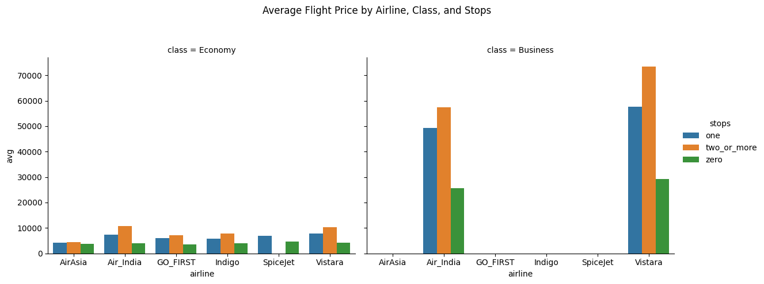
Q6- Do non-stop flights cost more than connecting ones for the same route?
As per the analyses and visualisation we can see that on an average non-stop flights are cheaper than the one, two or more stops. And this trend is almost same for all the airlines and classes.
This can be due to various factors like extra landing, take-off, ground and air services etc than the non-stop flights.

Slide 10
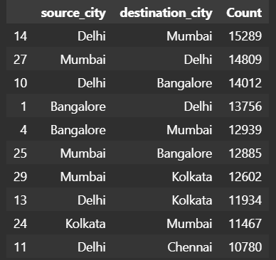
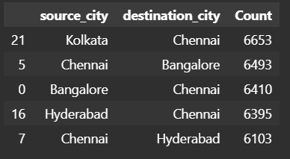
Q7- What are the top 5 most frequent flight routes?
These two tables represent the top 5 most and least frequent flight routes.
Delhi to Mumbai and vice versa are the top most frequent routes.
Chennai to Hyderabad and vice versa are the least frequent routes.

Slide 11
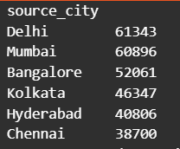
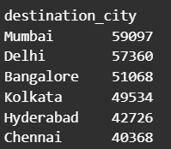
Q8- Which source cities have the most departures?
Delhi is the busiest source or departure city
Mumbai being the busiest arrival or destination city
Overall Mumbai is busier in the total arrival and departure combined

Slide 12
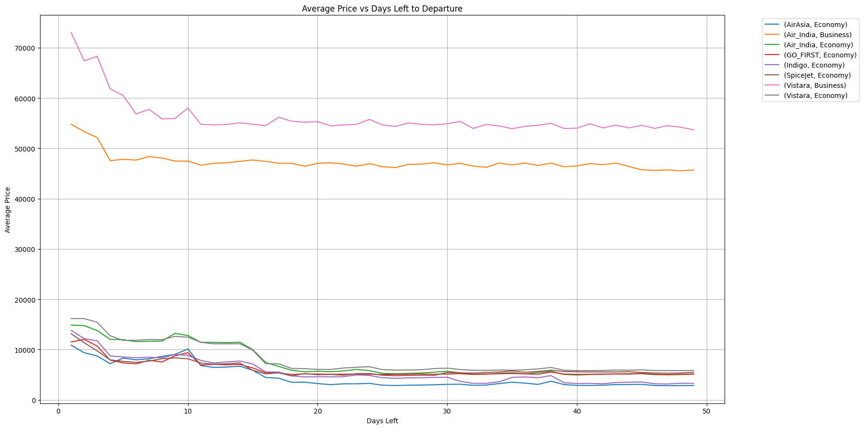
Q9- Do last-minute bookings (low days left) cost more than early bookings?
From the line graph we can see a downward trend in the lines representing the price.
This means the price tend to be higher or costlier when the days are less to the departure day and much more cheaper for early bookings.
We can also see the lines are not a smooth curve and have fluctuations in between, this is because of various reason like holidays, weekends, or seasonal months etc which can directly affect the price due to demand

Slide 13
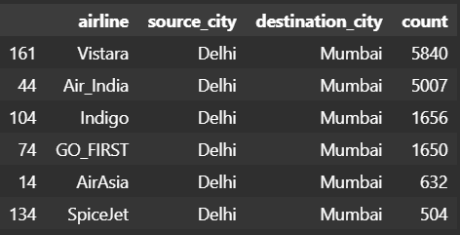
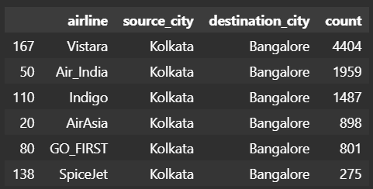
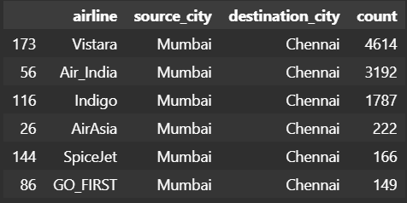
Q10- Do certain airlines dominate specific routes or regions?
In this we can see Vistara being dominant in all these three route pairs and Air India being the second

Slide 14
🧠 Sample Insights & Takeaways
Vistara being one of the overall better airline with various networking and faster flight routes offering both classes.
Morning being the most busiest
Late nights being less busier
Delhi an Mumbai being most busiest cities
SpiceJet being the outlier or under performer.
Non-stop flights cost less than connecting Flights
Last-minute bookings tend to be expensive
Vistara dominates the routes

