Slide 1
welcome

Slide 2
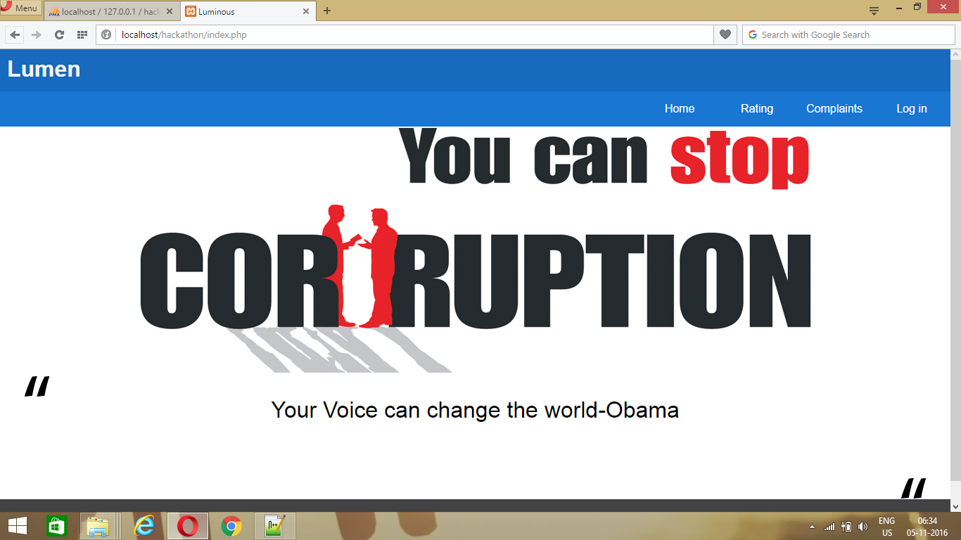
HOME PAGE

Slide 3
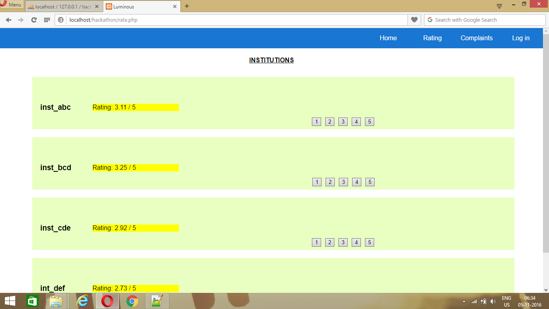
RATING

Slide 4
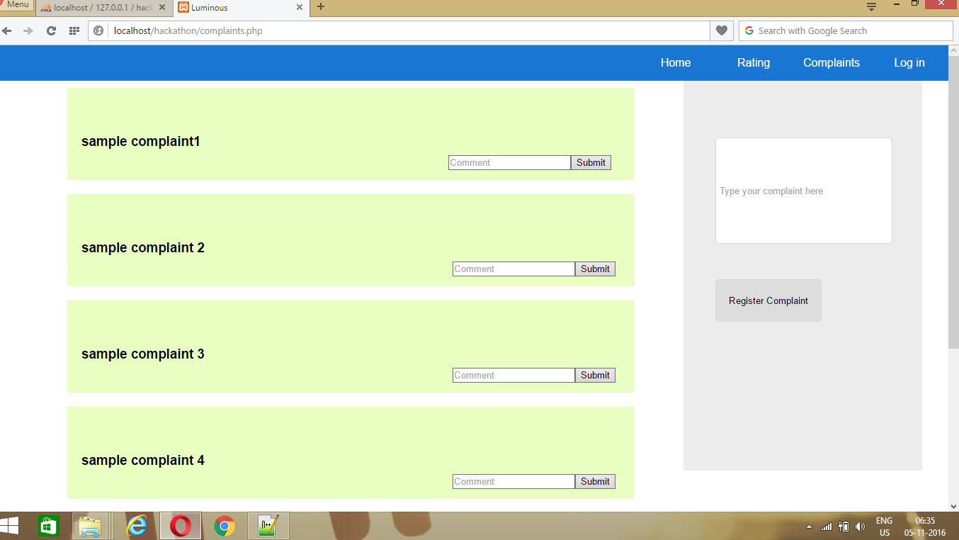
COMPLAINTS

Slide 5
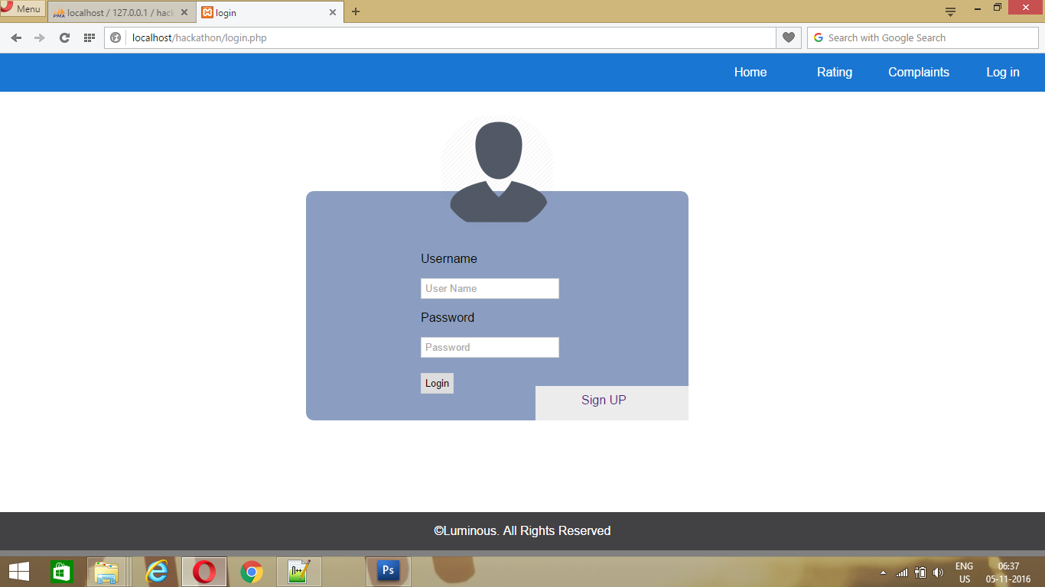
LOGIN

Slide 6
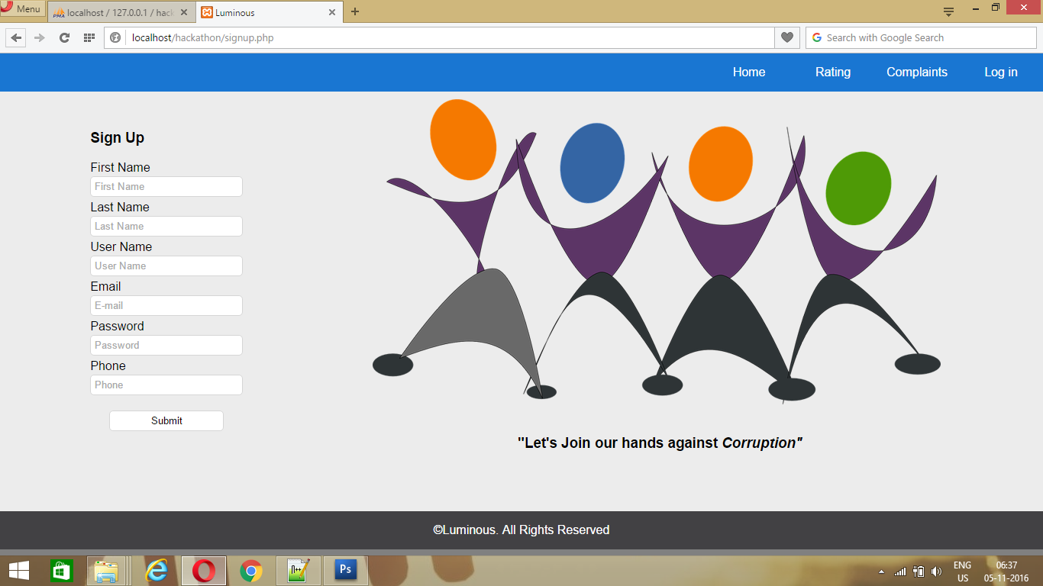
SIGN-UP

Slide 7
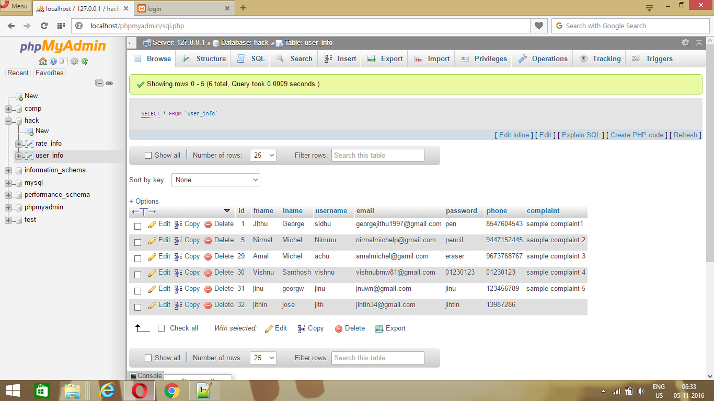
DATABASE

Slide 8
THANK YOU..

