Slide 1
PACKER AND MOVER
Guide name Presented by,
Ms. Fathima A Akshaya N
Roll no: 7

Slide 2
ABSTRACT
Packer and Mover is a project which is developed to provide a interactive platform between clients and packer and mover company. This project provides best and reliable services in relocating. Clients can book the services through this web portal. This Project provides useful information to clients in the process of relocating their house. . Packer and mover agency works according to the needs and requirement of the customers and provide them the desirable results. The packer and mover agencies uses best quality packing materials to pack our goods in such a way that all goods remain in safe condition during transit &moving services assure the safe delivery of our goods at our destination.
In a new place we can’t find a good workers for our home at a short period of time . but here the workers can register to the app and all user can view the available workers and contact them for our home works.

Slide 3
MODULES
Admin
Login
Add and manage driver
Approve freight worker
Add and manage vehicle
View request and update status
Assign work and vehicle to driver
View drivers rating
Block driver
View bill information
View rescheduled request and assign work to driver
View freight workers rating
User
Register
Login
Send request
View request status
Track request
Add rate to driver
View driver bill
Scan QR code
Request freight worker
View freight worker bill
Add rate to freight worker

Slide 4
Driver
Login
View assigned works and update status
Rescheduled request
View rescheduled work
Update location
Generate bill
Freight worker
Register
Login
View request and update status
bill generation

Slide 5

Data Flow Diagram
Level 0

Slide 6
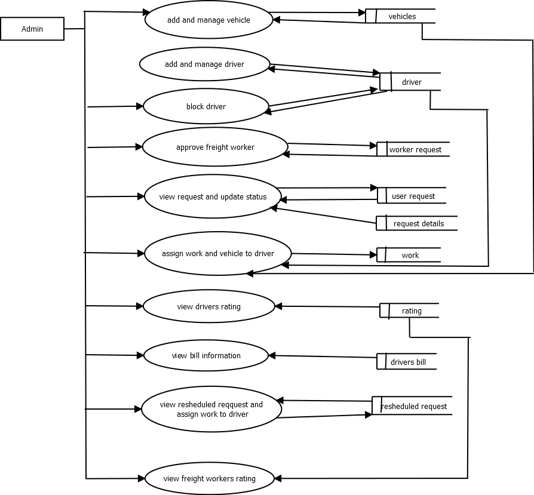
Level 1.1

Slide 7
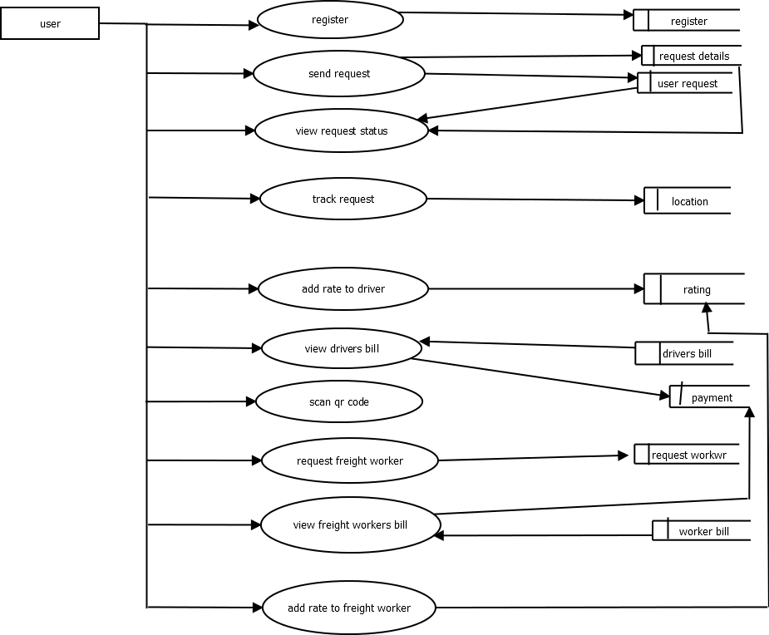
Level 1.2

Slide 8
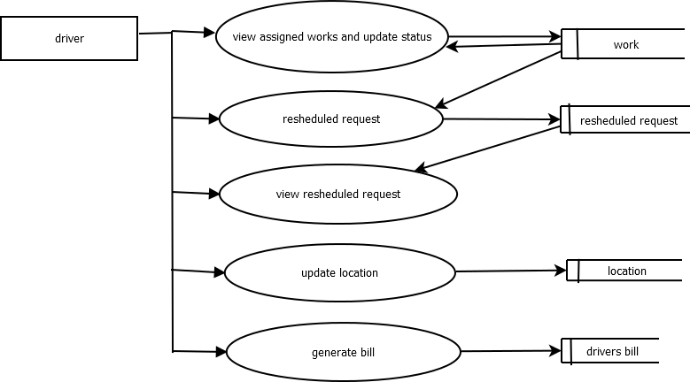
Level 1.3

Slide 9
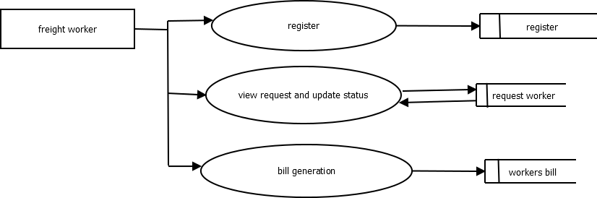
Level 1.4

Slide 10
TABLES

Slide 11
driver
Field | Datatype | constraints
D_id | int | Primary key
username | Varchar(50) | notnull
password | Varchar(50) | notnull
First name | Varchar(50) | notnull
Last name | Varchar(50) | null
Phone no | Varchar(20) | notnull
Date of birth | Date | notnull
License no | Varchar(50) | notnull
House name | Varchar(50) | notnull
place | Varchar(50) | notnull
post | Varchar(50) | notnull
City | Varchar(50) | notnull
district | Varchar(50) | notnull
state | Varchar(50) | notnull
pin | int | notnull

Slide 12
registration
Field | Datatype | Constraints
u_id | int | Primary key
username | Varchar(50) | notnull
password | Varchar(50) | notnull
First name | Varchar(50) | notnull
Last name | Varchar(50) | null
Phone no | Varchar(50) | notnull
Date of birth | Varchar(50) | notnull
House name | Varchar(50) | notnull
place | Varchar(50) | notnull
city | Varchar(50) | notnull
district | Varchar(50) | notnull
state | Varchar(50) | notnull
pin | Varchar(50) | notnull
Category | Varchar(50) | notnull

Slide 13
vehicles
Field | Datatype | Constraints
V_id | Int | Primary key
Vehicle_type | Varchar(50) | notnull
Rc_details | Varchar(50) | notnull
photo | Varchar(50) | Notnull

Slide 14
user request
Field | Datatype | Constraints
Ur_id | int | Primary key
u_id | int | Foregin key
date | DateTime | notnull
Request | Varchar(50) | notnull
status | Varchar(50) | notnull
latitude | Varchar(50) | notnull
longitude | Varchar(50) | notnull

Slide 15
request details
Field | datatype | constraints
rd_id | int | Primary key
Ur_id | int | Foreign key
Item name | Varchar(50) | notnull
count | int | notnull

Slide 16
work
field | datatype | constraints
W_id | int | Primary key
Ur_id | int | Foreign key
D_id | int | Foreign key
V_id | Int | Foreign key
status | Varchar(50) | notnull

Slide 17
driver bill
Field | datatype | constraints
Db_id | int | Primary key
W_id | int | Foreign key
Date | DateTime | notnull
charge | bigint | notnull
km | Varchar(50) | notnull
status | Varchar(50) | notnull

Slide 18
rescheduled request
Field | datatype | constraints
Resh_id | int | Primary key
W_id | int | Foreign key
D_id | int | Foreign key
reason | Varchar(50) | notnull
status | Varchar(50) | notnull

Slide 19
rating
field | datatype | constraints
Rtg_id | int | Primary key
u_id | int | Foreign key
type | Varchar(50) | notnull
rate | Varchar(50) | notnull

Slide 20
request worker
Field | datatype | constraints
Wr_id | int | Primary key
u_id | int | Foreign key
W_id | int | Foreign key
request | Varchar(50) | notnull

Slide 21
worker bill
Field | Datatype | Constraints
Wb_id | int | Primary key
Wr_id | int | Foreign key
Date | DateTime | notnull
charge | Varchar(50) | notnull
status | Varchar(50) | notnull

Slide 22
location
Field | Datatype | Constraints
Loc_id | int | Primary key
D_id | Int | Foreign key
latitude | Varchar(50) | notnull
longitude | Varchar(50) | notnull

Slide 23
payment
Field | Datatype | Constraints
P_id | int | Primary key
u_id | int | Foreign key
bank | Varchar(50) | notnull
Ifsc code | Varchar(50) | notnull
Account _no | bigint | notnull
Balance | bigint | notnull

Slide 24
THANK YOU

