Slide 1
MOTION CAPTURE TECHNOLOGY
GUIDE NAME, PRESENTED BY,
Ms. Anagha PB Akshaya n
Roll no:7

Slide 2
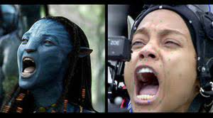
"Motion Capture" is the term used to describe the process of recording human movement and translating that movement onto a digital model.
In film making it refers to recording the actions of human actors, and using that information to animate digital character models in 2D or 3D computer animation. When it includes face, fingers and captures subtle expressions, it is often referred to as performance capture in motion capture sessions.
Also known as “Mo-Cap, Real-Time Animation or Performance capture”.

Slide 3
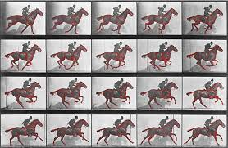
History of Motion Capture
The motion capture began in late 1800’s when Etienne Jules Marey and Edward Muybridge preformed motion studies on various animals and humans.
Historically, Motion Capture in animated movies was created using the extension of ‘ROTOSCOPING’ technique.
Animation is a method in which figures are manipulated to appear as moving images.
A “ROTOSCOPING” is a device that enables animators to trace live action movement, frame by frame, for use in animation.

Slide 4
Current motion capture systems
Electromagnetic motion capture: This approach has a central magnet with several receivers attached to the actors’s body. The receivers capture and record the actors movements and save them to the computer.
Electromechanical motion capture: it use potentiometers on the aforementioned plastic exoskeleton that an actor must “wear”, and then act out his or her movements. This is very accurate and transmits real-time data at a far greater range then any other technology.
Optical motion capture:
Reflective markers
Cameras digitize different views of performance.

Slide 5
Applications
Entertainment
Sports
Medicine
Science/Engineering

