Slide 1
git

Slide 2
Topics
Architecture
Branching
Merge Conflicts
Remotes
Github/Gitlab/BitBucket
Branching Strategy – Git Flow
Best Practice

Slide 3
Architecture

Slide 4
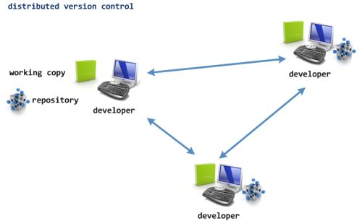
Architecture: Distributed Version Control

Slide 5
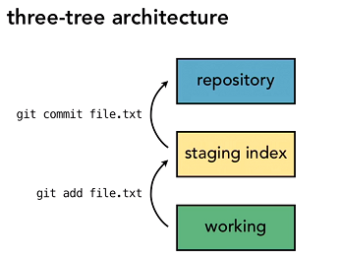
Architecture: Three-Tree Architecture
Traditional/Common
git

Slide 6
Architecture: Commit Data Integrity
Every time you commit a set of changes into the git repository

Slide 7
Architecture: Commit Data Integrity
Git generates a 40 character SHA-1 hash of:
Your change set data
The author
The Commit message
The SHA of the previous commit

Slide 8
Architecture: Commit Data Integrity
This SHA is the commit ID

Slide 9
Architecture: Commit Data Integrity
2. The commit is added to the repository, along with a pointer to its previous commit
The previous commit of the current commit is referred to as its parent.

Slide 10
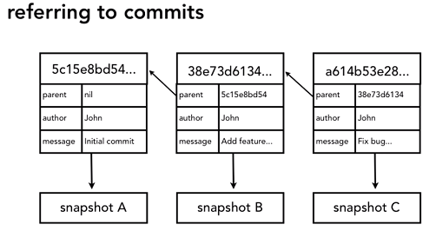
Architecture: Commit Data Integrity

Slide 11
Some Terminology

Slide 12
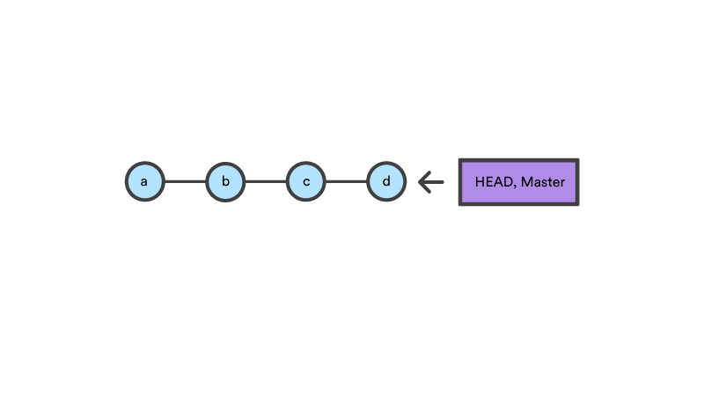
Terminology: The HEAD Pointer
A pointer to the tip of the current branch in the repository.
A pointer to the parent of the next commit.

Slide 13
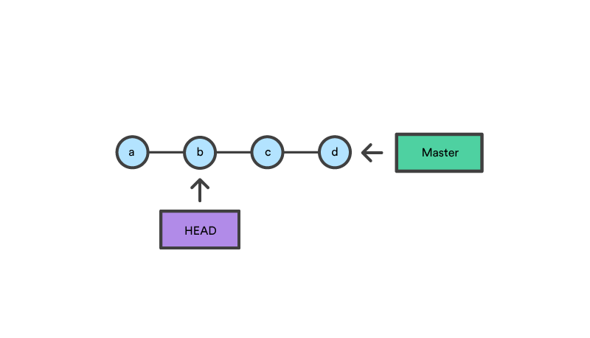
Terminology: The HEAD Pointer
The HEAD can be moved, like rewinding a cassette tape.

Slide 14
Terminology: tree-ish
A tree-ish refers to:
A SHA commit ID
The HEAD pointer
A branch reference
A tag reference

Slide 15
Demo 1

Slide 16
Demo 1
Create a new git repo
Make changes and commit
Make more changes
Undo changes between the three trees

Slide 17
Demo 1: Lessons
Your git workflow is:
Make changes → Stage changes → Commit changes

Slide 18
Demo 1: Lessons
Use git add to start tracking untracked files, and add them to staging

Slide 19
Demo 1: Lessons
Use git diff to view the difference between tracked files in your working directory and your repo.
Use git diff --staged to view the difference between staging and your repo

Slide 20
Demo 1: Lessons
Use git reset --soft <tree-ish> to move changes from the repo to staging
Use git reset --mixed <tree-ish> to move changes from the repo and staging
Use git reset --hard <tree-ish> to completely undo changes on all 3 trees

Slide 21
Demo 1: Lessons
Use git reset --soft <tree-ish> to move changes from the repo to staging
Use git reset --mixed <tree-ish> to move changes from the repo and staging
Use git reset --hard <tree-ish> to completely undo changes on all 3 trees

Slide 22
Demo 1: Lessons
You can also use:
git checkout BRANCH|FILE|TAG|COMMIT
To do similar things like reset.
Reset is a more convenient way of undoing changes.

Slide 23
Branching

Slide 24
Branching
Branches in git are:
Cheap
Quick
Encouraged to be abused

Slide 25
Branching
By default, your primary branch is called master

Slide 26

Branching: Merging
Fast-forward Merge
When the branch you merge into has no new commits, git simply moves the HEAD pointer to the tip of the other branch.
This behaviour can be changed.

Slide 27
Branching: Merging
True Merge
A merge is treated as a new commit.
This is always done if the branch you’re merging into has new commits.
If there are no new commits, Git will do a FF merge. For log history reasons, you can override it by forcing a true merge.

Slide 28
Merge Conflicts

Slide 29
Merge Conflicts: Definition
Occurs when there are competing changes in the same lines by two different commits.
Git can’t decide which commit to use.

Slide 30
Merge Conflicts: What Happens
Git will switch to a new branch, its name in the format:
CURRENT_BRANCH|MERGING
2. A conflict file will be created which will have the conflicting sections from each file in it.

Slide 31
Merge Conflicts: Options to Resolve
Abort the merge
Resolve the merge manually
Use a Merge Resolve tool (won’t be covered here)

Slide 32
Merge Conflicts: Abort a merge
git merge --abort

Slide 33
Merge Conflicts: Manual Conflict Resolution
Type git status to see the conflict files created.
Open the conflict files, and delete the sections you don’t want to use.
git add the resolved conflict files.
Commit the files.

Slide 34
Demo 2

Slide 35
Demo 2
Create two new branches
Show FF merge and true merge
Resolve a conflict

Slide 36
Remotes

Slide 37
Remotes
A remote is a common repository for your team to store code
You can have multiple remotes if you wish

Slide 38
Remotes
To add a new remote to your local git repository:
git remote add ALIAS URL

Slide 39
Remotes
By convention, we call the primary remote origin.
It is also the default name used by git when you clone/push a branch for the first time.

Slide 40
Remotes
When dealing with a new remote, we have one of two scenarios:
We want to create a new repository based off a remote.
We want a remote to match our repository branch.

Slide 41
Remotes: Scenario One
Create a new repository based off a remote
git clone URL

Slide 42
Remotes: Scenario Two
Remote should match our repository branch
git push –u ALIAS BRANCH
“-u” is only used once, as it creates a tracking branch
If you’re updating an existing remote branch, you may need to pull before you can push.

Slide 43
Remotes: Tracking Remote Branches
Git creates another branch locally to track a remote branch
This branch cannot be checked out.
It is in the named in the format: {alias}/{branch}
e.g. origin/master

Slide 44
Remotes: Workflow
Do your commits locally

Slide 45
Remotes: Workflow
2. Perform a fetch to update all tracking branches:
git fetch

Slide 46
Remotes: Workflow
3. Do a diff with your local branch and its tracking branch to see if you’re happy to merge
git diff origin/master master

Slide 47
Remotes: Workflow
4. If you’re comfortable to merge:
git merge origin/master

Slide 48
Remotes: Workflow
OR you could use:
git pull

Slide 49
Remotes: Workflow
5. Once your branch is synced with the remote, push the changes:
git push*
* If you have not setup a tracking branch it needs to be: git push ALIAS BRANCH

Slide 50
Remotes: Guidelines
Always fetch before you work. Then decide what to do with you.
2. Fetch before you push.
3. Fetch often - it's not destructive, so it's safe to do.

Slide 51
Github/GitLab/BitBucket

Slide 52
Github/GitLab/BitBucket
This is a repository hosting service.
In addition to typical git functionality they provide:
Cloud-based git repository hosting (or on-prem as well)
UI tools for managing the git repo
Assignment of roles for team members
Markdown rendered wikis
Most famous – pull requests.

Slide 53
Branching Strategies

Slide 54
Branching Strategies: Common Roles

Slide 55
Branching Strategies: Types of Branches

Slide 56
Branching Strategies: Long Running Branches
Long running branches always remain open and store the history of the project.
A trunk or master branch stores the current release of the project in production.
The develop branch will have ongoing feature development (most up-to-date common branch).

Slide 57
Branching Strategies: Types of Branches

Slide 58
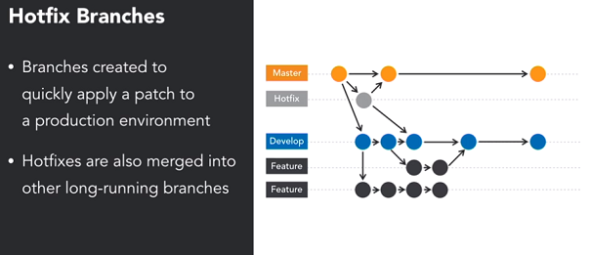
Branching Strategies: Types of Branches

Slide 59
Branching Strategies: Git Flow
https://nvie.com/posts/a-successful-git-branching-model/

Slide 60
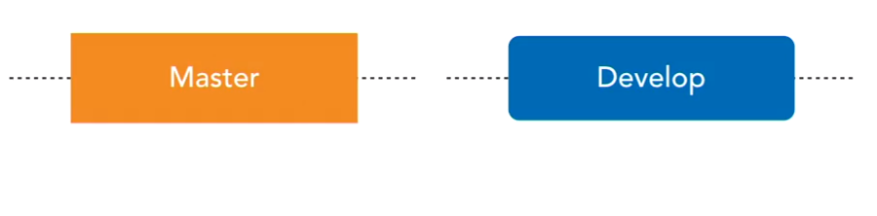
Branching Strategies: Git Flow
Git flow revolves around two long lived branches: Master and Develop.
The Master branch is tightly controlled.
The Develop branch is used by everyone to build feature branches.

Slide 61
Branching Strategies: Git Flow

Slide 62
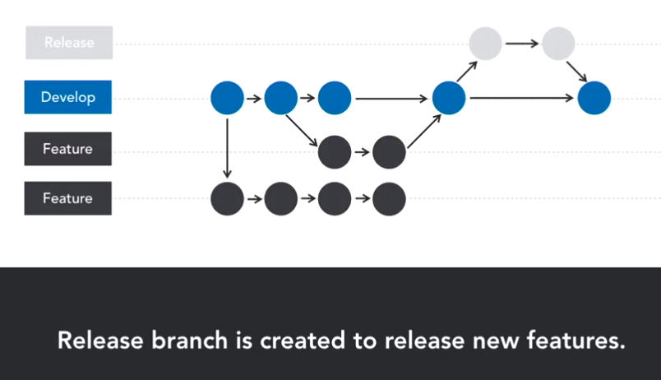
Branching Strategies: Git Flow

Slide 63
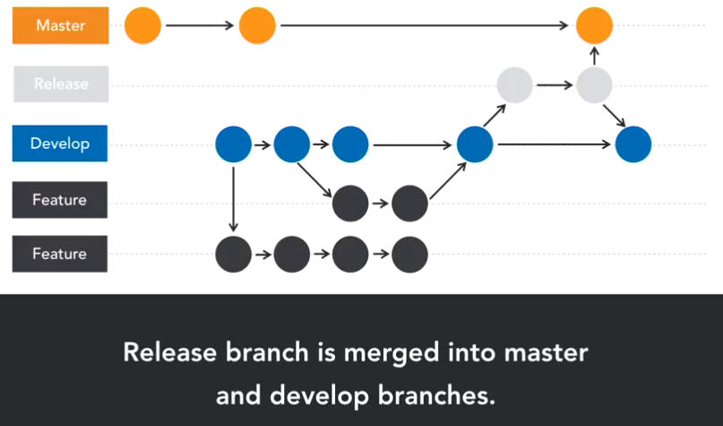
Branching Strategies: Git Flow

Slide 64
Best Practices

Slide 65
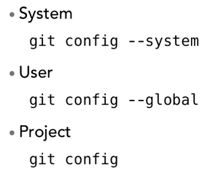
Best Practices: Configuration
There are 3 levels you can set configuration for Git:

Slide 66
Best Practices: Global Configuration
git config --global user.name "Jithya Nanayakkara“
git config --global user.email someone@nowhere.com
git config --global core.editor "Code”
git config --global color.ui true

Slide 67
Best Practices: Project Configuration
git config commit.template <"path to message template">
# Place a subject above the body, limit to 50 chars
# Specify the body of the commit one line below the subject wrapping at
# 70 characters to keep things neatly organized. Here you should explain
# why the commit was created.
# You can use multiple paragraphs and other formatting to describe the
# commit. Add details as necessary until you have provided enough info
# about the commit.
# - Bullets can be added
# - But should be persistent
# Additionally, work items can be tracked using their id numbers.
# Work Items Resolved: 557, 188, 122

Slide 68
Best Practices: Project Configuration
Use .gitignore to ignore compiled files, log files, etc
Edit .gitignore and add filename patterns
Templates: https://github.com/github/gitignore

Slide 69
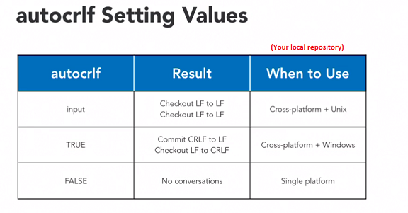
Best Practices: Project Configuration
git config core.autocrlf <value>
This will control how line endings are replaced when you add/checkout a file.

Slide 70
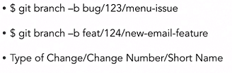
Best Practices: Usage Guidelines
Commit frequently
Fetch frequently – i.e. keep your repository in sync.
Try not to have feature branches that are too complex.
Use descriptive branch names:

Slide 71
Best Practices: Usage Guidelines
Use git rebase to squash commits in your feature branch:
git rebase –i HEAD~n
Where n is the number of commits from the tip of the branch you want to squash

Slide 72
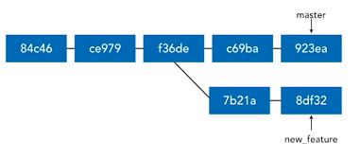
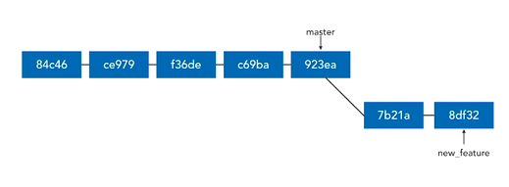
Best Practices: Rebasing
Before Rebase
After Rebase

