Slide 1
JUnit5

Slide 2
Modules
Junit 5 = Platform + Jupiter + Vintage

Slide 3
Architecture

Slide 4
API Walkthrough

Slide 5
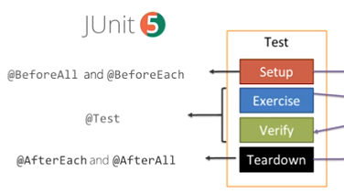
Lifecycle
Every test method must be annotated with @Test
@BeforeAll and @AfterAll must be static methods.
You can use @DisplayName(“Pretty test name”) to give descriptive names to tests

Slide 6
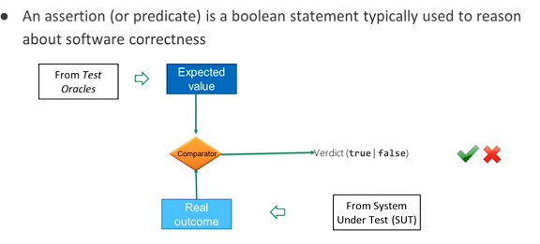
Assertions
Provides a bunch of static Assertion methods in the org.junit.jupiter.Assertions class
Many of their Assertions work with Java 8 lambdas.

Slide 7
Assertions
assertEquals(expected, actual)
assertTrue(expected == actual)
assertFalse(actual == incorrect)
assertAll(“Failure message”, …lambdas that return boolean)

Slide 8
Assertions
assertEquals(expected, actual)
assertTrue(expected == actual)
assertFalse(actual == incorrect)
assertAll(“Failure message”, …lambdas that return boolean)

Slide 9
Assertions
assertThrows(IllegalArgumentException.class,
() -> throw new IllegalArgumentException(“bad argument”),
“Failed test message”);

Slide 10
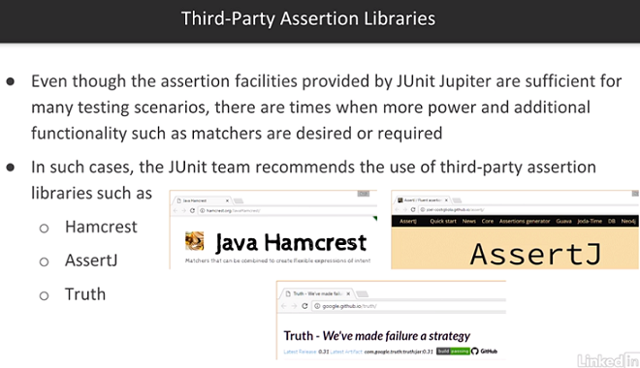
Other Assertion Libraries

