Slide 1
DEPARTMENT OF CSE, CSIT
FUNDAMENTALS OF DATA ENGINEERING
COURSE CODE – 24DEA3101
FOODFLOW -
End-to-End Food Delivery Data Engineering & Analytics Platform
Project Review-3
Under the guidance of
Dr.N.Shirisha
Associate Professor
Team Members:
T.K.Amulya - 2420030434
P. Goda Sahasra - 2420090128
Jithyasri.S - 2420030586

Slide 2


Methodology
FoodFlow follows a structured end-to-end data engineering methodology to collect, integrate, clean, validate, transform, store, and analyze food-delivery data. Data from customer, restaurant, order, payment, delivery, and review systems is collected in formats such as CSV and JSON and ingested using Python and Apache Kafka for batch and optional real-time processing.
The incoming data is processed using Apache Spark, where it is cleaned, transformed, standardized, and integrated. Great Expectations is used for data-quality validation, including checks for missing values, duplicates, invalid entries, and schema inconsistencies. The validated data is stored using MinIO and Apache Parquet, while PostgreSQL provides structured analytical storage.
The integrated data is organized using SQL and a Star Schema for efficient analysis. Random Forest is applied for classification, while SQL queries are used to derive key food-delivery trends and KPIs. Finally, Power BI provides interactive dashboards, with Apache Airflow supporting workflow orchestration and Docker supporting deployment.
Overall Methodology:
Data Sources → Python/Kafka Ingestion → Spark Processing → Data Quality Validation → Storage → Star Schema → Analytics & Random Forest → Power BI Dashboard

Slide 3
Base Paper
A Predictive Data Analytics Methodology for Online Food Delivery
Authors: Mariam Al Akasheh, Nehal Eleyan, Gürdal Ertek
https://doi.org/10.1109/SNAMS58071.2022.10062613
DOI: 10.1109/SNAMS58071.2022.10062613
• Systematic predictive analytics methodology for online food delivery.
• Uses classification and regression algorithms to predict key performance indicators (KPIs).
• Random Forest performed strongly for the prediction tasks.
• The methodology can help identify operational issues and possible root causes.
Relevance to FoodFlow
FoodFlow extends the predictive analytics approach with multi-source ingestion, cleaning, validation, integration, Random Forest classification,
real-time prediction, storage, and dashboard analytics.
Research gap addressed: connecting food-delivery prediction with an end-to-end data-engineering and real-time processing pipeline.

Slide 4
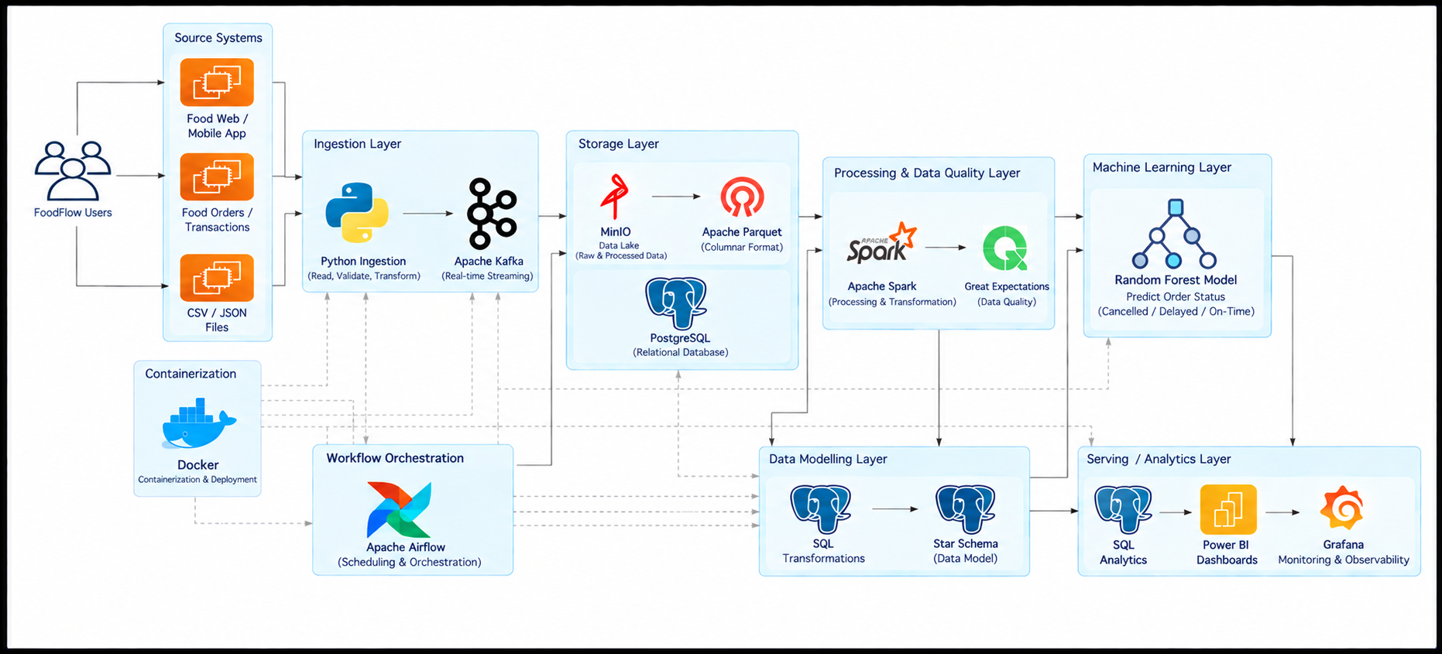
System Design

Slide 5
Architecture
Data Sources: Customer, Restaurant, Order, Payment, Delivery & Review data
Python / Kafka: Batch & real-time data ingestion
Apache Spark: Data processing, cleaning & transformation
Great Expectations: Data quality & validation
MinIO / Parquet: Raw & processed data storage
PostgreSQL: Structured data warehouse
SQL / Star Schema: Dimensional modeling & analytical queries
Random Forest: Data classification & pattern analysis
Apache Airflow: Workflow orchestration
Power BI: Data visualization & KPI dashboards
Docker: Containerized deployment
Overall Flow:
Data Sources → Python/Kafka → Spark Processing → Data Quality → MinIO/Parquet → PostgreSQL & Star Schema → Analytics/Random Forest → Power BI Dashboard

Slide 6
Technology Stack
Category | Technology | Purpose
Programming | Python, PySpark | Pipeline development and distributed data processing
Data Ingestion | CSV, JSON, Apache Kafka | Batch data ingestion and real-time event streaming
Data Processing | Apache Spark | Large-scale data processing, cleaning, and transformation
Data Quality | Great Expectations | Data validation, profiling, and quality checks
Data Lake | MinIO | Scalable object storage for raw and processed data
Data Storage | Apache Parquet, PostgreSQL | Efficient analytical storage and structured data persistence
Data Modeling | SQL, Star Schema | Dimensional modeling and efficient analytical queries
Machine Learning | Random Forest | Classification and pattern analysis
Workflow Orchestration | Apache Airflow | Pipeline scheduling and workflow management
Visualization | Power BI | Interactive dashboards, KPIs, and data visualization
DevOps & Version Control | Docker, Git, GitHub | Containerization, deployment, and source-code management

Slide 7
Use of Modern Technologies
Data Ingestion: Uses Python and Apache Kafka for batch and optional real-time data ingestion from multiple food-delivery sources.
Scalable Data Processing: Apache Spark enables large-scale data cleaning, transformation, and integration.
Automated Data Quality: Great Expectations performs validation checks for missing values, duplicates, invalid records, and schema inconsistencies.
Scalable Data Management: MinIO and Apache Parquet support storage of raw and processed data, while PostgreSQL provides structured analytical storage.
Dimensional Analytics: SQL and Star Schema enable efficient analytical queries across customers, restaurants, orders, payments, and deliveries.
Machine Learning Integration: Random Forest is used for classification and identifying patterns in integrated food-delivery data.
Workflow Orchestration: Apache Airflow supports scheduling and management of data pipeline workflows.
Interactive Visualization: Power BI provides dashboards and KPIs for revenue, orders, delivery performance, cancellations, and restaurant analysis.
Containerized Development: Docker supports consistent deployment and environment management.

Slide 8
Implementation
Developed the FoodFlow data pipeline using Python and Pandas.
Ingested food-delivery data from six source datasets:
Customers, Restaurants, Orders, Payments, Deliveries and Reviews.
Implemented data cleaning to remove duplicates, handle missing values and remove invalid records.
Performed data validation to check data quality and consistency before further processing.
Integrated the datasets using common identifiers such as customer_id, restaurant_id and order_id.
Created an analytics-ready integrated dataset with derived fields such as order hour, order day and order
performance.
Trained a Random Forest classifier to classify orders as Cancelled, Delayed or On-Time.
Developed a Flask Prediction API to serve predictions for new incoming orders.
Implemented a real-time order simulation pipeline that generates new orders and sends them to the
prediction API.
Stored real-time orders and prediction results in SQLite for persistent access.
Developed an interactive Streamlit dashboard for real-time monitoring, analytics and ML confidence
visualization.
Used Git/GitHub for source-code management and version control.

Slide 9

FLOWSYNC
Code Quality and Functionality
Code Quality
Modular Design: Separate modules for ingestion, processing, validation, and analytics.
Readable Code: Clear naming, organized functions, and consistent coding practices.
Error Handling: Handles invalid and inconsistent data through validation.
Version Control: Git and GitHub are used to track changes.
Functionality
Data Ingestion: Python and Kafka collect food-delivery data.
Data Processing: Spark cleans and transforms the data.
Data Validation: Great Expectations checks data quality.
Data Storage: MinIO, Parquet, and PostgreSQL store processed data.
Analytics: Star Schema, SQL, and Random Forest support analysis.
Dashboard: Power BI displays KPIs and food-delivery insights.

Slide 10


FLOWSYNC
Thank You!
Questions & Answers
FoodFlow – End-to-End Food Delivery Data Engineering & Analytics Platform

