Slide 1

Chef Fundamentals Refresher
v1.2.1
Copyright © 2015 Chef Software, Inc.
2-

Slide 2
Lesson Objectives
After completing this lesson, you should be able to:
Create a new Organization
Manually configure your certificate (.pem file) & knife.rb on your workstation so it can communicate with Chef Server
Bulk upload all cookbook, role, environment and data bag files to the Chef Server

Slide 3
Problem Statement
Problem: We want to pick up where we left off after Chef Fundamentals class
Proposed Solution: We need to
Set up a new Organization in Enterprise Chef
Configure your workstation to communicate with new Org
Download the Chef Fundamentals content from a GitHub repo
- cookbooks, data bags, environments and roles
Upload all artifacts to your new Org
Configure server run list
Bootstrap server

Slide 4
Exercise: Set Up a Working Directory
For the purposes of this class, make a working directory under your home directory called '~/intermediate', i.e.
Windows:-
C:\Users\you\intermediate
Mac/*nix:-
/Users/you/intermediate
Navigate to this working Directory

Slide 5
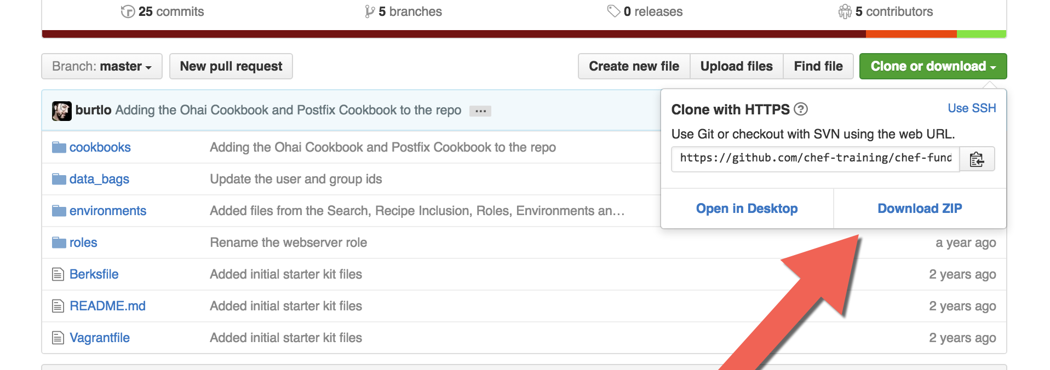
Exercise: Download the Chef Fundamentals Repo
Download the Chef Fundamentals working repo: github.com/chef-training/chef-fundamentals-repo

Slide 6
Exercise: Extract the repo to Your Working Directory
$ cp ~/Downloads/chef-fundamentals-repo-master.zip .
$ unzip chef-fundamentals-repo-master.zip
Archive: chef-fundamentals-repo-master.zip
bb06ea2c0cabaa855e4cb1d1c43bbe4d75caf70d
creating: chef-fundamentals-repo-master/
inflating: chef-fundamentals-repo-master/Berksfile
inflating: chef-fundamentals-repo-master/README.md inflating: chef-fundamentals-repo-master/Vagrantfile
creating: chef-fundamentals-repo-master/cookbooks/
creating: chef-fundamentals-repo-master/cookbooks/apache/
inflating: chef-fundamentals-repo-master/cookbooks/apache/CHANGELOG.md
inflating: chef-fundamentals-repo-master/cookbooks/apache/README.md
inflating: chef-fundamentals-repo-master/cookbooks/apache/attributes/
inflating: chef-fundamentals-repo-master
...

Slide 7
Exercise: View Your Working Directory
$ cd chef-fundamentals-repo-master
$ ls -a
. Berksfile Vagrantfile data_bags roles
.. README.md cookbooks environments
Notice there is no '.chef' directory here
You need to create one and place your 'knife.rb' file and your 'client.pem' in it

Slide 8
So What's in Our Working Directory Now?
cookbooks
├── apache
├── chef-client
├── chef_handler
├── cron
├── logrotate
├── motd
├── ntp
├── pci
├── users
└── windows
10 directories, 1 file
roles
├── base.rb
├── starter.rb
└── web.rb
0 directories, 3 files
data_bags
├── groups
│ └── clowns.json
└── users
├── bobo.json
└── frank.json
2 directories, 3 files
environments
├── dev.rb
└── production.rb
0 directories, 2 files
These are the artifacts created in Chef Fundamentals
Everything should be uploaded to the Chef Server

Slide 9
Exercise: Setup Steps
Create a new account on Hosted Chef
Configure your workstation to connect to Hosted Chef
What is required for this?
Do NOT download a starter kit
knife client list should show your validator client
Notes:
Give students some time to complete these tasks before walking them through it.

Slide 10
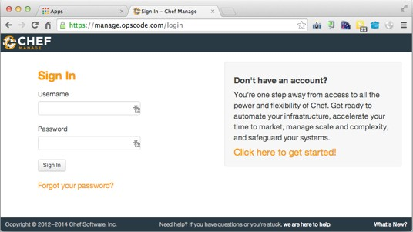
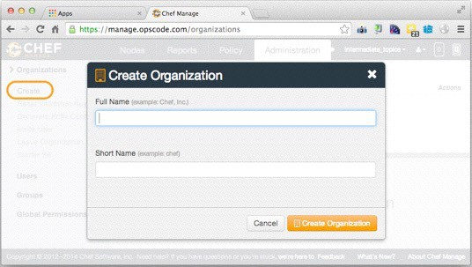
Exercise: Create a New Org
Visit Hosted Enterprise Chef (manage.chef.io)
Sign in or create a new account
Create a new Organization
1
2

Slide 11
Configuring Your Workstation
In Chef Fundamentals you set your workstation up the easy way using 'Starter Kit'
In this class you will download your user .pem file and knife.rb and configure it manually

Slide 12
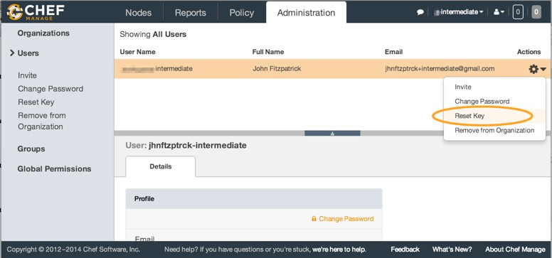
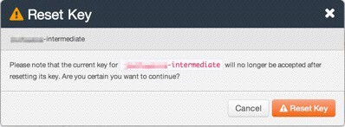
Exercise: Download Your Client pem
Reset and download your private client pem file
Only do this if you don't already have the .pem file available on your laptop
Notes:
Do not need the validator pem. See https://www.chef.io/blog/2015/04/16/validatorless-bootstraps/ for more info.

Slide 13
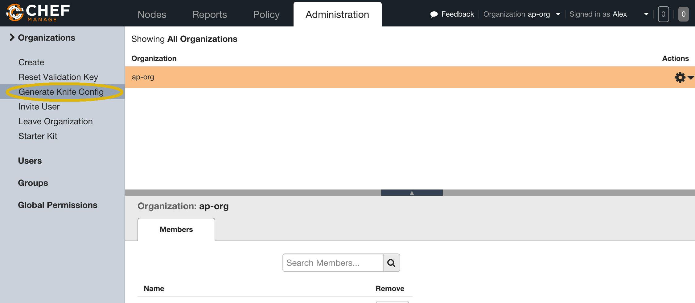
Exercise: Download knife.rb
Download a knife.rb file specific for your user and organization
Notes:
Do not need the validator pem. See https://www.chef.io/blog/2015/04/16/validatorless-bootstraps/ for more info.

Slide 14
Exercise: Create and Populate a .chef Directory
$ cd ~/intermediate/chef-fundamentals-repo-master
$ mkdir .chef
$ cp ~/Downloads/<yourname>.pem .chef
$ cp ~/Downloads/knife.rb .chef
knife.rb & .pem file reside in the .chef directory which can be in
<current-directory>/.chef
/etc/.chef
~/.chef

Slide 15
Exercise: Test Your Workstation
$ knife client list
<your-org>-validator.pem

Slide 16
Exercise: Upload to Hosted Chef
Upload the following to the Chef server
cookbooks
data bags
roles
environments
Notes:
Give students some time to complete these tasks before walking them through it.

Slide 17
Exercise: Upload Cookbooks
$ knife cookbook upload -a
Uploading apache [0.2.0]
Uploading chef-client [4.3.0]
Uploading chef_handler [1.1.9]
Uploading cron [1.6.1]
Uploading logrotate [1.9.2]
Uploading motd [0.1.0]
Uploading ntp [1.8.6]
Uploading pci [0.1.0]
Uploading users [0.1.0]
Uploading windows [1.37.0]
Uploaded all cookbooks.

Slide 18
Exercise: Upload data_bags
$ knife upload data_bags
Created data_bags/groups Created data_bags/users
Created data_bags/groups/clowns.json Created data_bags/users/bobo.json Created data_bags/users/frank.json

Slide 19
Exercise: Upload Roles
$ knife role from file base.rb starter.rb web.rb
Updated Role base! Updated Role starter! Updated Role web!

Slide 20
Exercise: Upload Environments
$ knife environment from file dev.rb production.rb
Updated Environment dev Updated Environment production

Slide 21
"Bootstrap" the Target Instance
$ knife bootstrap <EXTERNAL_ADDRESS> \
--sudo -x chef -P chef –N node1 –r 'role[web]' --bootstrap-version 12.5.1
uvo164727i3mvh1jup2.vm.cld.sr --2015-05-13 04:31:10-- https://www.opscode.com/chef/install.sh
uvo164727i3mvh1jup2.vm.cld.sr Resolving www.opscode.com... 184.106.28.90
uvo164727i3mvh1jup2.vm.cld.sr Connecting to www.opscode.com|184.106.28.90|:443... connected.
uvo164727i3mvh1jup2.vm.cld.sr HTTP request sent, awaiting response... 200 OK
uvo164727i3mvh1jup2.vm.cld.sr Length: 15934 (16K) [application/x-sh]
uvo164727i3mvh1jup2.vm.cld.sr Saving to: `STDOUT'
uvo164727i3mvh1jup2.vm.cld.sr
100%[======================================>] 15,934 --.-K/s in 0s
uvo164727i3mvh1jup2.vm.cld.sr
uvo164727i3mvh1jup2.vm.cld.sr 2015-05-13 04:31:10 (538 MB/s) - written to stdout [15934/15934]
uvo164727i3mvh1jup2.vm.cld.sr
uvo164727i3mvh1jup2.vm.cld.sr Downloading Chef 12.5.1 for el...
uvo164727i3mvh1jup2.vm.cld.sr downloading https://www.opscode.com/chef/metadata?
v=12.5.1&prerelease=false&nightlies=false&p=el&pv=6&m=x86_64
uvo164727i3mvh1jup2.vm.cld.sr to file /tmp/install.sh.41533/metadata.txt
uvo164727i3mvh1jup2.vm.cld.sr trying wget...
uvo164727i3mvh1jup2.vm.cld.sr url https://opscode-omnibus-packages.s3.amazonaws.com/el/6/x86_64/
chef-12.5.1-1.el6.x86_64.rpm
...
Notes:
GOTCHA! Don’t use the old-school bootstrapping
You may see something like the following:
Doing old-style registration with the validation key at /Users/nathenharvey/intermediate/chef-fundamentals-repo-master/.chef/nharveynyc201506prep-validator.pem...
Delete your validation key in order to use your user credentials instead
…
54.174.197.139 Server Response:
54.174.197.139 ----------------
54.174.197.139 Failed to authenticate as 'node1'. Ensure that your node_name and client key are correct.
54.174.197.139
54.174.197.139 Relevant Config Settings:
54.174.197.139 -------------------------
54.174.197.139 chef_server_url "https://api.opscode.com/organizations/nharveynyc201506prep"
54.174.197.139 node_name "node1"
54.174.197.139 client_key "/etc/chef/client.pem"
54.174.197.139
54.174.197.139 If these settings are correct, your client_key may be invalid, or
54.174.197.139 you may have a chef user with the same client name as this node.
54.174.197.139
54.174.197.139 [2015-06-23T04:22:59+00:00] FATAL: Stacktrace dumped to /var/chef/cache/chef-stacktrace.out
54.174.197.139 Chef Client failed. 0 resources updated in 1.216833535 seconds
54.174.197.139 [2015-06-23T04:22:59+00:00] ERROR: 401 "Unauthorized"
54.174.197.139 [2015-06-23T04:22:59+00:00] FATAL: Chef::Exceptions::ChildConvergeError: Chef run process exited unsuccessfully (exit code 1)
The solution is to remove your validator.pem from your .chef directory.

Slide 22
knife bootstrap (no validator key)
Chef Server
Workstation
Node

Slide 23
knife bootstrap (no validator key)
knife bootstrap HOSTNAME -x root -P PASSWORD -N node1 …
Chef Server
Workstation
Node

Slide 24

knife bootstrap (no validator key)
knife bootstrap HOSTNAME -x root -P PASSWORD -N node1 …
register node
register client
Chef Server
Workstation
Node

Slide 25

knife bootstrap
knife bootstrap HOSTNAME -x root -P PASSWORD -N node1 …
register node
register client
Chef Server
Workstation
ssh / scp
chef_server_url
Node

Slide 26

knife bootstrap
knife bootstrap HOSTNAME -x root -P PASSWORD -N node1 …
register node
register client
Chef Server
Workstation
ssh / scp
chef_server_url
install chef-client configure chef-client run chef-client
Node

Slide 27
knife bootstrap (no validator key)
knife bootstrap HOSTNAME -x root -P PASSWORD -N node1 …
register node
register client
Chef Server
Workstation
save node details
ssh / scp
chef_server_url
install chef-client configure chef-client run chef-client
Node

Slide 28

knife bootstrap
knife bootstrap HOSTNAME -x root -P PASSWORD -N node1 …
Chef Server
Workstation
save node details
ssh / scp
chef_server_url
install chef-client configure chef-client run chef-client
Node

Slide 29

knife bootstrap
knife bootstrap HOSTNAME -x root -P PASSWORD -N node1 …
Chef Server
Workstation
save node details
ssh / scp
chef_server_url
install chef-client configure chef-client run chef-client
Node

Slide 30
What Just Happened?
Chef and all of its dependencies installed via an operating system-specific package ("omnibus installer")
Installation includes
The Ruby language - used by Chef
knife - Command line tool for administrators
chef-client - Client application
ohai - System profiler
...and more

Slide 31
Verify Your Target Instance’s Chef-Client is Configured Properly
$ ssh chef@<EXTERNAL_ADDRESS>
chef@node1:~$ ls /etc/chef
client.pem client.rb first-boot.json ohai
chef@node1:~$ which chef-client
/usr/bin/chef-client
chef@node1:~$ chef-client -v Chef: 12.5.1

Slide 32
Exercise: Re-run the Chef Client
chef@node1$ sudo chef-client -l info
[2015-06-23T05:06:02+00:00] INFO: Forking chef instance to converge...
Starting Chef Client, version 12.5.1
[2015-06-23T05:06:02+00:00] INFO: *** Chef 12.5.1 ***
[2015-06-23T05:06:02+00:00] INFO: Chef-client pid: 5704
[2015-06-23T05:06:03+00:00] INFO: Run List is [role[web]]
[2015-06-23T05:06:03+00:00] INFO: Run List expands to [chef-client::delete_validation, chef-client, ntp, motd, users, apache]
[2015-06-23T05:06:03+00:00] INFO: Starting Chef Run for node1
[2015-06-23T05:06:03+00:00] INFO: Running start handlers
[2015-06-23T05:06:03+00:00] INFO: Start handlers complete.
resolving cookbooks for run list: ["chef-client::delete_validation", "chef-client", "ntp", "motd", "users", "apache"]
[2015-06-23T05:06:04+00:00] INFO: Loading cookbooks [apache@0.2.0, chef-client@4.3.0, cron@1.6.1, logrotate@1.9.2, motd@0.1.0, ntp@1.8.6, pci@0.1.0, users@0.1.0, chef_handler@1.1.9, windows@1.37.0]
Synchronizing Cookbooks:
- apache

Slide 33
Exercise: Verify chef-client is Running
chef@node1$ ps awux | grep chef-client
root 8933 0.3 2.2 130400 37816 ? Sl
03:19 0:01 /opt/chef/embedded/bin/ruby /usr/bin
chef-client -d -c /etc/chef/client.rb -L /var/log/
chef/client.log -P /var/run/chef/client.pid -i 1800
-s 300

Slide 34
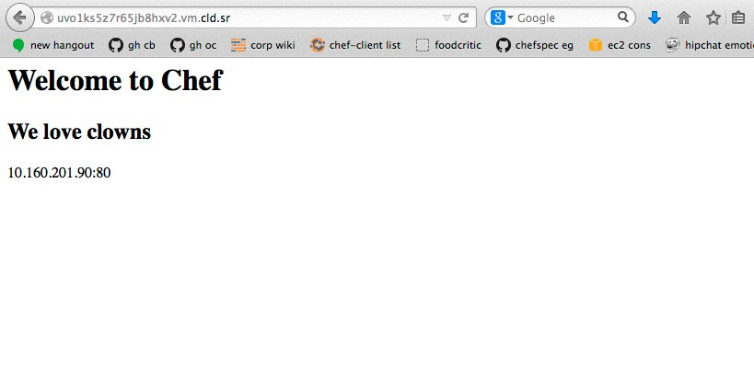
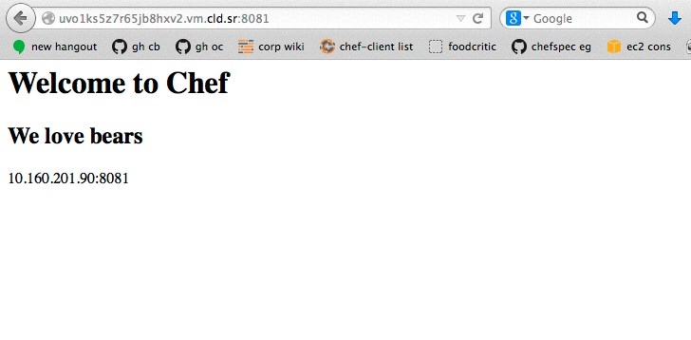
Exercise: Verify That the Two Sites Are Working
Notes:
Virtual hosts are setup on ports 80, 8000, and 8081

Slide 35
Review Questions
What files did we download from Chef Server to configure our workstation?
Where did we place these files?
What other way could we have copied the repo files from GitHub?
Bonus point - why did we not do this?
How did we upload all cookbooks to the Chef Server?

