Slide 1

A PRESENTATION on “Car Price Prediction”
HENRY HARVIN EDUCATION
SECTOR-2, c-107, Noida, up
Teacher’s Guide By ANIL JADON DHIRAJ UPADHAYAY POOJA GUPTA (mentor)
Submitted BY :
Abhijit Roy

Slide 2
Predictive Analysis Case Study
SUBMISSION :
Linear Regression Model to Predict the price of cars and determine the factors driving car price.
Page : 2

Slide 3
CASE STUDY OVERVIEW
PROBLEM STATEMENT
A Japanese automobile company Torao Yamaha Auto aspires to enter the US market by setting up their manufacturing unit there and producing cars locally to give competition to their US and European counterparts.
They have contracted an automobile consulting company to understand the factors on which the pricing of cars depends. Specifically, they want to understand the factors affecting the pricing of cars in the American market, since those may be very different from the Japanese market. The company wants to know:
- Which variables are significant in predicting the price of a car
- How well those variables describe the price of a car
Page : 3

Slide 4
BUSINESS GOAL
It is required to model the price of cars with the available independent variables. It will be used by the management to understand how exactly the prices vary with the independent variables. They can accordingly manipulate the design of the cars, the business strategy etc. to meet certain price levels.
Further, the model will be a good way for management to understand the pricing dynamics of a new market.
Page : 4

Slide 5
Data Reading and Understanding
The data set contains 205 entries and 29 columns. The names of those columns are :
Company, Car_ID, cars range, car length, Symboling, car width, fuel type, engine type, car height, carbody, car volume, door number, curb weight, engine location, Horsepower, fuel system, Bore Ratio, cylinder number, Compression Ratio, aspiration, Highway miles per gallon (mpg), drive wheel, Engine Size, Stroke, City Miles per gallon (mpg), Fuel economy, Peak Revolutions per Minute (rpm), Wheel Base, Price.
Here, our target variable is “PRICE”.
Page : 5

Slide 6
Assumptions and Data Handling
Car Company: We have assumed that Volkswagen, vokswagen, and vw are the same companies, and same for others.
Data Cleaning: We have renamed the car company names to their correct names, as per our understanding. We have converted all the data to lower case to avoid any case errors. The duplicated function searched for any duplicate values in our data and found none.
There were no missing values in the data and by performing the above steps, we prepared our data for analysis.
A separate data set corr was created that dealt only with the correlation of our target variable, price. This was done in order to select the best response variables for our study.
Another dataset cars was created that included only the columns that we selected based on our data exploration.
Page : 6

Slide 7
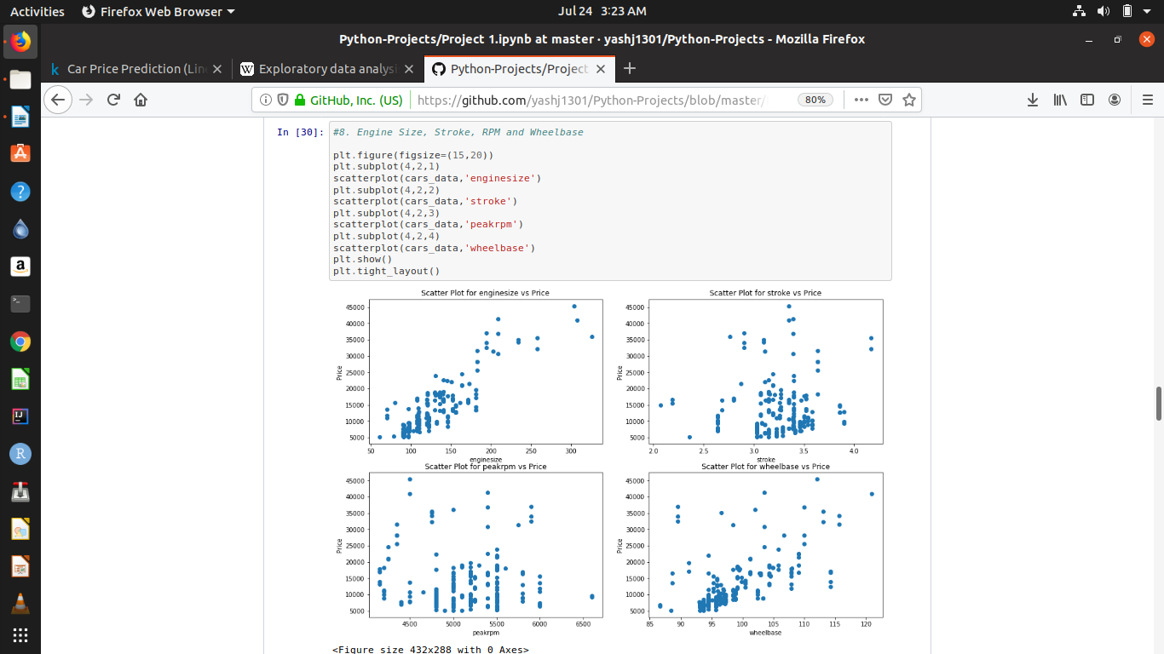
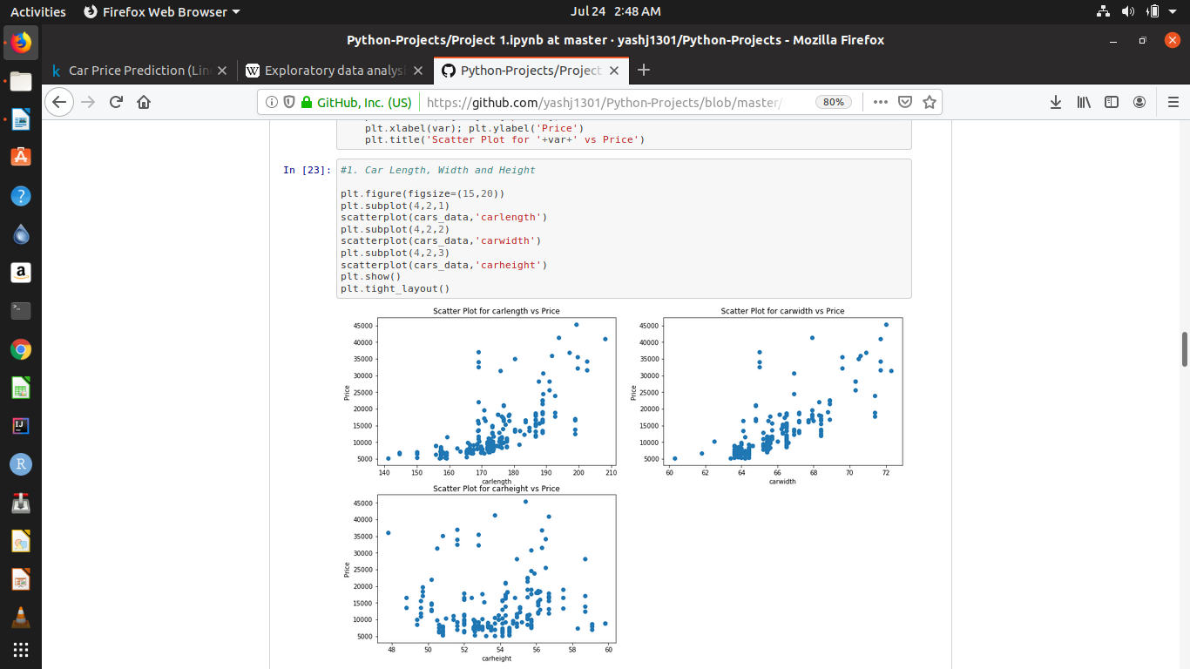
Data Exploration
Based on our data exploration, we chose the best features that would help us predict the prices of the cars. These are :
Wheel Base, Car Length, Car Width, Curb Weight, Engine Size, Bore Ratio, Horsepower, Car Volume, Fuel Economy, Cars Range, Car Body, Fuel Type, Engine Type, Aspiration, Cylinder Number, Drive wheel
1. Wheel Base
2. Car Length
It seems to have a significant positive correlation with price.
It seems to have a significant positive correlation with price.
Page : 7

Slide 8
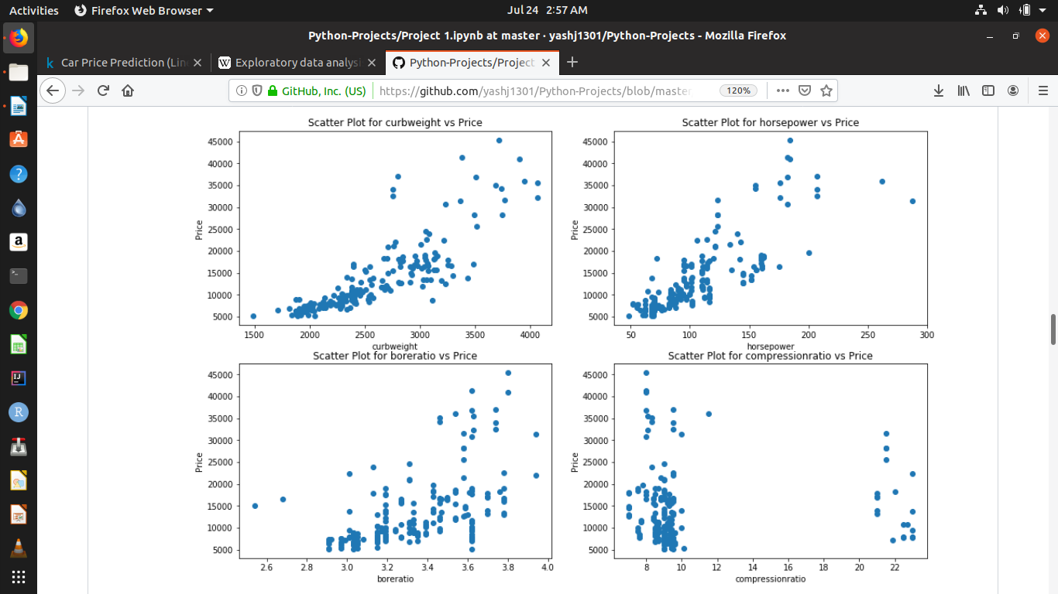
Exploratory Data Analysis
Based on our data exploration, we chose the best features that would help us predict the prices of the cars. These are :
Wheel Base, Car Length, Car Width, Curb Weight, Engine Size, Bore Ratio, Horsepower, Car Volume, Fuel Economy, Cars Range, Car Body, Fuel Type, Engine Type, Aspiration, Cylinder Number, Drive wheel
3. Car Width
4. Curb Weight
It seems to have a significant positive correlation with price.
It seems to have a significant positive correlation with price.
Page : 8

Slide 9
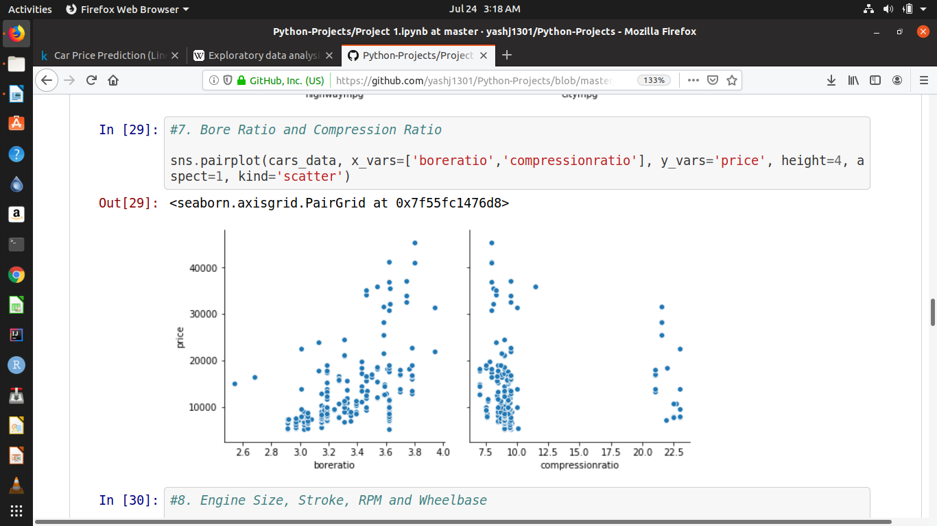
Exploratory Data Analysis
Based on our data exploration, we chose the best features that would help us predict the prices of the cars. These are :
Wheel Base, Car Length, Car Width, Curb Weight, Engine Size, Bore Ratio, Horsepower, Car Volume, Fuel Economy, Cars Range, Car Body, Fuel Type, Engine Type, Aspiration, Cylinder Number, Drive wheel
5. Engine Size
6. Bore Ratio
It seems to have a significant positive correlation with price.
It seems to have a significant positive correlation with price.
Page : 9

Slide 10
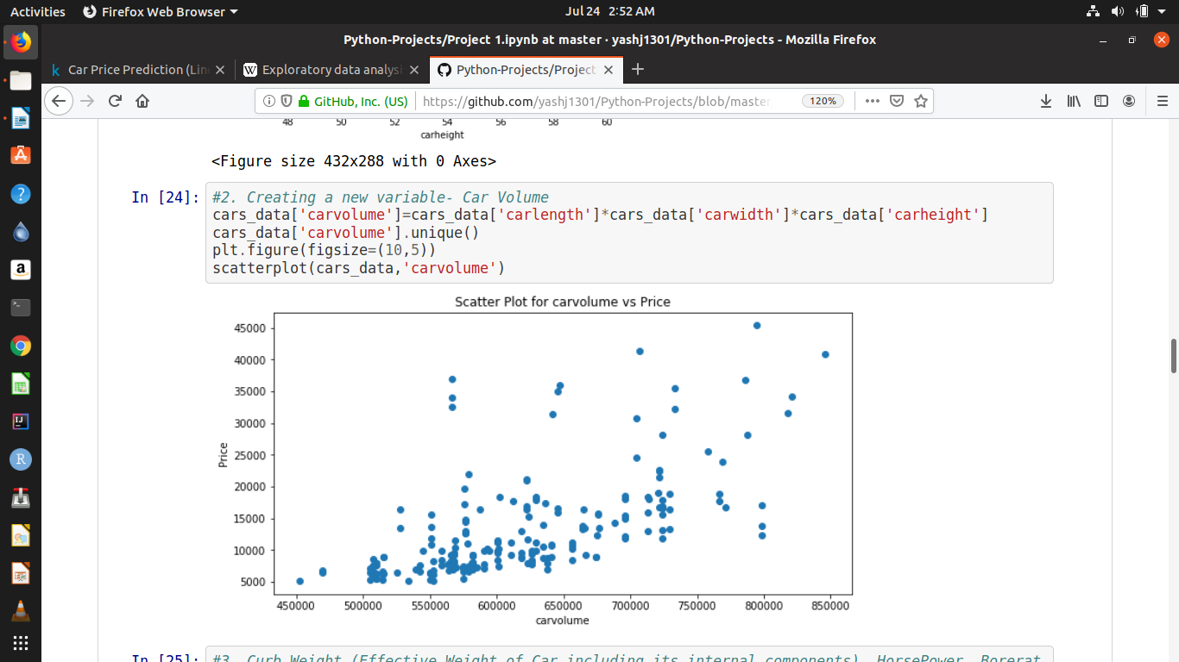
Exploratory Data Analysis
Based on our data exploration, we chose the best features that would help us predict the prices of the cars. These are :
Wheel Base, Car Length, Car Width, Curb Weight, Engine Size, Bore Ratio, Horsepower, Car Volume, Fuel Economy, Cars Range, Car Body, Fuel Type, Engine Type, Aspiration, Cylinder Number, Drive wheel
7. Horse Power
8. Car Volume
It seems to have a significant positive correlation with price.
It seems to have a significant positive correlation with price.
Page : 10

Slide 11
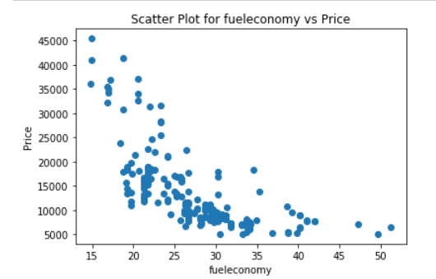
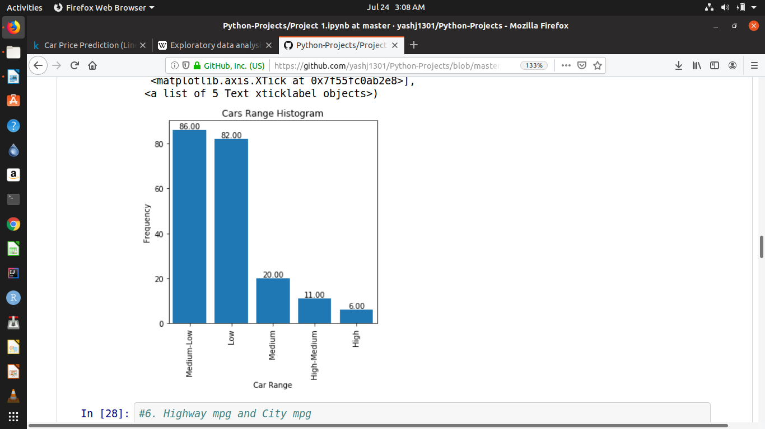
Exploratory Data Analysis
Based on our data exploration, we chose the best features that would help us predict the prices of the cars. These are :
Wheel Base, Car Length, Car Width, Curb Weight, Engine Size, Bore Ratio, Horsepower, Car Volume, Fuel Economy, Cars Range, Car Body, Fuel Type, Engine Type, Aspiration, Cylinder Number, Drive wheel
9. Fuel Economy
10. Cars Range
It seems to have a significant negative correlation with price.
It seems that most people prefer medium-low range and low range cars.
Page : 11

Slide 12
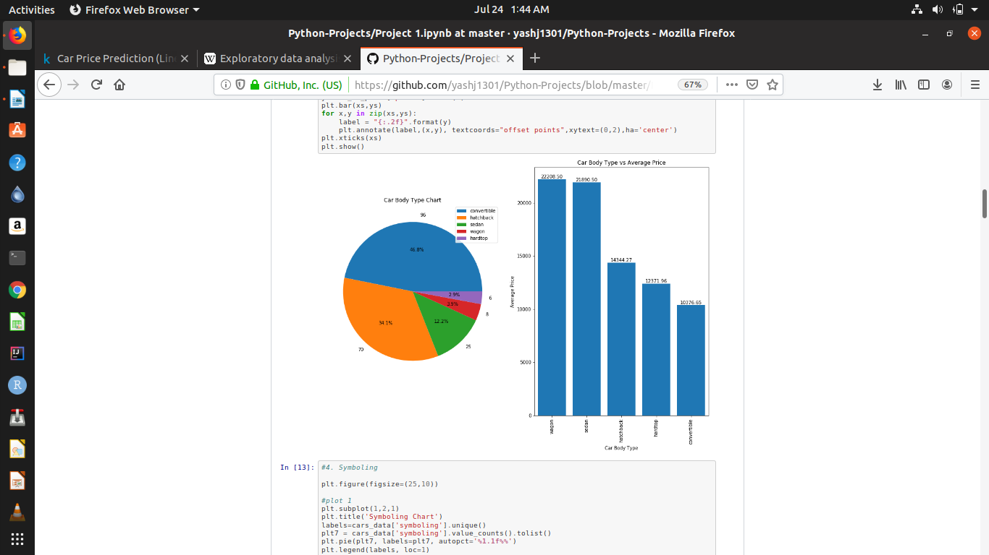
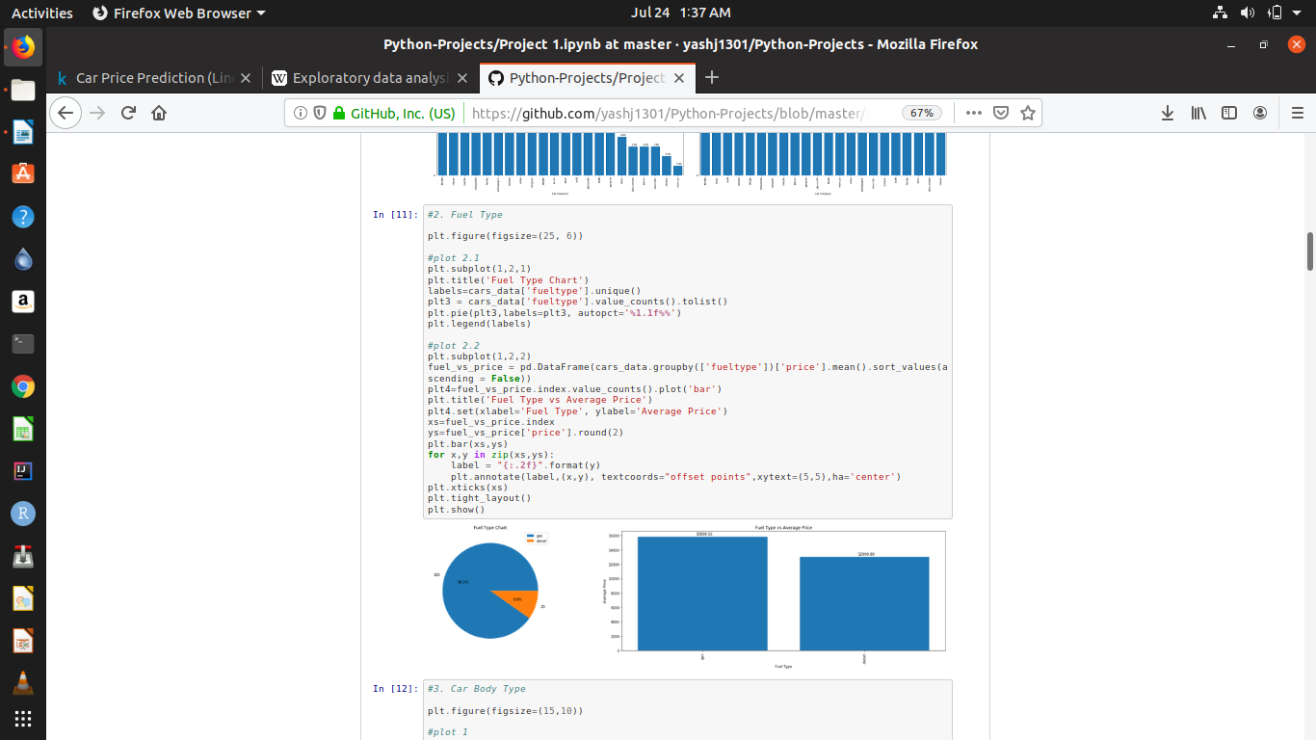
Exploratory Data Analysis
Based on our data exploration, we chose the best features that would help us predict the prices of the cars. These are :
Wheel Base, Car Length, Car Width, Curb Weight, Engine Size, Bore Ratio, Horsepower, Car Volume, Fuel Economy, Cars Range, Car Body, Fuel Type, Engine Type, Aspiration, Cylinder Number, Drive wheel
11. Car Body
12. Fuel Type
It seems that people prefer convertible due to its low price range
It seems that most people prefer gas cars despite their high price range.
Page : 12

Slide 13
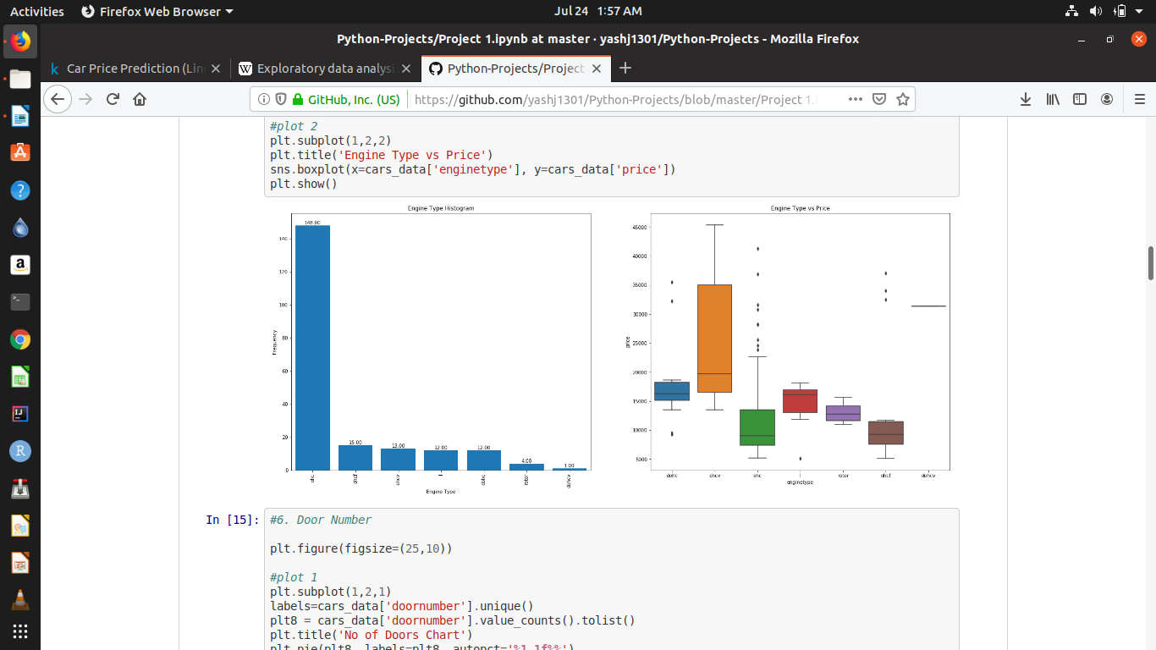
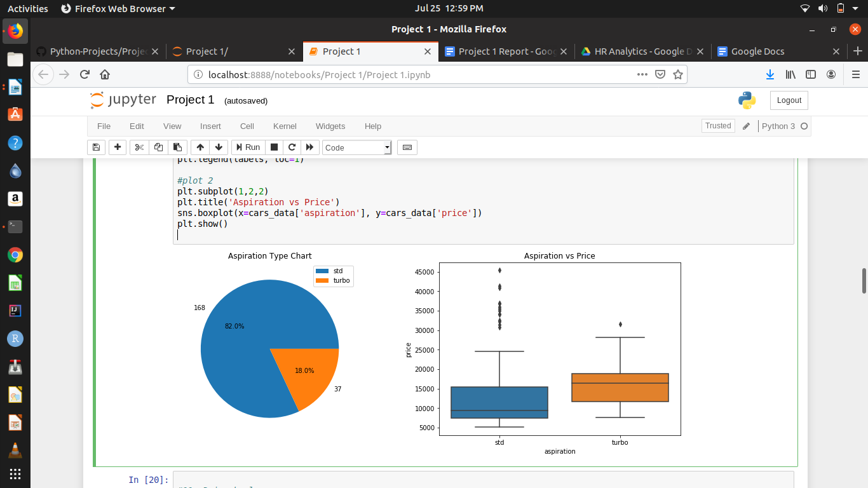
Exploratory Data Analysis
Based on our data exploration, we chose the best features that would help us predict the prices of the cars. These are :
Wheel Base, Car Length, Car Width, Curb Weight, Engine Size, Bore Ratio, Horsepower, Car Volume, Fuel Economy, Cars Range, Car Body, Fuel Type, Engine Type, Aspiration, Cylinder Number, Drive wheel
13. Engine Type
14. Aspiration
It seems that most people prefer std aspiration for their cars.
It seems that people prefer ohc engine type for their cars.
Page : 13

Slide 14
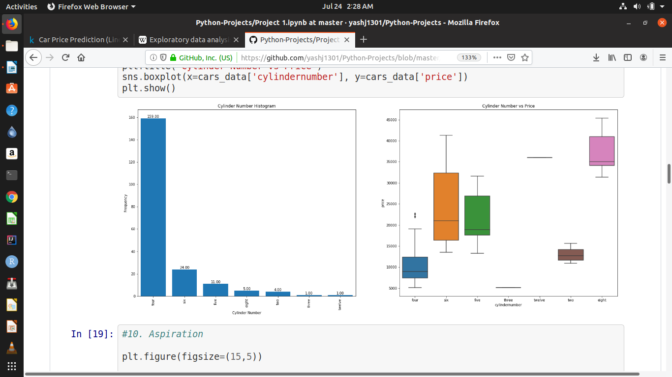
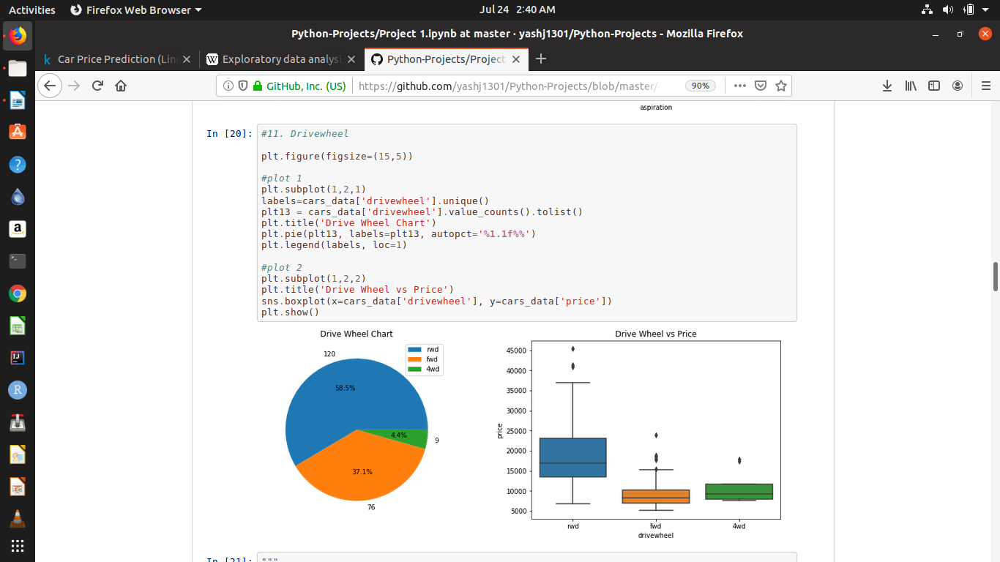
Exploratory Data Analysis
Based on our data exploration, we chose the best features that would help us predict the prices of the cars. These are :
Wheel Base, Car Length, Car Width, Curb Weight, Engine Size, Bore Ratio, Horsepower, Car Volume, Fuel Economy, Cars Range, Car Body, Fuel Type, Engine Type, Aspiration, Cylinder Number, Drive wheel
15. Cylinder Number
16. Drive wheel
It seems that people prefer four cylinders for their cars.
It seems that most people prefer rwd drive wheel despite of its high price range.
Page : 14

Slide 15
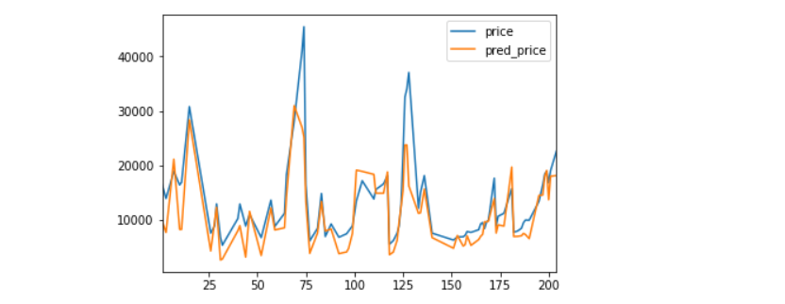
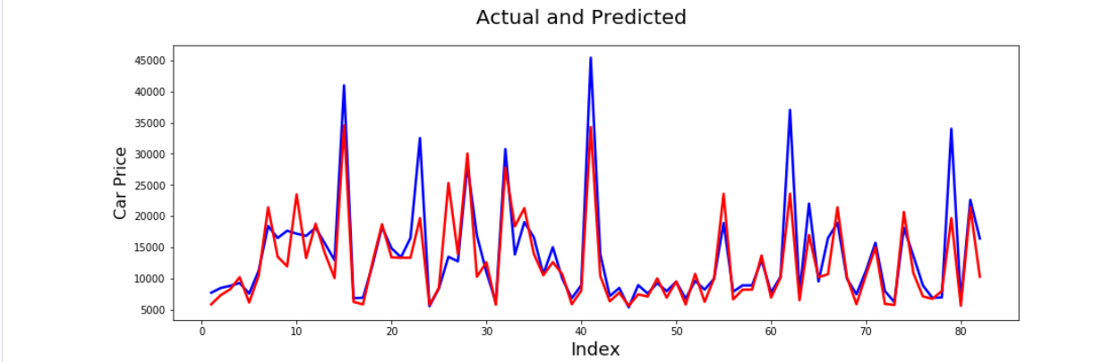
Technique Comparison
Simple Linear Regression | Random Forest Regression
In simple linear regression our accuracy score was 64.377% | Using random forest our accuracy was 76.147%
When plotted a graph between actual and predicted price, we could see some significant irregularities. | When plotted a graph between actual and predicted price, we noticed negligible irregularities.
Page : 15

Slide 16
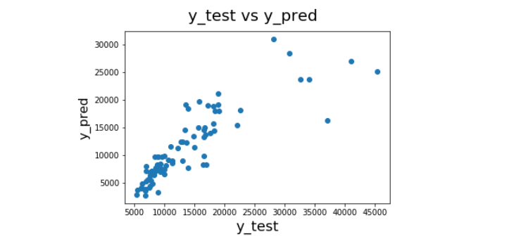
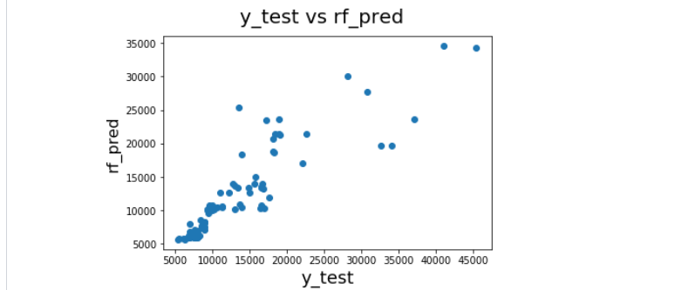
Technique Comparison
Simple Linear Regression | Random Forest Regression
When checked the price spread between values, we can clearly see some data points scattered too far away from the rest. | When checked the price spread between values, we can clearly see some data points scattering only after a little while, which is earlier than what we saw in simple linear regression.
Page : 16

Slide 17
Suggestions and Insights
1. Cars Range is one of the most significant variables for deciding price. Hence, the company should select their price range within 18500$ to 30000$ initially.
2. Fuel Economy of the car is very important for the customers these days. The company should make sure the fuel economy of cars is not less than 5 litres/100km.
3. The company should make sure to have cars with drive wheel ‘rwd’ because people prefer it despite its high price.
4. Most of the cars should have petrol fuel type, because people prefer petrol way more than diesel.
5. Most people prefer convertible despite its price range being medium-high. Hence, company should focus on this as well.
Page : 17

Slide 18
NOTE: After doing this analysis we can say that A Car is an Asset to anyone who owns it.
Hence, choose your car very carefully, whether it is for business or for personal purpose.
Page : 18

Slide 19
Thank You!
You can access the project in the following GITHUB Repository:
https://github.com/jitroy160/Final_Projects/blob/master/Final_Projects/Final_Project_Car_Price_Prediction.ipynb
Contact details:
Abhijit Roy
7908198464
Bagdogra, Darjeeling-734014,
West Bengal
jitroy160@gmail.com
https://github.com/jitroy160
Page : 19

Slide 20
THANK YOU

