Slide 1

A PRESENTATION on “HR Analytics”
HENRY HARVIN EDUCATION
SECTOR-2, c-107, Noida, up
Teacher’s Guide By ANIL JADON DHIRAJ UPADHAYAY POOJA GUPTA (mentor)
Submitted BY :
Abhijit Roy

Slide 2
Human Resource Analytics Case Study
SUBMISSION :
Logistic Regression Model to Predict if the employee is going to leave the company or not and determine the factors driving it.
Page : 2

Slide 3
CASE STUDY OVERVIEW
PROBLEM STATEMENT
A company XYZ has around 9000 employees. However, in every 3-4 months, their employees are leaving and they have to hire new (raw) talent from the market. Training them and guiding them becomes extremely difficult when they have to hire new person in every 3-4 months.
They have contacted a consulting company to understand the factors on which the decision of employees to leave the company depends. Specifically, they want to understand why people are leaving their company on a frequent basis.. The company wants to know:
- Which variables are significant in predicting the decision of leaving the company
- How well those variables describe the probability of the person leaving the company
Page : 3

Slide 4
BUSINESS GOAL
It is required to model the price of cars with the available independent variables. It will be used by the management to understand how exactly the prices vary with the independent variables. They can accordingly manipulate the design of the cars, the business strategy etc. to meet certain price levels.
Further, the model will be a good way for management to understand the pricing dynamics of a new market.
Page : 4

Slide 5
Data Reading and Understanding
The data set contains 14999 entries and 10 columns. The names of those columns are:
Number of projects, work_accident, left, promotion last 5 years, department, salary, time_spend_company, average_monthly_hours, satisfaction_level, last_evaluation
Here, our target variable is “LEFT”.
Page : 5

Slide 6
Assumptions and Data Handling
Technical: we have assumed that ‘technical’, ‘IT’ and ‘support’ are the same categories. Same with others as well.
Data Cleansing: We have renamed the ‘IT’ and ‘support’ columns to ‘technical’, as per our understanding. We have converted all the data to lower case to avoid any case errors. We renamed ‘average_montly_hours’ to it correct name. The duplicated function searched for any duplicate values in our data and found 3008 entries. Hence, we deleted them. After deletion, we have 9653 entries and 10 columns.
There were no missing values in the data and by performing the above steps, we prepared our data for analysis.
A separate data set corr was created that dealt only with the correlation of our target variable, left. This was done in order to select the best response variables for our study.
Another dataset hr was created that included only the columns that we selected based on our data exploration.
Page : 6

Slide 7
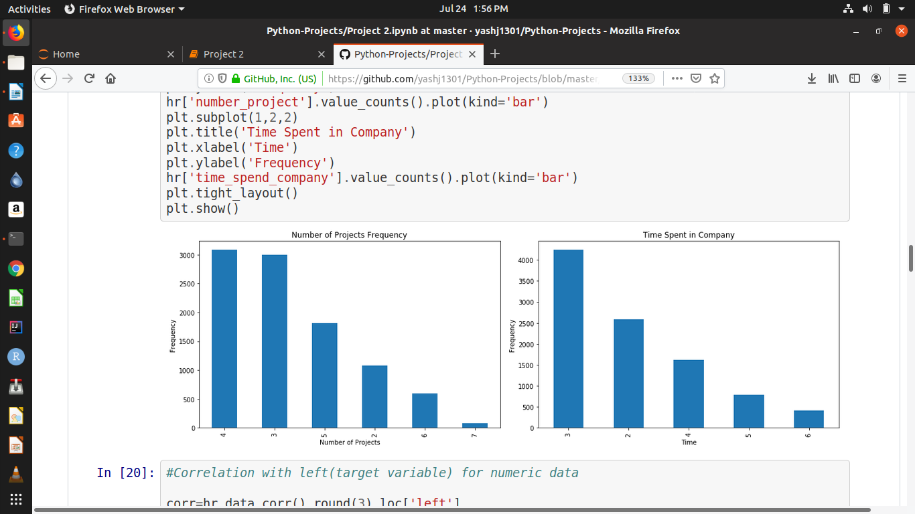
Data Exploration
Based on our data exploration, we chose the best features that would help us predict the prices of the cars. These are :
Satisfaction Level, Time Spend Company, Last Evaluation, Number of Projects, Work Accident, Promotion last 5 years, Salary, Department.
Time Spend Company
2. Number of Projects
It seems that most employees spent just around 3 hours in the company.
It seems that most employees are able to complete only 4 projects on time.
Page : 7

Slide 8
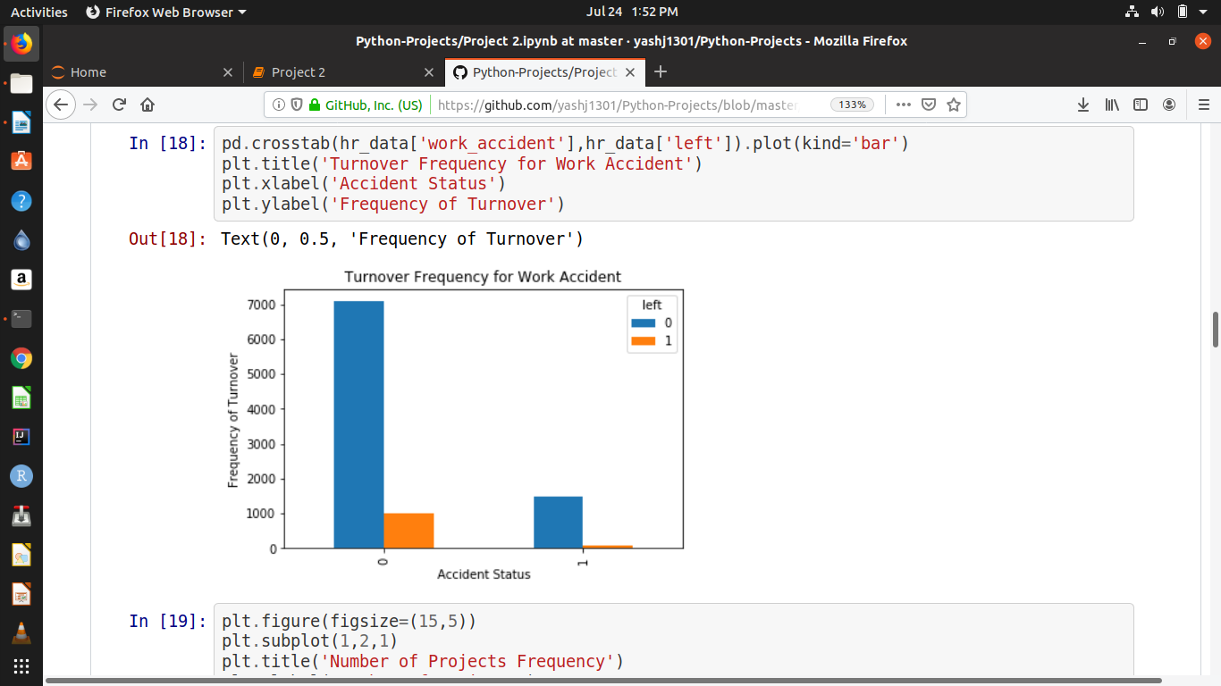
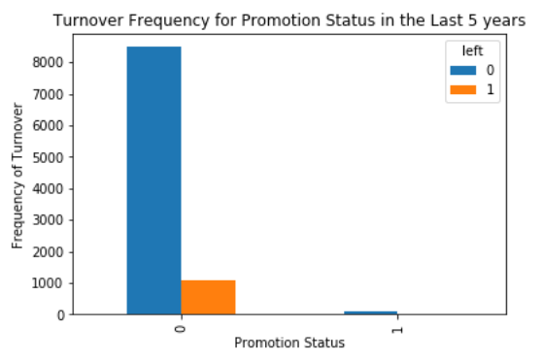
Exploratory Data Analysis
Based on our data exploration, we chose the best features that would help us predict the prices of the cars. These are :
Satisfaction Level, Time Spend Company, Last Evaluation, Number of Projects, Work Accident, Promotion last 5 years, Salary, Department.
3. Work Accident
4. Promotion Status in the last 5 years
It seems that people who don’t have any work accidents are leaving the company more.
It is clearly visible that people are often not getting promotions and hence they are leaving the company.
Page : 8

Slide 9
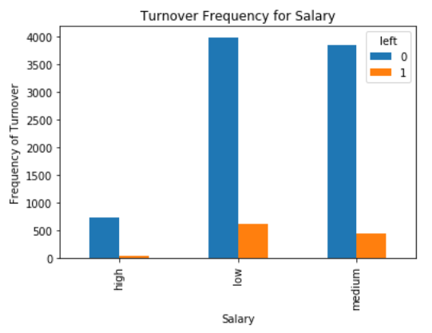
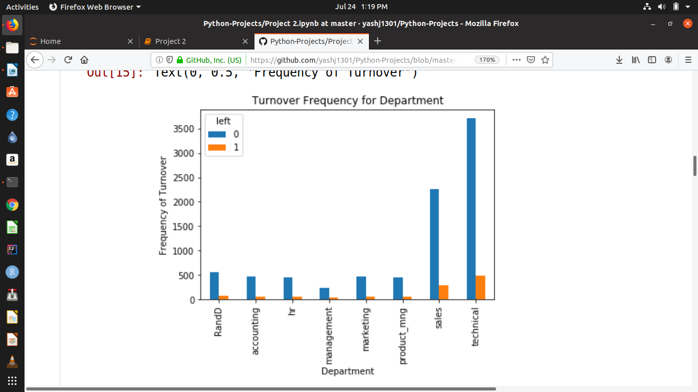
Exploratory Data Analysis
Based on our data exploration, we chose the best features that would help us predict the prices of the cars. These are :
Satisfaction Level, Time Spend Company, Last Evaluation, Number of Projects, Work Accident, Promotion last 5 years, Salary, Department.
5. Salary
6. Department
It seems that people with low salary range are leaving the company more frequently.
It seems that most people leaving the company are from technical department.
Page : 9

Slide 10
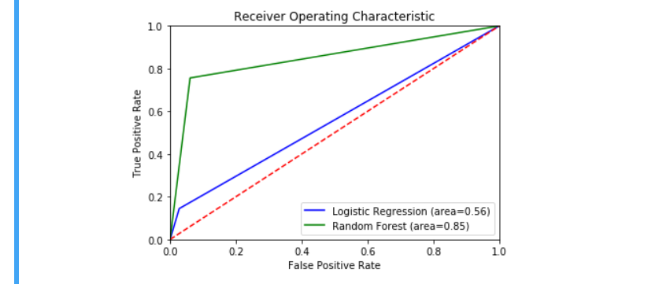
Technique Comparison
Simple Logistic Regression | Random Forest Regression
In simple linear regression our accuracy score was 88.607% | Using random forest our accuracy was 92.025%
The receiver Operative characteristic (ROC) Curve was covering area=0.56 | The receiver Operative characteristic (ROC) Curve was covering area=0.85.
Here is the ROC Curve:
Page : 10

Slide 11
Suggestions and Insights
One of the most important thing for an employee is his salary. Most employees leaving the company have low or medium salary.
Promotion is something that motivates an employee to give his 100% for the company. However, the people leaving the company did not get promotion for half a decade.
The company is inflicting workload too much on the employees. Most employees are able to complete only 4 projects on time.
Training could be done more efficiently. Most people leaving are from technical background.
Satisfaction level of employees is very important for a company. Hence, they should work on keeping the satisfaction level of the employees high.
Page : 11

Slide 12
NOTE: After doing this analysis hence, we can predict that an employee is an asset of the company.
They define the future and present of the company.
Page : 12

Slide 13
Thank You!
You can access the project in the following GITHUB Repository:
https://github.com/jitroy160/Final_Projects/blob/master/Final_Projects/Final_Project_HR_Analytics.ipynb
Contact details:
Abhijit Roy
7908198464
Bagdogra, Darjeeling-734014,
West Bengal
jitroy160@gmail.com
https://github.com/jitroy160
Page : 13

Slide 14
THANK YOU

