Slide 1
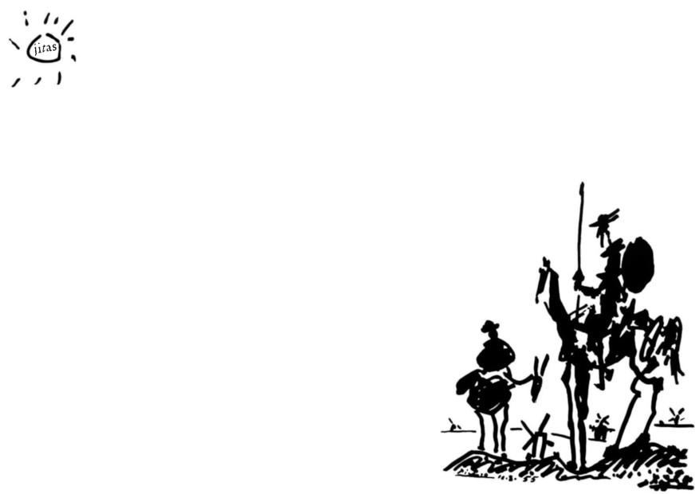
Jitsi Assistant

Slide 2
Jitsi Assistant
WHY
Our computers can play anything but why can’t we share all of them in a Jitsi meeting?

Slide 3
Jitsi Assistant
WHY
Our computers can play anything but why can’t we share all of them in a Jitsi meeting?
BECAUSE
We have some limitations while sharing our desktop
no audio support for shared applications
low video frame rate
client-side bandwidth issues
client-side hardware resource issues

Slide 4
Jitsi Assistant
WHY
Our computers can play anything but why can’t we share all of them in a Jitsi meeting?
BECAUSE
We have some limitations while sharing our desktop
no audio support for shared applications
low video frame rate
client-side bandwidth issues
client-side hardware resource issues
IF
we put the desktop to the cloud
bind its screen to a virtual camera
bind its audio to a virtual microphone
connect it to a Jitsi meeting

Slide 5
Jitsi Assistant
WHY
Our computer can play anything but why can’t we share all of them in a Jitsi meeting?
BECAUSE
We have some limitations while sharing our desktop
no audio support for shared applications
low video frame rate
client-side bandwidth issues
client-side hardware resource issues
IF
we put the desktop to the cloud
bind its screen to a virtual camera
bind its audio to a virtual microphone
connect it to a Jitsi meeting
and allow collaboration on this desktop

Slide 6
Jitsi Assistant
Technical Infrastructure
Jitas is a cloud-based virtual desktop environment that assists the teacher to share high quality materials in the Jitsi session.

Slide 7
Jitsi Assistant
Technical Infrastructure
Jitas is a cloud-based virtual desktop environment that assists the teacher to share high quality materials in the Jitsi session.
Similar to Jibri
Technically it's very similar to Jibri (Jitsi Broadcasting Infrastructure)
Jitas has a virtual desktop environment like Jibri
Jitas has virtual audio devices like Jibri
Jitas has virtual video devices like Jibri
Jitas connects to the meeting room using a customized Chrome instance like Jibri

Slide 8
Jitsi Assistant
Technical Infrastructure
Jitas is a cloud-based virtual desktop environment that assists the teacher to share high quality materials in the Jitsi session.
Similar to Jibri
Technically it's very similar to Jibri (Jitsi Broadcasting Infrastructure)
Jitas has a virtual desktop environment like Jibri
Jitas has virtual audio devices like Jibri
Jitas has virtual video devices like Jibri
Jitas connects to the meeting room using a customized Chrome instance like Jibri
But
Jitas does completely the opposite task
Jibri pulls audio and video from the Jitsi meeting room
Jitas pushes audio and video to the Jitsi meeting room

Slide 9

Jitsi Assistant
Use Case 1
Sharing high quality multimedia contents in lessons
YouTube is no longer the only option. It is now possible to share in lessons:
High quality local audio files (mp3, wav etc)
High quality local video files (mp4, avi etc)
Animation
Livestream
Media from any site (YouTube, PeerTube, Netflix etc)
Media using any player (Web players, VLC, smplayer, mpv etc)
HQ background music for dance classes, yoga courses etc
Make Me Believe
play video

Slide 10
Jitsi Assistant
Use Case 2
One teacher, one lecture but hundreds of students
As you know it’s difficult to handle big conference. But Jitas can connect to multiple classroom sessions at the same time. This allows the teacher to teach multiple classes at the same time.
Movie time
Another very similar use case is the movie time for students:
one movie
multiple movie theaters (classrooms in our case)
hundreds of students
each student group can only interact within their own classroom
Make Me Believe
play video

Slide 11
Jitsi Assistant
Use Case 3
Collaboration desktop for student workgroup
Students can share the same Jitas desktop while talking in Jitsi meeting room.
remote collaboration
as a remote presentation tool for student team
can be used as whiteboard
Two teachers in the same lecture
Very similar use case is when a lesson is taught by two teachers at the same time, alternately. Then the teachers can connect to the same Jitas desktop and can use it alternately.

Slide 12
Jitsi Assistant
Mobile Support
Jitas desktop is fully supported on mobile devices. Thanks go to noVNC. It runs well in any modern browser including mobile browsers (iOS and Android)
play video
* Recorded using a mobile device emulator. Therefore the desktop keyboard cannot be seen in the video but it works on real devices.

Slide 13
Jitsi Assistant
Links
Jitas GitHub repo
Jitas Live Demo
video: Sharing desktop on Jitsi using Jitas
video: Movie time with Jitas
video: Mobile device support on Jitas desktop

