Slide 1

MINI PROJECT: IDEA LAB II - PROJECT REPORT
Student Name : M . Deepak
Register Number :210625205019
Department / Section : INFORMATION TECHNOLOGY/C
Sub. Code :AEEC302
Faculty In-charge :Mr. Arul Kumar
Year / Semester : I / II
Academic Year : 2025-2026
Project Title : Smart waste segregation system using AI
PO Mapping : PO7 – Environment and Sustainability
SDG Mapping : SDG 12 – Responsible Consumption and Production

Slide 2
Problem Statement
Rapid urbanization and population growth have led to a significant increase in municipal solid waste, creating challenges in effective waste management. Traditional segregation methods are labor-intensive, error-prone, and inefficient, often resulting in improper disposal that harms the environment and public health. There is a pressing need for an intelligent, automated system that can accurately classify and segregate waste into categories such as biodegradable, recyclable, and hazardous. Leveraging Artificial Intelligence (AI) for waste segregation can enhance accuracy, reduce human effort, and promote sustainable waste management practices.

Slide 3
Existing Solutions
AI-based waste segregation systems are already being tested worldwide. Smart bins with cameras and sensors use machine learning to classify waste into categories like plastic, paper, organic, and metal with over 95% accuracy. Some low-cost models rely on capacitive and inductive sensors to detect wet waste and metals. Advanced deep learning models such as ResNet achieve up to 98% accuracy in recycling plants. In smart city projects, AI is integrated with IoT and RFID tags to monitor bin status, predict collection needs, and optimize routes. These solutions show promise but face challenges like high costs, infrastructure gaps, and diverse waste compositions.

Slide 4
PROPOSED SYSTEM
User Interface Layer
Provides a simple, intuitive way for users to interact with the system.
Handles requests (text, commands, or inputs).
Input Processor
Parses user requests.
Identifies intent, context, and required parameters.
Tool Selector
Chooses the appropriate tool (e.g., search, memory, image generation).
Ensures modularity and flexibility.
Execution Engine
Runs the selected tool with structured schema.
Handles parallel execution when multiple tools are needed
Output Formatter
Ensures consistency and clarity.

Slide 5
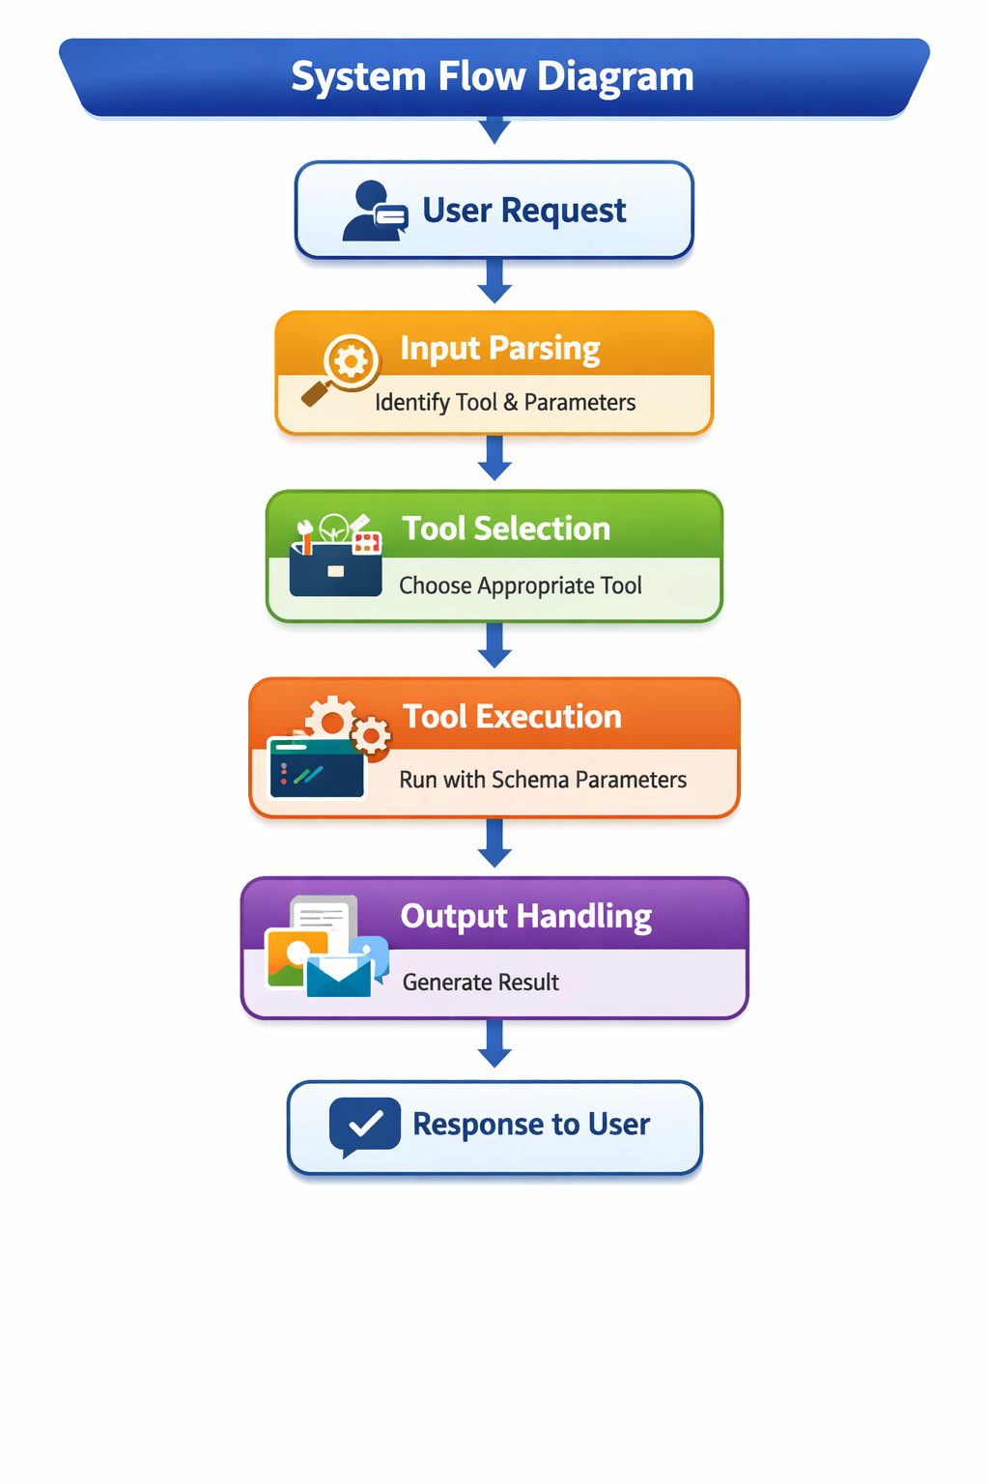
System Flow

Slide 6
ADVANTAGES
Clarity and Structure: Each stage — from user request to response — is clearly defined, making the process easy to understand and maintain.
Modularity: Components like input parsing, tool selection, and execution are independent, allowing updates or replacements without affecting the entire system.
Scalability: New tools or features can be added seamlessly within the existing schema.
Efficiency: Automated tool selection and execution reduce manual intervention, speeding up responses.
Consistency: The JSON-like schema ensures uniformity across all operations, minimizing errors.
User-Centric Design:The flow prioritizes accurate interpretation of user intent, leading to precise and relevant outputs.

Slide 7
Software Requriements
Programming Language/Frameworks:
Backend: Python, Node.js, or Java (for tool execution and orchestration)
Frontend: React, Angular, or Vue.js (for user interface)
Database: SQL (MySQL/PostgreSQL) or NoSQL (MongoDB) for storing logs, preferences, and configurations
APIs & Middleware: REST/GraphQL APIs for communication between modules
Visualization Tools: Libraries like D3.js, Mermaid, or diagramming tools for flow/ADG representation
Operating System: Windows, Linux, or macOS (depending on deployment environment

Slide 8
HARDWARE REQUIREMENTS
Processor: Multi-core CPU (Intel i5/i7 or AMD equivalent for development; Xeon/EPYC for production)
Memory (RAM): Minimum 8 GB for development, 16–32 GB for production environments
Storage: SSD with at least 256 GB for development; scalable storage (1 TB+) for production logs and data
Network: Stable broadband connection; enterprise-grade networking for production

Slide 9
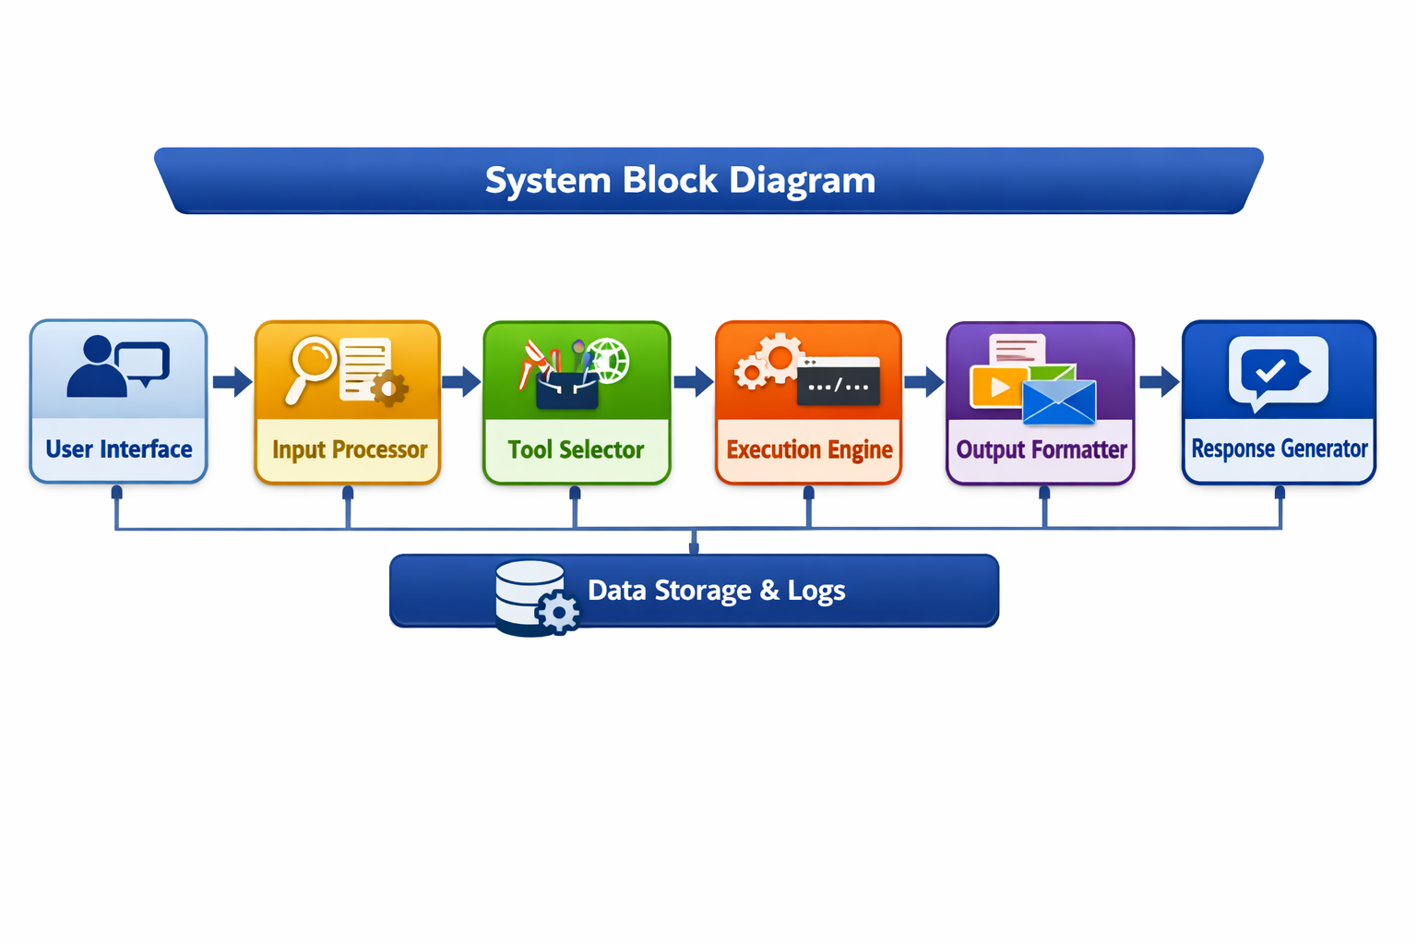
BLOCK DIAGRAM

Slide 10
S.NO | ARTICLE TITLE/AUTOR/YEAR OF PUBLICATION | PROS | CONS
1 | When to Choose Which Architecture for System Design/GeeksforGeeks Editorial Team/2025 | Covers multiple architectures clearly. - Practical guidance for scalability and performance. | Few real-world case studies. - Focuses more on theory.
2 | Types of System Design: A Comprehensive Guide to Architectures/ScholarHat Team/2025 | Detailed comparison of system types. - Includes deployment strategies. | Detailed comparison of system types. - Includes deployment strategies.
3 | System Design: Core Concepts, Architecture, and Strategies/Chenwi Ngu/2024 | Real-world insights. - Explains CI/CD and scalability. | Web-centric examples. - Less legacy system coverage.
4 | Modern Software Architecture Patterns Explained/Martin Fowler/2024 | Deep dive into microservices and event-driven design. - Industry-standard practices. | Dense technical language. - Requires prior experience. - Limited beginner accessibility.

Slide 11
REFRENCES
GeeksforGeeks Editorial Team. When to Choose Which Architecture for System Design. GeeksforGeeks, 2025.
ScholarHat Team. Types of System Design: A Comprehensive Guide to Architectures. ScholarHat, 2025.
Chenwi Ngu. System Design: Core Concepts, Architecture, and Strategies. Medium, 2024.
Martin Fowler. Modern Software Architecture Patterns Explained. ThoughtWorks, 2024.
IEEE Software Journal Team. Architectural Design Principles for Scalable Systems. IEEE, 2023.

Slide 12
RESULT
Clear structure and easy maintenance
Seamless scalability for new tools/features
Automated efficiency in execution
Secure with encryption and role-based access
Accurate, user-focused responses

Slide 13
THANK YOU

