Slide 1

CUSTOMER REVIEW CLASSIFICATION
Group 3
Jitendra Sharma - B2020022
Sartyaki Manna - B2020048
Sudharshanam S - B2020057
Nikhil Shah - B2020092
Santhosh Kumar T - B2020109

Slide 2

Business Problem
Business Context
Amazon Alexa available in multiple variants. Customer review data has been collected for each variant.
Data Context
The reviews are categorized as either good or bad with the help of NLP.
Outcome
The classified reviews can be used to derive further insights about the product's performance

Slide 3

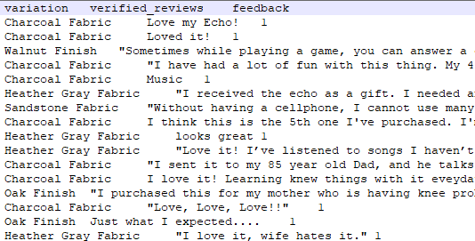
Data Overview
Variables
Data Shape
Product Name
Review
Rating
Rows - 1409
Columns - 3
Analysis process flow
Dataset
Text Pre Processing
LSTM

Slide 4
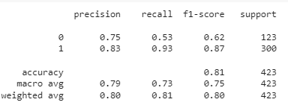
Conclusion
Model Performance
81%
Accuracy
Further Analysis
Percentage of Positive and Negative reviews for each variant.
Modifications according to the reviews

