Slide 1
Data Analysis
Kecheng Liang

Slide 2
Introduction
National Basketball Association(NBA)
EDA
Chi-square Tests

Slide 3
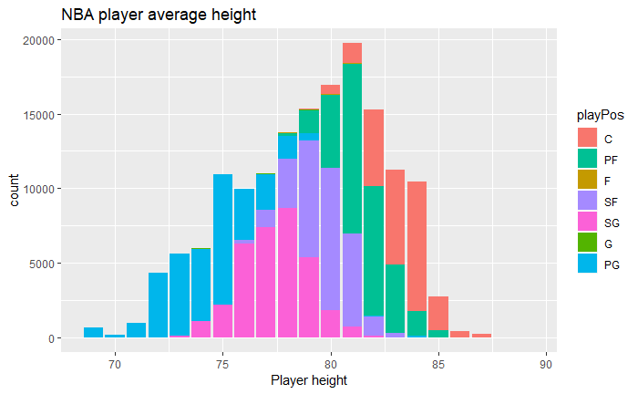
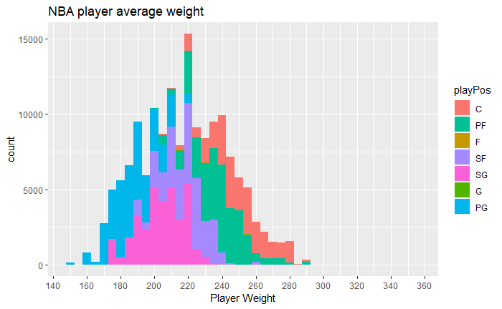
EDA
NBA player average height
NBA player average weight

Slide 4
Chi-square Test
For Assist
For Rebound
Pearson's Chi-squared test
data: total_ast
X-squared = 95.549, df = 23, p-value = 8.177e-11
Pearson's Chi-squared test
data: total_trb
X-squared = 64.517, df = 29, p-value = 0.000164
By doing the chi square test, we found that the both assist and rebound do not have significance difference between home game and away game.

Slide 5
Thank You!

