Slide 1
Kaiser and SEAHI Data Analysis
STAT427 Team: Yujia Deng, Jiuchen Zhang, Jing Pan
Client: Liliane Windsor

Slide 2
Project datasets
Kaiser
SEAHI

Slide 3
Kaiser Project Review-Aims
Focus on identifying HIV+ individuals through HIV testing
Identifying HIV+ individuals and effectively linking them to quality care
evaluate the effectiveness of the NJCRI’s intervention

Slide 4
Kaiser Project Review-Procedures
Enrollment: Identifying HIV+ individuals with substance use disorders
Group Assign: Provided services through NJCRI (Intervention) or Lenard (control)
Data collect: baseline, 3, and 6 months follow-up.

Slide 5
Kaiser Project Review-Question
What is the best analysis to look at change over time and compare groups given significant differences in baseline?

Slide 6
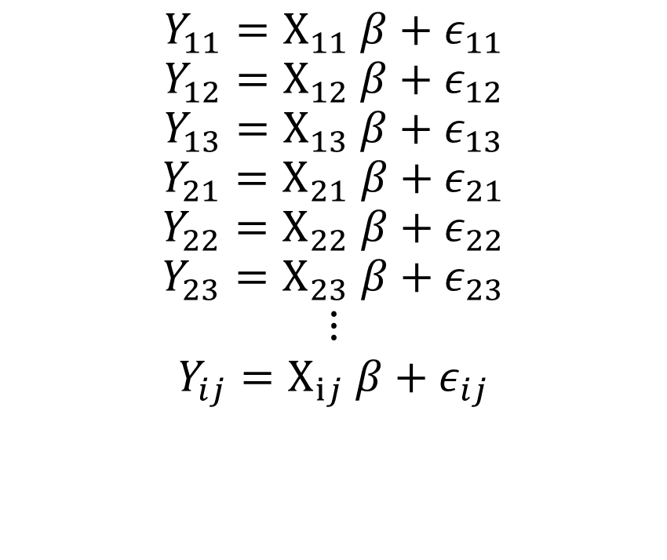
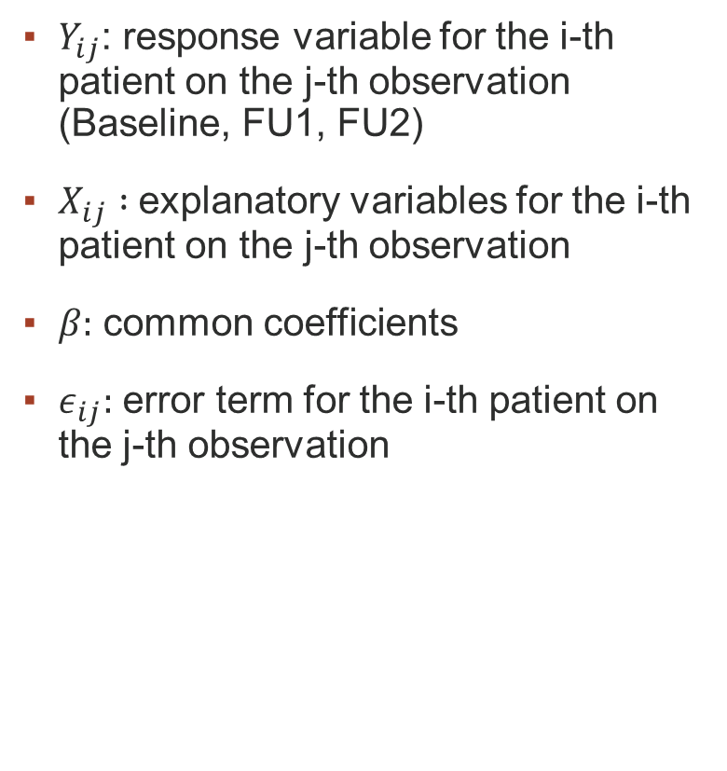
Kaiser – GEE Model
$Y_{ij}$: response variable for the i-th patient on the j-th observation (Baseline, FU1, FU2)
$X_{ij} :$explanatory variables for the i-th patient on the j-th observation
$β:$ common coefficients
$ε_{ij}:$ error term for the i-th patient on the j-th observation
$$Y_{11}=X_{11} β+ε_{11}$$
$$Y_{12}=X_{12} β+ε_{12}$$
$$Y_{13}=X_{13} β+ε_{13}$$
$$Y_{21}=X_{21} β+ε_{21}$$
$$Y_{22}=X_{22} β+ε_{22}$$
$$Y_{23}=X_{23} β+ε_{23}$$
$$⋮$$
$$Y_{ij}=X_{ij} β+ε_{ij}$$

Slide 7
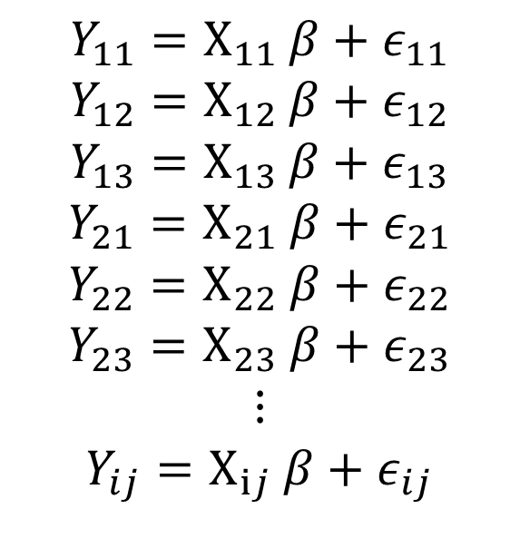

Kaiser – GEE Model
Ordinary Linear Regression Assumption:
${ Y}_{ij}$ not correlated
Generalized Estimating Equation (GEE)
${ Y}_{i1}{ Y}_{i2 }Y_{i3}$correlated
$$Y_{11}=X_{11} β+ε_{11}$$
$$Y_{12}=X_{12} β+ε_{12}$$
$$Y_{13}=X_{13} β+ε_{13}$$
$$Y_{21}=X_{21} β+ε_{21}$$
$$Y_{22}=X_{22} β+ε_{22}$$
$$Y_{23}=X_{23} β+ε_{23}$$
$$⋮$$
$$Y_{ij}=X_{ij} β+ε_{ij}$$

Slide 8
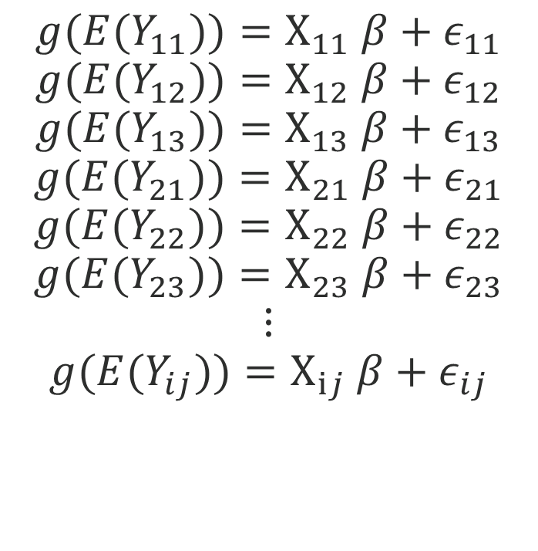

Kaiser - What if Y is not numerical?
$g\left(y\right)$ is a link function that transforms the binary (or other kind of variables) to a numerical one on real line.
$${g(E(Y}_{11}))=X_{11} β+ε_{11}$$
$${g(E(Y}_{12}))=X_{12} β+ε_{12}$$
$$g(E(Y_{13}))=X_{13} β+ε_{13}$$
$${g(E(Y}_{21}))=X_{21} β+ε_{21}$$
$$g(E(Y_{22}))=X_{22} β+ε_{22}$$
$$g({E(Y}_{23}))=X_{23} β+ε_{23}$$
$$⋮$$
$${g(E(Y}_{ij}))=X_{ij} β+ε_{ij}$$

Slide 9
Kaiser – Variables Overview
Response Variable:
Variable | Variable name | Type
CD4 count | CD4_count_0 | numerical
Drug risk |  | binary
Sex Risk |  | binomial
HIV Stigma |  | numerical
Viral Load |  | numerical
Substance overuse |  | binary

Slide 10
Kaiser – Variables Overview
Explanatory Variables:
Baseline Factor | Variable | Type
Mean age | age_0 | numerical
Time | Time | numerical
Women | women | binary
Heterosexual | heter | binary
Black | black | Binary
Latino | Latino | binary
Completed GED/HS | highedu | binary
Earns than $1,000 p/month | highinc | binary
Had stable housing | stable_housing | binary
Had a history of incarceration | jail_hist | binary
Had health insurance | Health_Insurance_0 | binary
Intervention or control | Group | binary
Current Taking ART | CurART | binary
Interaction with time | x:time
25 variables in total (intercept excluded)

Slide 11
Kaiser –Baseline Summary
 | Control (n= 58) | Intervention (n=43)
women | 0.57 | 0.56
heter | 0.66 | 0.72
black | 0.90 | 0.79
Latino | 0.05 | 0.16
highedu | 0.52 | 0.44
highinc | 0.17 | 0.05
stable_housing | 0.64 | 0.74
jail_hist | 0.78 | 0.77
Health_Insurance_0 | 0.97 | 0.72
CurART | 0.88 | 0.49

Slide 12
Kaiser – Variable Selection
Delete the variables that contains too many missing/ too little variation
Model selection through QIC[1]:
QIC: based on the log of quasi-likelihood
The smaller, the better
Backward:
Start with the 25, delete the most insignificant variable at each step
[1] Pan, W. (2004). Akaike’s Information Criterion in Generalized Estimating Equations. Biometrics, 57(March), 120–125. https://doi.org/10.1111/j.0006-341X.2001.00120.x

Slide 13
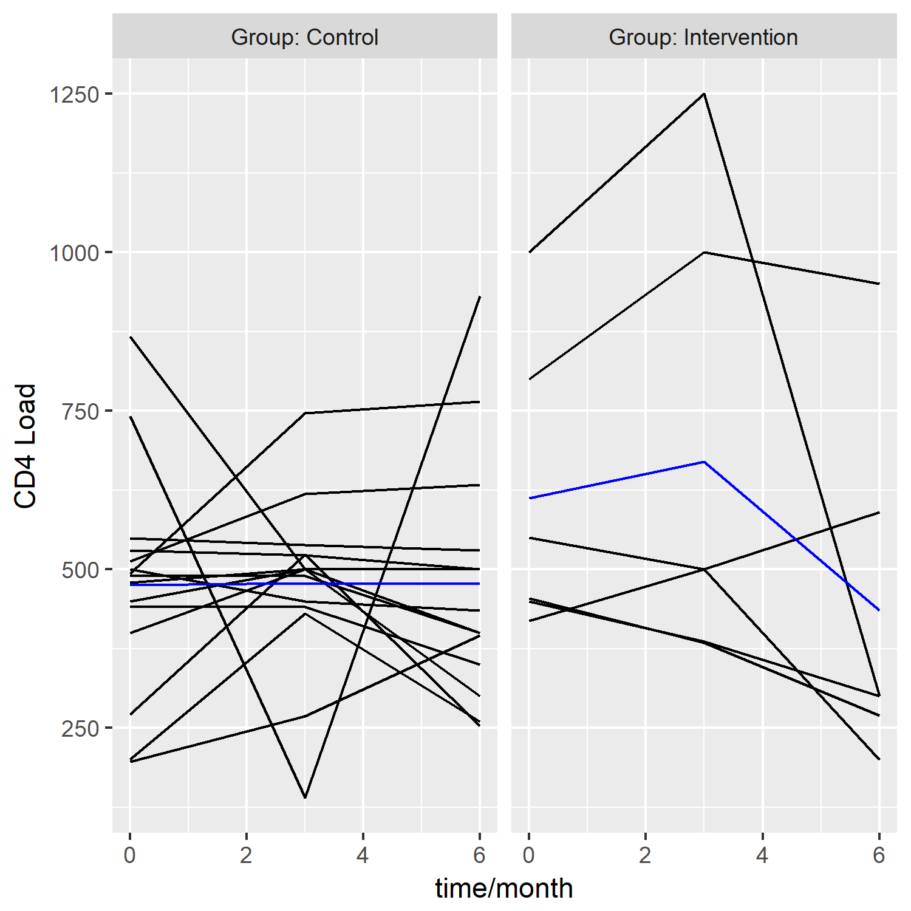
Kaiser – CD4_count
The higher, the better
Sample size: 29 with 15 control, 14 intervention

Slide 14
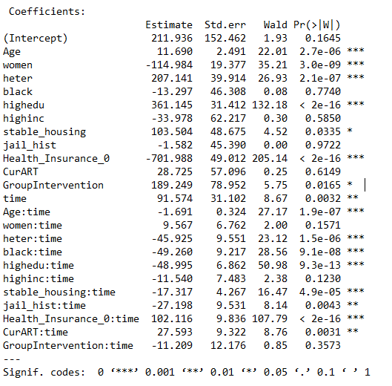
Kaiser – CD4_count
Main result:
Intervention group has higher CD4 on average of all time period.
The CD4 count will go up in both groups as time goes by.
The increasing rate in intervention group is less than that of the control group, yet not significant.
Byproduct:
The increasing rate among people with health insurance is higher than those without.

Slide 15
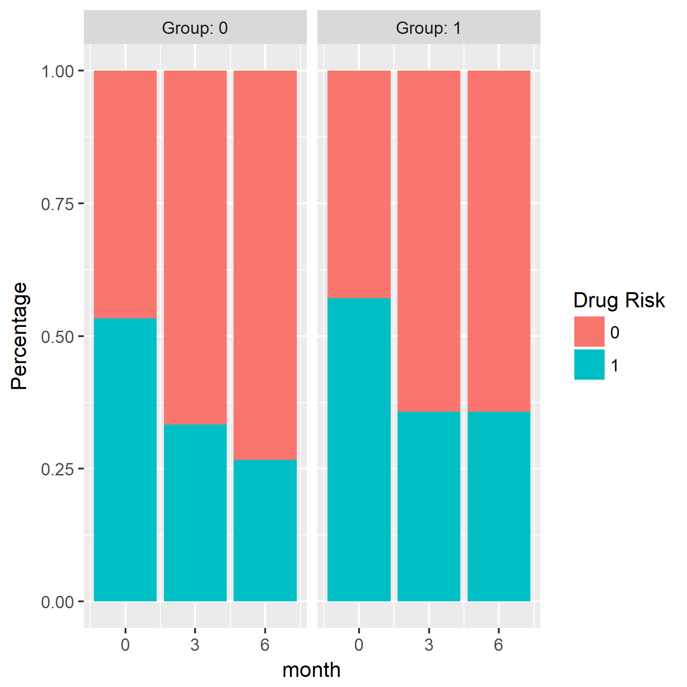
Kaiser – Drug risk
Definition: whether people get injection during the past 30 days
Sample size: 29 with 15 control, 14 intervention

Slide 16
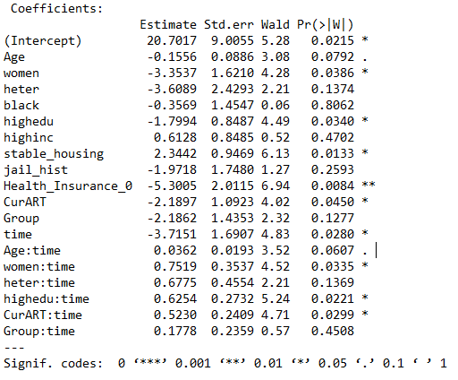
Kaiser – Drug Risk
Drug Risk in both group decreases as time goes by.
Yet the intervention group has lower decreasing rate.
But again this difference is not significant.

Slide 17
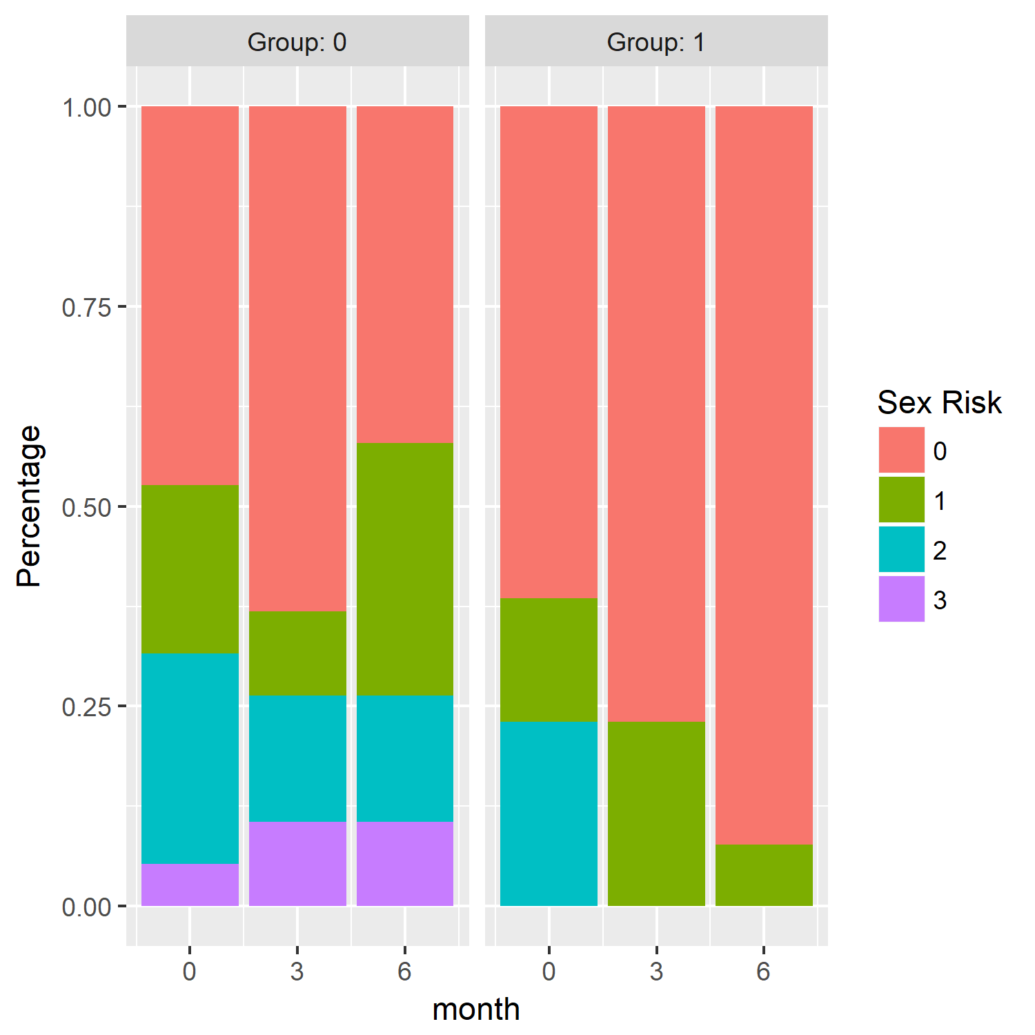
Kaiser – Sex Risk
Definition:
(whether have more than one sex partners)
+
(whether have sold sex in the past 90 days)
+
(whether have purchased sex in the past 90 days)
Sample size:
32 with 19 control 13 intervention

Slide 18
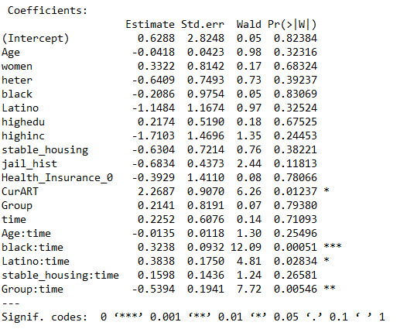
Kaiser – Sex Risk
The sex risk on average tends to increase with time.
The sex risk in the intervention group tends to decrease, which is statistically significant.

Slide 19
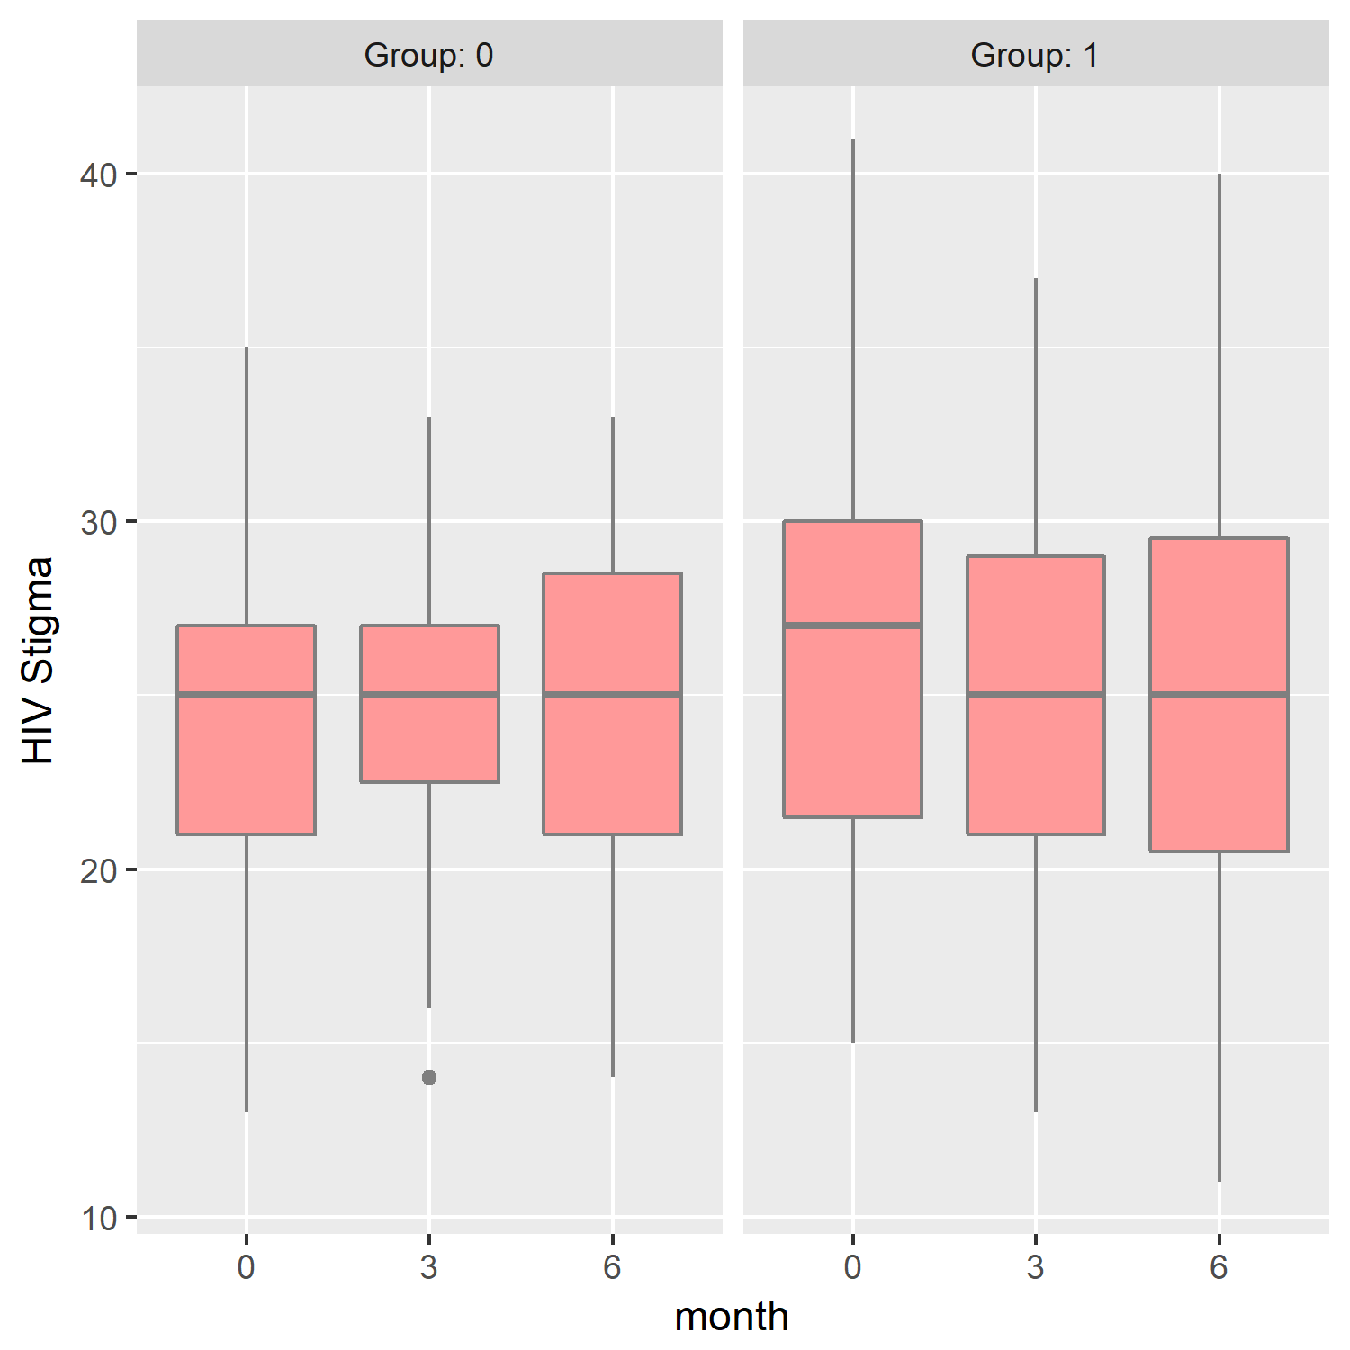
Kaiser – HIV Stigma
Definition: Scores of questions regarding several social relationships
The higher, the higher HIV potential risk
Sample size: 78 with 47 control and 31 intervention

Slide 20
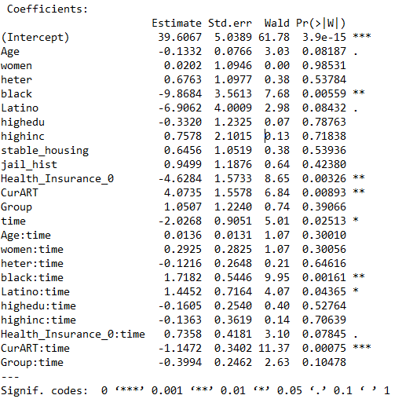
Kaiser – HIV Stigma
Both groups have lower HIV Stigma in the later phase.
If taken ART at the beginning, this drop rate will be larger.
The intervention helps, with little statistical significance.

Slide 21
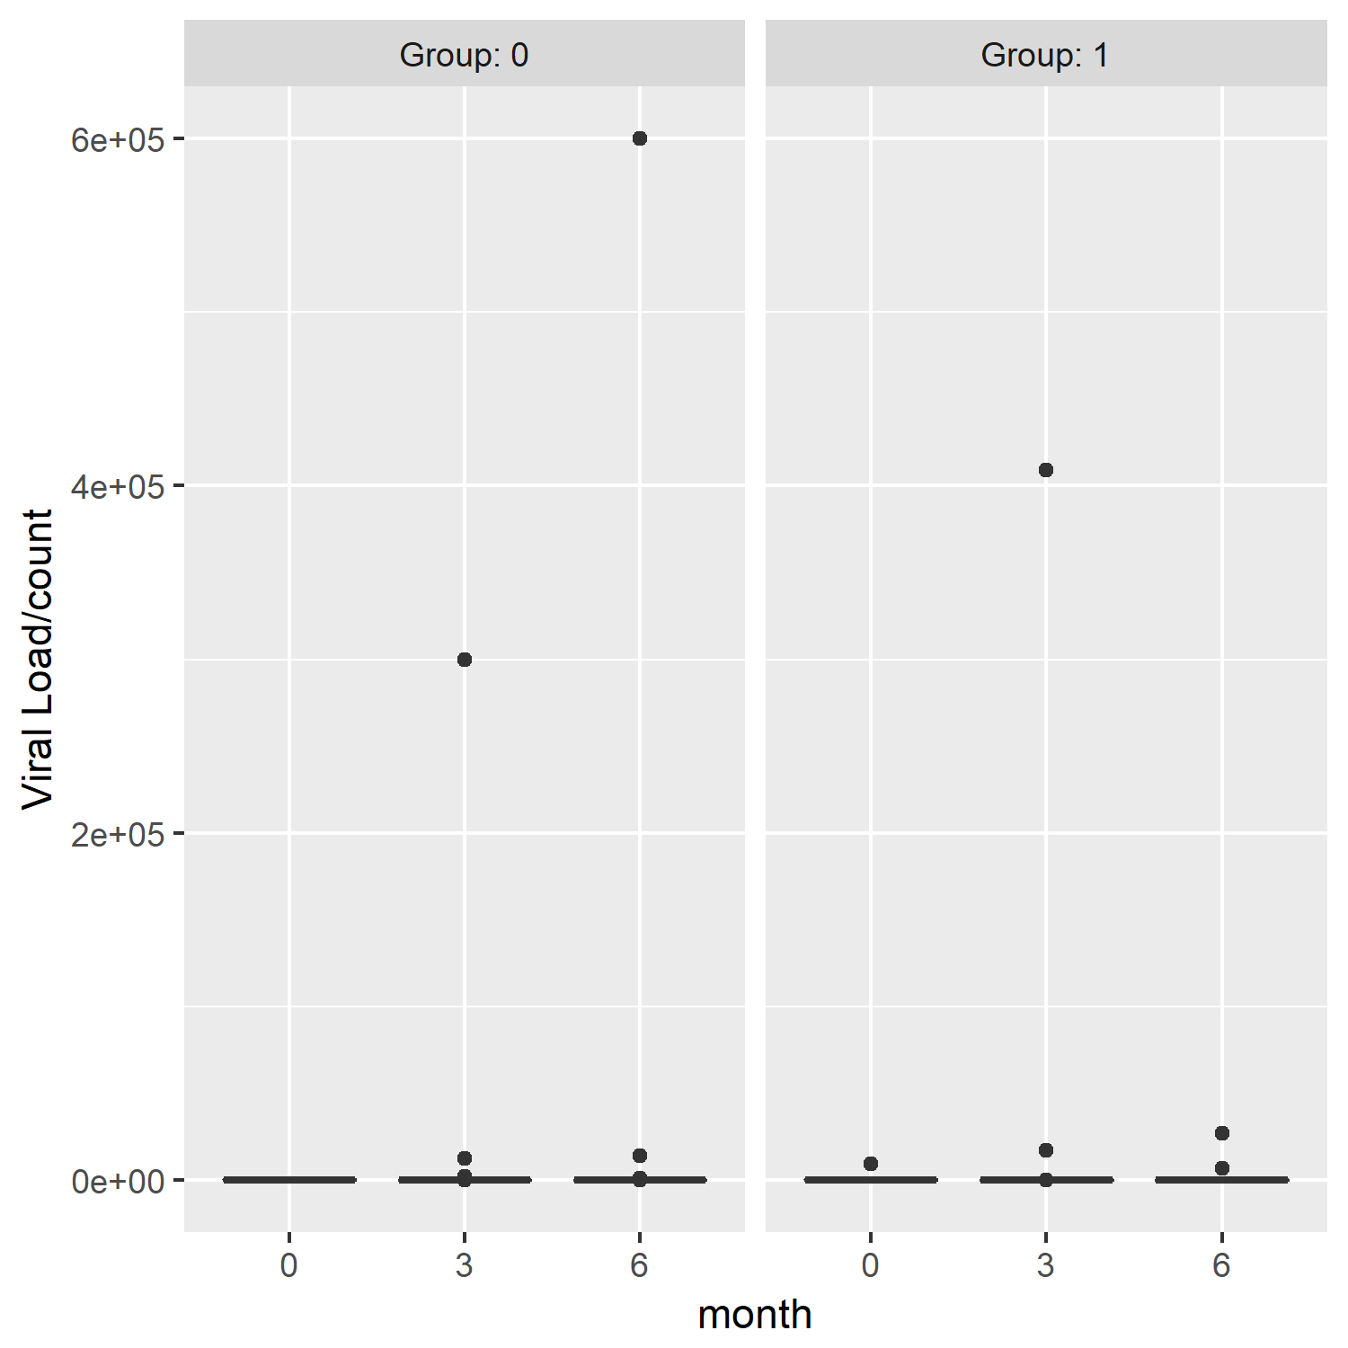
Kaiser – ill Data[Viral Load]
Group | Baseline (0 month) | FU1 (3 month) | FU2 (6 month)
Control | 0.61 | 0.81 | 0.86
Intervention | 0.70 | 0.79 | 0.90

Slide 22
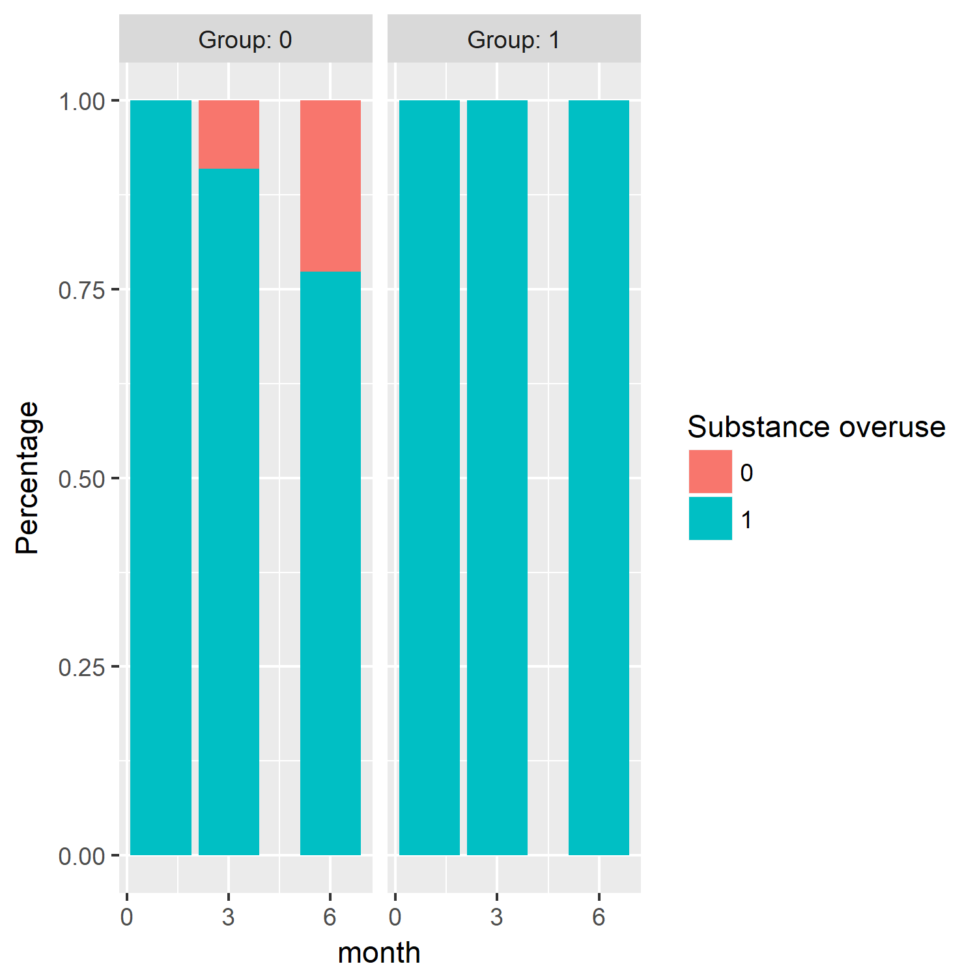
Kaiser – ill Data[Substance Overuse]
Substance Overuse proportion | Baseline | FU1 | FU2
Conrol | 98% | 87.2% | 62.5%
Intervention | 100% | 100% | 96.6%

Slide 23
Kaiser - Conclusion
Both control group and intervention group behave better regarding CD4 count, Drug risk and HIV Stigma as therapy goes on.
The intervention has significant effect in reducing the sex risk.
The effect of intervention on other indexes is not statistically significant.
The effect of other factors can be analyzed from result presented before.
E.g: ART enrollment has positive effect on the drop of HIV Stigma

Slide 24
Possible problems
Small sample size in most of the analysis process.
Data not censored completely randomly.

Slide 25
SEAHI Project Review-Aims&Procedures
Measure knowledge and action about social determinants of health and health inequalities
Data collected from Turkprime survey and Community Wise data
Total 515 participants answered 79 questions

Slide 26
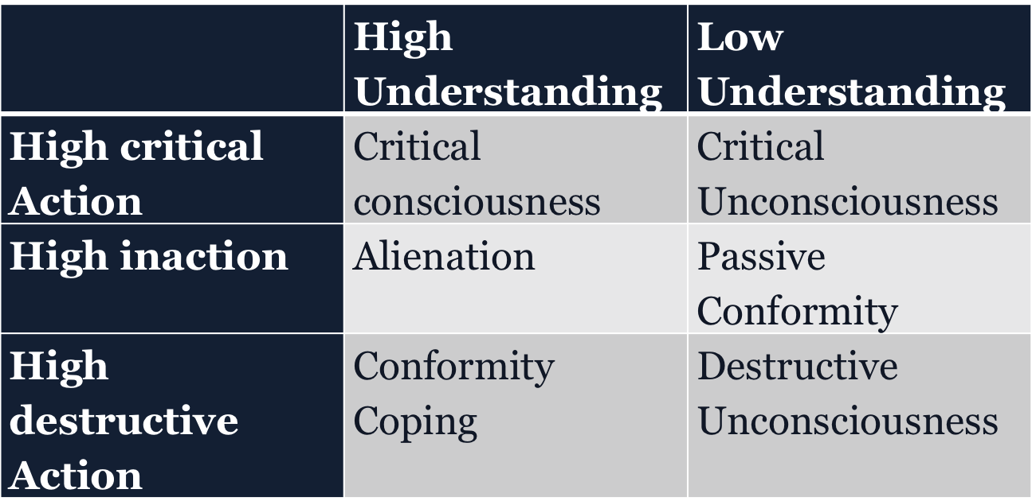
SEAHI Project Review- Hypothesized Categories

Slide 27
SEAHI Project Review-Questions
Is it OK run a LCA to confirm the 6 categories
Is it OK to run the PCA and LCA using same data?

Slide 28
SEAHI - Liliane’s Goal
1. Design a more concentrate questionnaire based on 79 questions [Variable selection]
2.Divide 515 participants into 6 different groups and test if they fits 6 Hypothesized Categories [Clustering]

Slide 29
SEAHI - Variable Selection [EFA-Communalities]
Exploratory Factor Analysis[EFA] - A statistical approach for determining the correlation among variables
Communalities – The extent to which an item correlates with all other items[higher is better]
Criteria: Communalities >0.6
Dataset contains 487 participants with 33 variables
Notes:
“Exploratory Factor Analysis.” Exploratory Factor Analysis - StatWiki, StatWiki, 4 Nov. 2017, statwiki.kolobkreations.com/index.php?title=Exploratory_Factor_Analysis#Communalities.

Slide 30

SEAHI-Clustering [LCA]
Latent Class Analysis[LCA] – Identify discrete, mutually exclusive latent classes of individuals based on categorical responses (Lanza2007)
Assumption: Local Independence
Gmax -the maximum number of clusters [has to be 3 based on the following condition]
Cj - the number of categories of variables, M is the number of variables[33].(Fop 2017)
Notes:
Lanza, Stephanie T., Linda M. Collins, David R. Lemmon, and Joseph L. Schafer. "PROC LCA: A SAS procedure for latent class analysis." Structural Equation Modeling 14, no. 4 (2007): 671-694.
Fop, M., Smart, K. and Murphy, T. B. (2017). Variable selection for latent class analysis with application to low back pain diagnosis. Annals of Applied Statistics. 11(4), 2085-2115.

Slide 31
SEAHI-Clustering [RF]
Hierarchical Clustering : objects that are similar tend to land in the same leaves of classification or regression trees.
Random Forest[RF] clustering – Estimate distance matrix with proximity
Notes:
Buttrey, S. E., & Whitaker, L. R. (2015). treeClust: an R package for tree-based clustering dissimilarities.

Slide 32
SEAHI-Clustering [K-mean]
K-means: to partition observations into clusters in which observations belongs to cluster with nearest mean.
Divided in to 4,6 and 5,7 cluster[5,7 with the consideration of trash cluster]
Inaction behavior can be consider as Destructive action

Slide 33
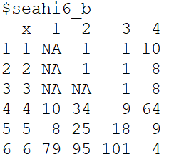
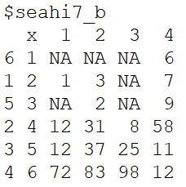
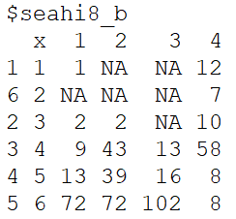
Results [K-mean]
Similar distribution and matched with PCA result
Example:

Slide 34
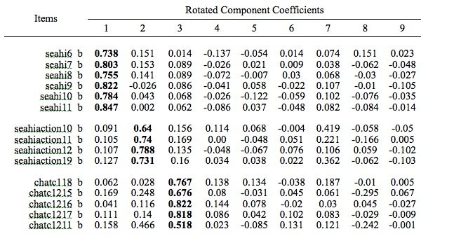
SEAHI-Clustering [K-mean]

Slide 35
SEAHI-Clustering [K-mean]
 | K1 | K2 | K3 | K4
seahi | 6 | 6[54] | 6 | 4 | High_U
C13 | 1 | 534 | 54 | 54 | Low_U
Seahia10-19 | 534 | 1 | 65 | 132 | Critical
C101-103 | 3 | 3[2] | 34 | 3[2] | Critical
C118-12 | 45 | 34 | 54 | 34 | Critical
Seahia20,22 | 123 | 3 | 1 | 3 | Incation
C16 | 13 | 123 | 12 | 123 | Inaction
chatc15a1 | 12 | 342 | 324 | 324 | Destructive
C14,15 | 12 | 12 | 12 | 23 | Destructive

Slide 36
SEAHI-Clustering [K-mean]
 | K1 | K2 | K3 | K4 | K5 | K6 | K7
seahi | 6 | 6 | 456 | 46 | 6 | 6 | 4 | High_U
C13 | 1 | 35 | 45 | 35 | 35 | 34 | 234 | Low_U
C101-03 | 3 | 3 | 34 | 23 | 4 | 3 | 3 | Critical
C118-12 | 4 | 34 | 45 | 123 | 5 | 4 | 34 | Critical
Seahi10-19 | 23 | 34 | 45 | 1 | 6 | 13 | 13 | Critical
C16 | 3 | 13 | 34 | 1 | 1 | 123 | 12 | Inaction
Seahi20,21 | 23 | 1 | 3 | 35 | 1 | 3 | 3 | Inaction
Chatc15a1 | 12 | 34 | 34 | 4 | 13 | 23 | 3[2] | Destructive
C14,15 | 12 | 1 | 34 | 12 | 1 | 12 | 23 | Destructive

Slide 37
Thanks!

