Slide 1
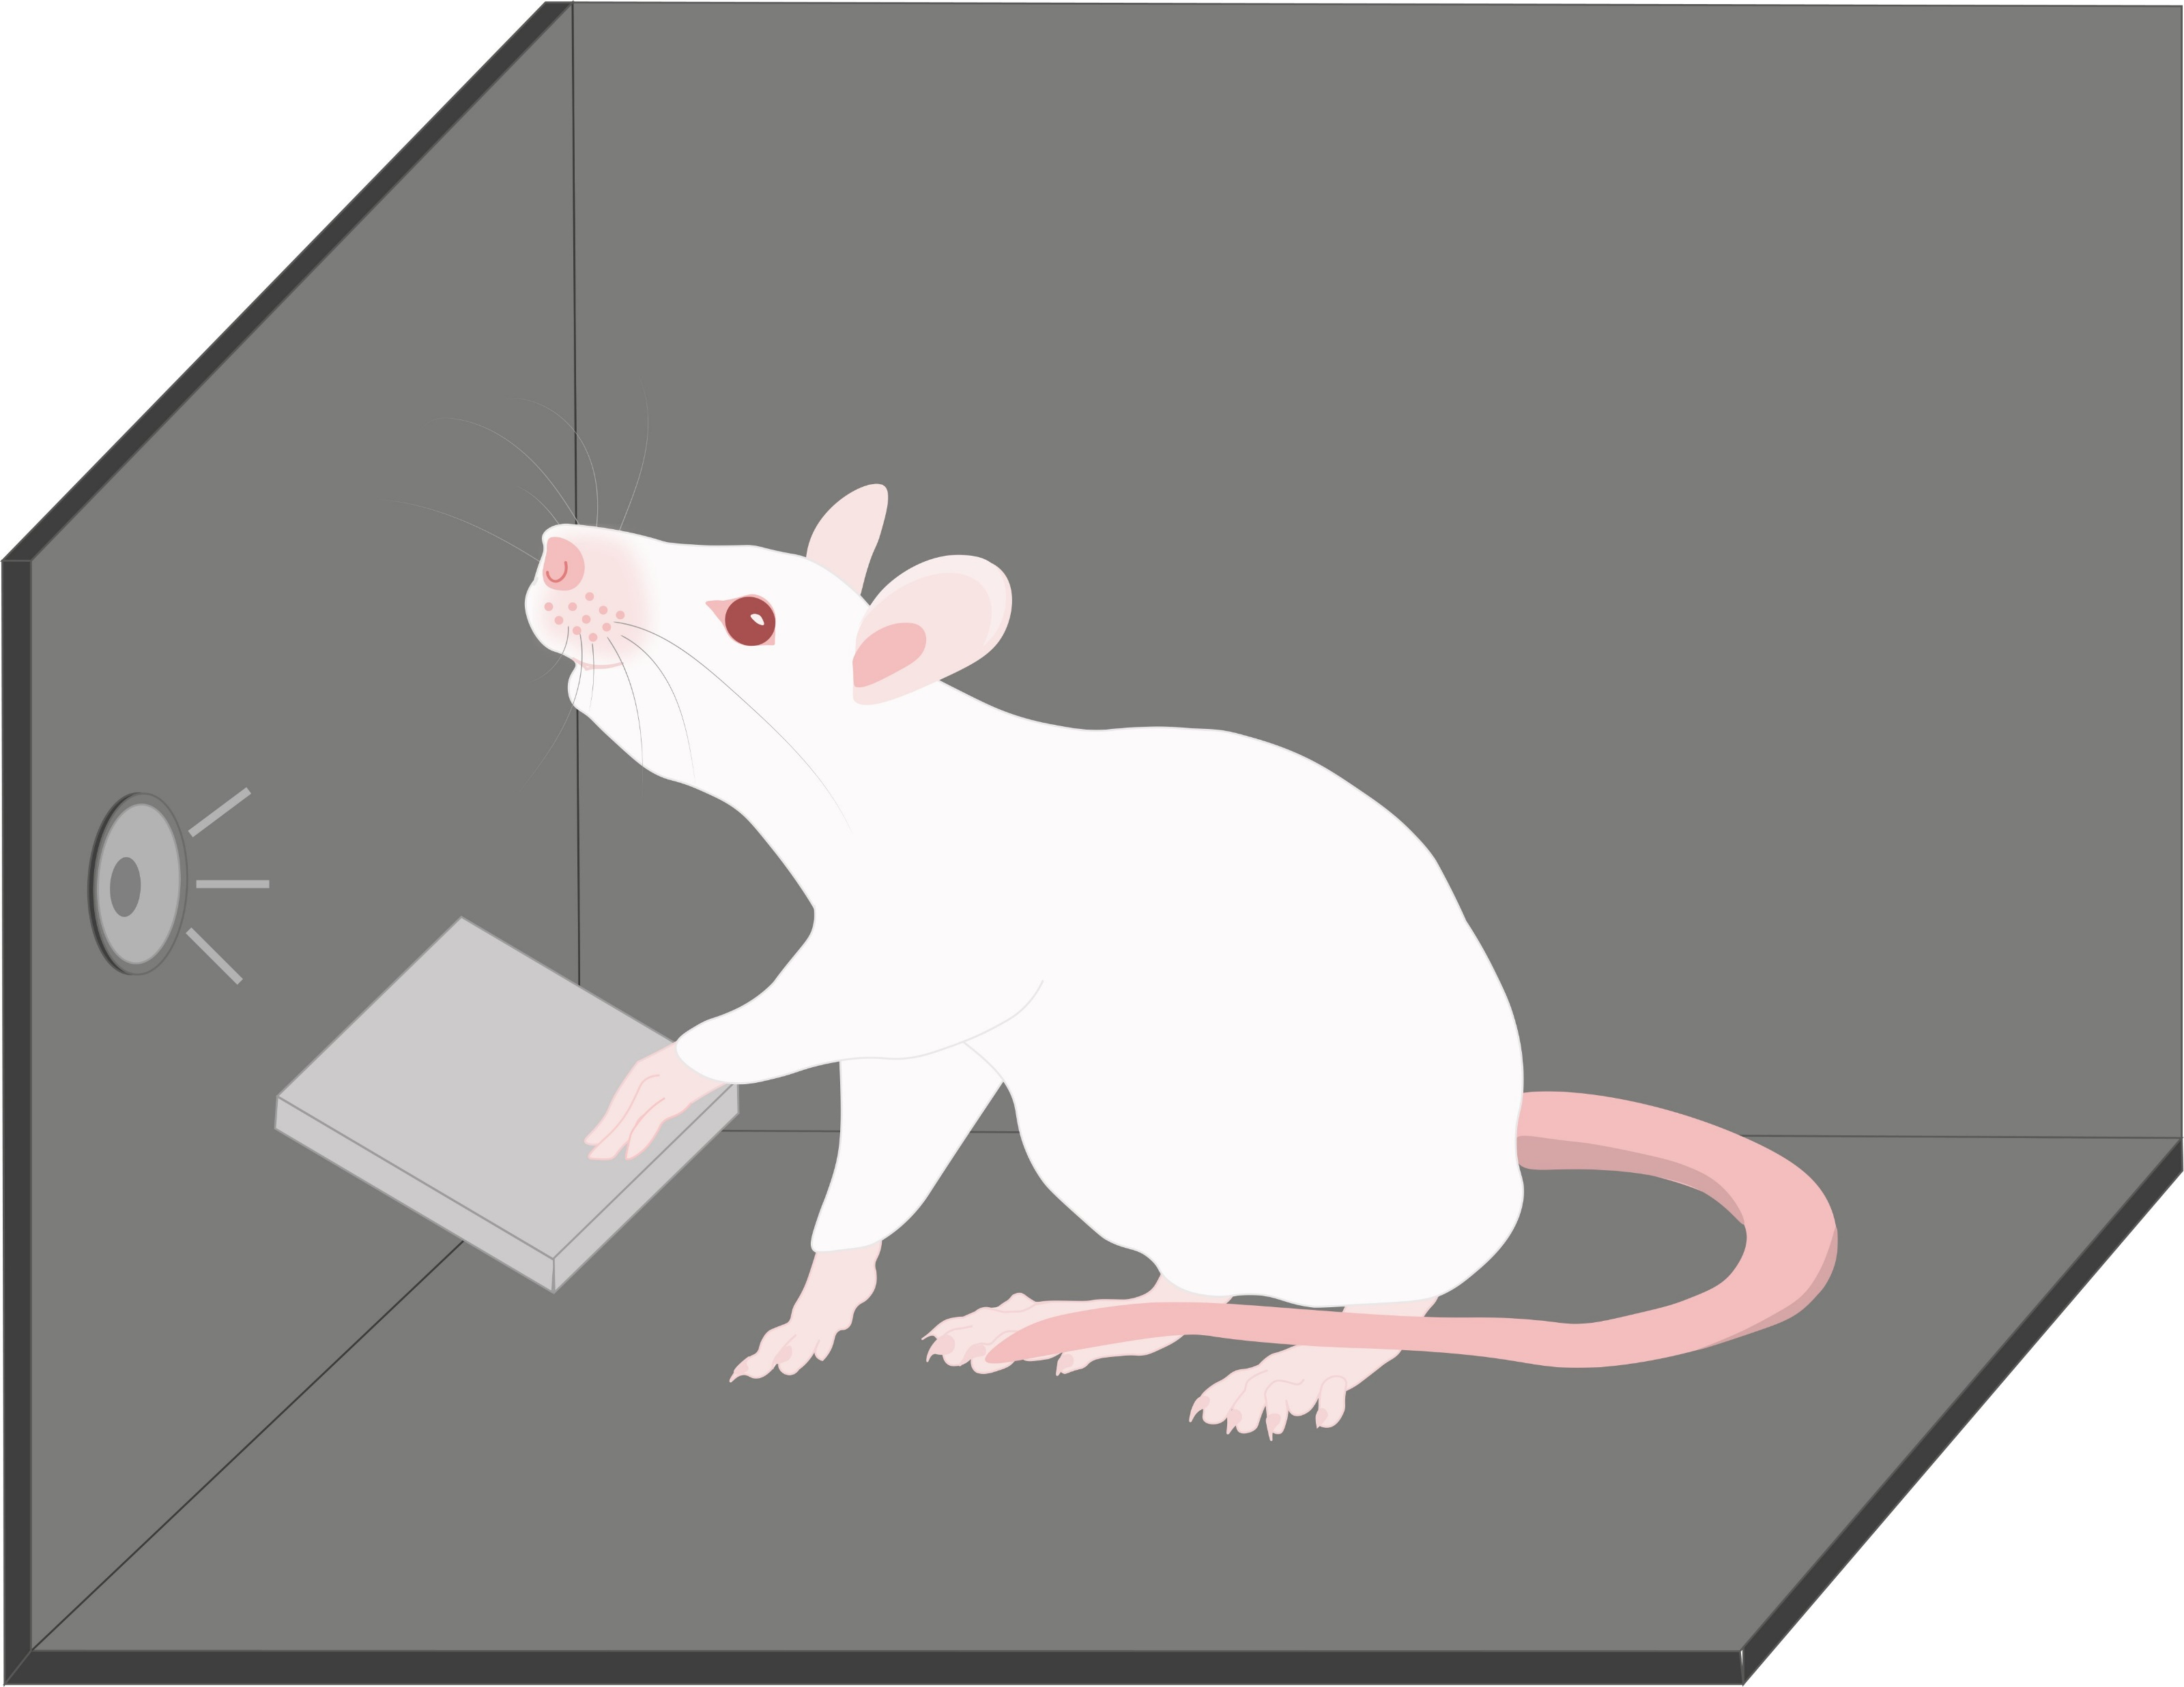
A
B
Tone
Foreperiod = 0.75s or 1.5s
Response Window
Press
Holding
Release
Premature
Late

Slide 2
A
B
触发信号
Foreperiod = 0.75 s或1.5 s
反应窗口
按杆
维持按杆
松杆
Premature
Late

