Slide 2
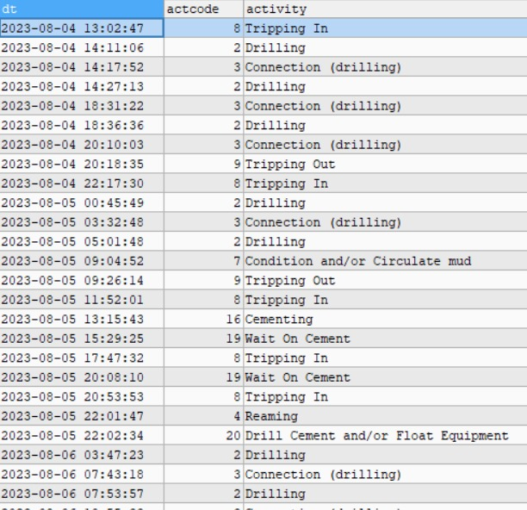
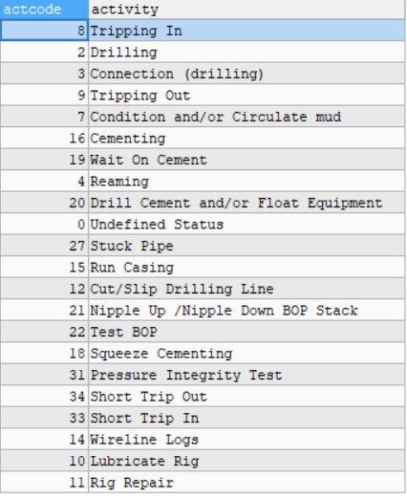
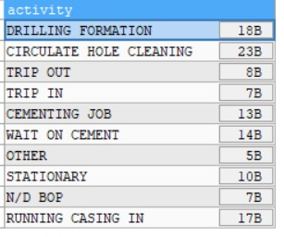
Example:
Unique Activity:
Unique Activity:

Slide 3
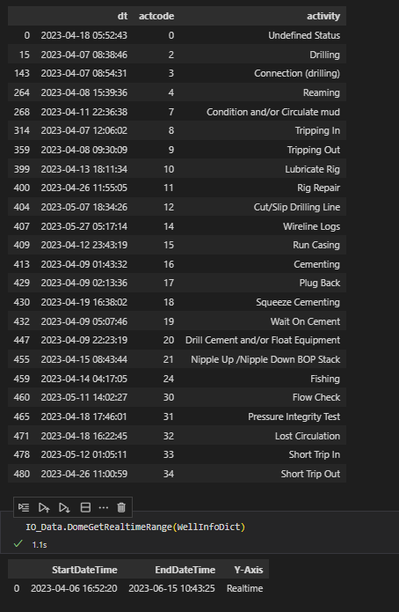
Example Case:
Company : MCG
Wells : IJN 2-1
The Realtime Range is very different with the Rig Activity
Especially on the EndDateTime

