Slide 1

COMPAS Algorithm Fairness Analysis: A Logistic Regression
Mitigating the racial disparity gap to achieve an equitable recidivism risk assessment.

Slide 2
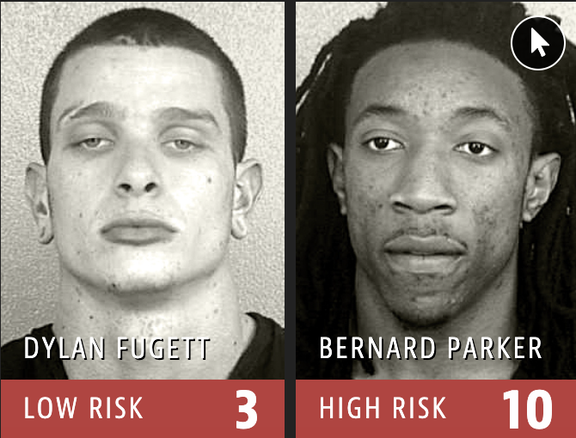

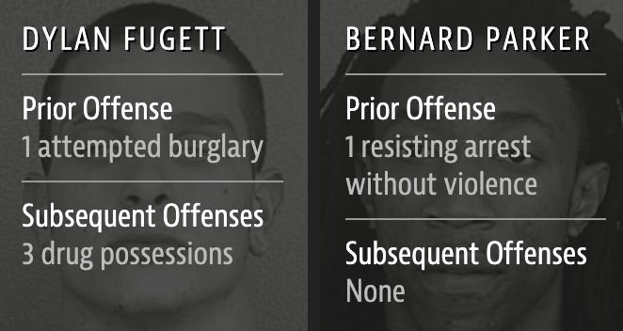
Background & Core Objectives
•
Introduction to COMPAS: A proprietary risk assessment tool widely used to predict a defendant's likelihood of recidivism.
•
Racial Inequality: Research indicates significant systemic bias, specifically a glaring discrepancy in False Positive Rates (FPR) between Black and White defendants.
•
Optimization Goal: To restructure the algorithm and significantly weaken the predictive gap between races, all while maintaining overall model accuracy.

Slide 3

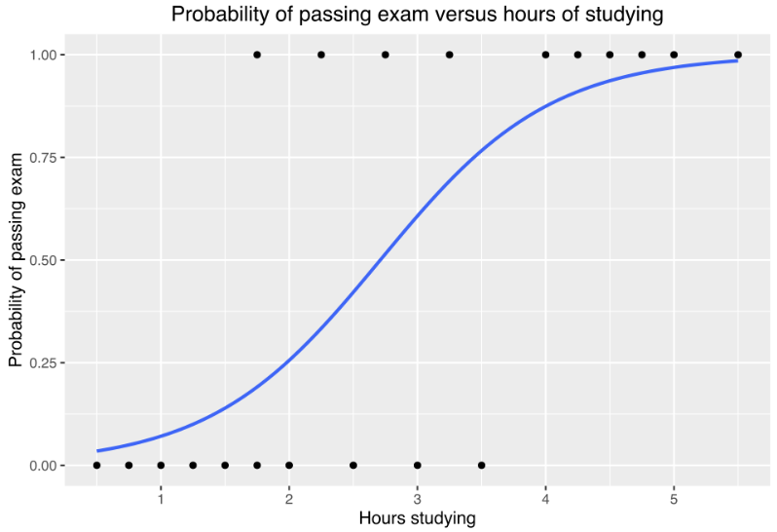

Methodology & Data Source
Core Model
Rationale
- Better Interpretability
- Highly robust against overfitting,
- Particularly suitable for small to medium-sized datasets.
Data Source
The standardized CSV file provided via the course, containing anonymized defendant features and their verified two-year recidivism records.
Logistic Regression
Unlike complex black-box algorithms, it outputs clear probabilities and transparent relationships.

Slide 4
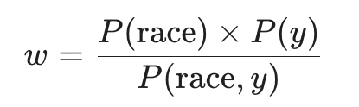
Removing Systemic Bias via Sample Reweighing
Core Concept: We use Sample Weights to break the "false correlation" between race and recidivism, forcing the model to ignore race and focus on criminal behavior.
How it works (A "Parallel World" Example):
Imagine a dataset of 100 people (50 Black, 50 White):
Reality (Biased): 40 Black recidivists vs. 10 White recidivists.
The Shortcut: A "lazy" model would simply learn: "Being Black = High Risk."
Black Recidivists: W = (0.5 * 0.5) / 0.4 = 0.625
White Recidivists: W = (0.5 *0.5) / 0.1 = 2.5
For Black Recidivists: The penalty for a wrong guess drops from 1 to 0.625. The model realizes "over-focusing" on this group doesn't yield high rewards.
For White Recidivists: The penalty for a wrong guess jumps from 1 to 2.5. The model is now "scared" of missing these cases and must study their specific features to get them right.
"While Reweighing removes the model's 'subjective prejudice', it cannot erase 'historical systemic bias' embedded in features like priors_count. However, it ensures the model treats the evidence (5 priors) equally, regardless of the person's race."

Slide 5
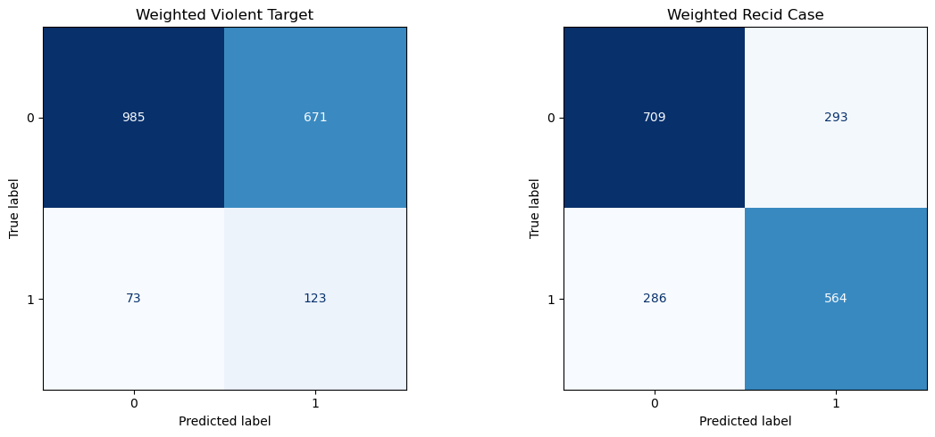
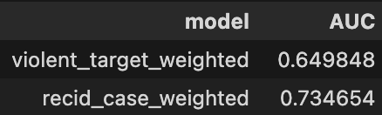
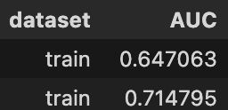
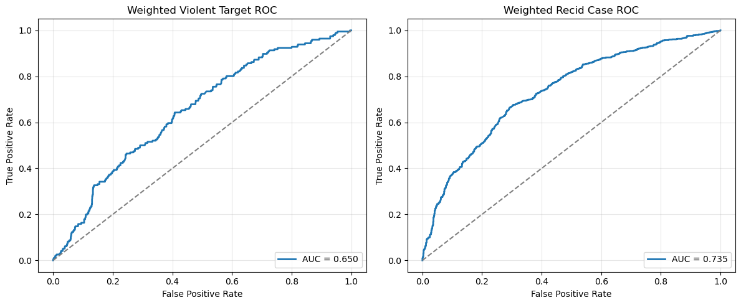
Our Model Performance
Data Split: 80/20 train-test split mechanism
Performance:
•
•
Sample Weighting: Applied strategic Sample Weights during training to penalize predictive biases caused by class imbalances.
•

Slide 6
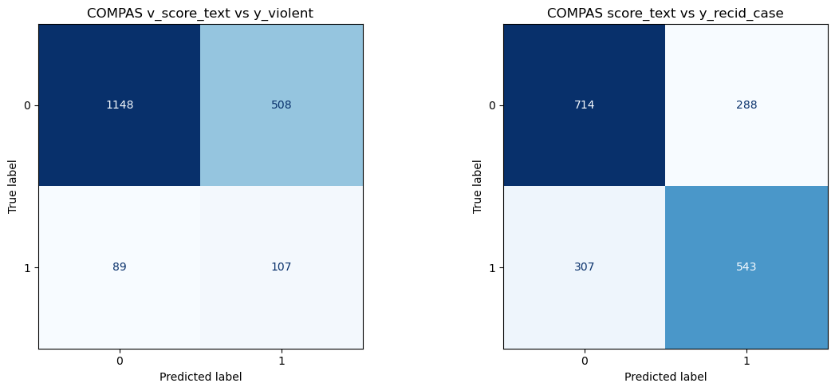
Compare with COMPAS
AUC, Accuracy, FPR, FNR ……
Useful?
•

Slide 7
Defining True Fairness
True algorithmic fairness is not about ignoring race but strictly balancing the metrics like False Positive Rate (FPR) and False Negative Rate (FNR) across demographics to substantially close the predictive gap.
"
"

Slide 8
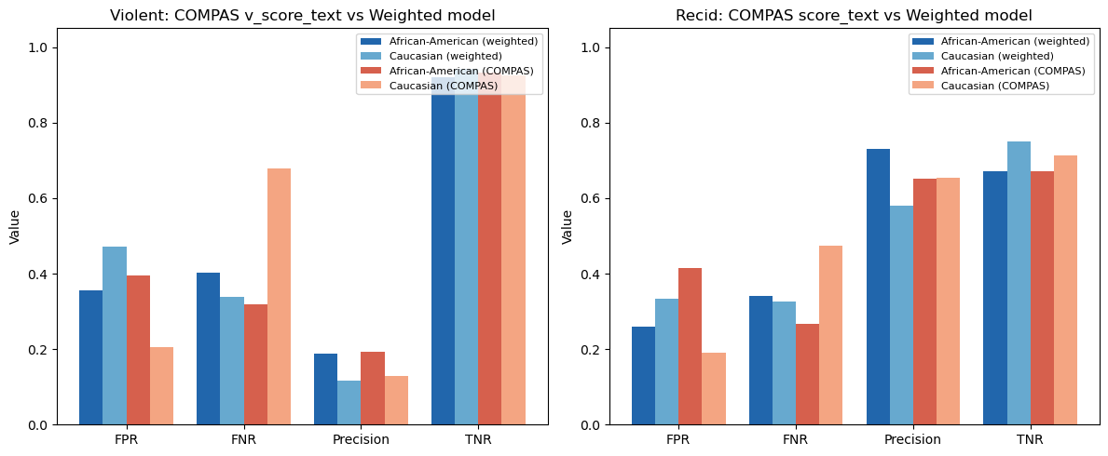
Compare with COMPAS -- Fairness

Slide 9
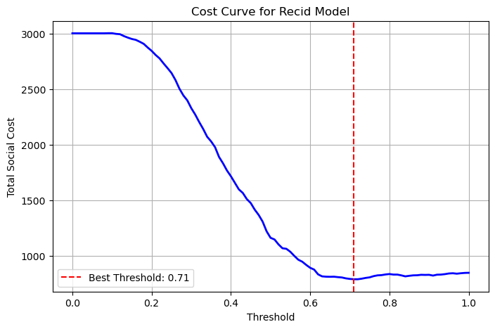
About Threshold…
For violent defendants, the judge is willing to reject the parole request of 4 non-recidivating defendants if it successfully stops 1 violent recidivist from getting released. (low FN, high recall)
For non-violent defendants, the judge is only willing to reject the parole request of 1 non-recidivating defendant if it means preventing the early release of 3 non-violent defendants. (low FP, high precision)
But we need high recall for violent defendants
For non-violent : 0.71
For violent : 0.5
Totalcost = (FN*cost_fn)+(Fp*cost_fp)
cost_fn, cost_fp = (4,1) or (1,3)

Slide 10

Interpretability and Explainability
Our prediction: P(violent=1)): 0.3926
P(non-violent=1)): 0.3322
In Data Set: Did not recidivate in 2 years
(two_year_recid = 0)
COMPAS: score = 2 get LOW text level
v_score = 2 get LOW text level
Threshold: 0. 71(non-violent: to get best Precision) 0.5 (violent: to get best Recall)
Markee Singletary
Under Our Threshold: Low risk defendant
Is_recid = 0
Is_violent_recid = 0

Slide 11
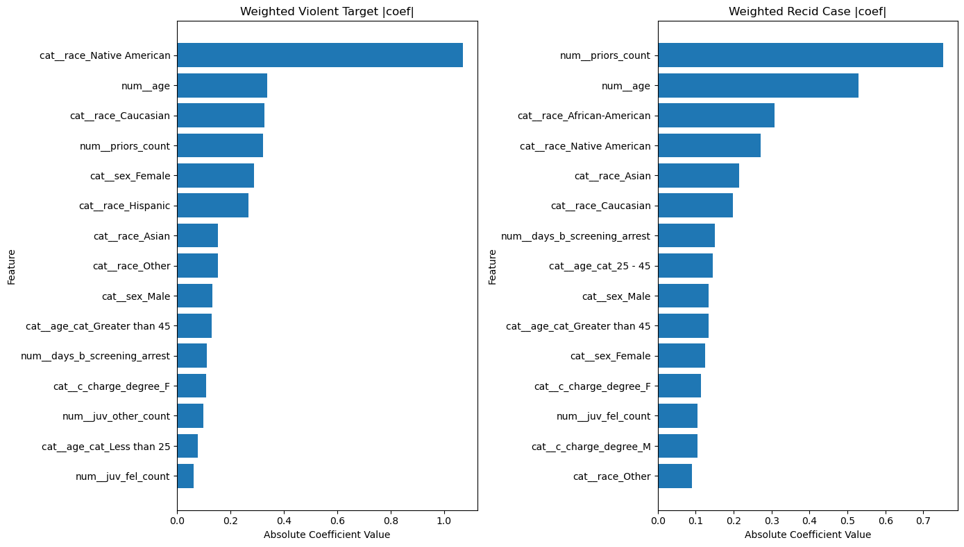
Interpretability and Explainability
Key Risk Factor
Prior count
Strongest predictor. Individuals with more previous convictions are statistically more likely to reoffend.
Age factor
Age shows a negative relationship with recidivism risk, with younger individuals generally exhibiting a higher probability of reoffending than older individuals.
African-American factor:
Significant predictor but not a casual factor.
- policing intensity
- socioeconomic inequality
Since the model is trained on historical criminal justice data, it may also inherit biases in the system.

Slide 12

Final Recommendations & Alignment
Parole Request Recommendations: For defendant ID: 2218, we will recommend the judge granted the parole request.
Aligning with the COMPAS Score: 0.33/1 vs 2/10. Our results are consistent with COMPAS.
Resolving Model Disagreements: If our model contradicts the COMPAS conclusion, we strongly advice you make inferences based on our predictions. It maintains equivalent predictive accuracy while actively suppressing systemic racial misclassification bias.

Slide 13
Questions?
Thank you for your attention. We welcome any questions regarding the model architecture or fairness metrics.

