Slide 1
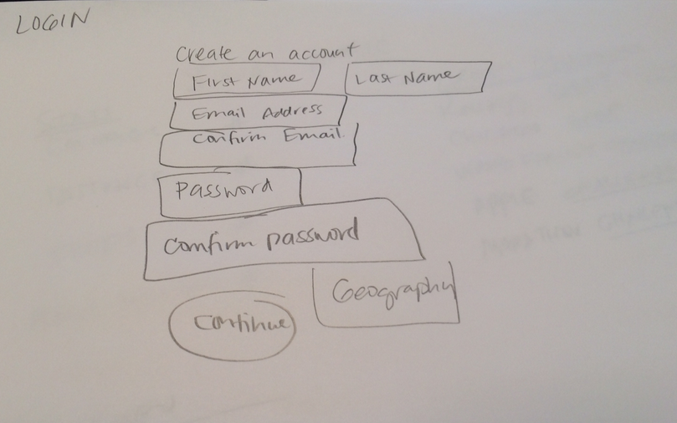

Slide 2
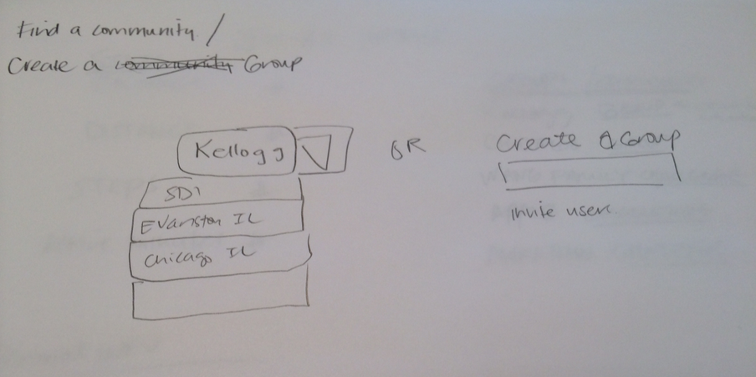
Notes:
Community model//members model database – members and groups.

Slide 3
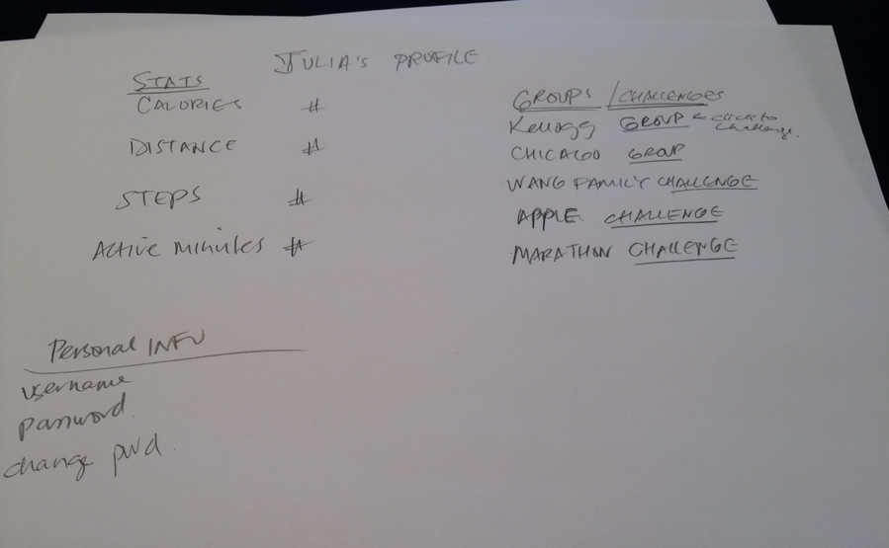
Notes:
Calorie - integer
Distance - float
Steps - integer
Active Minutes - integer

Slide 4
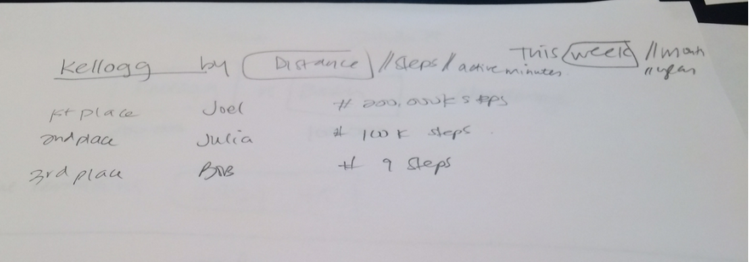

Slide 5
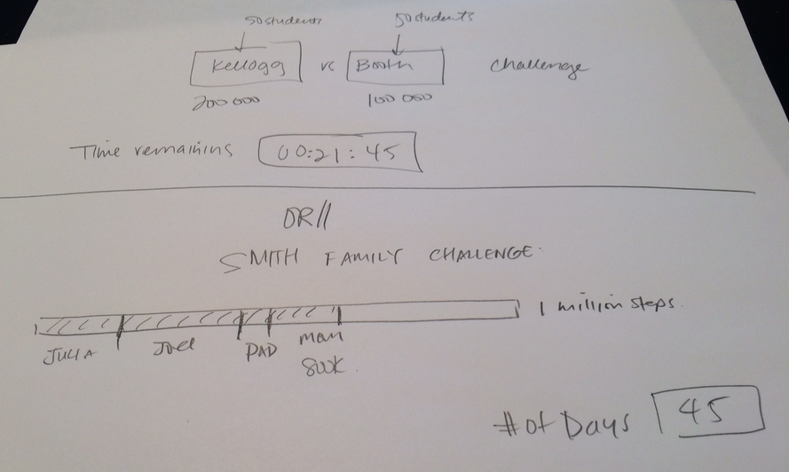

Slide 6
