Slide 1
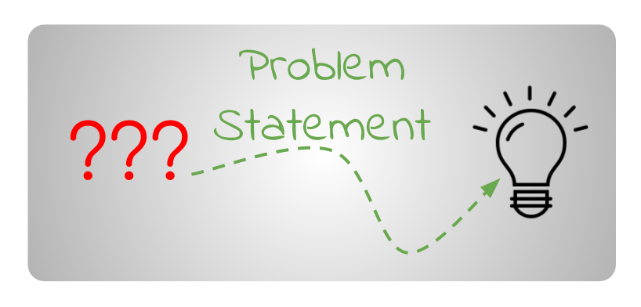


EDA Problem Statement
The CEO of Very Nice Bank is concerned about customer attrition in their credit card services and wants to proactively address the issue by predicting which customers are most likely to cancel their accounts.
How can we address the issue of customer attrition in the credit card services provided by Very Nice Bank Inc?

Slide 2

Goals of EDA
The objective is to offer an initial collection of predictor variables and machine learning models that could be employed for predictive modeling.
This would involve identifying a set of features that may potentially have a significant impact on predicting customer attrition.
Additionally, exploring various machine learning techniques that could be utilized to generate accurate predictions based on the identified features.
The end goal is to create a reliable and effective model that can be used to predict which customers are likely to cancel their credit card services with Very Nice Bank.

Slide 3
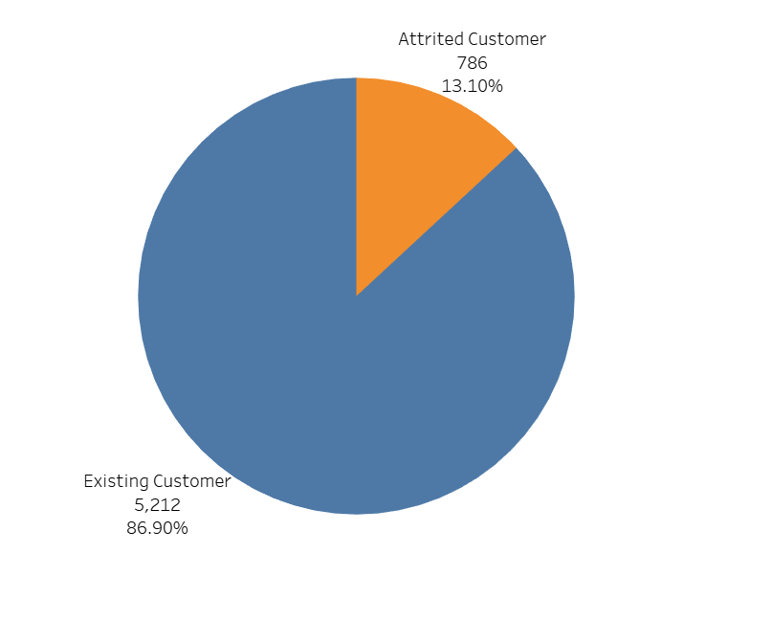
Attrition Count
Data set contains 86.9% of the customers who are using the bank services.
It contains 13.1% of the customers who are not using the services of the bank.
Are there any specific feature/category/sub-category in which the customers are dropping off the bank services?
- Yash Jivani -
Notes:
Pie chart shows %- Among 786 customers, what’s the trend of churning?

Slide 4
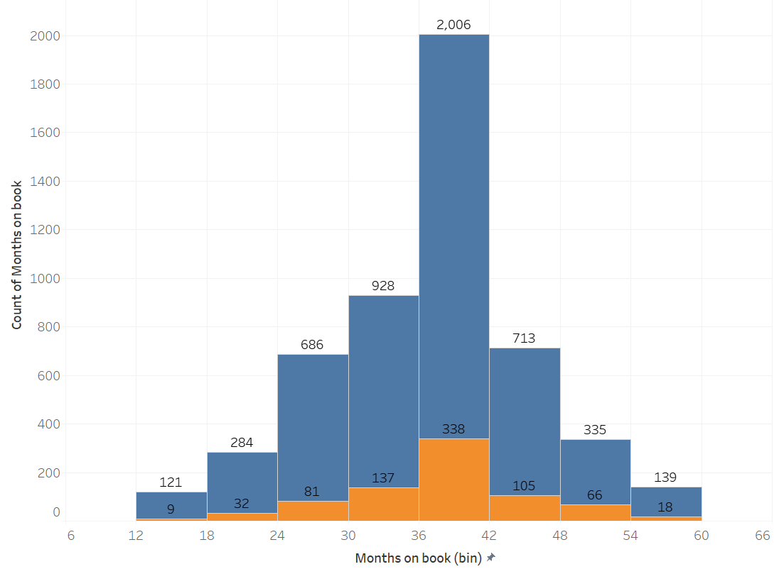

Months on book
(Period of relationship with bank)
Numerical
745 out of 786 (95%) churners are using bank services more than 2 years.
338 out of 745 (45%) churners are the customers using services b/w 3 to 3-1/2 years.
- Yash Jivani -

Slide 5
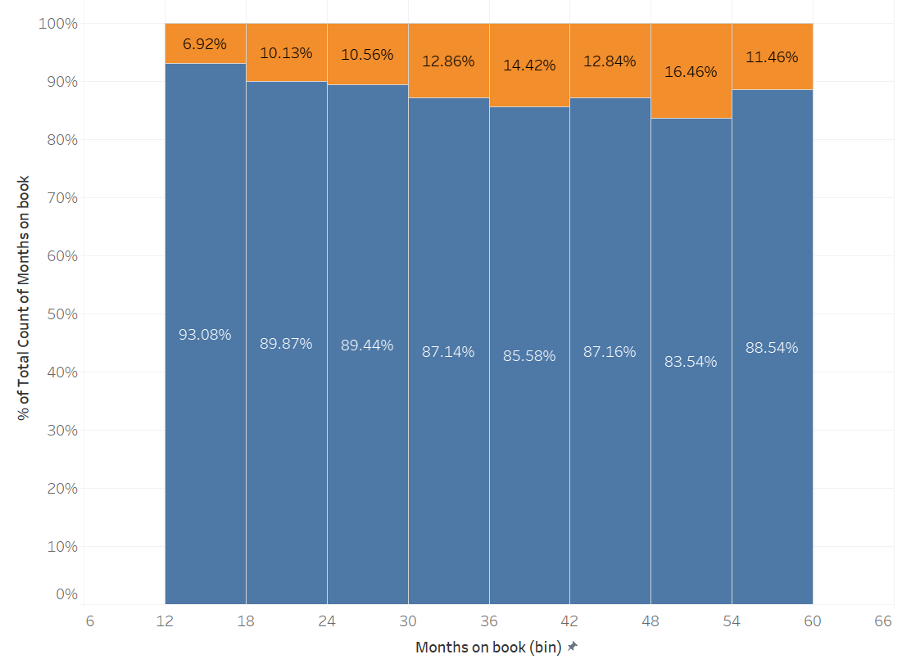
Months on book
After normalizing, the bin of 30-36 months (3 to 3-1/2 yrs), only 14% of the customers in that period are churners.
Nearly around 12% churners in each months’ bin.
- Yash Jivani -

Slide 6
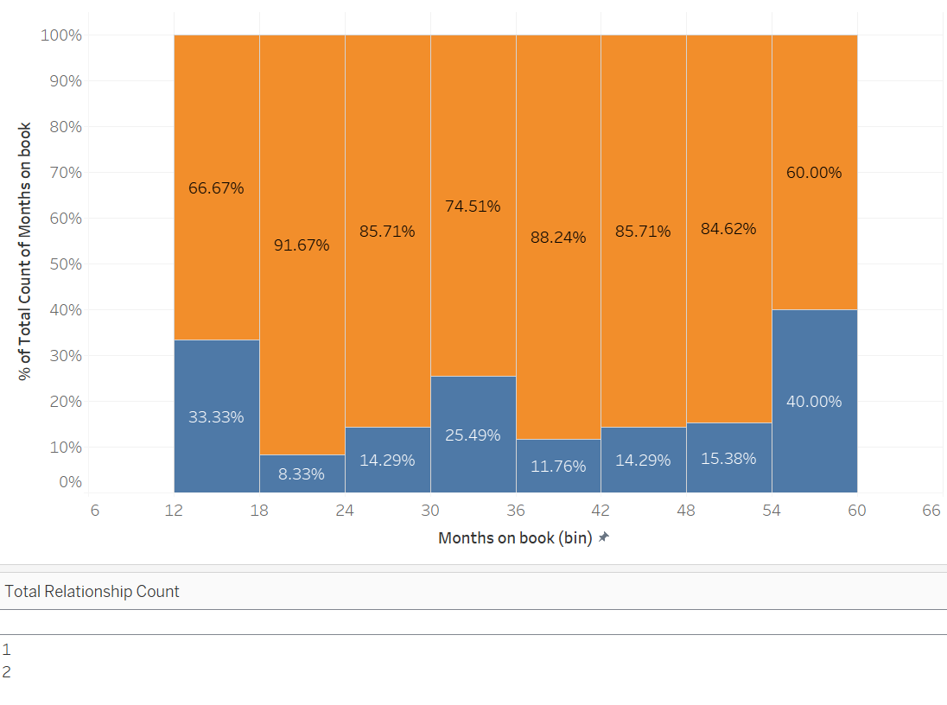
Months on book
After adding filters with Total Relationship Count - 1 & 2, it is clear that customers churn who are almost same.
- Yash Jivani -

Slide 7
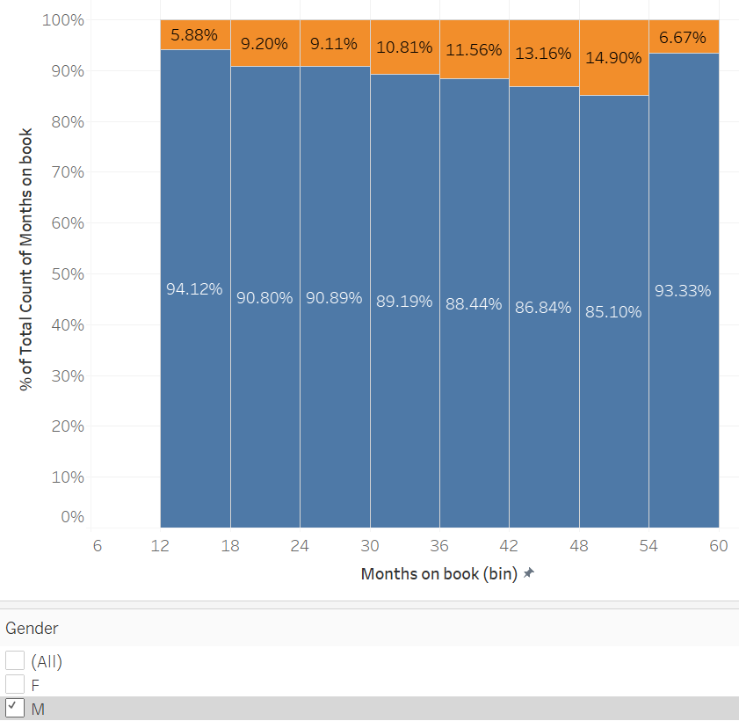
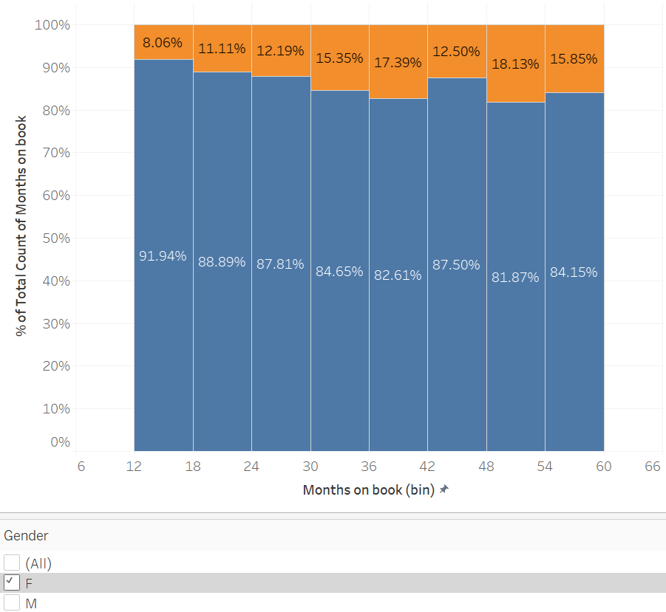

Months on book
Either Male or Female, customer are churning at almost equal %
- Yash Jivani -

Slide 8
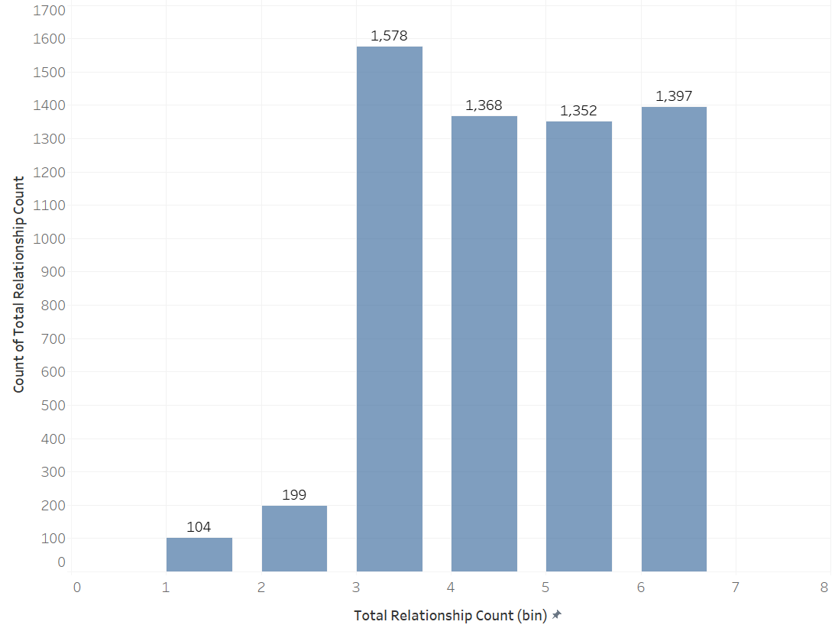
Total Relationship Count
(No. of products/services the customer/s is/are using)
Discrete Categorical
Around 95% customers use products/services more than 2
8
- Yash Jivani -

Slide 9
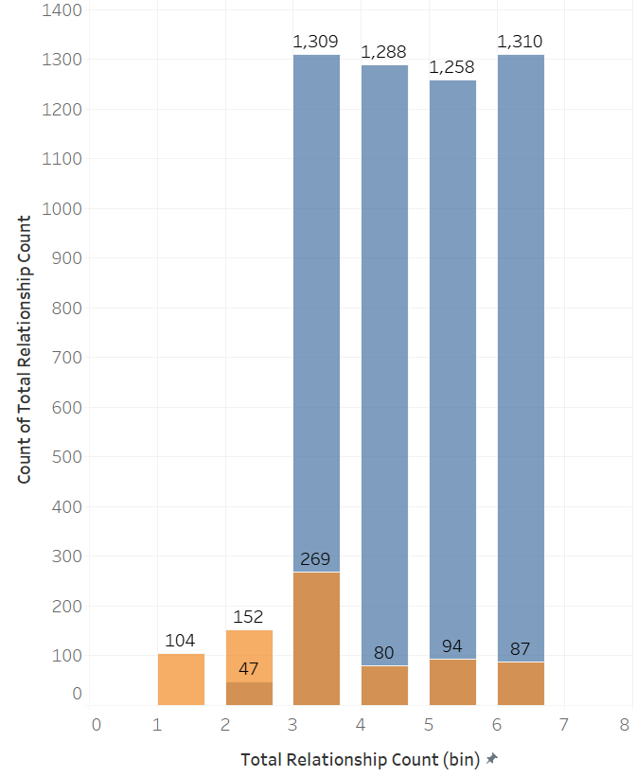
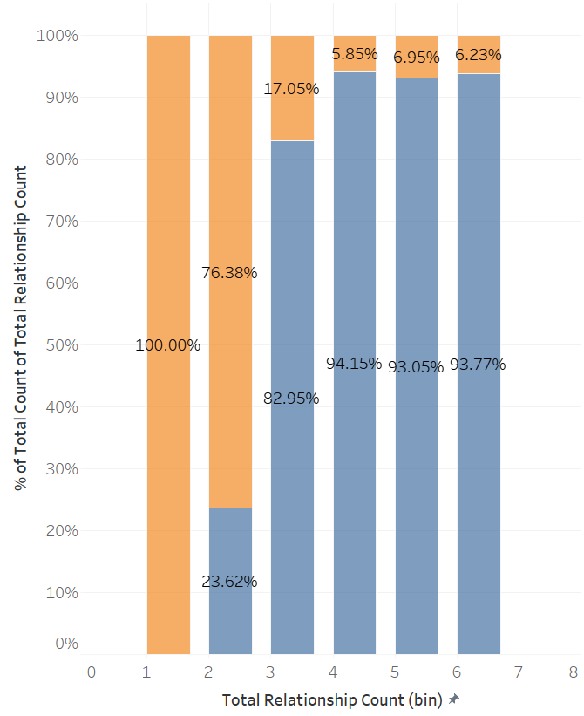
Total Relationship Count
9
Customers using products/services count-1 or 2 are churning
- Yash Jivani -

Slide 10
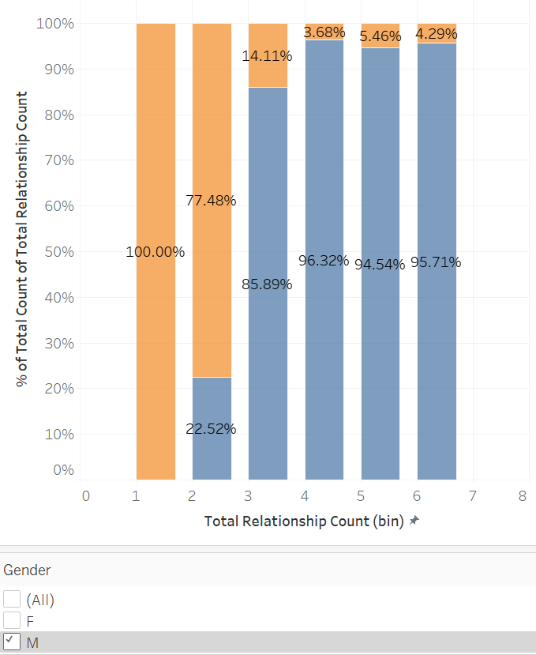
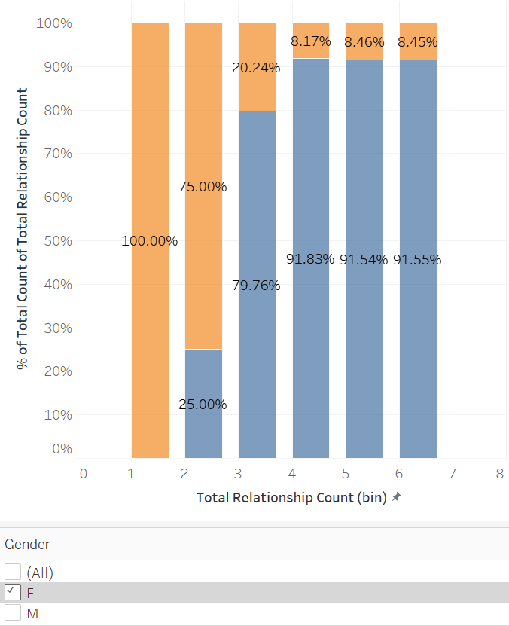

Total Relationship Count
Either Male or Female customer using products/services count-1 or 2 are churning
10
- Yash Jivani -

Slide 11
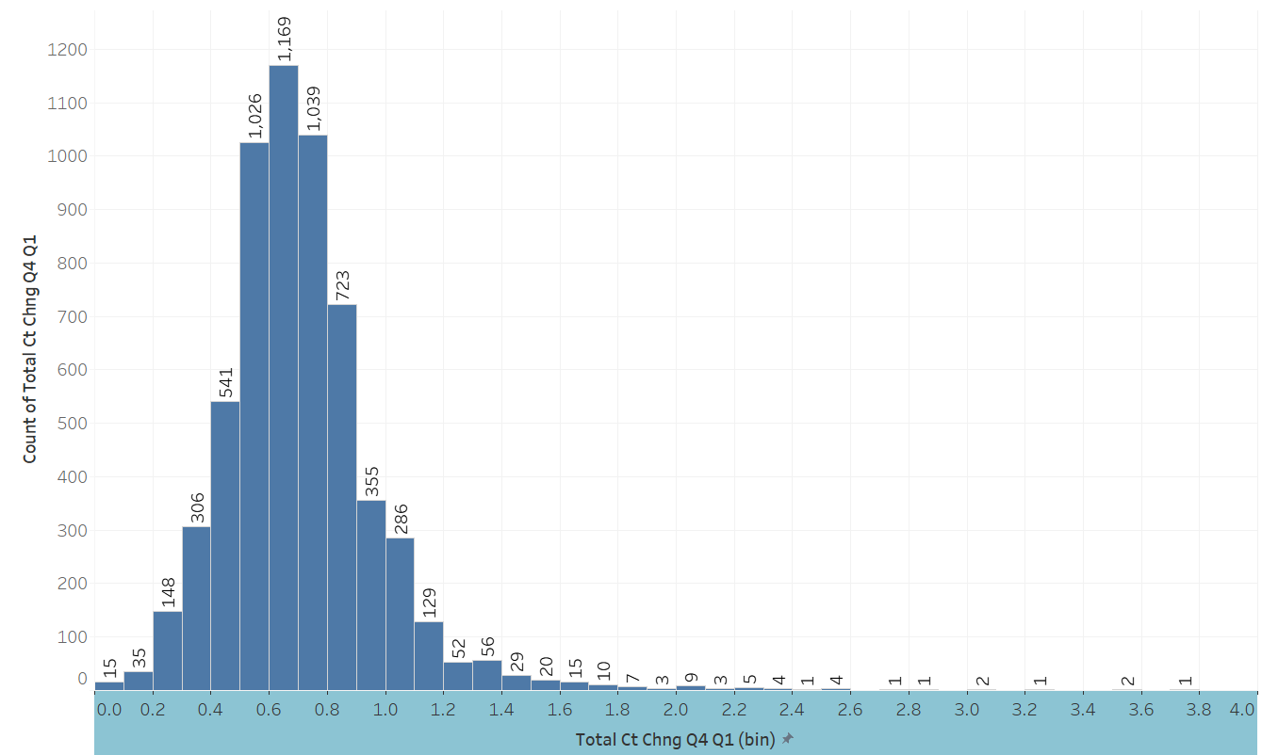
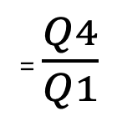
Total Ct Chng Q4-Q1
(ratio of no. of transactions done in Q4 vs Q1)
Numerical
= $\frac{Q4}{Q1}$
- last quarter of the business year (last 3 months)
- first quarter of the business year (first 3 months)
11
- Yash Jivani -

Slide 12
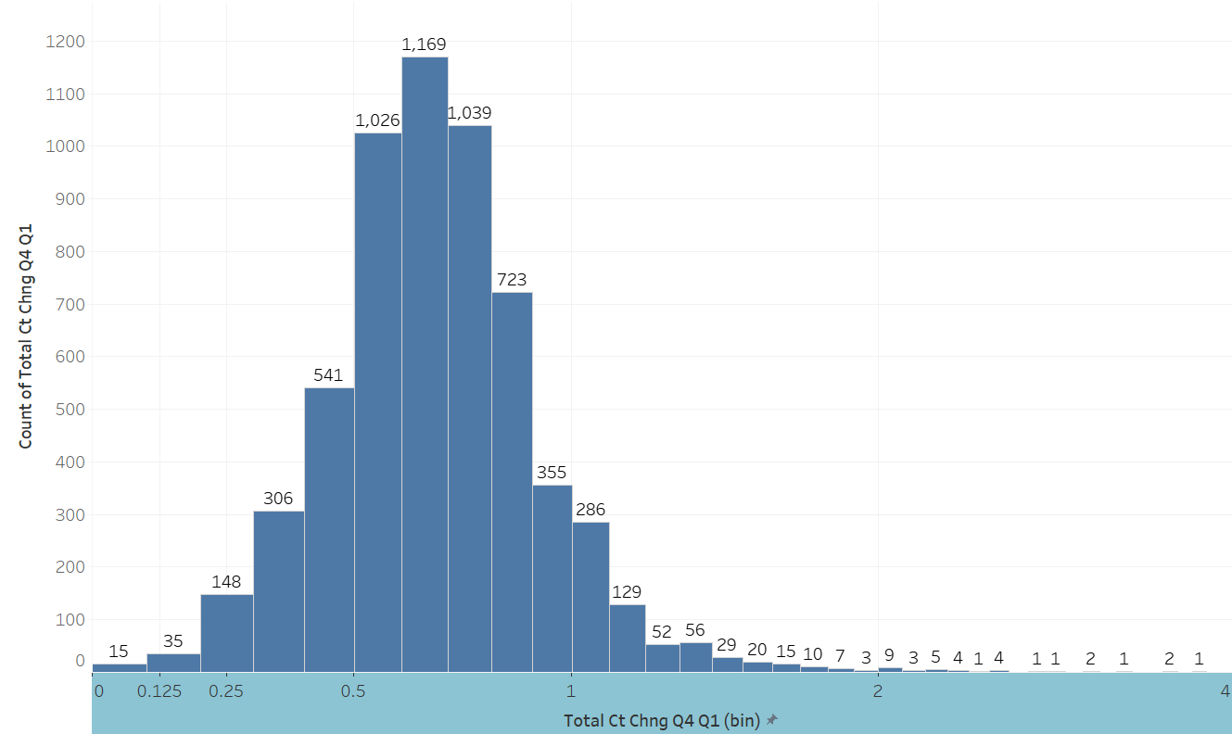
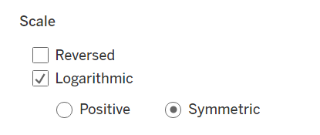
Total Ct Chng Q4-Q1
(ratio of no. of transactions done in Q4 vs Q1)
Using a symmetric log axis scale for small values has a similar effect to using a linear scale (i.e. a normal quantitative axis)
(Source:https://help.tableau.com/current/pro/desktop/en-us/formatting_editaxes.htm#Transform)
12
- Yash Jivani -
Notes:
Using a symmetric log axis scale for small values has a similar effect to using a linear scale (i.e. a normal quantitative axis)
(Source:https://help.tableau.com/current/pro/desktop/en-us/formatting_editaxes.htm#Transform)

Slide 13
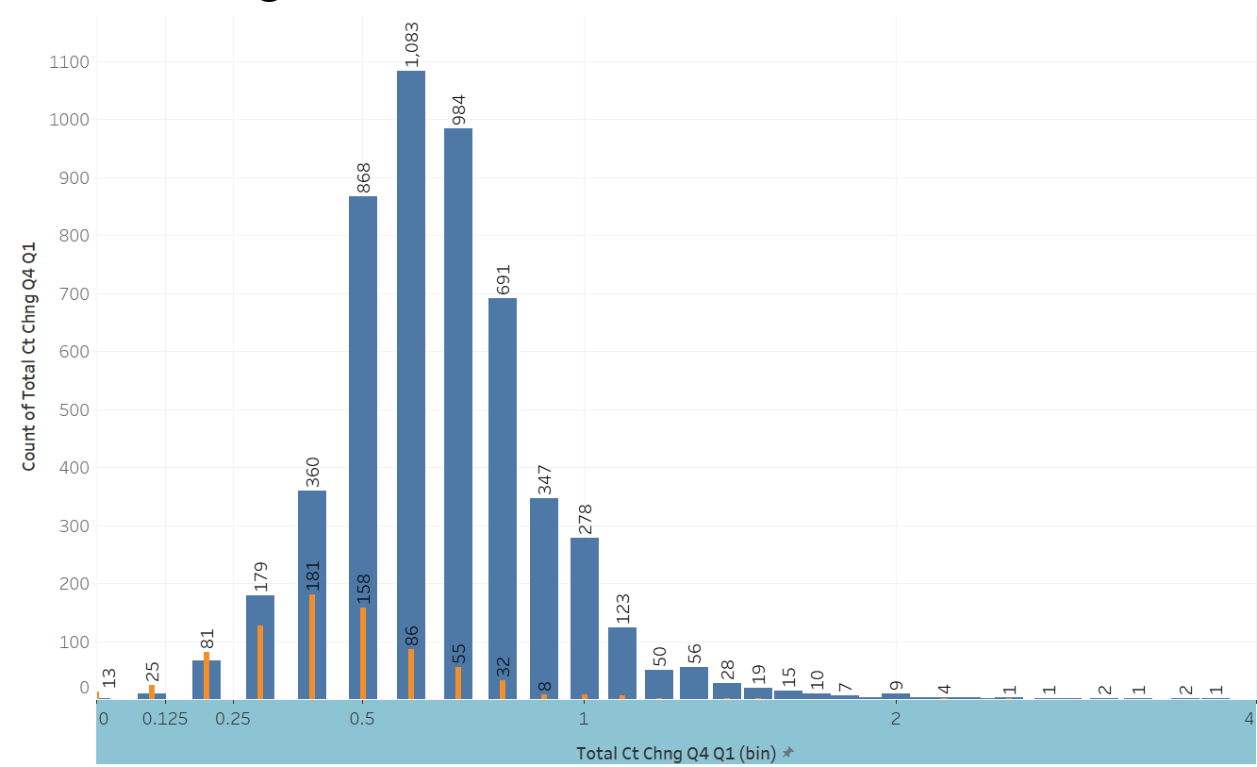
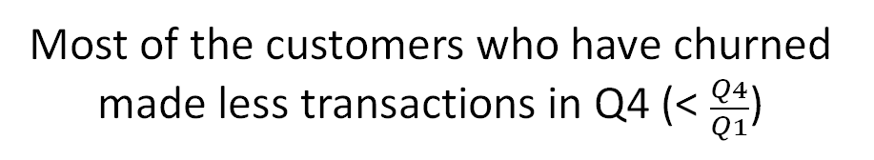
Total Ct Chng Q4-Q1
(ratio of no. of transactions done in Q4 vs Q1)
Most of the customers who have churned made less transactions in Q4 (< $\frac{Q4}{Q1}$)
13
- Yash Jivani -
Notes:
Using a symmetric log axis scale for small values has a similar effect to using a linear scale (i.e. a normal quantitative axis)
(Source:https://help.tableau.com/current/pro/desktop/en-us/formatting_editaxes.htm#Transform)

Slide 14
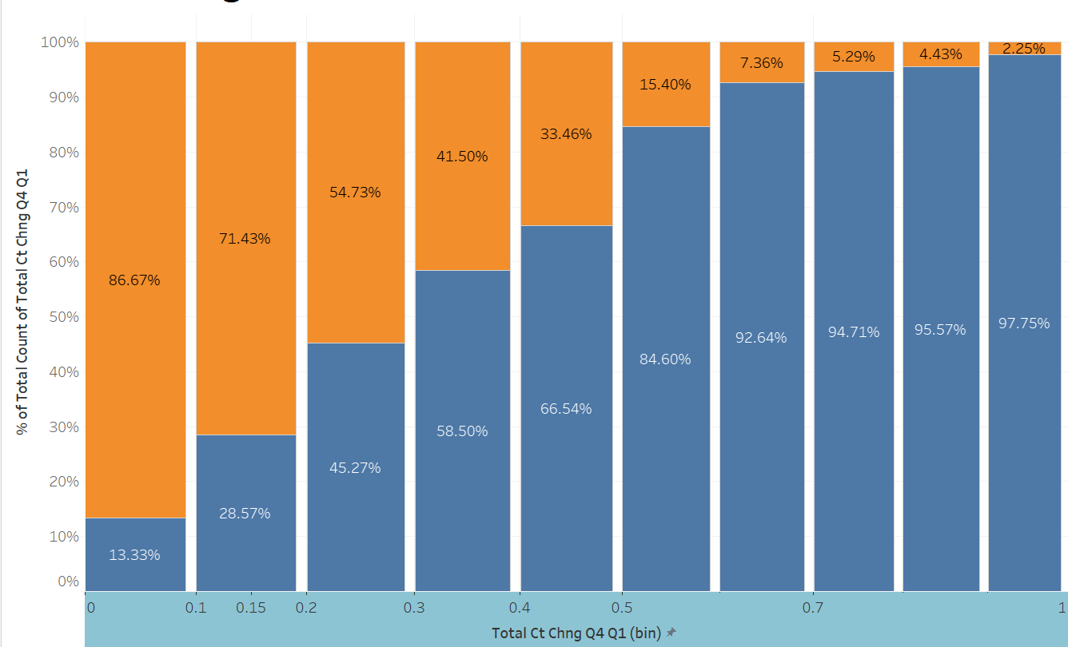
Total Ct Chng Q4-Q1
(ratio of no. of transactions done in Q4 vs Q1)
14
- Yash Jivani -

Slide 15
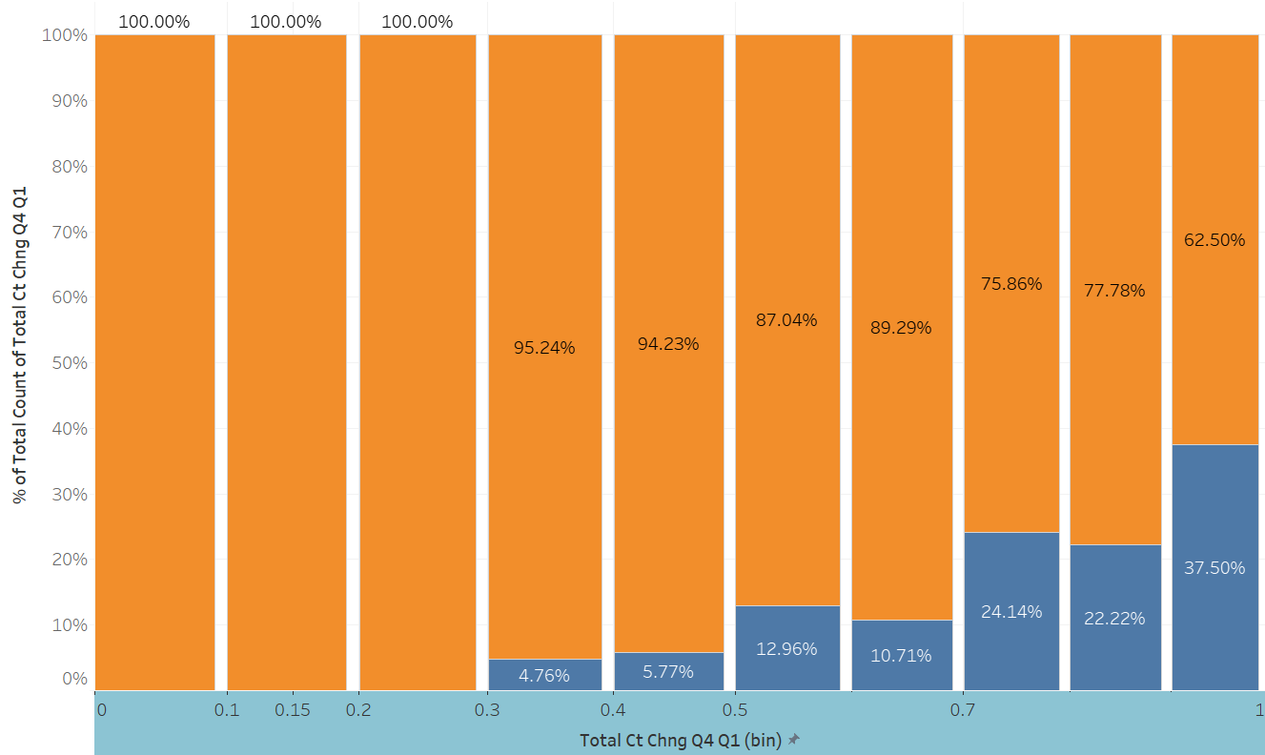
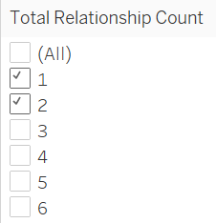
Total Ct Chng Q4-Q1
(ratio of no. of transactions done in Q4 vs Q1)
15
- Yash Jivani -
Notes:
This attribute is to be included in model as

