Slide 1

Tkoi System
Walkthrough
Screens, workflows, roles, business rules, and technical architecture
Functional documentation • 26 October 2026

Slide 2
SYSTEM OVERVIEW
Users, sellers, and administrators share one platform
Access changes according to account status, verified phone, and admin permissions.
1
2
3
Buyer
Seller
Administrator
Browse fish, search, save favorites, chat, checkout, track orders, request returns, review purchases, and contact support.
A verified phone unlocks shop setup, listing management, order fulfillment, earnings, payout accounts, and withdrawals.
Permission-gated tools cover users, tickets, reports, content, orders, finance, audit logs, and the admin team.
Account controls
Active accounts use the marketplace. Suspended accounts retain limited order and support access. Restricted accounts can appeal.
03

Slide 3
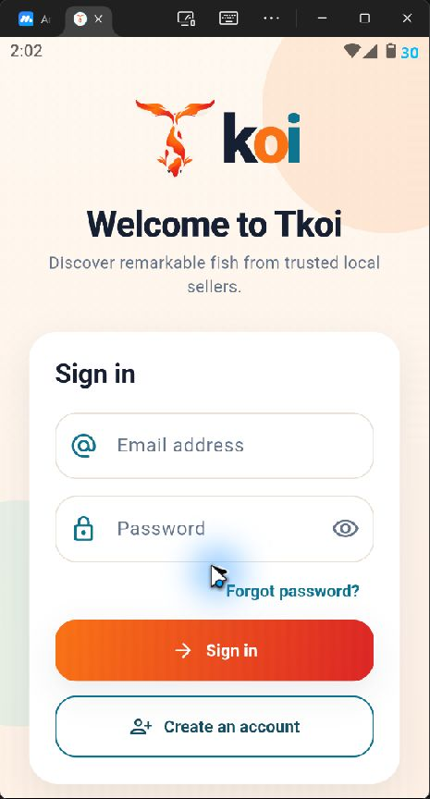
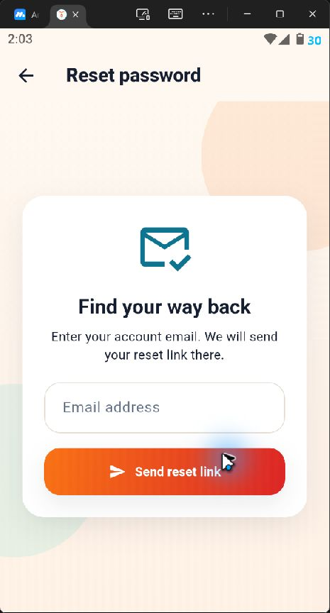
AUTHENTICATION
Sign-in and password recovery
Email authentication connects the user to the correct buyer, seller, restricted, or admin destination.
Users sign in with an email address and password.
Password recovery sends a reset link to the registered email.
The authentication gate resolves password recovery events before normal routing.
Account status and admin role determine the first screen after authentication.
Sign in
Password recovery
04

Slide 4
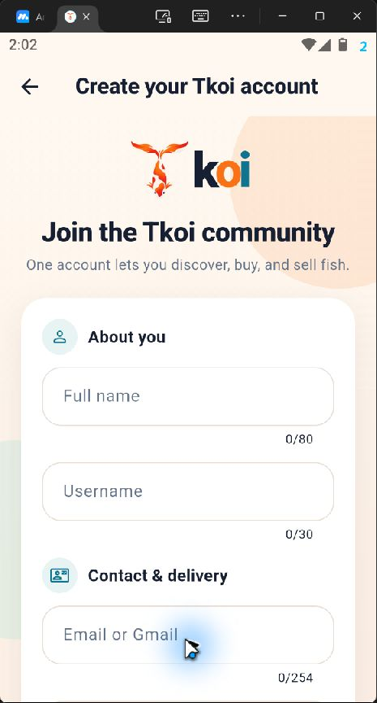
AUTHENTICATION
Account registration
One account supports both buying and selling, while seller access requires an additional phone check.
Registration collects the user’s name, username, email, phone number, delivery address, and password.
Supabase sends a six-digit email verification code before the account becomes usable.
Password and field validators provide immediate feedback before submission.
A verified phone number is required before creating or managing a fish shop.
Related screens
Email verification, phone verification, password reset, and restricted-account appeal are implemented as separate guarded flows.
05

Slide 5
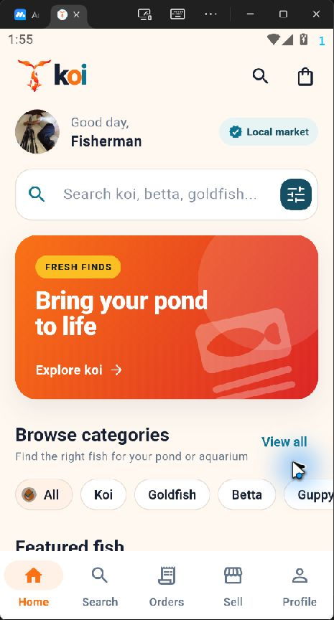
BUYER EXPERIENCE
Marketplace home
The home screen brings discovery, search, category browsing, cart access, and the primary navigation into one view.
A personalized greeting and local-market indicator establish the user context.
Search and category shortcuts help buyers narrow the catalog quickly.
Featured fish cards show price, ratings, sold count, shop, location, and favorite count.
Persistent navigation links Home, Search, Orders, Sell, and Profile.
Cart access
The bag icon opens the cart from the home, search, and order areas.
06

Slide 6
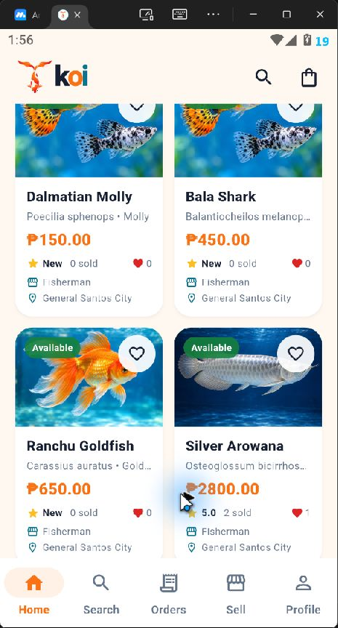
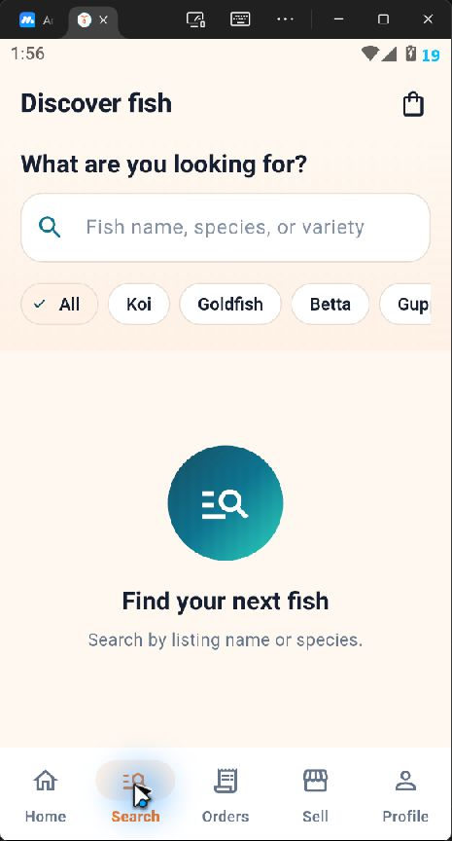
BUYER EXPERIENCE
Catalog browsing and search
Buyers can scan visual product cards or search by fish name, species, and category.
Product cards expose availability, stock, price, seller, location, ratings, sales, and favorites.
Search supports listing name, species, or variety.
Category chips provide quick filters for koi, goldfish, betta, guppy, and other types.
Empty states explain the next action instead of leaving a blank screen.
Product catalog
Search and filters
07

Slide 7
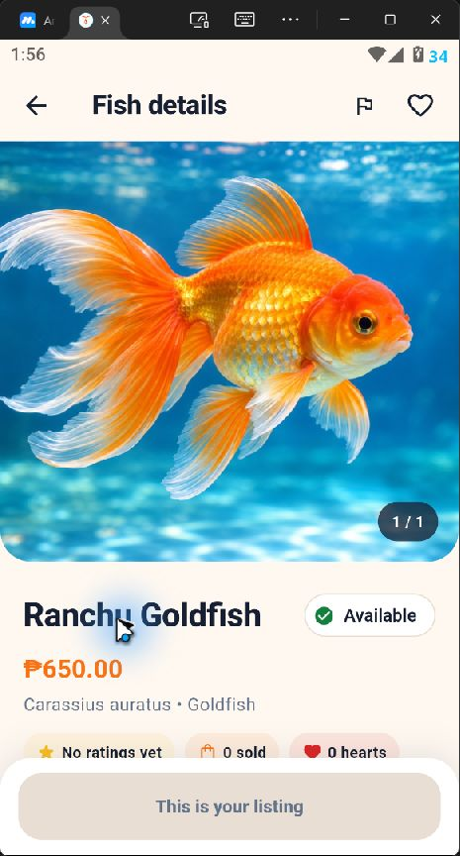
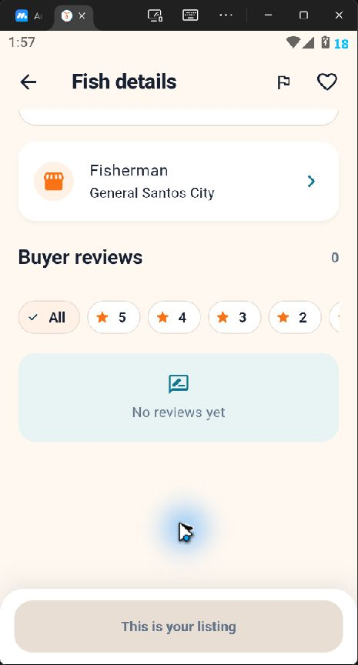
BUYER EXPERIENCE
Fish details, seller context, and reviews
Each listing combines evidence about the fish with the seller identity and buyer feedback.
The gallery presents listing photos, name, price, species, category, and availability.
Buyer actions include favorite, report, add to cart, and Buy Now when the listing belongs to another seller.
The seller panel links to the shop profile and conversation workflow.
Review filters support all ratings or a selected star score.
Listing summary
Seller and reviews
08

Slide 8
BUYER EXPERIENCE
Cart, checkout, and payment choices
The transaction flow supports shop-level order splitting and both cash and hosted online payment.
Cart
Adjust quantities or remove items. Stock-safe database functions validate every change.
1
Checkout
Confirm delivery address and review one order group for each seller.
2
Payment
Choose Cash on Delivery, GCash, Maya, card, BPI, BDO, UnionBank, or QRPh.
3
Confirmation
Pending online orders reserve stock until the verified Xendit result arrives.
4
Online-payment safety
The Flutter client never stores the Xendit secret. Supabase Edge Functions create and cancel payment requests, while a verified webhook updates payment status.
09

Slide 9
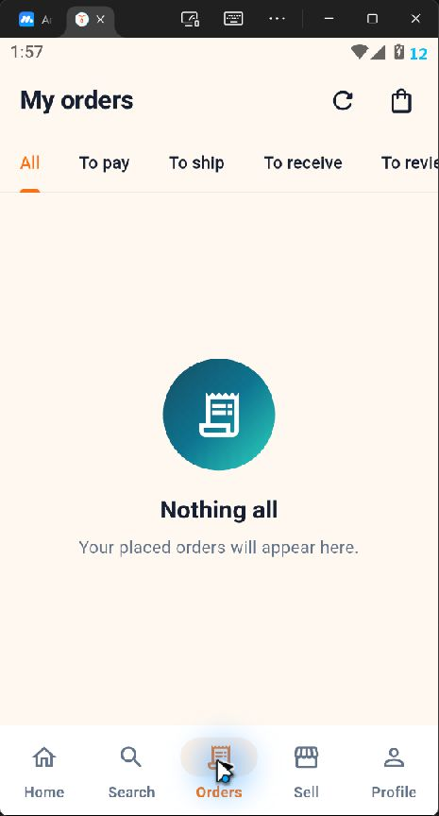
BUYER EXPERIENCE
Buyer orders and aftercare
Order tabs separate payment, fulfillment, receipt, review, cancellation, and return stages.
Filters group orders into All, To pay, To ship, To receive, To review, Completed, Cancelled, and Returns.
Order details show seller, items, payment status, delivery address, and next actions.
Eligible completed purchases can open the review composer with a star rating, comment, and photos.
Return requests follow the configured return window and preserve their review history.
Current captured state
The signed-in seller account had no buyer-side orders, so the slide shows the implemented empty state and filter structure.
10

Slide 10
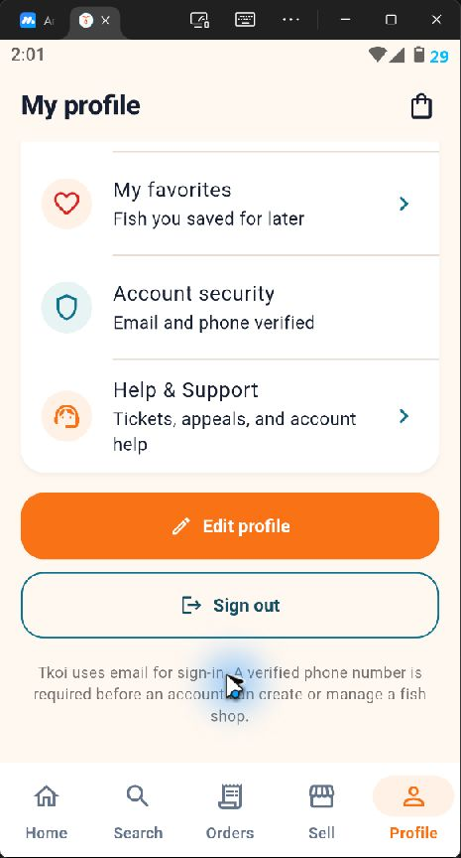
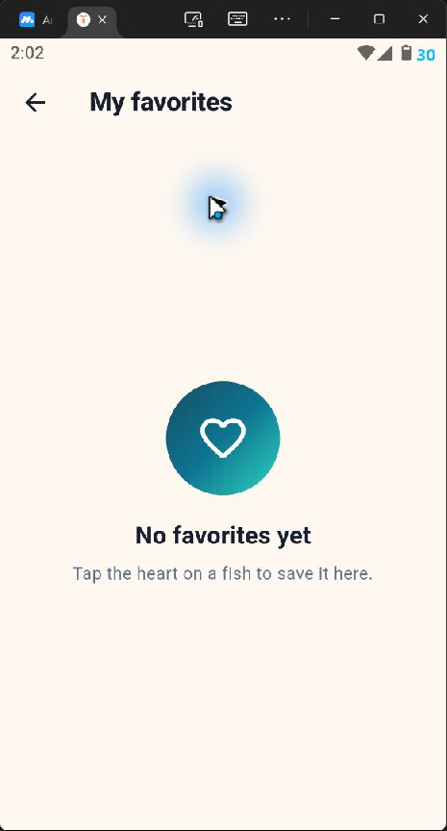
BUYER EXPERIENCE
Profile, favorites, messages, and account tools
The profile area acts as the account hub for saved products, conversations, security, support, and personal details.
My Orders, Messages, and My Favorites provide quick access to frequent activities.
Account security reports email and phone verification state.
Edit Profile updates identity, contact, delivery information, and the profile image.
Chat supports buyer and seller conversations linked to a product or order context.
Profile tools
Saved fish
11

Slide 11
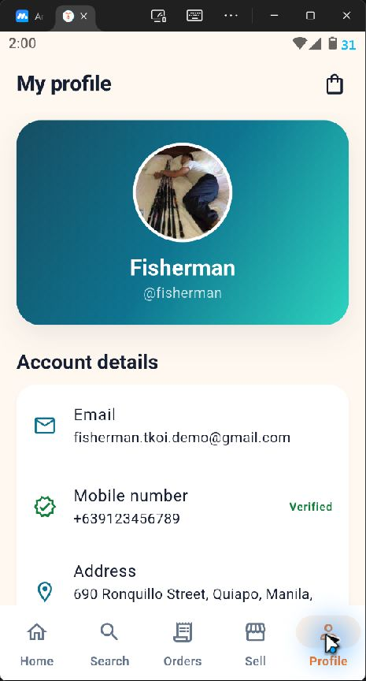
BUYER EXPERIENCE
Profile identity and verification status
The account profile displays the user identity and verified seller eligibility.
The profile header displays the avatar, full name, and username.
Account details include email, mobile verification status, and delivery address.
Phone verification controls whether the Sell area is available.
Contact details shown here belong to a local demonstration account.
Privacy note
Mask or replace contact details before distributing this deck outside the project team.
12

Slide 12
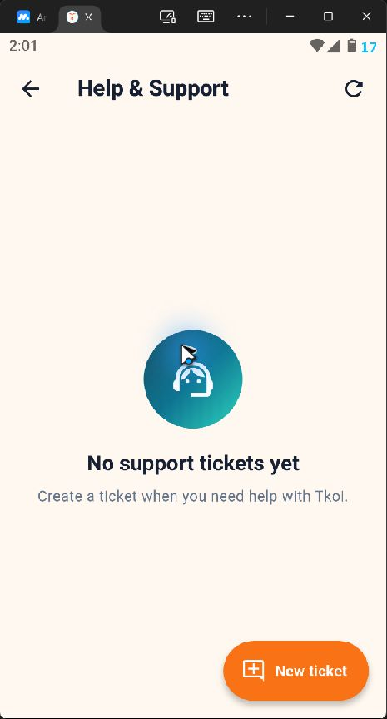
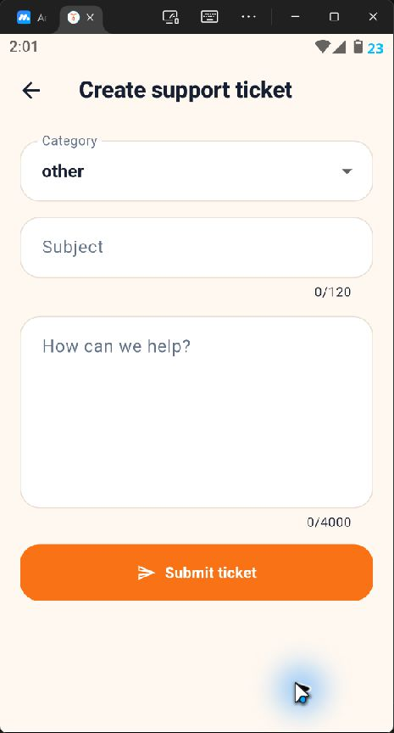
SUPPORT
Help center and ticket submission
Users can create categorized support cases for marketplace issues, account help, or appeals.
The support center lists existing tickets and their current status.
A new ticket records category, subject, and a detailed message.
Restricted users can open an appeal with the category and subject preselected.
Administrators can assign, prioritize, reply to, and close support cases.
Ticket list
New ticket
13

Slide 13
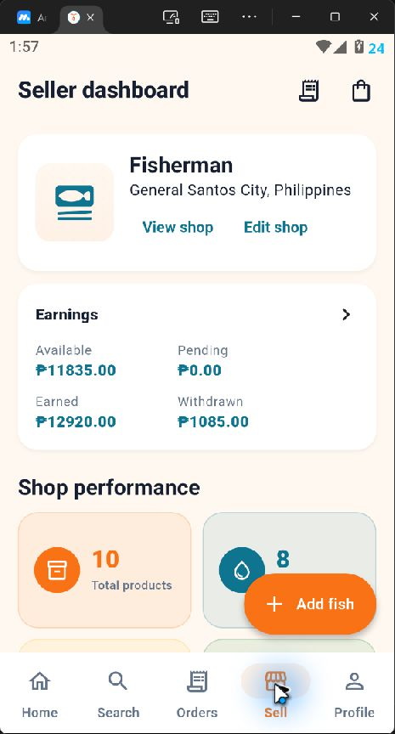
SELLER WORKSPACE
Seller dashboard and shop performance
Verified sellers manage their shop, financial summary, product performance, and daily actions from one workspace.
Shop controls open the public shop or edit seller information.
Earnings summarize available, pending, earned, and withdrawn amounts.
Performance metrics count products, stock, sales, ratings, views, and favorites.
Quick actions connect the dashboard to new listings and seller order management.
Shop requirement
A verified account can create one shop. Existing shop owners enter this dashboard directly.
14

Slide 14
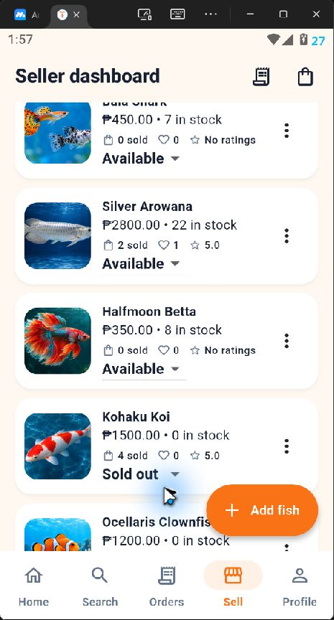
SELLER WORKSPACE
Seller inventory
Each listing remains editable and exposes its operational status directly in the product list.
Inventory rows show the product photo, price, stock, sales, favorites, rating, and status.
The status control switches a listing among Available, Sold out, and Hidden.
The overflow menu opens listing edit and management actions.
Add fish starts a validated listing form with image requirements.
Stock visibility
Sold-out products remain visible to the seller while buyer availability follows the listing status and quantity.
15

Slide 15
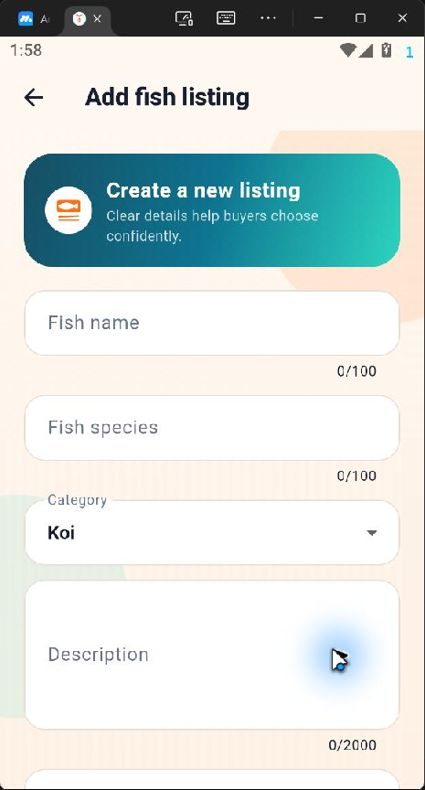
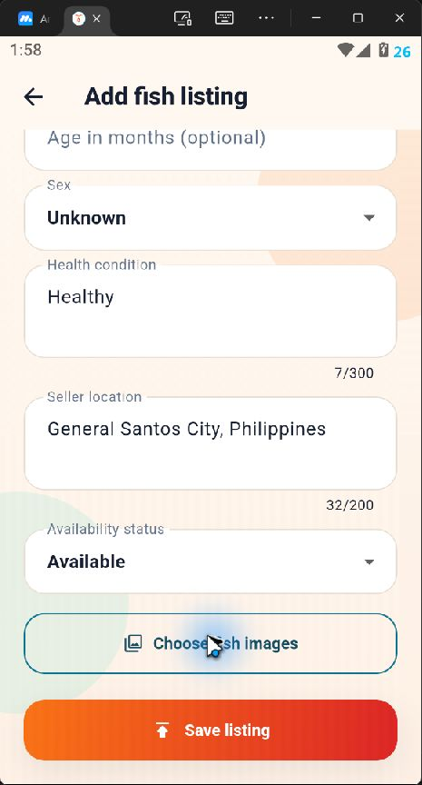
SELLER WORKSPACE
Fish listing creation
The listing form captures product identity, condition, inventory, location, availability, and visual evidence.
Required details include fish name, species, category, description, price, and quantity.
Optional attributes record size, age, and sex.
Health condition and seller location help buyers evaluate suitability and delivery distance.
At least one fish image is required before the listing can be saved.
Listing identity
Inventory and images
16

Slide 16
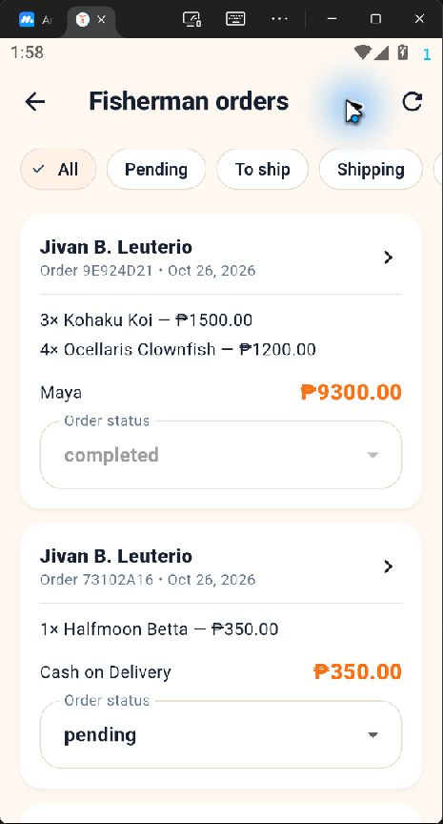
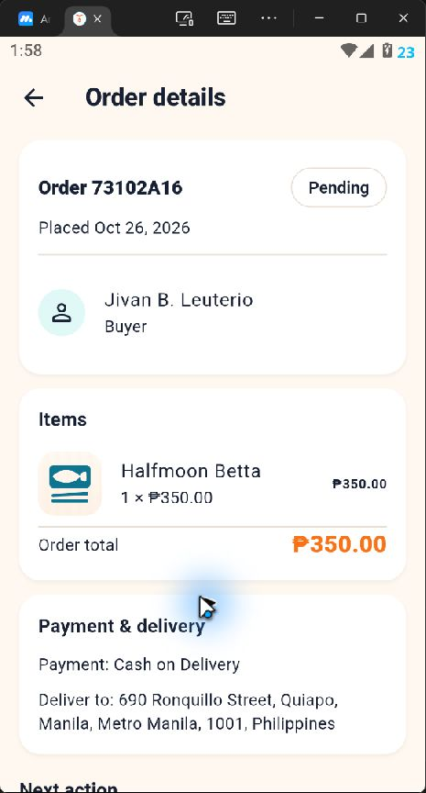
SELLER WORKSPACE
Seller order queue and order evidence
Sellers can filter orders, inspect buyer and item details, and manage fulfillment from a single queue.
Tabs filter orders by pending, to ship, shipping, completed, cancelled, and return status.
Each order card shows buyer, date, items, payment method, total, and current status.
The detail screen displays item quantities, order total, payment, and delivery information.
Paid Xendit orders follow stricter cancellation rules because automated refunds are not included.
Seller order queue
Order details
17

Slide 17
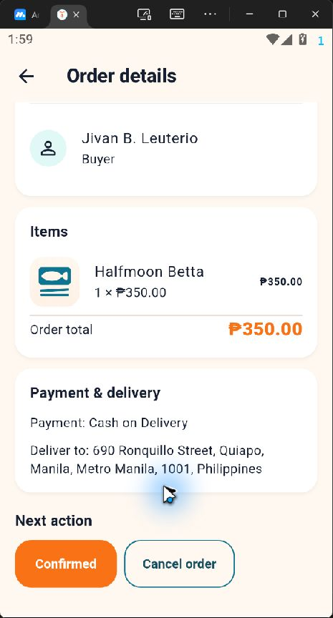
SELLER WORKSPACE
Order fulfillment controls
The next-action section advances the order while preserving a separate cancellation path.
Pending Cash on Delivery orders can move to Confirmed or be cancelled.
Later stages support shipping updates, delivery confirmation, and completion.
Return requests appear inside the seller order workflow with their reason and status.
Status changes are backed by database rules that protect inventory and payment state.
Documentation capture
No order status was changed while collecting screenshots.
18

Slide 18
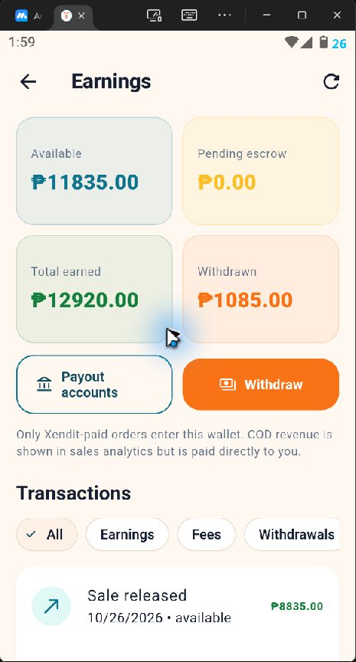
FINANCE
Seller earnings wallet
The wallet separates money that can be withdrawn from pending escrow, lifetime earnings, and completed withdrawals.
Available balance includes released earnings from eligible online payments.
Pending escrow tracks money awaiting release.
The transaction ledger filters earnings, platform fees, and withdrawals.
Cash on Delivery revenue appears in sales analytics because payment goes directly to the seller.
Wallet boundary
Only Xendit-paid orders enter the in-app seller wallet.
19

Slide 19
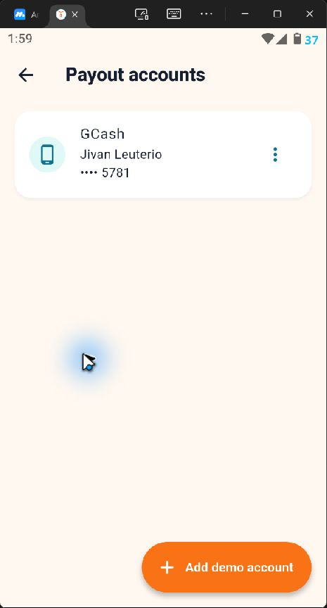
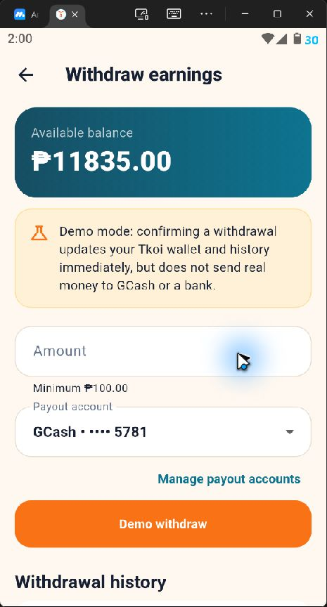
FINANCE
Payout accounts and withdrawals
Sellers choose a saved payout destination and submit an amount against their available balance.
Payout accounts show the provider, account holder, and masked destination number.
The withdrawal form validates the minimum amount and available balance.
Withdrawal history records status and allows eligible pending requests to be cancelled.
The captured environment uses demo withdrawals and does not transmit real funds.
Payout destinations
Withdrawal request
20

Slide 20
ADMINISTRATION
Permission-gated admin console
The admin shell reveals only the sections allowed by the signed-in role.
Dashboard
Users
Support
Marketplace metrics, operational queues, and sales trend
Search accounts, inspect history, suspend, ban, or reactivate
Assign, prioritize, reply to, and close tickets
Reports
Content
Orders
Review user reports and record resolutions
Moderate products, shops, reviews, and profile content
Search orders and inspect protected delivery details
Finance
Audit
Team
Withdrawals, returns, wallets, fees, and settings
Search administrative actions and actor history
Review role membership and permission coverage
21

Slide 21
ADMINISTRATION
Account and content moderation
Administrative actions require explicit permissions and produce an auditable history.
USER ACCOUNTS
CONTENT AND REPORTS
Search and filter active, suspended, or banned accounts.
Inspect masked identity, order count, shop data, and moderation history.
Reveal protected contact details through an audited action.
Suspend for a period, ban indefinitely, or reactivate an account.
Review reported products, shops, reviews, and profile content.
Record a moderation reason and resolution.
Hide or restore content according to the moderator permission set.
Protect privileged admin accounts from unsafe account actions.
Public reasons
User-facing restriction text stays separate from internal administrative notes.
22

Slide 22
ADMINISTRATION
Support, finance, audit, and team operations
Operational modules connect customer cases with financial controls and role accountability.
Support
Status, priority, assignment, internal notes, customer replies, and case-linked conversations
Finance
Withdrawal queue, return decisions, seller wallets, ledger inspection, platform fee, and return-window settings
Orders
Marketplace-wide order search, detail inspection, and audited address reveal
Audit
Searchable record of privileged actions, actors, targets, reasons, and timestamps
Team
Admin role membership and effective permission review
Role model
The super admin has full access. Other administrative roles receive only the permissions required for their responsibilities.
23

Slide 23
TECHNICAL DESIGN
Application architecture and integrations
Flutter provides the user interface while Supabase and Xendit handle identity, data, storage, and online payments.
Supabase Auth
Email sessions, verification, password recovery, and phone verification
Flutter app
Edge Functions
Xendit
Buyer, seller, admin, authentication, validation, and navigation
Create, cancel, simulate, and reconcile Xendit payment requests
Hosted test checkout, payment channels, simulation API, and verified webhooks
Postgres + RLS
Profiles, shops, products, carts, orders, reviews, chat, wallets, and admin data
Storage
Profile photos, shop logos, product images, and review media
Server-side secrets
Xendit secret keys and webhook tokens stay in Supabase Edge Function secrets. The Flutter client uses only public Supabase configuration.
24

Slide 24
TECHNICAL DESIGN
Business rules and safeguards
Database constraints and role checks support safe marketplace behavior.
Ordering
Cart checkout splits mixed-shop items into one order per seller. Stock is locked, rechecked, and reduced atomically.
Seller policy
Users cannot buy their own listings. Selling requires a verified phone and one shop per account.
Payments
Pending online orders reserve stock. Failure, cancellation, or expiry restores that stock.
Access control
Row Level Security limits records by ownership, participant, and administrative permission.
Moderation
Account restrictions preserve eligible order and support access while blocking normal marketplace activity.
Auditability
Protected contact and address reveals are explicit administrative actions recorded in the audit trail.
Testing and demo modes
The repository includes widget tests, SQL integration tests, seeded seller data, a demo admin, and a payment simulator that rejects live Xendit keys.
25

Slide 25
REFERENCE
Functional coverage index
Implemented screens and major capabilities covered by this walkthrough.
Area | Screens and functions
Authentication | Splash, sign in, register, email verification, forgot/reset password, phone verification, restricted account
Buyer | Home, search, product details, shop details, favorites, cart, checkout, payment method, orders, returns, reviews
Communication | Chat inbox, conversation, product/order context, support ticket list, ticket detail, ticket creation
Seller | Shop setup/edit, dashboard, listings, product form, orders, order details, earnings, payout accounts, withdrawals
Administration | Dashboard, users, account details, tickets, reports, content, orders, finance, audit, team
Integrations | Supabase Auth, Postgres/RLS, Storage, Edge Functions, Xendit hosted payment and webhook handling
26

Slide 26
REFERENCE
Capture scope and presentation notes
The deck combines verified live screens with code-based documentation for protected or state-dependent flows.
Live screenshots came from the running Android build using the signed-in Fisherman demonstration account.
The deck did not submit a purchase, change an order status, withdraw money, create a support ticket, or modify marketplace data.
Admin screens are documented from their implemented widgets, services, permission checks, and database migrations because the emulator keyboard blocked a clean account switch during capture.
Some screens require specific data states, such as another seller’s product, a completed order, an open return, or a pending moderation case.
Replace or mask demonstration contact details before sharing the deck outside the project team.
Recommended next capture
Open the demo admin account and a non-seller buyer account, then append screenshots for admin queues, cart, checkout, payment selection, chat, reviews, and returns.
27

Slide 27
Tkoi connects fish buyers, sellers, and marketplace operations in one role-aware system
End of system walkthrough

