Slide 1
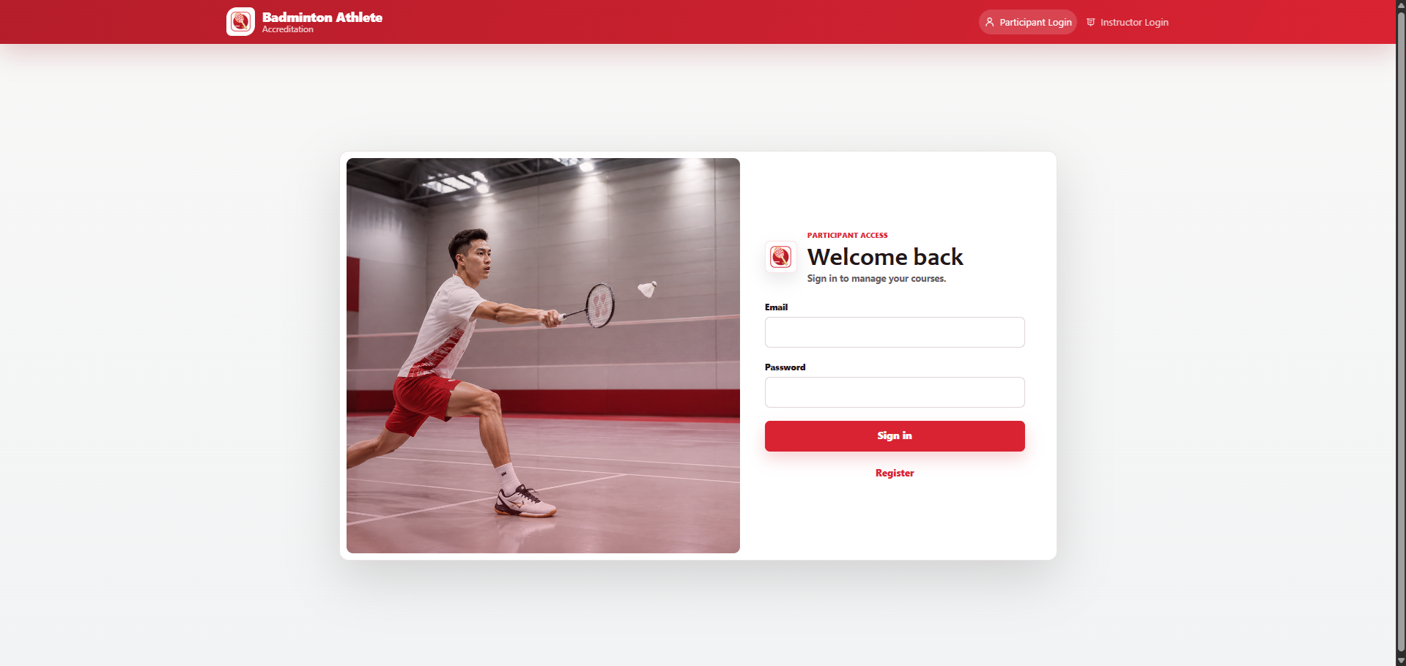
Badminton Athlete
Accreditation
Accreditation
Platform
Centralized registration, payment proof, attendance, grading, feedback, certification readiness, and reporting.
Working foundation ready to configure around the client's courses, roles, reports, branding, security, and rollout process.
Prepared for UAE client discussion
2026
Notes:
Opening position: present the app as an operations system, not a registration website.
[Sources]
- Internal guide: docs/uae-client-presentation-guide.md
- UI screenshot: D:\Jiven Files\Projects\BOMS Screenshots\Participant-Login.png

Slide 2
CURRENT CHALLENGE
Scattered Data Makes Accreditation Hard To Control
When registration, receipts, attendance, grading, feedback, and reports live in separate tools, the team loses a reliable operational picture.
Participant intake
Forms and messages create inconsistent records.
Operational
control
not just
registration
Payment proof
Receipts are difficult to match against registration status.
Course day
Attendance and walk-ins create extra reconciliation work.
Evaluation reports
Instructor grading, feedback, and summaries are rebuilt later.
Badminton Accreditation Management System | UAE client discussion
02
Notes:
Use this slide to frame the client problem before showing screens.
[Sources]
- Internal guide: docs/uae-client-presentation-guide.md

Slide 3
TARGET WORKFLOW
One Workflow Links Every Step Of The Journey
The application centralizes the complete accreditation path from first registration through management reporting.
1
>
2
>
3
>
4
>
5
>
6
>
7
>
8
Register
Pay
Approve
Attend
Grade
Feedback
Certify
Report
One participant record supports every next step.
Payment, attendance, evaluation, feedback, and reporting all reference the same course data.
Badminton Accreditation Management System | UAE client discussion
03
Notes:
Recommended one-line pitch: the app centralizes registration, payment proof, admin approval, attendance, grading, feedback, certification readiness, and reporting.
[Sources]
- Internal guide: docs/uae-client-presentation-guide.md
- Feature list: README.md

Slide 4
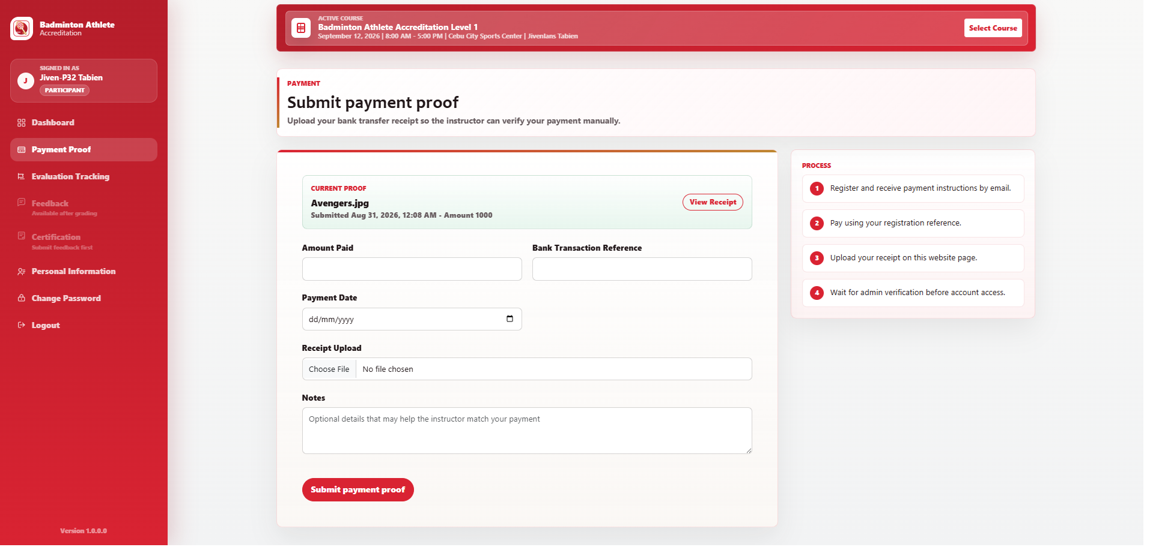
PARTICIPANT INTAKE
Clean Registration And Payment Proof
Capture each record once.
- Course and reference number
- Payment proof attached to registration
- Manual review using the current bank process
Secure storage
Move receipt files to object storage before go-live.
Badminton Accreditation Management System | UAE client discussion
04
Notes:
Position manual payment proof as a practical first release path while being clear about production storage.
[Sources]
- Internal guide: docs/uae-client-presentation-guide.md
- Feature list: README.md
- UI screenshot: D:\Jiven Files\Projects\BOMS Screenshots\Participant-Payment-Proof.png

Slide 5
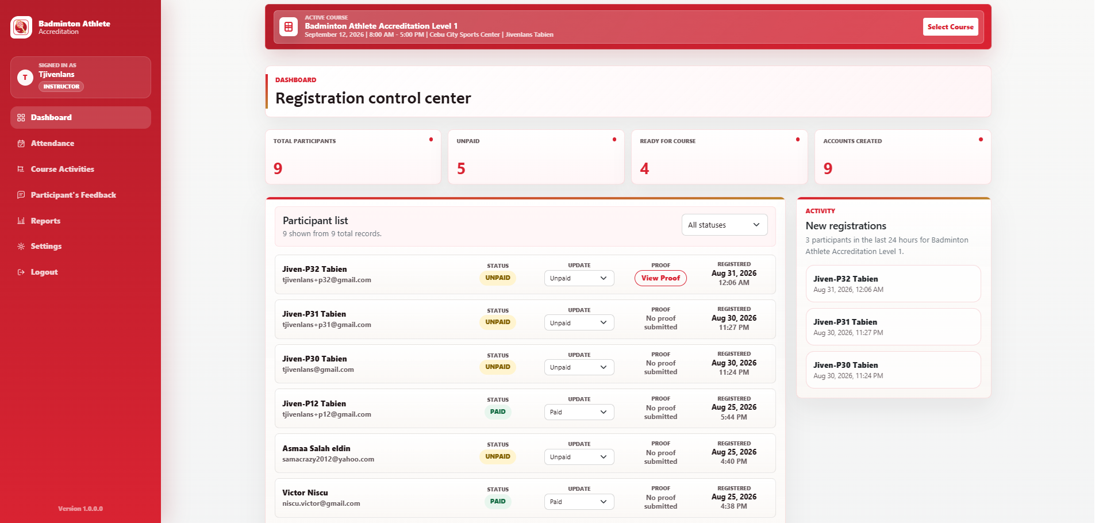
INSTRUCTOR CONTROL CENTER
Operations Control Status, Proof, And Accounts
A live queue shows registrations, payment proof review, and account creation.
Live
Paid
REGISTRATION QUEUE
STATUS VISIBILITY
Badminton Accreditation Management System | UAE client discussion
05
Notes:
Emphasize that this replaces spreadsheet reconciliation and gives admins a live operational queue.
[Sources]
- Internal guide: docs/uae-client-presentation-guide.md
- Feature list: README.md
- UI screenshot: D:\Jiven Files\Projects\BOMS Screenshots\Instructor-Dashboard.png

Slide 6
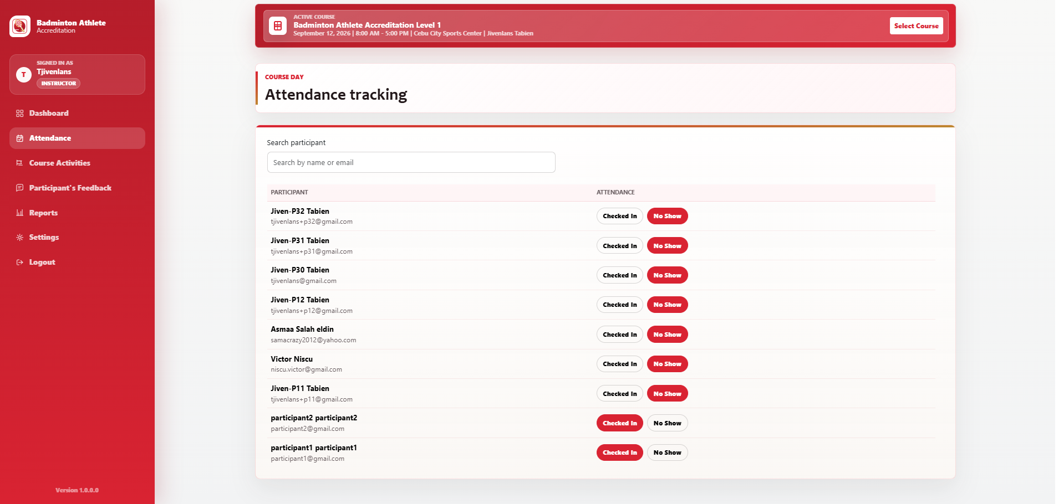
ATTENDANCE AND WALK-INS
Attendance And Walk-Ins Stay Connected
Check-in, absent states, and walk-ins are handled from the same course record.
Walk-ins become participant records.
Badminton Accreditation Management System | UAE client discussion
06
Notes:
Use this slide to show the operational value on course day: faster check-in and immediate reporting data.
[Sources]
- Internal guide: docs/uae-client-presentation-guide.md
- Feature list: README.md
- UI screenshot: D:\Jiven Files\Projects\BOMS Screenshots\Instructor-Attendance.png

Slide 7
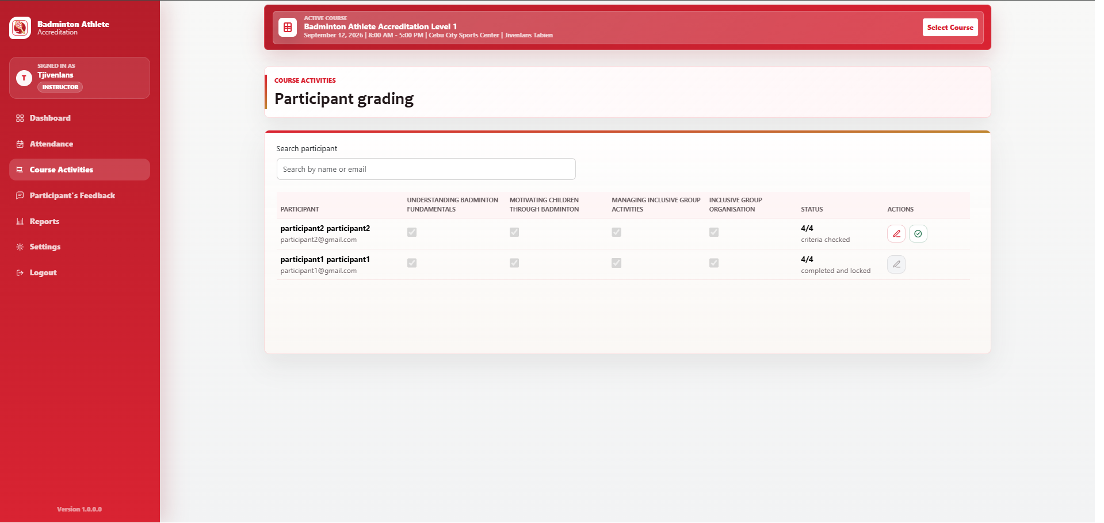
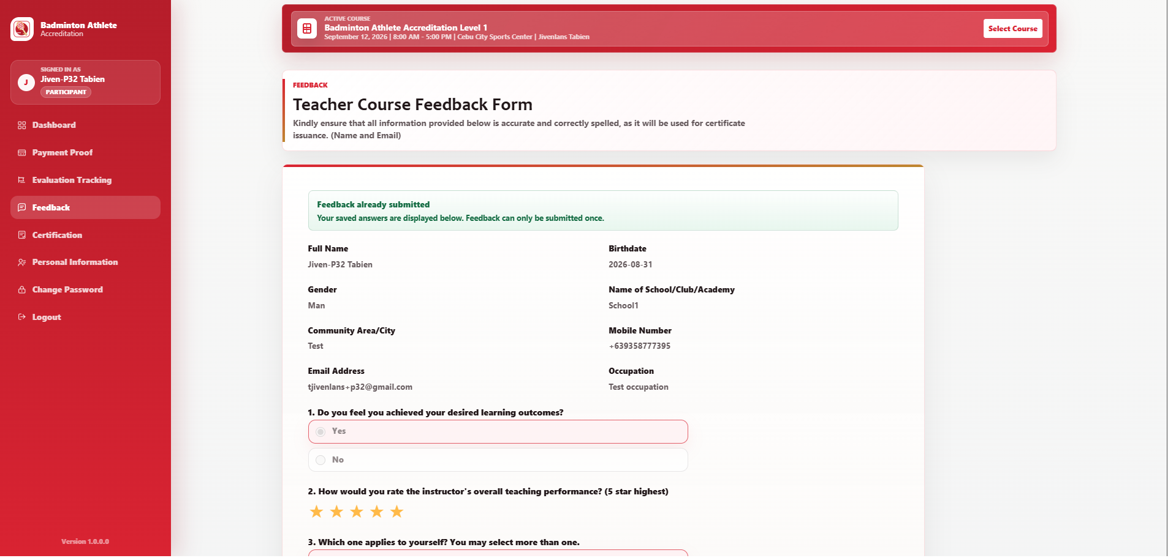
ACCREDITATION QUALITY
Grading And Feedback Follow The Same Standard
Central criteria keep evaluations consistent and feedback tied to the participant record.
Standard criteria
Accountability
Certification readiness
The organization controls what instructors evaluate.
Course activity completion becomes visible.
Participant status is based on linked records.
Badminton Accreditation Management System | UAE client discussion
07
Notes:
Keep this focused on standardization and trust in accreditation decisions, not technical implementation.
[Sources]
- Internal guide: docs/uae-client-presentation-guide.md
- Feature list: README.md
- UI screenshot: D:\Jiven Files\Projects\BOMS Screenshots\Instructor-Grading.png
- UI screenshot: D:\Jiven Files\Projects\BOMS Screenshots\Participant-Certification.png

Slide 8
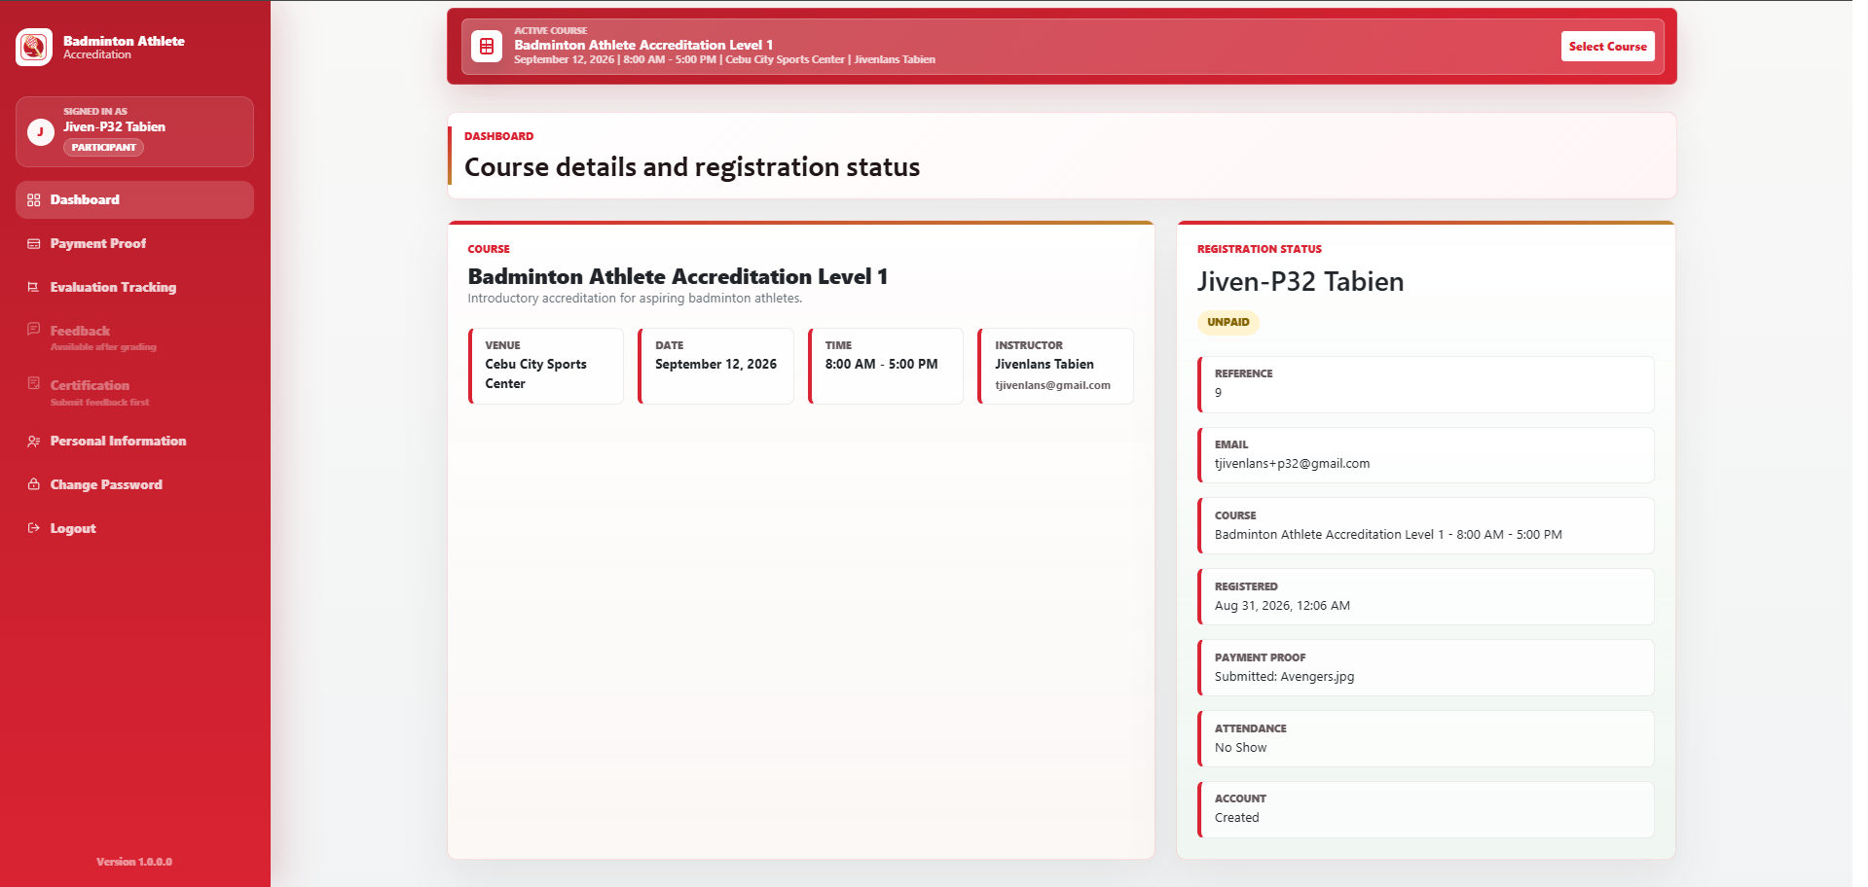
PARTICIPANT PORTAL
Participants Get A Clear View Of Their Progress
Athletes can check their course, payment proof, evaluation progress, profile, feedback, and certification steps without asking admin for every update.
Operational value
Fewer status questions
Cleaner self-service
Feedback tied to records
Badminton Accreditation Management System | UAE client discussion
08
Notes:
Use this slide to show that the system improves the participant journey, not only the admin workflow.
[Sources]
- Internal guide: docs/uae-client-presentation-guide.md
- Feature list: README.md
- UI screenshot: D:\Jiven Files\Projects\BOMS Screenshots\Participant-Dashboard.png

Slide 9
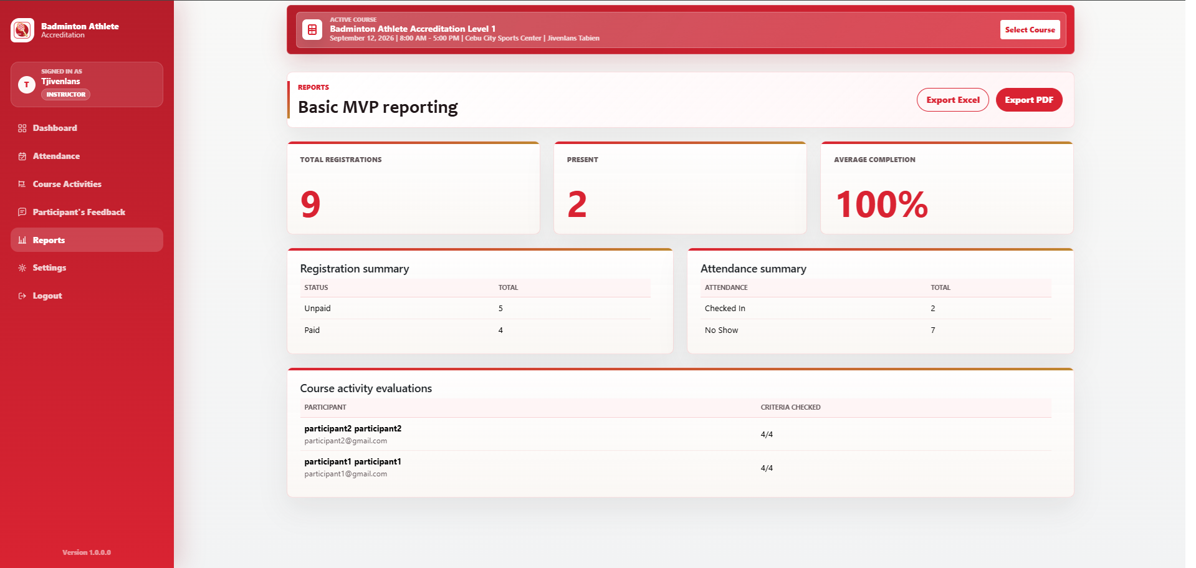
REPORTING VALUE
Reports Come Directly From Operations
Because activity is captured in one system, summaries and exports can be generated from operational records instead of manual spreadsheet work.
Excel and PDF-ready exports
Badminton Accreditation Management System | UAE client discussion
09
Notes:
Tie reporting back to management visibility, reduced manual errors, and batch/course comparison.
[Sources]
- Internal guide: docs/uae-client-presentation-guide.md
- Feature list: README.md
- UI screenshot: D:\Jiven Files\Projects\BOMS Screenshots\Instructor-Reporting.png

Slide 10
Questions?

Slide 11
ROLLOUT AND INVESTMENT
Launch The Right Scope After A Workshop
1
Workshop
Recommended commercial anchor
Confirm roles, workflow, reports, branding, language, deployment, and migration needs.
Option
Implementation
Managed support
Pilot Launch
$9.5k-$14k
AED 35k-51k
$300-$750/mo
AED 1.1k-2.75k/mo
2
Rollout
Choose a focused pilot course or move directly to a production association launch.
Production Association
System
$18k-$28k
AED 66k-103k
$1k-$1.5k/mo
AED 3.7k-5.5k/mo
3
Hardening
Secure deployment, email delivery, file storage, backups, monitoring, training, and support.
Enterprise Federation
Platform
$35k-$60k+
AED 128.5k-220.4k+
$2k-$5k+/mo
AED 7.35k-18.35k+/mo
Cloud/vendor costs are separate and should be validated before formal quote: approximately $200-$650/month for safer production.
Next step: confirm workshop stakeholders and the first rollout course.
Badminton Accreditation Management System | UAE client discussion
10
Notes:
Lead with Production Association System unless the client clearly prefers a smaller controlled pilot.
[Sources]
- Internal guide pricing and rollout guidance: docs/uae-client-presentation-guide.md
- AED conversion assumptions from the internal guide pricing tables.

