Slide 1
Our world is changing…

Slide 2
Our world is changing…
But how much this impacts our communities is debated, ignored, or deemed “unknowable.”

Slide 3
With the tools available to us today, we should be able to predict and visualize climate impact on community resources.
Water availability
Changes in extreme weather frequency
Crop yields
Healthcare and wellness
Local wildlife populations

Slide 4
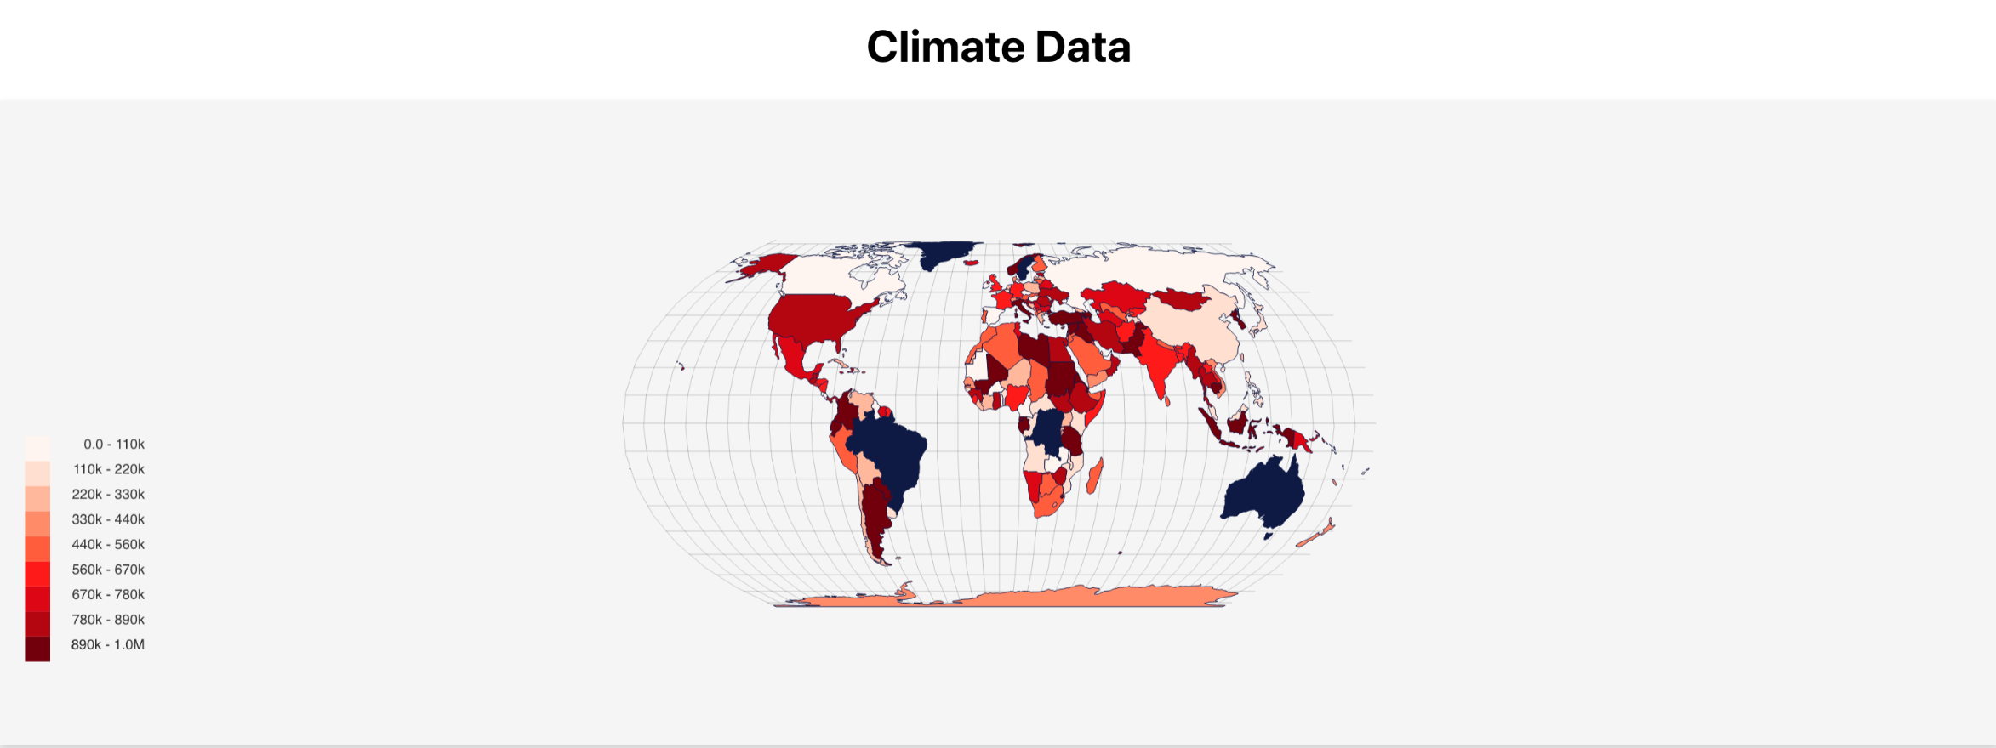
Machine learning plus a wealth of historical data can turn into an interactive visualization.

Slide 5
Taking Historic data correlating temperature increases with resource trends

Slide 6
And then taking those correlated trends to predict impact on each continent, in each country, and every community

Slide 7
With this data, and these visual aids, we could:
Enable non-profits and individual communities to be better prepared
Selectively focus on necessary infrastructure to mitigate climate change in areas predicted to be most negatively affected
Empower activists, individuals, and forward-thinking politicians and countries in their efforts to discuss and address climate change

Slide 8
So how far did we get in this endeavor?
Historical Data
Machine Learning
Interactive Web Visualizations
Ultimately, not far. But the knowledge gained in the process was worth the effort.
With each passing day, more relevant data is generated and more convincing visuals could be created.
We have the tools, we have the need, the next step is to put it all together.

