Slide 1
APPLIED MATHEMATICS FOR ELECTRONICS DESIGN
PROJECT 1
Adaptive Patch-Based
SVD Image Denoising
Comparing three singular-value strategies
Rank-3
Adaptive singular value shrinkage
Hybrid 1–6–1
Presenter: R JIVITH ABHISHEK • Roll number: M260957EC

Slide 2
01 | MOTIVATION
What are we trying to solve?
Noise changes pixel intensities; denoising should reduce it without destroying useful detail.
The problem
The idea
The comparison
Noise introduces unwanted variations. Strong smoothing can also blur edges and fine details.
Process small image patches with SVD, modify singular values, then reconstruct each patch.
Use the same noisy input for three methods; compare MSE, PSNR, energy retention and visuals.
Aim | Implement patch-based SVD denoising and evaluate how singular-value modification affects reconstruction quality.
Setup: grayscale image • Gaussian noise • 8 × 8 patches • stride = 4
02

Slide 3
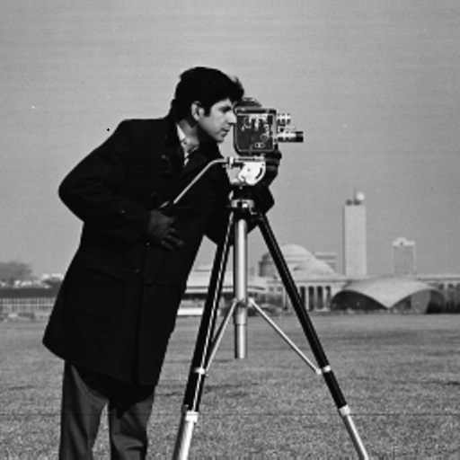
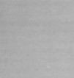
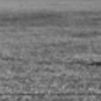
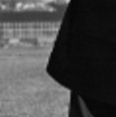
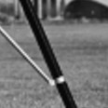

Slide 4
02 | MATHEMATICS
SVD: represent a patch in a useful form
Each 8 × 8 patch is decomposed so its singular values can be selectively preserved or reduced.
Illustrative singular-value pattern
A = U Σ Vᵀ
A: image patch
U and V: orthonormal matrices
Σ: diagonal matrix of singular values
1
2
3
4
5
6
7
8
Large values often capture dominant structure; small values may contain detail and/or noise.
Caution: small singular values are not automatically noise.
03

Slide 5
03 | METHOD
From image to denoised reconstruction
The same noisy input and patch settings are used for all three methods.
1
Load + grayscale
2
Add noise
3
Extract patches
Normalize pixels to [0, 1]
Gaussian noise, σ = 0.05
8 × 8 patches, stride 4
4
Apply SVD
5
Modify Σ
6
Reconstruct
A = UΣVᵀ per patch
Choose one of three strategies
Overlap-add, then average
Overlapping patches give several estimates for many pixels; averaging combines those estimates.
04

Slide 6
04 | THREE STRATEGIES
What changes in the singular values?
All methods start from the same patch SVD but treat the eight singular values differently.
01 Rank-3 truncation
02 Adaptive soft threshold
03 Hybrid 1–6–1
Keep s₁, s₂, s₃
Set s₄ … s₈ to zero
A simple low-rank baseline.
ŝᵢ = max(sᵢ − τₚ, 0)
Threshold depends on patch activity.
Keep s₁ unchanged
Threshold s₂ … s₇
Set s₈ to zero
A mixed strategy.
1
2
3
4
5
6
7
8
1
2
3
4
5
6
7
8
1
2
3
4
5
6
7
8
The hybrid is a design choice to test—not a method assumed to be best.
05

Slide 7







Slide 8
05 | ADAPTIVE RULE
How is the patch threshold selected?
The threshold is adjusted using the variance of each patch.
Base threshold
Final threshold
τ₀ = α σ (√p + √p)
τₚ = τ₀ (1 − γ Aₚ)
Activity estimate
Parameters used
Aₚ = max(vₚ − σ², 0) / (vₚ + ε)
α = 0.50 • γ = 0.45 • σ = 0.05 • p = 8
Patch variance influences the threshold, so the amount of shrinkage can vary from patch to patch.
06

Slide 9
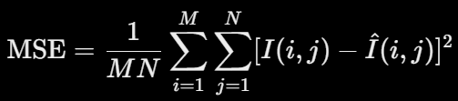

06 | IMPLEMENTATION
Code and evaluation
Python libraries: NumPy, Pillow, and Matplotlib.
Reconstruction
MSE
PSNR
Rebuild each patch with (U × ŝ) Vᵀ, then average overlapping estimates.
Average squared pixel difference from the original. Lower is generally better.
Calculated from MSE for peak intensity 1. Higher is generally better.
Energy retention = modified singular-value energy ÷ original singular-value energy
Use the measures together: energy retained is not the same as noise removed.
Reproducibility: fixed random seed = 42.
07

Slide 10
07 | RESULTS
Compare the measured outputs
Enter actual values printed by your final code; do not use illustrative numbers.
Method | MSE (×0.001): lower is better ↓ | PSNR (dB) ↑
Noisy image | 2.382 | 26.231 dB
Rank-3 truncation | 1.574 | 28.029 dB
Adaptive soft thresholding | 0.999 | 30.006 dB
Hybrid 1–6–1 | MSE: 0.834 | PSNR: 30.789 dB
Lower MSE and higher PSNR indicate stronger numerical reconstruction for this test; inspect detail too.
Energy retained :
• Rank-3 : 98.22%
• Adaptive : 83.94%
• Hybrid : 94.60%
08

