Slide 1
WordMind —
Semantic Memory Battle
An interactive word association game powered by natural language processing
Student: MAHI PANCHAL, JIYA VYAS

Slide 2



Rules are manual
THE PROBLEM
Word association is
easy to play,
hard to judge
Traditional word games often depend on manually defined rules or basic word matching.
Spelling misses meaning
“doctor” and “hospital” are not character matches, but they express related meaning.
Meaning can connect words that spelling never will.
WordMind measures the link
NLP makes the relationship semantic, measurable, and interactive.

Slide 3




PROJECT CONCEPT
The project turns
meaning into a game mechanic
Browser-based word association game
Represent word meaning
With pretrained sentence embeddings.
For one human and AI opponents.
Measure relatedness
Support
With cosine similarity.
Difficulty, timers, lives, duplicate detection, hints, and an evaluation module.

Slide 4
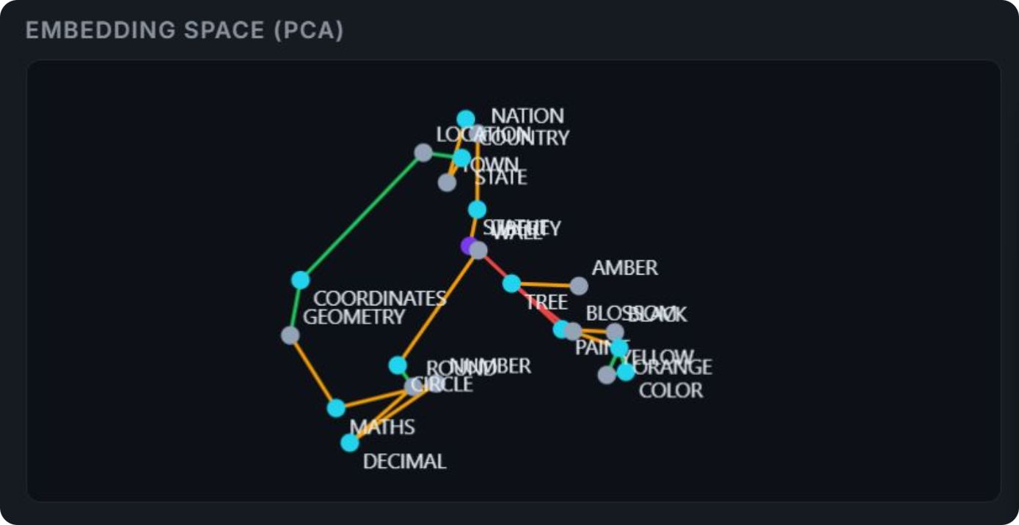
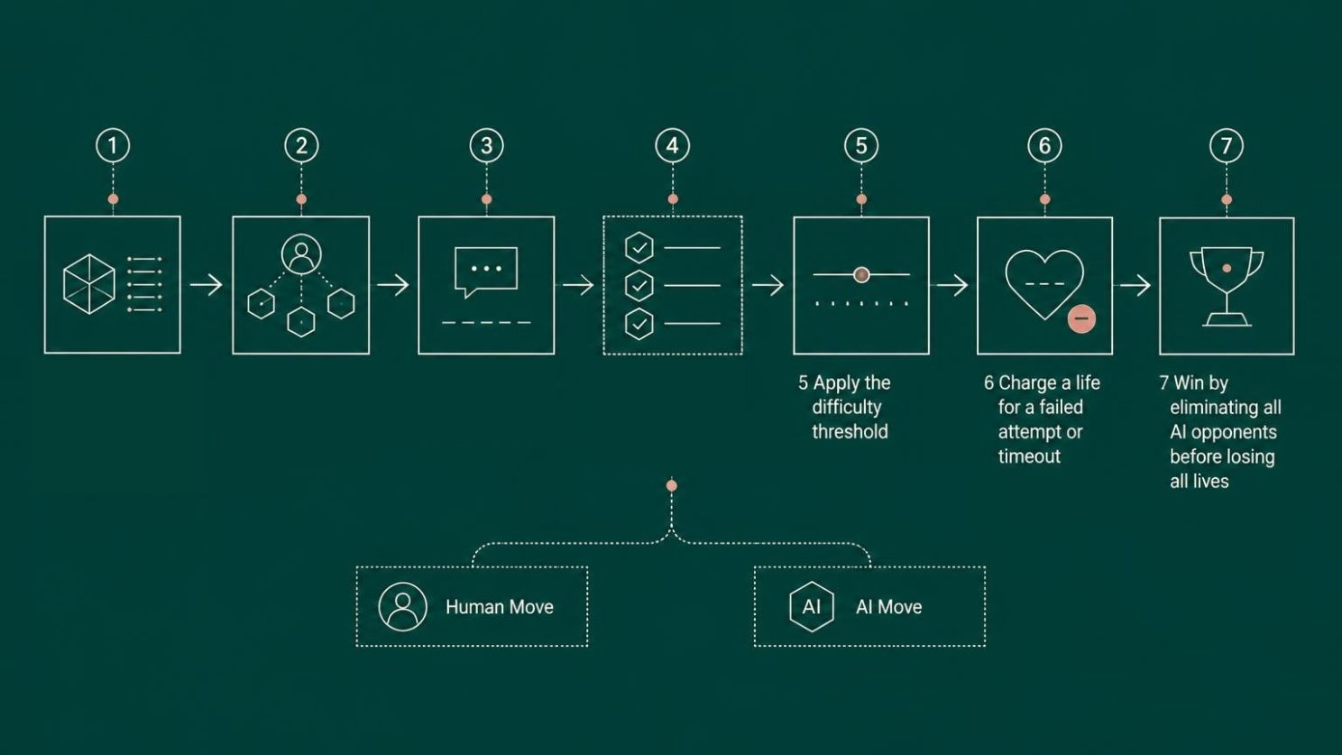
1 Load the NLP model in the browser and warm the vocabulary cache
2 Start a game with one human and AI opponents
3 Submit a word related to the current word
4 Check validity, repetition, and semantic similarity

Slide 5





IMPLEMENTATION
The browser contains
the full NLP stack
HTML + CSS
JavaScript
Interface, page structure, responsive visual design
Turns, timers, lives, game engine, AI decisions, and evaluation logic
Transformers.js
ONNX + WebAssembly/WebGPU
Loads and runs the NLP model in the browser
Browser inference were supported
Hugging Face CDN (all-MiniLM-L6)
Model download on initial load; no custom backend or API key for NLP inference

Slide 6
REPRESENTATION
Embeddings give each word a position in meaning-space
Example neighborhood
doctor → numerical vector
hospital → numerical vector
The pretrained Xenova/all-MiniLM-L6-v2 model turns words into numerical vectors.
nurse → numerical vector
384-dimensional embeddings · mean pooling · L2 normalization
The vector captures useful semantic relationships, but it does not understand words exactly like a human.
Semantic neighborhood
doctor · hospital · nurse

Slide 7
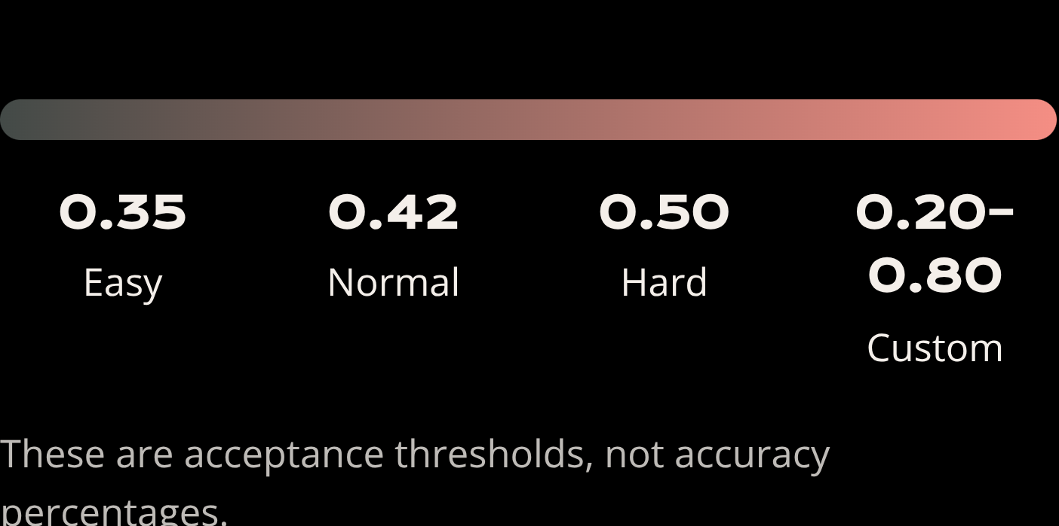

COMPARISON RULE
Cosine similarity compares direction,
not spelling
Acceptance thresholds
A and B: embedding vectors for two words
Dot product: how strongly the vectors point together
Vector magnitudes: normalize scale so the comparison focuses on direction
Related words can produce stronger similarity than unrelated words, but the actual score depends on the model and pair.

Slide 8
EVALUATION MODULE
The NLP Lab measures
the decision rule
Evaluation tests the threshold, not a claimed experimental score.
Evaluation element | Implemented plan and reported result
Dataset | Manually labelled dataset: 65-word pairs — 43 related and 22 unrelated
Threshold sweep | Evaluate cosine thresholds from 0.20 to 0.70 in 0.05 increments
Metrics | Report accuracy, precision, recall, and F1-score
Baseline | Compare with character-level Jaccard similarity as an evaluation-only baseline
Output | Identify the best F1 threshold and export evaluation results as CSV
No experimental score is claimed here without measured results.

