Slide 1

PunarjeevAnn
Leftover Food Recipe Generator
MEMBER 1: JIYA LALIT VYAS
MEMBER 2: MAHI KALPESH PANCHAL
TEAM ID: 8

Slide 2

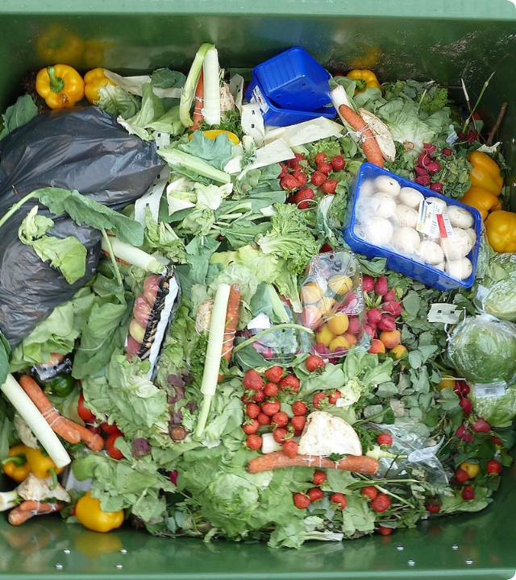
PROBLEM STATEMENT
Household food waste is a significant environmental and financial problem, often caused not by a lack of food but by a lack of ideas about how to use leftover ingredients.
People frequently open their refrigerators and find a few unrelated items—such as half a tomato, cooked rice, and some cheese—and assume that these ingredients cannot be combined into a viable meal.
This decision fatigue can lead to unnecessary food purchases, expensive takeout, and the premature disposal of perfectly edible food.
Therefore, there is a need for a simple and fast solution that helps users discover practical ways to use their existing leftover ingredients before they become waste.

Slide 3


ENVIRONMENTAL AND HOUSEHOLD IMPACT
Landfill Methane Emissions
Uneaten food decomposing in landfills produces ~8–10% of global greenhouse gas emissions, severely accelerating climate damage.
30%–40%
Wasted Embedded Resources
of Purchased Household Food is Wasted
Disposing of leftovers wastes thousands of liters of embedded agricultural water, soil nutrients, and energy used in food production.
Direct financial loss for families discarding edible groceries weekly.
Direct Financial Loss
Substantial monetary loss per household per month, directly hitting middle-class household grocery budgets.

Slide 4
LITERATURE REVIEW
Platform | Regional Target Market | Primary Input Method | AI & Vision Capabilities | Environmental Impact Tracking | Key Limitations & Gaps
Leftover Magics | India | Manual Text Entry (Indian staple ingredients) | LLM text prompt generator | Qualitative basic food waste saving tips | Lacks computer vision for ingredient photo scanning; no hard eco-metrics
Cook GPT India | India | Text Inputs & Preferences | LLM-based meal planner & personalized recipe assistant | None (Focuses on dietary calories & meal scheduling) | Focuses primarily on weekly meal planning rather than immediate leftover utilization
Sanjeev Kapoor (Tiny Chef) | India | Voice & Text natural language queries | AI intent parsing mapped to a curated recipe database | None | Tied to pre-recorded video/recipe databases; lacks dynamic generative AI for random leftovers

Slide 5
LITERATURE REVIEW
Platform | Regional Target Market | Primary Input Method | AI & Vision Capabilities | Environmental Impact Tracking | Key Limitations & Gaps
Cookpad India | India & Global | Manual Search by ingredient keyword | Community database search engine | None | Relies on user-submitted static recipes; requires exact search matches
SuperCook | Global | Checklist & Manual Pantry Selection | Rule-based database lookup (No generative AI) | None | Rigid recipe matching; fails when facing unusual random leftover combinations
DishGen | Global | Freeform Text Prompt | Standard LLM Text Generation | None | Lacks native image/photo recognition for fridge contents

Slide 6




PROPOSED SOLUTION
Smart Text Input Engine
Ingredient Photo Upload
AI Recipe Generator
Client-side fuzzy auto-correction (corrects typos like 'tomto' → 'Tomato') with auto-categories & default quantities.
Users snap/upload a photo of leftover items; multimodal AI automatically extracts an editable ingredient list.
Generates 100% vegetarian, fast recipes using available items + pre-assumed household staples (oil, salt, spices).
Quantitative Eco-Impact Score
Displays exact CO2 emissions saved (kg) and Water saved (L) based on UN environmental lifecycle data per generated recipe.

Slide 7



SYSTEM WORKFLOW
The generator returns a structured recipe: title → ingredients → short steps → timing → eco-impact values. This keeps the UI predictable and easy to render.
Output:
STEP 01
STEP 02
STEP 03
STEP 04
STEP 05
USER INPUT
PROCESSING
SERVER API
AI GENERATOR
ECO DISPLAY
Type text OR
Upload photo
Gemini 3.6
Next.js Gateway &
JSON Prompt Builder
Gemini 3.6 Flash
Structured Engine
Recipe steps +
CO2 & Water score

Slide 8
TECHNOLOGY STACK
Technology / Library | Version | Role & Purpose
Next.js (App Router) | 16.3.2 | Full-stack React framework for building the web application, including routing, server-side rendering, API routes, and server components.
TypeScript | ^5 | Provides static type safety for application state, database models, API payloads, and React components.
Tailwind CSS | ^4 | Utility-first CSS framework used for responsive, mobile-first styling and UI themes.
Zustand | ^5.0.15 | Lightweight client-side state management for controlling the multi-step application flow, including the current step.
PostgreSQL + Neon Serverless | @neondatabase/serverless ^1.1.0 | Cloud-based relational database used to store persistent user data, pantry inventory, and saved recipes.
Prisma | 5.22.0 | Type-safe ORM used for database queries, schema management, and migrations.
Google Gemini Flash | Gemini 3.6 Flash Gemini 3.5 Flash | Multimodal AI used to analyze fridge and pantry images and identify available ingredients.

Slide 9
ASSUMPTIONS
Common household staples are available — Ingredients such as oil, salt, basic spices, and water can be assumed unless the user specifies otherwise.
Users provide reasonably accurate ingredient information — For text input, the system assumes that the entered ingredients are actually available and usable.
Photo-based ingredient detection may require confirmation — The AI may not identify every ingredient correctly from an image, so detected ingredients should be editable or confirmable by the user.

Slide 10
REFERENCES
30%–40% Household Food Waste:
Source: USDA (United States Department of Agriculture) & UN Food and Agriculture Organization (FAO).
8%–10% Global Greenhouse Gas Emissions:
Source: UNEP (United Nations Environment Programme) Food Waste Index Report & IPCC (Intergovernmental Panel on Climate Change Special Report on Climate Change and Land).

Slide 11
Thank You

