Slide 1

Purchasing and Finance Department
Head: Jivan H. Mozo

Slide 2
Contents:
Purchasing and Finance Class Diagram
Sequence Diagrams
Brewery Supply Chain Risk Management

Slide 3
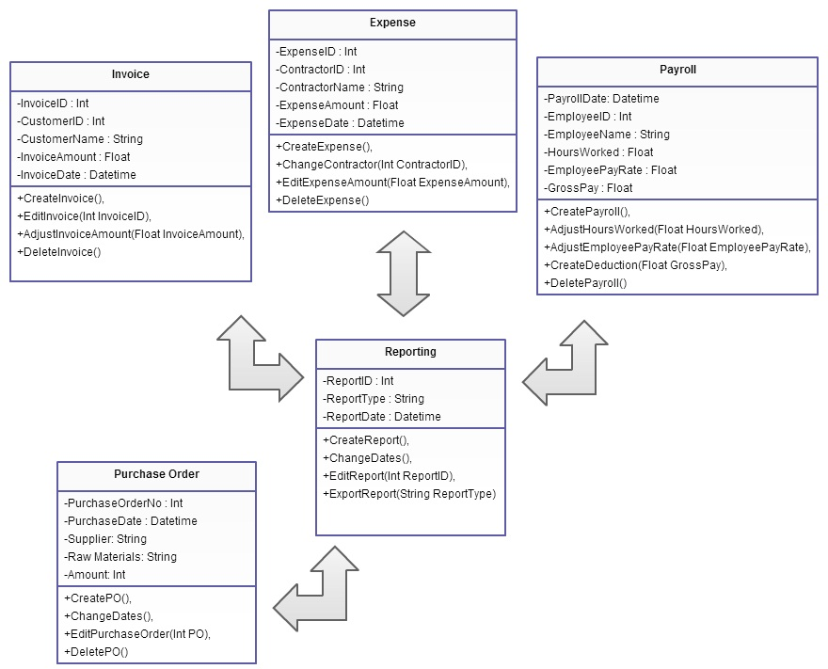
Purchasing and Finance
Class Diagram

Slide 4
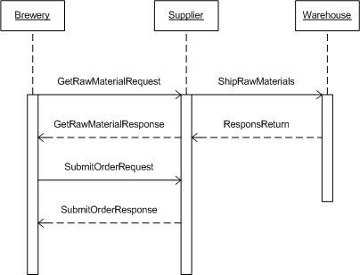
Purchasing
Sequence Diagram

Slide 5
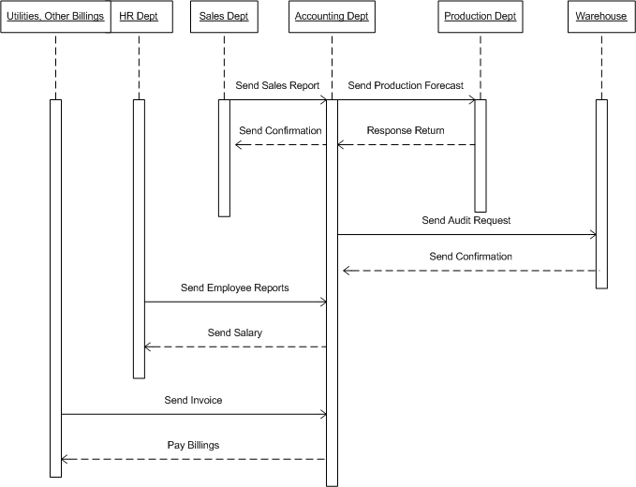
Accounting Department
Sequence Diagram

Slide 6
RISK MANAGEMENT TABLE

Slide 7
ID | Risk | Category | Probabaility | Mitigation | Impact
1 | Raw Materials out of stock | Operational | 20% | Maintains sales forecast and have atleast 2 weeks stock of raw materials | 1
2 | Port Congestion - Raw materials | Operational | 20% | Support local raw materials | 1
3 | Equipment breakdown | Operational | 10% | Follow the schedule equipment maintenance | 1
4 | Warehouse Full | Operational | 30% | Coordination between Purchasing, production and warehouse dept. | 3
5 | Increase delivery cost due to high rise of fuel | Operational | 60% | Delivery routes should properly be identified | 3
6 | Accidents Occurance | Operational | 10% | Prioritize employees safety training and facilities safety standards | 1
7 | Commodity and currency price volatility | Operational | 50% | Support local raw materials | 3

Slide 8
8 | Loss of Key personnel | Operational | 30% | Proper trainings and benefits should be given to employees | 2
9 | Reliance on strategic partners | Administration | 30% | Good Marketing strategy | 3
10 | Enviromental |  | 20% | Implement good enviromental standards. Proper training of employees | 1
11 | Mistrust from customers | Marketing | 30% | Good marketing plans | 1
12 | Accurate and proper records | Administration | 60% | Software and proper training of employees | 3
13 | Low product quality | Process | 20% | Good production plans | 2
14 | Low production target | Process | 50% | Coordination between different dept. | 3
15 | Cost associated due to late delivery | Administration | 40% | Delivery routes should properly be identified | 4
16 | Incorrect market surveys | Marketing | 20% | Good marketing plans | 3

